Slide 1
TFM-15
Enterprise Edition
Autopilot and Peripherals
Connections and Connectors

Slide 2
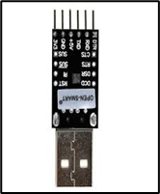
Auto-Pilot Baseboard Top View
SMA
GNSS F9P
UART2
UART1
CAN1
CAN1
PWR/I/V from
CAN PMU
GPS&SAFETY
X7 Pro
Power C
I2C2
I2C2
UART
Moving
Base
USB Cable (service)
USB
TELEM1
USB Cable(Companion)
TELEM2
I2C2
I2C1
UART4
PWR/I/V from Lift
5V DC + I/V ADC
Power A
CAN2
CAN2
UART2
UART1
GNSS F9P
RFD 868x
SMA
SMA
SMA

Slide 3
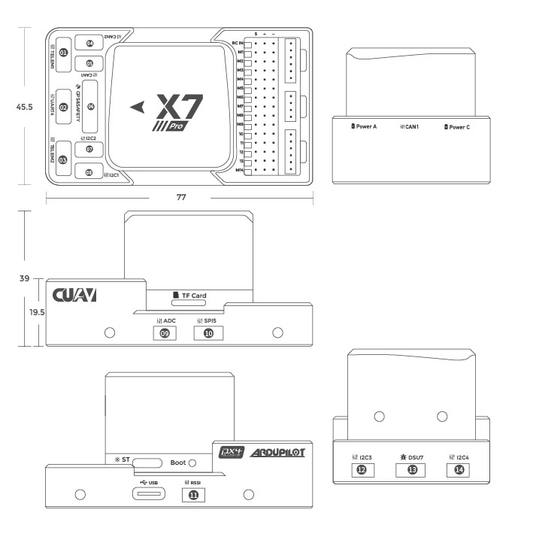
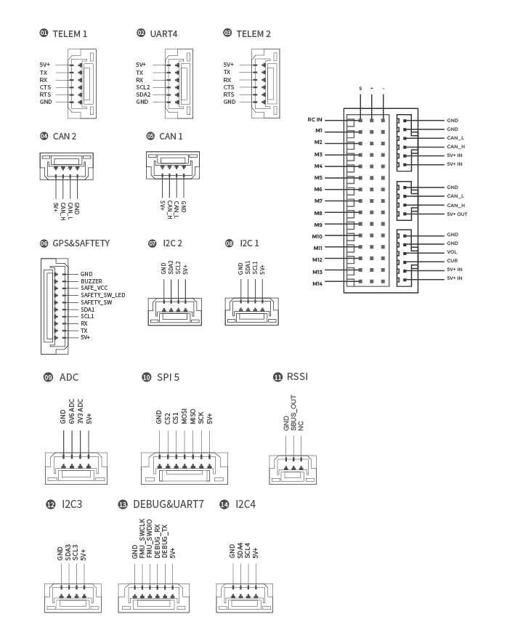
Auto-Pilot Baseboard Connections and Pin-outs

Slide 4
Bill of Quantity and Weight Summary
 | Subsystem | Item | Vendor | Type | Unit Weight, g | Cost Retail, USD | Quantity per UAV | Total Cost Retail, USD | Total Weight, g
1 | AP & Peripherals | Enclosure | ALI | YGKT Enclosure 95x55x150 | 300,0 | 10,0 | 1,0 | 10,0 | 300,0
2 | AP & Peripherals | FMU Baseboard | CUAV | Standard Baseboard | 50,0 | 150,0 | 1,0 | 150,0 | 50,0
3 | AP & Peripherals | FMU | CUAV | X7 Pro Core | 100,0 | 1000,0 | 1,0 | 1000,0 | 100,0
4 | AP & Peripherals | Telemetry | RFD | RFD 868x (incl antenna) +TXMOD | 14,0 | 600,0 | 1,0 | 600,0 | 14,0
5 | AP & Peripherals | GNSS Receiver | CUAV | RTK GNSS (XL F9P) | 23,0 | 210,0 | 2,0 | 420,0 | 46,0
6 | AP & Peripherals | GNSS Antenna | TOPGNSS | AN506, ZED-F9P GNSS internal RTK Antenna GPS GLONASS GALILEO BEI DOU GNSS L1,L2 | 150,0 | 63,0 | 2,0 | 126,0 | 300,0
7 | AP & Peripherals | MAG/Baro | Raccoon | UAV CAN Professional Grade Magnetometer RM3100 and Baro | 10,0 | 40,0 | 1,0 | 40,0 | 10,0
8 | AP & Peripherals | Airspeed | Raccoon | UAV CAN MS4525 Airspeed Sensor | 20,0 | 108,0 | 1,0 | 108,0 | 20,0
9 | AP & Peripherals | CAN PMU | CUAV | CUAV CAN PMU High Precision Power Detection Unit | For UAV and Flight Controller Drone Hardware | 100,0 | 139,0 | 1,0 | 139,0 | 100,0
10 | AP & Peripherals | Airspeed MS5525 | CUAV | CUAV MS 5525 Airspeed sensor I2C | 10,0 | 28,0 | 1,0 | 28,0 | 10,0
 | AP & Peripherals | RM3100 Mag | Drotek | RM3100 professional grade magnetometer i2c
11 | AP & Peripherals | Lidar | Garmin | Lidar Lite v 3 | 40,0 | 130,0 | 1,0 | 130,0 | 40,0
12 | AP & Peripherals | Optical Flow | CUAV | PX4 Flow | 2.1 Optical Flow Sensor Smart Camera | 30,0 | 139,0 | 1,0 | 139,0 | 30,0
13 | AP & Peripherals | Connectors and Cables | Weipu | 4 PIN WEIPU ST12 Male | 10,0 | 5,0 | 2,0 | 10,0 | 20,0
14 | AP & Peripherals | Connectors and Cables | Weipu | 4 PIN WEIPU ST12 FeMale | 10,0 | 5,0 | 2,0 | 10,0 | 20,0
15 | AP & Peripherals | Connectors and Cables | Weipu | 2 PIN WEIPU ST12 Male | 10,0 | 5,0 | 1,0 | 5,0 | 10,0
16 | AP & Peripherals | Connectors and Cables | Weipu | 2 PIN WEIPU ST12 FeMale | 10,0 | 5,0 | 1,0 | 5,0 | 10,0
19 | AP & Peripherals | Connectors and Cables | Any | 4 PIN CAN M8 Female | 10,0 | 5,0 | 2,0 | 10,0 | 20,0
20 | AP & Peripherals | Connectors and Cables | Any | 4 PIN CAN M8 Male | 10,0 | 5,0 | 2,0 | 10,0 | 20,0
21 | AP & Peripherals | Connectors and Cables | Any | 4 PIN I2C M12 Female | 10,0 | 5,0 | 1,0 | 5,0 | 10,0
22 | AP & Peripherals | Connectors and Cables | Any | 4 PIN I2C M12 Male | 10,0 | 5,0 | 1,0 | 5,0 | 10,0
23 | AP & Peripherals | Connectors and Cables | Any | 8 PIN SAF+I2C M12 Female | 10,0 | 5,0 | 1,0 | 5,0 | 10,0
24 | AP & Peripherals | Connectors and Cables | Any | 8 PIN SAF+I2C M12 Male | 10,0 | 5,0 | 1,0 | 5,0 | 10,0
25 | AP & Peripherals | Connectors and Cables | Any | RC RF SMA Male to Female 0,2 m | 10,0 | 5,0 | 2,0 | 10,0 | 20,0
26 | AP & Peripherals | Connectors and Cables | Any | GNSS RF SMA Male to BNC Female 1-1,5 m | 10,0 | 5,0 | 2,0 | 10,0 | 20,0
27 | AP & Peripherals | Connectors and Cables | Any | GNSS RF BNC Male to SMA Female 1-1,5m | 10,0 | 5,0 | 2,0 | 10,0 | 20,0
28 | AP & Peripherals | Connectors and Cables | Any | 4 Wire shielded cable 10-20m | 100,0 | 10,0 | 1,0 | 10,0 | 100,0
29 | AP & Peripherals | Connectors and Cables | Any | 8 Wire Shielded Cable 3m | 50,0 | 10,0 | 1,0 | 10,0 | 50,0
30 | AP & Peripherals | Status LED | ALIEXPRESS | FEICHAO Pixhawk PX4 RGB | 5,0 | 5,0 | 1,0 | 5,0 | 5,0
 | Subtotal |  |  |  |  |  |  | 3625,0 | 1475,0
Power Summary
5V -> 2x5A

Slide 5
Products information
YGS-006 95*55*150 mm (w*h*l) ygkt Aluminum project box, switch enclosures | Обустройство дома | АлиЭкспресс (aliexpress.ru)
X7/X7 Pro autopilot – CUAV 雷迅创新
RXLRS, Professional Receiver RC & Tel | eXtended Long Range System
RFDesign RFD900x
RTK DP0601 GNSS (ZED-F9P) by Drotek (store-drotek.com)
for ZED-F9P module High-precision GNSS internal antenna uav ugv RTK GPS Antenna GPS GLONASS GALILEO BEI DOU GNSS L1,L2 AN506 | Автомобили и мотоциклы | АлиЭкспресс (aliexpress.ru)
Professional Grade Magnetometer RM3100 by Drotek (store-drotek.com)
CUAV CAN PMU High Precision Power Detection Unit | For UAV and Flight Controller Drone Hardware – CUAV Official Store
CUAV MS5525 Airspeed Sensor with Pitot Tube – CUAV Official Store
CUAV DISPLAY I2C OLED Monitor | Pixhack/Pichawk RM Multicopter Flight Control RC Models Diy Accessories – CUAV Official Store
CUAV PX4 Flow | 2.1 Optical Flow Sensor Smart Camera – CUAV Official Store
Garmin LIDAR-Lite v3 | GPS Sensors
UAVCAN Gps+Mag+Baro node (innopolisaero.github.io)
Introduction (innopolisaero.github.io)
UAVCAN PWM node (innopolisaero.github.io)
UAVCAN UI LEDS node (innopolisaero.github.io)
UAVCAN Airspeed node (innopolisaero.github.io)

Slide 6
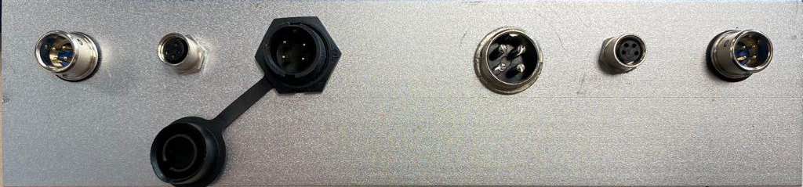
Connector Panel to the TAIL of the Aircraft
I2C1
XS12/4Pin Male
CAN1
M8/4Pin FeMale
Power C (CAN)
PY07/4Pin Male
Power A (I/V)
GX12/4Pin Male
CAN2
M8/4Pin FeMale
I2C2
XS12/4Pin Male

Slide 7
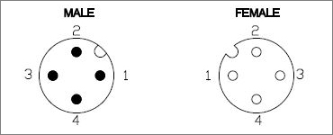
Connector Panel Description
PIN AP baseboard | PIN Connector | Color cable in AP BOX | Devices
Power A +5V (1,2) | PWRA – 1 +5V | RED cable in AP BOX | DC/DC Power Cube
Power A VOL (3) | PWRA –2 Voltage | Yellow | V/I Sensor
Power A CUR (4) | PWRA –3 Current | Blue | V/I Sensor
Power A GND (5,6) | PWRA –4 Ground | BLACK | DC/DC Power Cube
Power C +5V (1,2) | PWRC-1 +5V | Center | CAN PMU
Power C CAN_H (3) | PWRC-2 CAN_H | Center | CAN PMU
Power C CAN_L (4) | PWRC-3 CAN_L | Center | CAN PMU
Power C GND (5,6) | PWRC-4 Ground | Center | CAN PMU

Slide 8
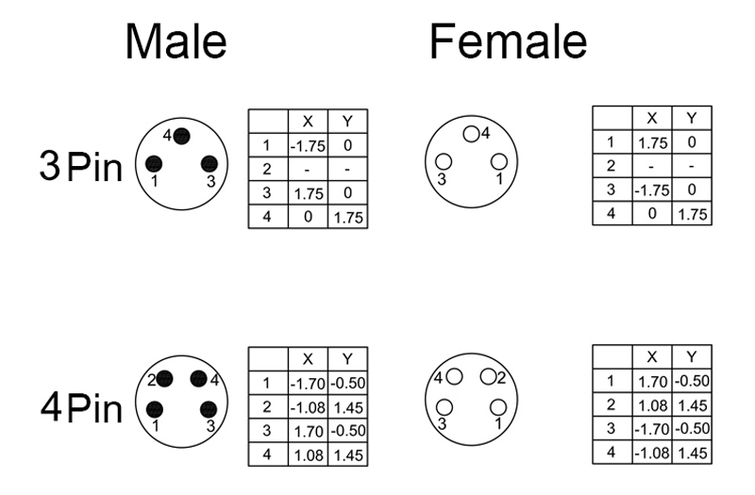

Signal Connections
MALE
FEMALE
CAN
I2C
PIN AP baseboard | PIN Connector | Color in AP Box | Devices
CAN1/2 +5V | CAN1–1 +5V | Red | Sensors and Actuators
CAN1/2 CAN_H | CAN1–2 CAN_H | White | Sensors and Actuators
CAN1/2 CAN_L | CAN1–3 CAN_L | Yellow | Sensors and Actuators
CAN1/2 GND | CAN1–4 GND | Black | Sensors and Actuators
I2C1 +5V | I2C1-1 +5V | Red | Mag and Airspeed
I2C1 SCL1 | I2C1-2 SCL1 | White | Mag and Airspeed
I2C1 SDA1 | I2C1-3 SDA1 | Yellow | Mag and Airspeed
I2C1 GND | I2C1-4 GND | Black | Mag and Airspeed
I2C2 +5V | I2C2-1 +5V | Red | PX4 Flow and Lidar
I2C2 SCL2 | I2C2-2 SCL2 | White | PX4 Flow and Lidar
I2C2 SDA2 | I2C2-3 SDA2 | Yellow | PX4 Flow and Lidar
I2C2 GND | I2C2-4 GND | Black | PX4 Flow and Lidar

Slide 9

RFD Telemetry Connections
Pin # Name Direction Description Max Voltage
1 GND - Ground 0V
2 GND - Ground 0V
3 CTS Input Clear to send 3.3V
4 Vcc - Power supply 5V
5 Vusb - Power supply from USB 5V
6 Vusb - Power supply from USB 5V
7 RX Input UART Data In 3.3V
8 GPIO5/P3.4 I/O Digital I/O 3.3V
9 TX Output UART Data Out 3.3V
10 GPIO4/P3.3 I/O Digital I/O 3.3V
11 RTS Output Request to send 3.3V
12 GPIO3/P1.3 I/O Digital I/O 3.3V
13 GPIO0/P1.0 I/O Digital I/O 3.3V
14 GPIO2/P1.2 I/O Digital I/O 3.3V
15 GPIO1/P1.1 I/O Digital I/O, PPM I/O 3.3V
16 GND - Ground 0V
PIN AP baseboard, Color | PIN RFD Connector , Color | PIN AP BOX
Telem 1, Tx, Yellow | UART Rx, Brown | NA
Telem 1, Rx, Blue | UART Tx, Orange | NA
NA | VCC +5V, pin 4 | PWRA – 1 +5V
NA | GND, pin 2 | PWRA –4 Ground

Slide 10
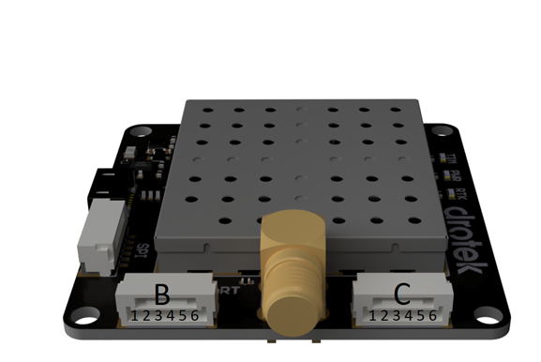
GNSS UART Connections
*CUT the B4,B5 wires on Rover and Base -> I2C conflict
Wire N° Corresponding pinout
B1 5V IN
B2 UART1 HOST RX
B3 UART1 HOST TX
B4 I2C SCL
B5 I2C SDA
B6 GND
PIN AP baseboard, Color | Color | PIN DP601 GNSS module
GPS&SAFETY, +5V | RED | ROVER B1 5V IN
GPS&SAFETY, Tx | WHITE | ROVER B2 UART1 HOST RX
GPS&SAFETY, Rx | YELLOW | ROVER B3 UART1 HOST TX
GPS&SAFETY, GND | BLACK | ROVER B6 GND
UART4, +5V | RED | MOVING BASE B1 5V IN
UART4, Tx | WHITE | MOVING BASE B2 UART1 HOST RX
UART4, Rx | YELLOW | MOVING BASE B3 UART1 HOST TX
UART4, GND | BLACK | MOVING BASE B6 GND
Wire N° Corresponding pinout
C1 5V IN
C2 UART2 RTCM3 TX
C3 UART2 RTCM3 RX
C4 EXTINT
C5 TIMEPULSE
C6 GND
Moving Base
Antenna on the LEFT side
Rover
Antenna on the RIGHT side
Heading
direction
Moving Base |  | Rover
C3 UART2 RTCM3 RX |  | C2 UART2 RTCM3 TX
C2 UART2 RTCM3 TX |  | C3 UART2 RTCM3 RX

Slide 11
Front Aircraft
Left Panel
RC Telemetry Antenna
SMA Female
Rubber Ring
GNSS Antenna
SMA Female
Rubber Ring

Slide 12
Right Panel
Front Aircraft
GNSS Antenna
SMA Female
Rubber Ring
RC Telemetry Antenna
SMA Female
Rubber Ring

Slide 14
TFM-30
Professional and Enterprise Edition
Autopilot Connections and Connectors

