Slide 1
Generating Audio for Muted Piano-Playing Video
Using Deep Learning
XIA Junzhe, YANG Baichen, HUANG Zeyu

Slide 2
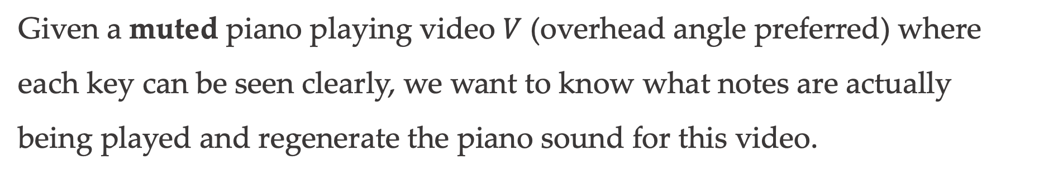
Problem Overview
Given a muted piano playing video $V$ (overhead angle preferred) where each key can be seen clearly, we want to know what notes are actually being played and regenerate the piano sound for this video.
Generating Audio for Muted Piano-Playing Video Using Deep Learning
May 3, 2019

Slide 3
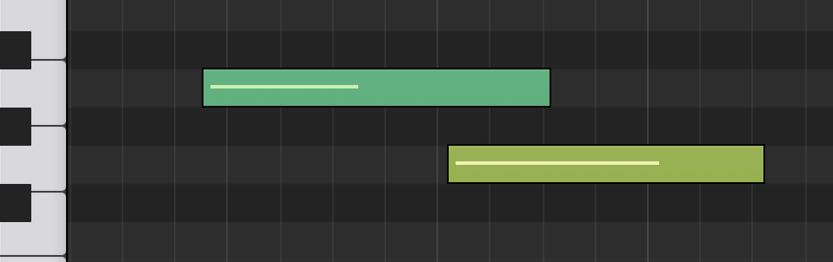

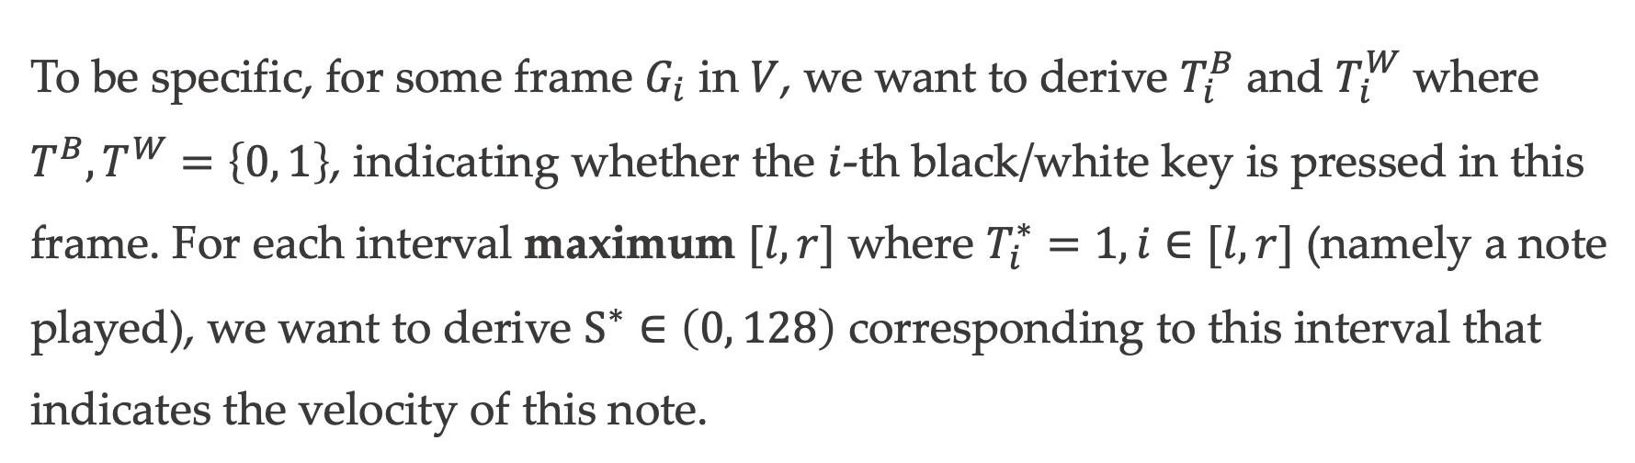



Problem Overview
To be specific, for some frame $G_{i}$ in $V$, we want to derive $T_{i}^{B}$ and $T_{i}^{W}$ where $T^{B}, T^{W}=\left\{0, 1\right\}$, indicating whether the $i$-th black/white key is pressed in this frame. For each interval maximum $[l, r]$ where $T_{i}^{∗}=1, i∈[l, r]$ (namely a note played), we want to derive $S^{∗}∈\left(0, 128\right)$ corresponding to this interval that indicates the velocity of this note.
$$T_{33}^{W}=1$$
$$T_{32}^{W}=1$$
$$S^{∗}=56$$
$$S^{∗}=85$$
Generating Audio for Muted Piano-Playing Video Using Deep Learning
May 3, 2019

Slide 4
Background
A realistic problem for music lovers
Come across a splendid piano piece and hope to learn it. But in most of cases, the piano sheet is nowhere to be found
Existing solutions
Manual Transcript (need much professional training & music theory knowledge, relatively accurate)
Automatic Transcript (mostly based on audio analysis, or traditional CV, no mature product in the market)
Generating Audio for Muted Piano-Playing Video Using Deep Learning
May 3, 2019

Slide 5
Our Method
To address this problem, we divide the whole process into three parts:
Keyboard Detection
Keypress Detection
Velocity Evaluation
we
Generating Audio for Muted Piano-Playing Video Using Deep Learning
May 3, 2019

Slide 6
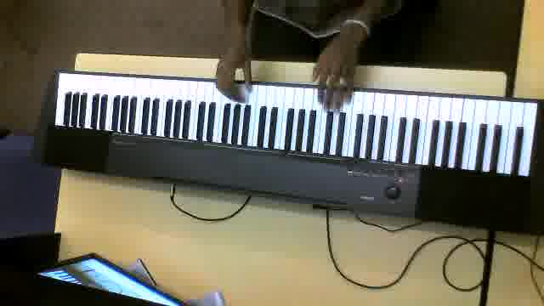
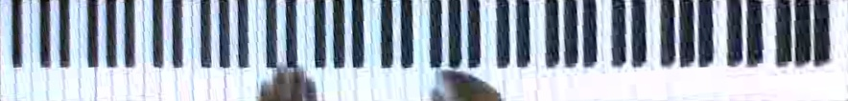
Keyboard Detection
Find out coordinates of the four corners of piano keyboard. Then use perspective transformation to get a standardized keyboard.
Original Image
Extracted Keyboard
Generating Audio for Muted Piano-Playing Video Using Deep Learning
May 3, 2019

Slide 7
Keyboard Detection
Method Tried #1 Hough Line Detection
The method used by almost all previous work.
Details of this method:
1. Get edge image by Canny edge detector
2. Apply Hough Transformation to detect lines on preprocessed image to get boundary candidates and prune repeated lines
3. Use pre-defined property (ratio of black and white pixels on the keyboard) to select the exact two parallel lines that bound the keyboard
Generating Audio for Muted Piano-Playing Video Using Deep Learning
May 3, 2019

Slide 8
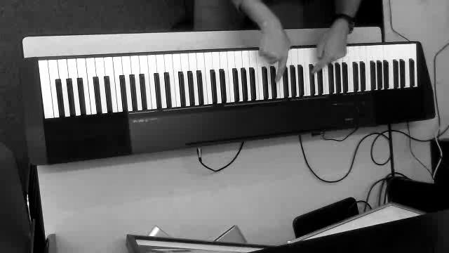
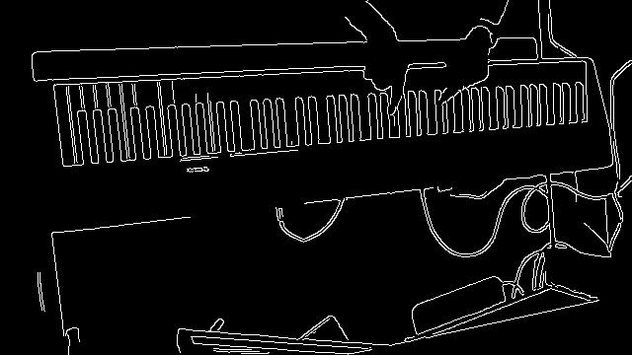
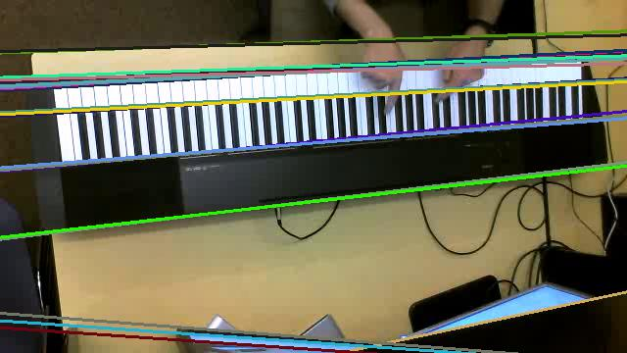
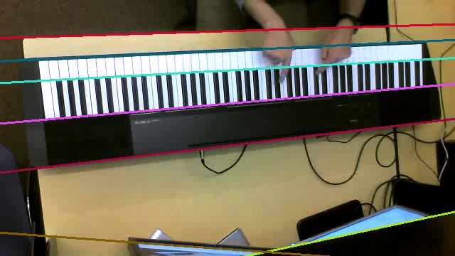
Keyboard Detection
Method Tried #1 Hough Line Detection
Generating Audio for Muted Piano-Playing Video Using Deep Learning
May 3, 2019

Slide 9
Keyboard Detection
Method Tried #1 Hough Line Detection
Details of pre-defined property
The maximum brightness in the lower one-third
The maximum number of black keys located in the upper two-third parts (black keys are detected by Flood Fill Algorithm)
Generating Audio for Muted Piano-Playing Video Using Deep Learning
May 3, 2019

Slide 10
Keyboard Detection
Method Tried #1 Hough Line Detection
Major drawbacks:
Need to tune several hyperparameters of Canny edge detector and Hough line detection to fit different illumination conditions, which leads to a very unstable performance
Require there is a frame where there are no hands on the keyboard because the flood fill algorithm will fail if there is a hand involving in. However, we can not guarantee that all piano videos can fulfil this requirement
Generating Audio for Muted Piano-Playing Video Using Deep Learning
May 3, 2019

Slide 11
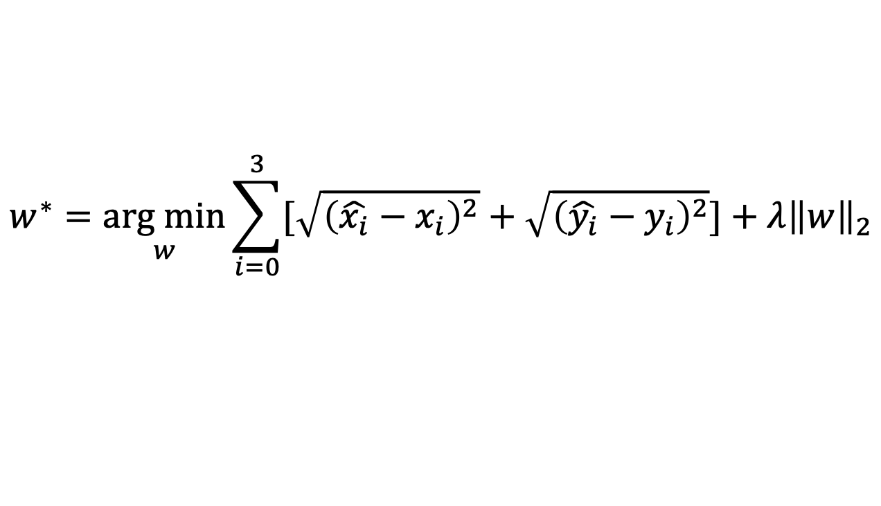
Keyboard Detection
Method Tried #2 Deep Convolutional Neural Network
We manually labelled coordinates of keyboards on images extracted from piano playing videos
Used a pretrained Resnet-18 model for coordinates regression
This method does not require a frame with empty keyboard
$$w^{∗}=\underset{w}{arg min}{\sum_{i=0}^{3}{[\sqrt{{\left(\hat{x_{i}}−x_{i}\right)}^{2}}+\sqrt{{\left(\hat{y_{i}}−y_{i}\right)}^{2}}}]+λ{\left\|w\right\|}_{2}}$$
Generating Audio for Muted Piano-Playing Video Using Deep Learning
May 3, 2019

Slide 12
Keyboard Detection
Method Tried #2 Deep Convolutional Neural Network
Major Drawbacks:
Since our dataset is highly homogeneous because they are extracted from around 65 videos, the model tends to build a mapping between image features to 65 fixed coordinate sets, which made the model’s performance on test set quite undesirable
Computational Expensive
A Failed Example
Generating Audio for Muted Piano-Playing Video Using Deep Learning
May 3, 2019

Slide 13
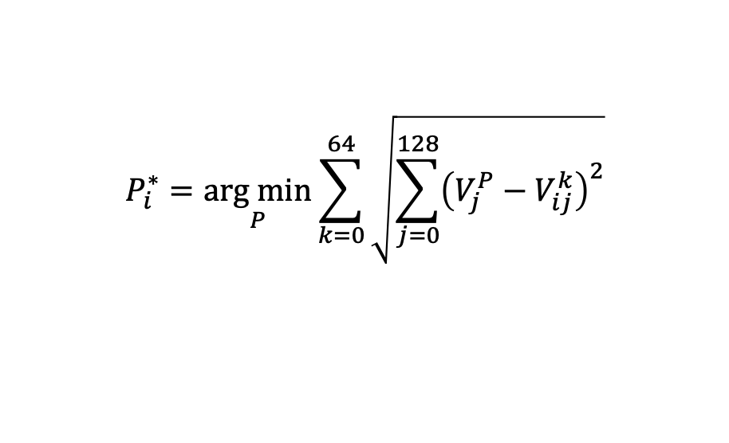
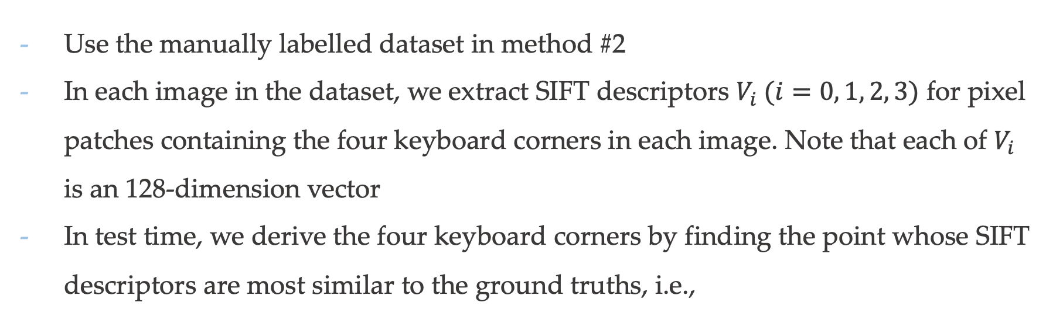
Keyboard Detection
Method Tried #3 Scale Invariant Feature Transform
Use the manually labelled dataset in method #2
In each image in the dataset, we extract SIFT descriptors $V_{i} (i=0, 1, 2, 3)$ for pixel patches containing the four keyboard corners in each image. Note that each of $V_{i}$ is an 128-dimension vector
In test time, we derive the four keyboard corners by finding the point whose SIFT descriptors are most similar to the ground truths, i.e.,
$$P_{i}^{∗}=\underset{P}{arg min}{\sum_{k=0}^{64}{\sqrt{\sum_{j=0}^{128}{{\left(V_{j}^{P}−V_{ij}^{k}\right)}^{2}}}}}$$
Generating Audio for Muted Piano-Playing Video Using Deep Learning
May 3, 2019

Slide 14
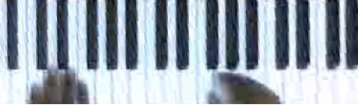
Keypress Detection
Given a standardized keyboard image (maybe with keyboard images in neighbor frames), determine whether each key is pressed or not.
Extracted Keyboard
Pressed Key
Generating Audio for Muted Piano-Playing Video Using Deep Learning
May 3, 2019

Slide 15
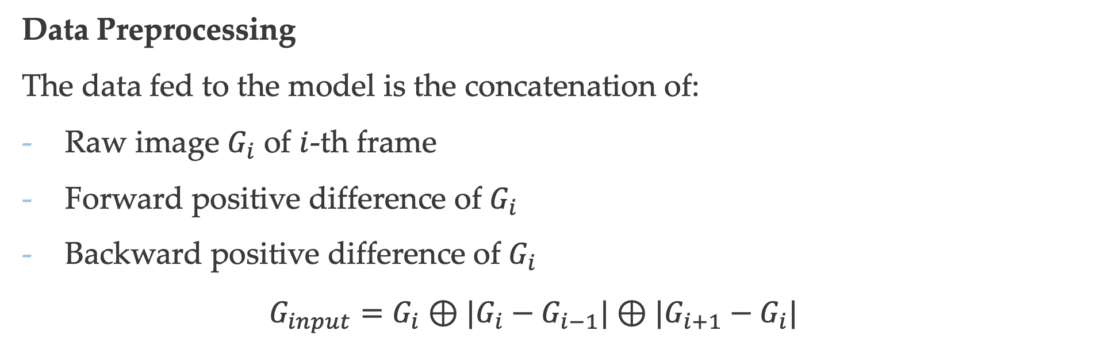
Keypress Detection
Data Preprocessing
The data fed to the model is the concatenation of:
Raw image $G_{i}$ of $i$-th frame
Forward positive difference of $G_{i}$
Backward positive difference of $G_{i}$
$$G_{input}=G_{i}⊕|G_{i}−G_{i−1}|⊕|G_{i+1}−G_{i}|$$
We include difference information because it reveals the changes in depth of keys, which is helpful for determining whether they are pressed
Generating Audio for Muted Piano-Playing Video Using Deep Learning
May 3, 2019

Slide 16
Keypress Detection
Models Tried
Model #1 - Receive the whole keyboard and output the pression conditions of all 88 keys
Model #2 - Receive a single key and output the pression condition of this key
Model #3 - Receive a single key together with its two neighbor keys and output the pression condition of this key
Generating Audio for Muted Piano-Playing Video Using Deep Learning
May 3, 2019

Slide 17
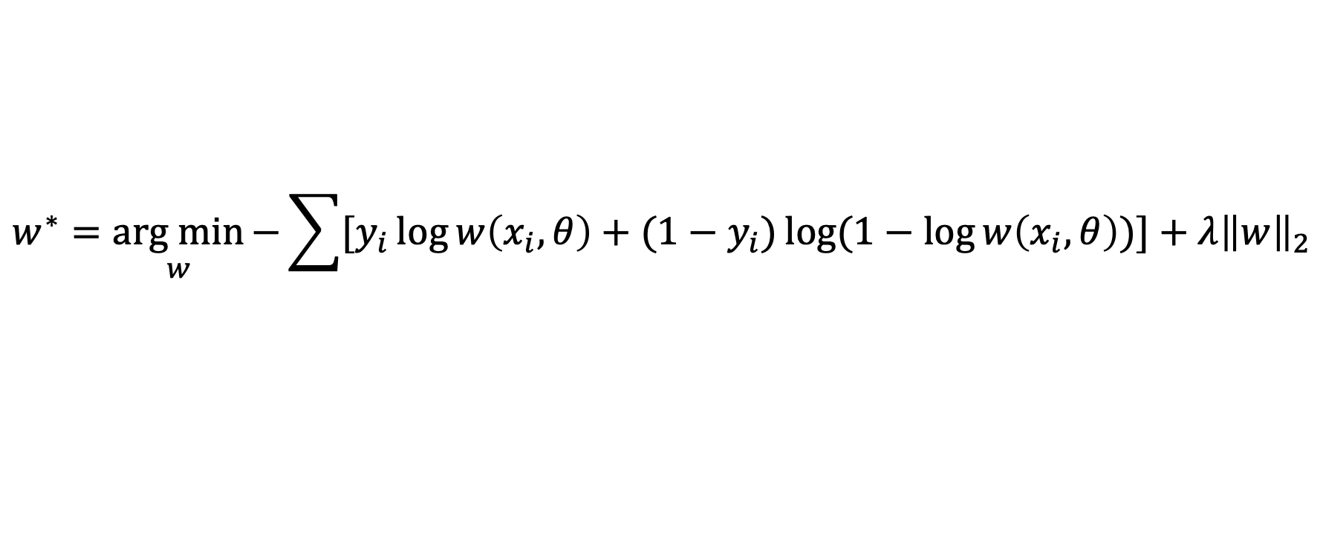
Keypress Detection
Loss Function
We use Binary Cross Entropy in this task:
$$w^{∗}=\underset{w}{arg min}{−\sum{[y_{i}\log{w\left(x_{i}, θ\right)}}+(1−y_{i})\log{(1−\log{w\left(x_{i}, θ\right)})}]+λ{\left\|w\right\|}_{2}}$$
Generating Audio for Muted Piano-Playing Video Using Deep Learning
May 3, 2019

Slide 18
Keypress Detection
16 Conv 3*3
Model #1
16 Conv 3*3
Maxpool 2*2
32 Conv 3*3
32 Conv 3*3
Input Raw Image
Maxpool 2*2
64 Conv 3*3
64 Conv 3*3
Maxpool 2*2
Pros: No key segmentation needed, easy to prepare data
Cons: Some keys are pressed frequently in train set while some are rarely pressed. This unbalance leads to the weakness in detecting some keys’ contidions
128 Conv 3*3
128 Conv 3*3
Maxpool 2*2
FC 1024
FC 88
Sigmoid
Network Architecture
Generating Audio for Muted Piano-Playing Video Using Deep Learning
May 3, 2019

Slide 19

Keypress Detection
Model #2
Input Raw Image
16 Conv 3*3
16 Conv 3*3
Maxpool 2*2
32 Conv 3*3
32 Conv 3*3
Maxpool 2*2
FC 512
FC 1
Pros: Higher accuracy, won’t be affected by the frequency unbalance in model #1
Cons: Longer running time since every key should be fed into the model / Need to train two models for white keys and black keys respectively
Sigmoid
Network Architecture
Generating Audio for Muted Piano-Playing Video Using Deep Learning
May 3, 2019

Slide 20

Keypress Detection
Model #3
16 Conv 3*3
16 Conv 3*3
Maxpool 2*2
Input Raw Image
32 Conv 3*3
32 Conv 3*3
Maxpool 2*2
64 Conv 3*3
64 Conv 3*3
Maxpool 2*2
Pros: Introduce some extra information coming from neighbor keys and hand motion surrounded
Cons: Same as #2
FC 512
FC 1
Sigmoid
Network Architecture
Generating Audio for Muted Piano-Playing Video Using Deep Learning
May 3, 2019

Slide 21
Keypress Detection
Current Result
Generating Audio for Muted Piano-Playing Video Using Deep Learning
May 3, 2019

Slide 22
Velocity Evaluation
Approximate the velocity of each detected note. The velocity value ranges from 0 (no sound) to 127 (very loud).
Generating Audio for Muted Piano-Playing Video Using Deep Learning
May 3, 2019

