Slide 1
Gee’s project

Slide 2
today’s menu
Gee
Gee
teammember
teamproject

Slide 3
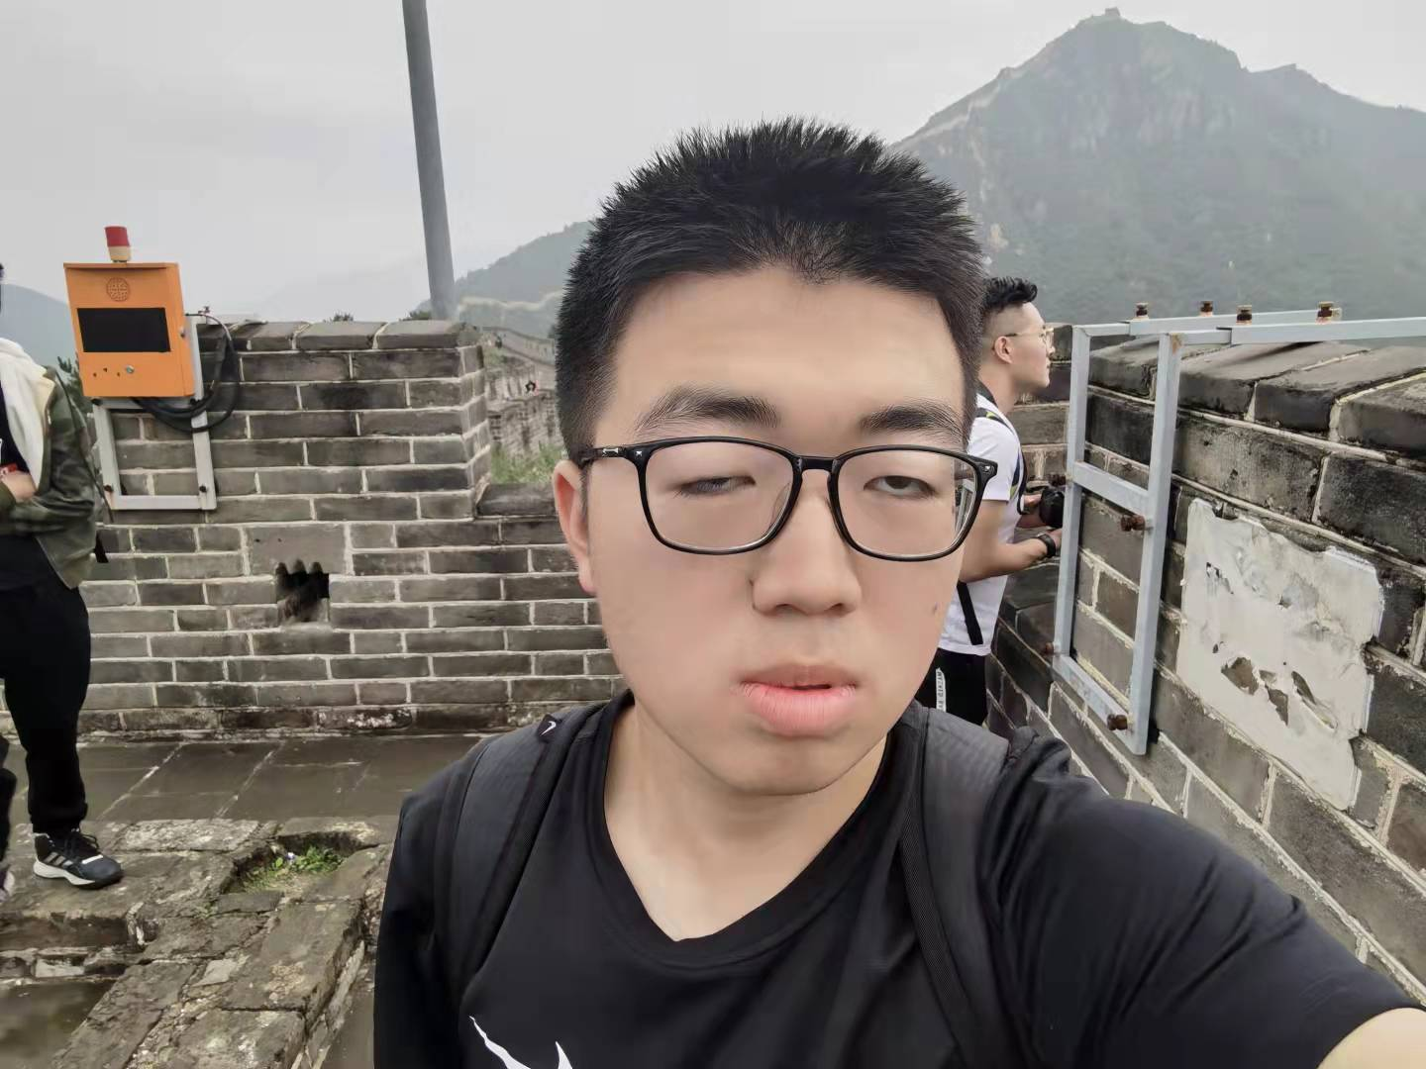
lead/CIO
Zane--王大榕
As a team leader, even though I'm a bit silly, I have the ability to handle things properly while having a great passion for c.

Slide 4
TECH LEAD
Temirlan 黎萤
he is a fast learner,and ready for challenges.

Slide 5
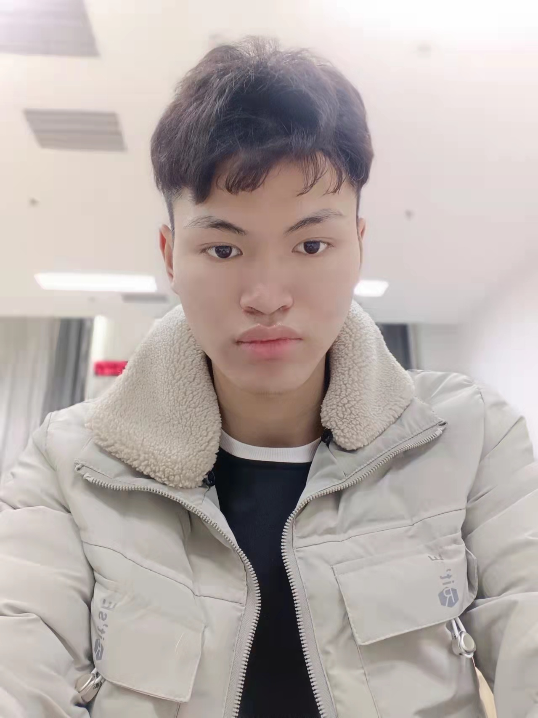
DESIGNER
TIAN--田德亮
I can draw pictures ,and well design the plot .

Slide 6
architect
william--王怡然
careful, responsible,habe a good ability

Slide 7
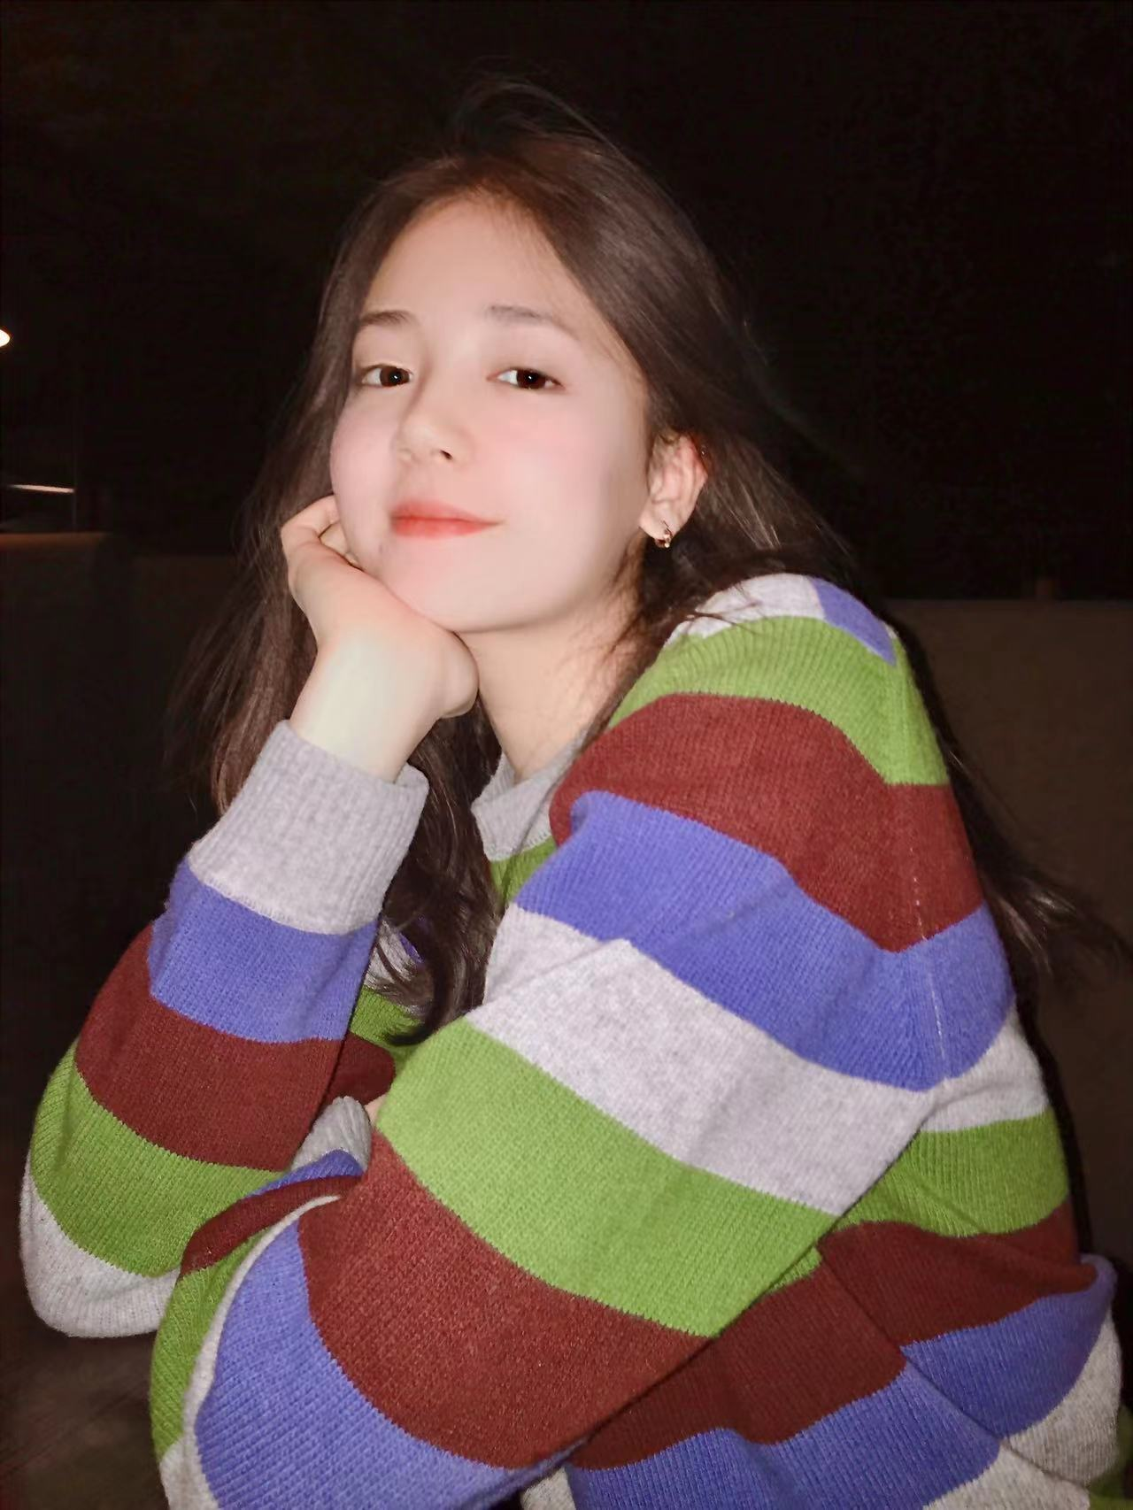
programmer
Bermet talantbekova--明珠
resonsible,ambitious,perseverance,good at research work

Slide 8
TESTER
Diana--帝安娜
very serious, very responsible,work good in group

Slide 9
Gee’s project

Slide 10
space ship
This is a space travel game. Its core is aircraft war. In the script, players need to go through a maze or do some decryption games to enter the rocket warehouse, so as to carry the rocket to defeat the boss. The game combines decryption and fighting, campus and other elements

Slide 11
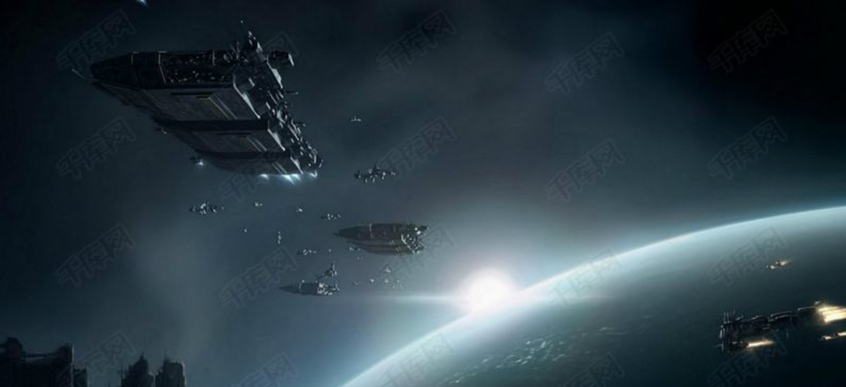
project

Slide 12
thank you!

