Slide 2
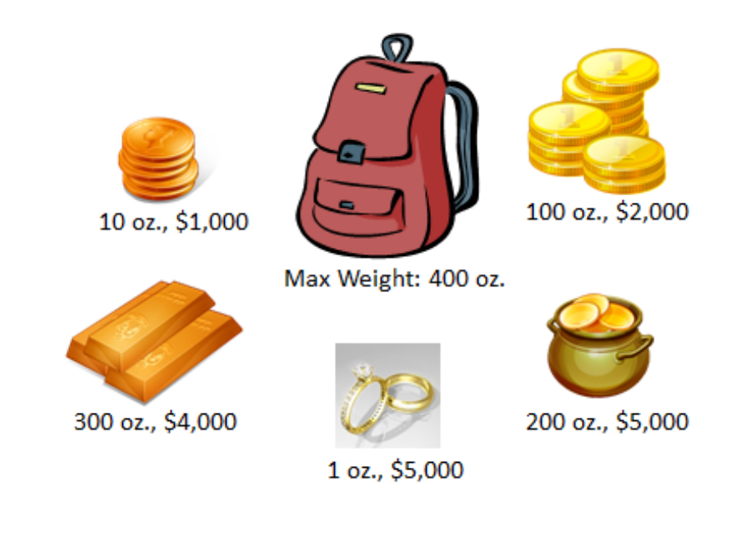
Knapsack Problem
BY FRANZI BRÄNDLE, PATRICK ROHMANN, PHILIPP FUKAS, BHASKAR MAJUMDER AND FARINA KOCK

Slide 3
Structure of our Knapsack Algorithm
Algorithm
Neighbourhood
swap
Hill Climbing (HC)
transposition
swap
First Choice Hill Climbing (FCHC)
transposition

Slide 4
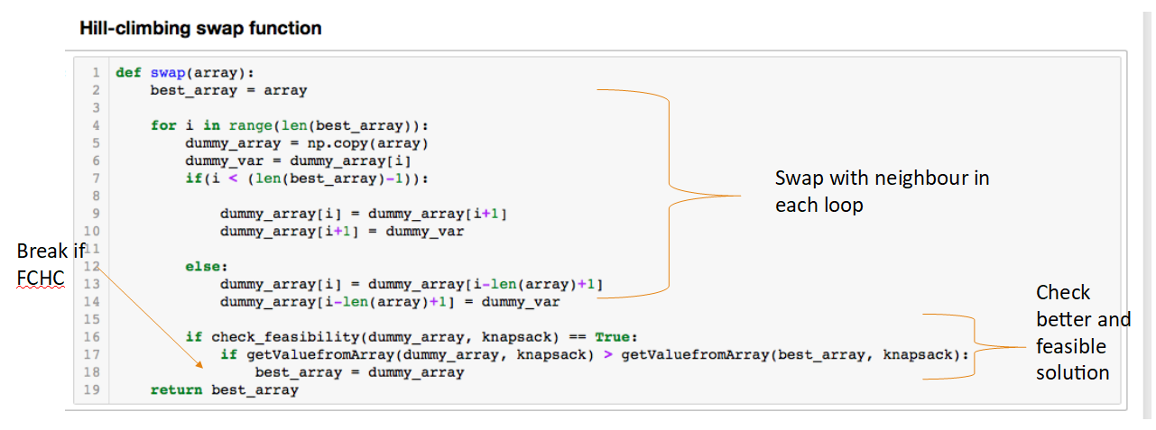
Hill Climbing Swap Function

Slide 5
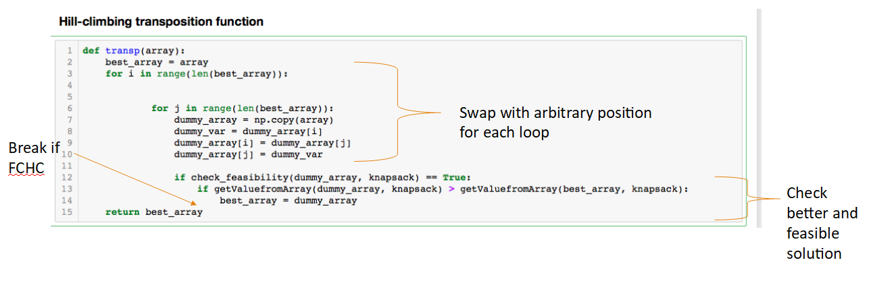
Transposition Function

Slide 6
Results
Run | Algorithm | Neighbourhood | Iteration | Value
1 | HC | swap | 2 | 7,000
 | FCHC | swap | 2 | 7,000
 | HC | transposition | 2 | 8,000
 | FCHC | transposition | 2 | 7,000
2 | HC | swap | 2 | 12,000
 | FCHC | swap | 2 | 12,000
 | HC | transposition | 2 | 13,000
 | FCHC | transposition | 2 | 12,000
3 | HC | swap | 1 | 12,000
 | FCHC | swap | 1 | 12,000
 | HC | transposition | 2 | 13,000
 | FCHC | transposition | 2 | 13,000

Slide 7
Results 100 Runs
Run | Algorithm | Neighbourhood | Iteration | Median | Time (ms) | Time per iteration
1 | HC | swap | 9056 | 18,000 | 0 | 0
 | FCHC | swap | 9023 | 15,950 | 0 | 0
 | HC | transposition | 9950 | 18,500 | 0 | 0.0078165
 | FCHC | transposition | 9863 | 15,950 |  | 0.007799

Slide 8
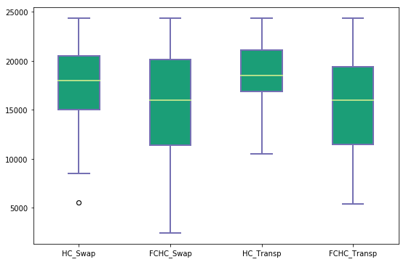
Boxplots

