Slide 1
Genetic Algorithms
BY FRANZI BRÄNDLE, PATRICK ROHMANN, PHILIPP FUKAS, BHASKAR MAJUMDER AND FARINA KOCK

Slide 2
Content
Makespan Problem
Which optimization techniques did we try
Fixed Parameters
Results:
Benchmark Problem 1
Benchmark Problem 2
Benchmark Problem 3
Conclusion

Slide 3
1. Makespan Problem
The Makespan problem deals with the time a job takes from the beginning to the end
Given 1,...,n jobs with processing time p₁,...,p_{n} and m machines, the task is to assign jobs to machines in a way that minimizes time to finish all jobs

Slide 4
2. Which optimization techniques did we try
Selection
Roulette-Wheel
Tournament
Recombination
One-Point Crossover
Uniform Crossover
Mutation
Flip
Swap
Replacement
Delete All
Choose Best

Slide 5
3. Fixed Parameters
Crossover probability = 90 %
i.e. that in 90 % of the cases we apply recombination techniques
Mutation probability = 10 %
i.e. in 10 % of the cases we apply mutation techniques
Mating Pool Size = 80%
i.e. that 80 % of the population will get children

Slide 6
4. Results
We only used functions → no OOP
After trying out a few combination, we decided to simplify our optimization problem
We decided to use:
Selection: Roulette wheel
Recombination: uniform crossover
Mutation: Swap
Replacement: Choose-Best

Slide 7
4.1 Results for Benchmark Problem 1
Initial situation:
Selection: Roulette wheel
Recombination: uniform crossover
Mutation: Swap
Replacement: Choose-Best

Slide 8
4.2 Results for Benchmark Problem 2

Slide 9
4.3 Results for Benchmark Problem 3

Slide 10
Problems & further outlook
Computation time:
e.g. population size = 100 took so long we had to interrupt it…
Adapt code and try to get rid of a few for loops
Further outlook:
considering all possible combinations of optimization techniques
adapting fixed parameters

Slide 11
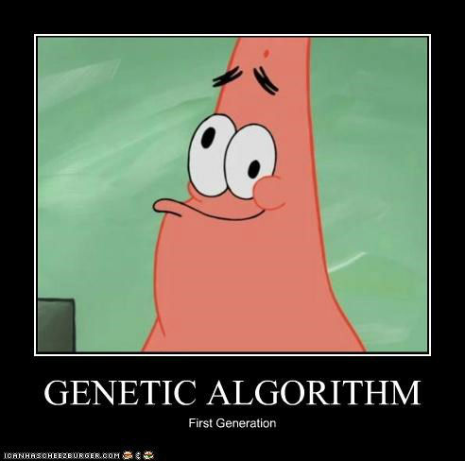
The End

