Slide 1
Ensure.ai
Ensuring your health with the best that money can buy

Slide 2
Company description
Mission - Provide a holistic healthcare solution for every life that we touch
Goals
Short Term (0-18 months)
1,00,000 people to have a seamless experience right from purchasing insurance to getting the reimbursement using the app
Tie up with 5 insurance companies to enable cashless treatments and cashless limits of the policy holder
Tie up with 3 hospital chains to get medical history of the policy holder
Long Term (18-36 months)
Become the one stop app for all your medical and insurance needs
Etie up with 1,00,000 doctors nationwide for virtual consultations
5,00,000 new people under the net of insurance

Slide 3
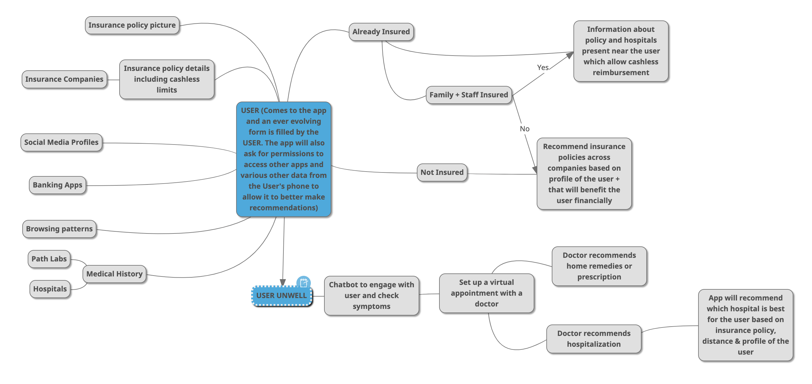
Solution at Glance

Slide 4
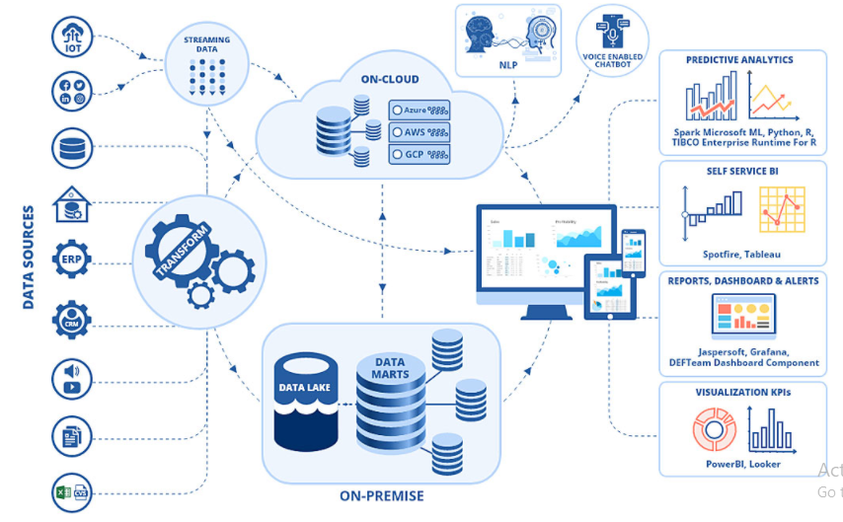
Detailed SOLUTION
EnSure.AI will have essentially four key functional blocks to be executed on-demand in the cloud:-
Data Processing Section – This function will be at the end points of the incoming data sources from multiple streams.
Data Analytics Section – We are looking for a series of NLP and CV algorithms to extract the required personalization’s for every profile & setting it up for following CNNs. It performs actions on the identified data set & designs a profile with the health priorities & financial condition of that individual
Data Insights Section – This section deals with the CNNs and recommendation systems that will divulge in the profile created for a customer in the previous step and work towards bringing good accuracy to make the systems efficient.
Feedback Section – This feature will record and notify the Analytics section as to how far the predictions have been accepted.

Slide 5
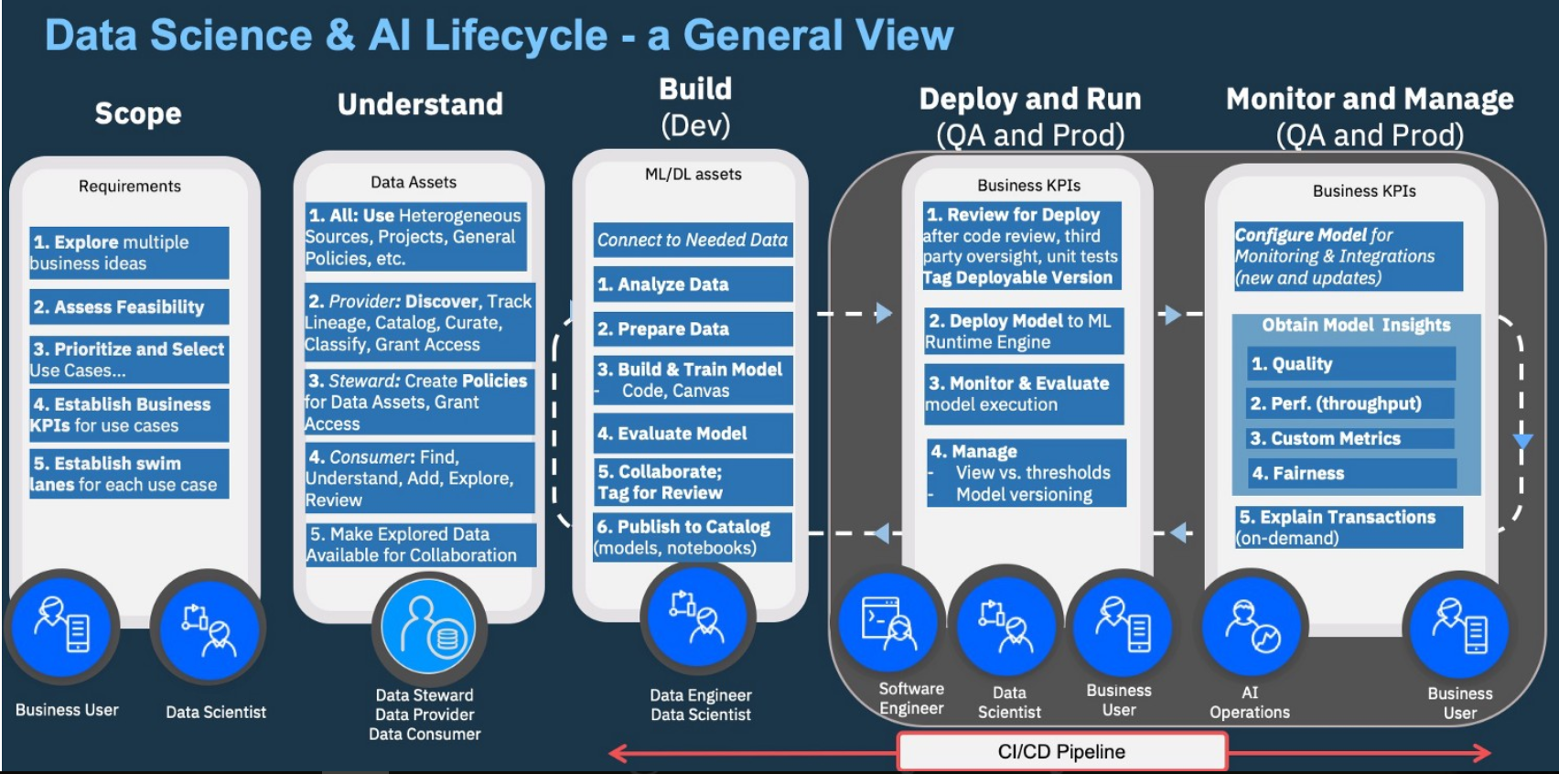
AI Model Development
AI Model Lifecycle
Scope & deliverables
Solution & Product selection
Source Systems & Data Assets
Set-up, Configure & Build
Cut-over, Roll Out & Run
Monitor & Manage
Continuous Improvements
* Credit Source with thanks & regards - John Thomas - Medium - Operationalizing AI — Managing the End-to-End Lifecycle of AI - https://medium.com/inside-machine-learning/ai-ops-managing-the-end-to-end-lifecycle-of-ai-3606a59591b0

Slide 6
Data Science Ecosystem
Data Planning
Data Base Management
Data Source – ServiceNow, Intelligent Monitoring Agents & Hubs
Data Collection period – 5-7 years data available
ETL tools from Azure Synapse Analytics
Largely homogenous data format from sources
Text, Voice, KEDB and Image data also available
Azure hosted DB instances
DBs – Azure SQL
Azure Table Storage
Azure Maria DB
Azure COSMOS
Synapse Analytics
ServiceNow ESM DB instances
ServiceNow ESM DB data
CMDB
KEDB
Service requests
Incident
Problem
Change
Data Warehousing
AI Model Development *
Data extraction from ServiceNow ESM DB
ETL tools from Azure Synapse Analytics
Azure Synapse Analytics DWH solution
Scope & deliverables
Solution & Product selection
Source Systems & Data Assets
Set-up, Configure & Build
Cut-over, Roll Out & Run
Monitor & Manage
Continuous Improvements
AI Product Lifecycle Management
Virtualization
5 Core aspects
Product backlog
CI/CD roadmap
ML & DS Pipelines
Continuous Improvement, Deployment & Monitoring
Continuous Benefit measurement metrics & reporting
Use Cloud hosted instances
ServiceNow Cloud hosted instances
Azure ML Studio Cloud hosted instances
Datawarehouse (DWH) & DBs Cloud Hosted on Azure
Zero use of On-Premise hosted solution components

Slide 7
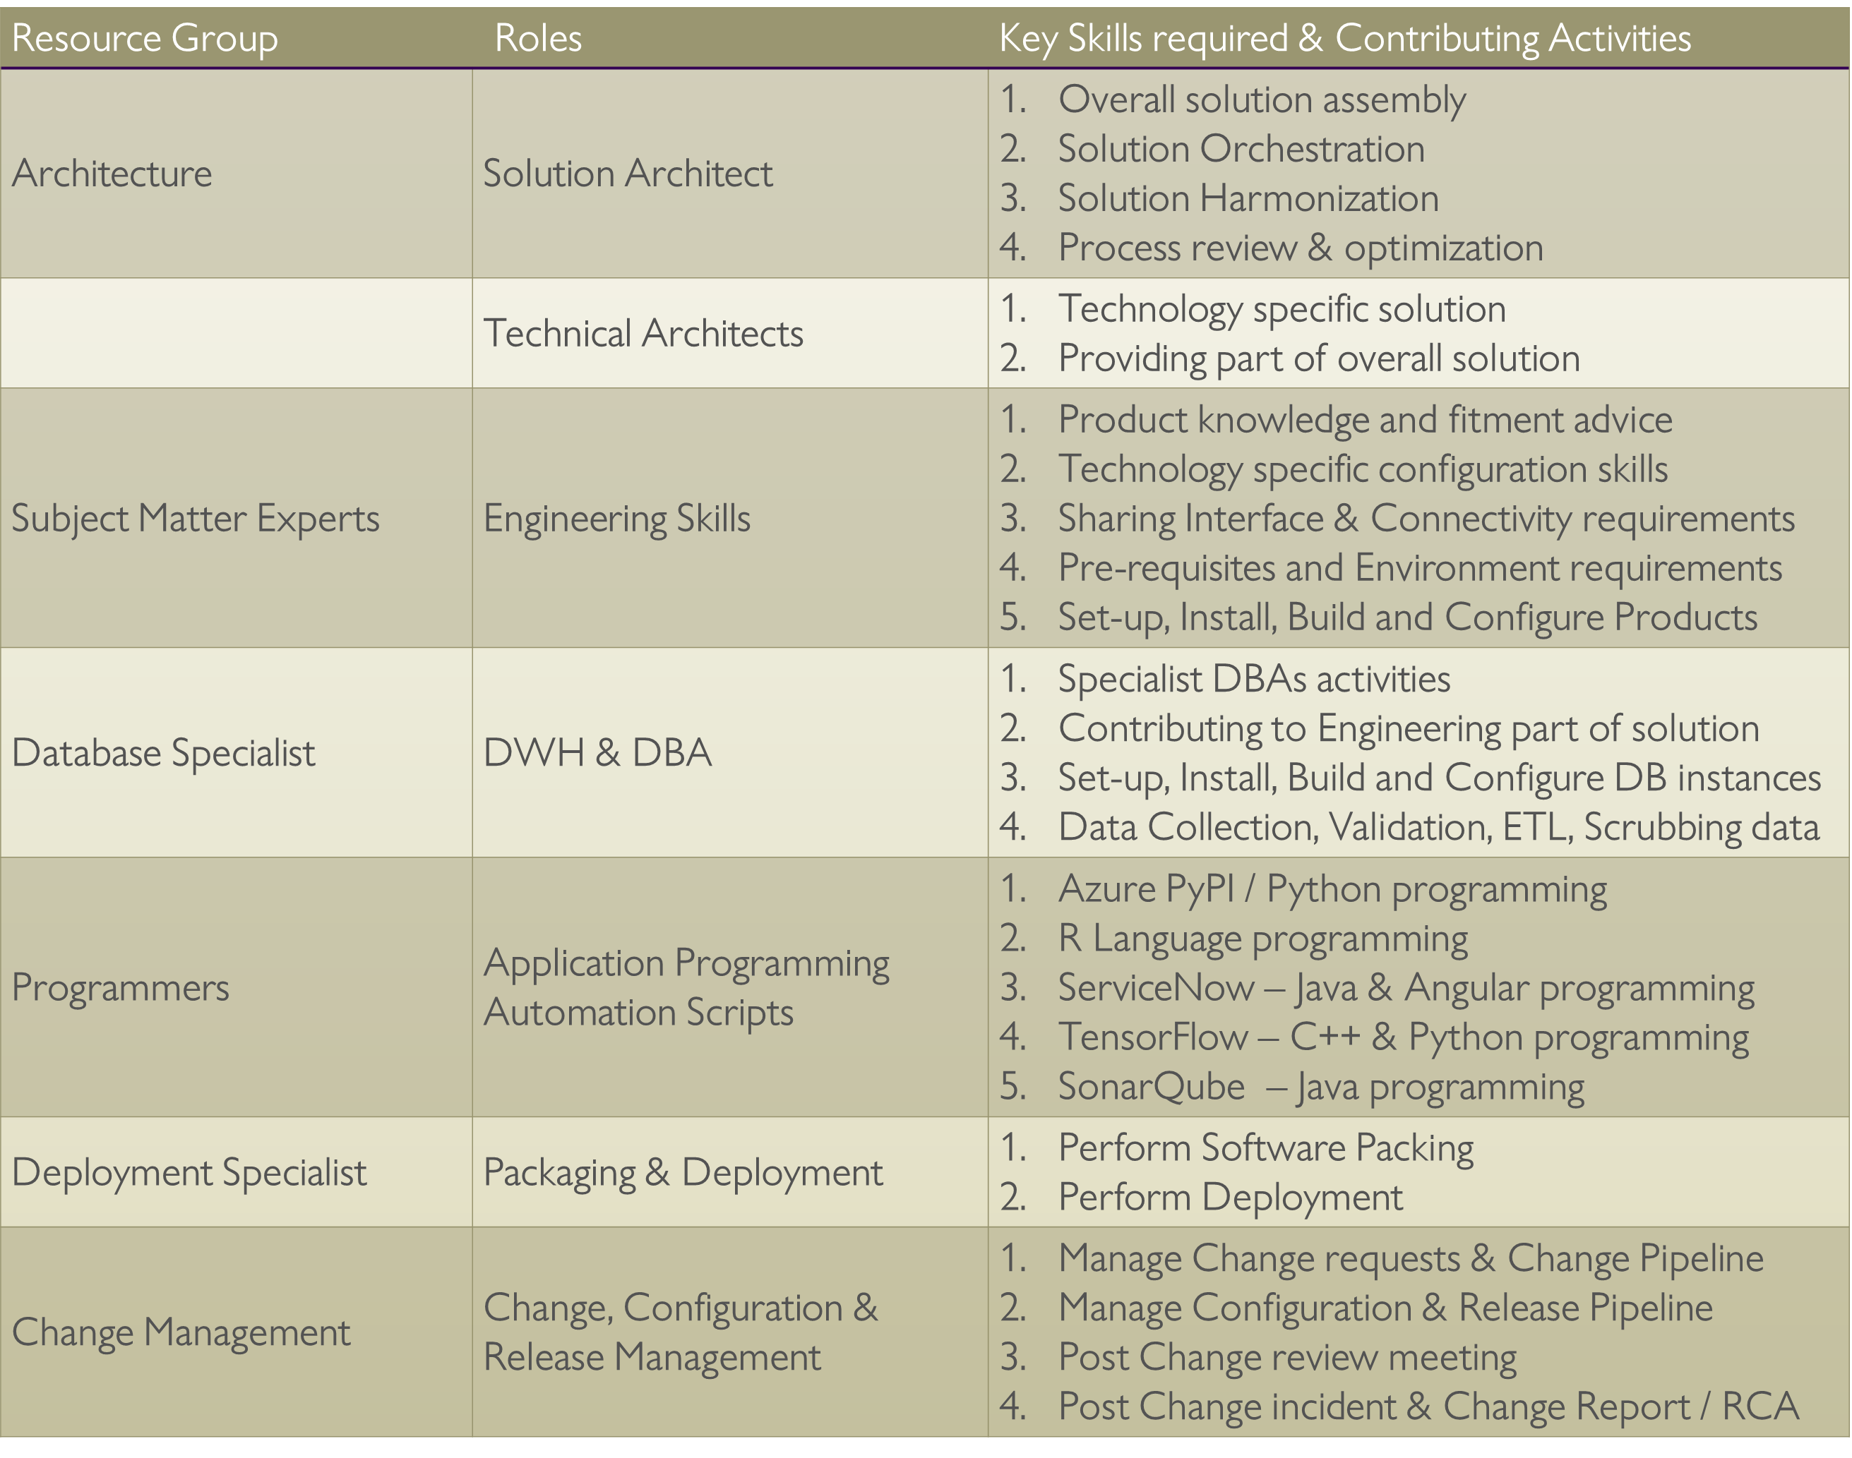
Solution requirements & Talent skills

Slide 8
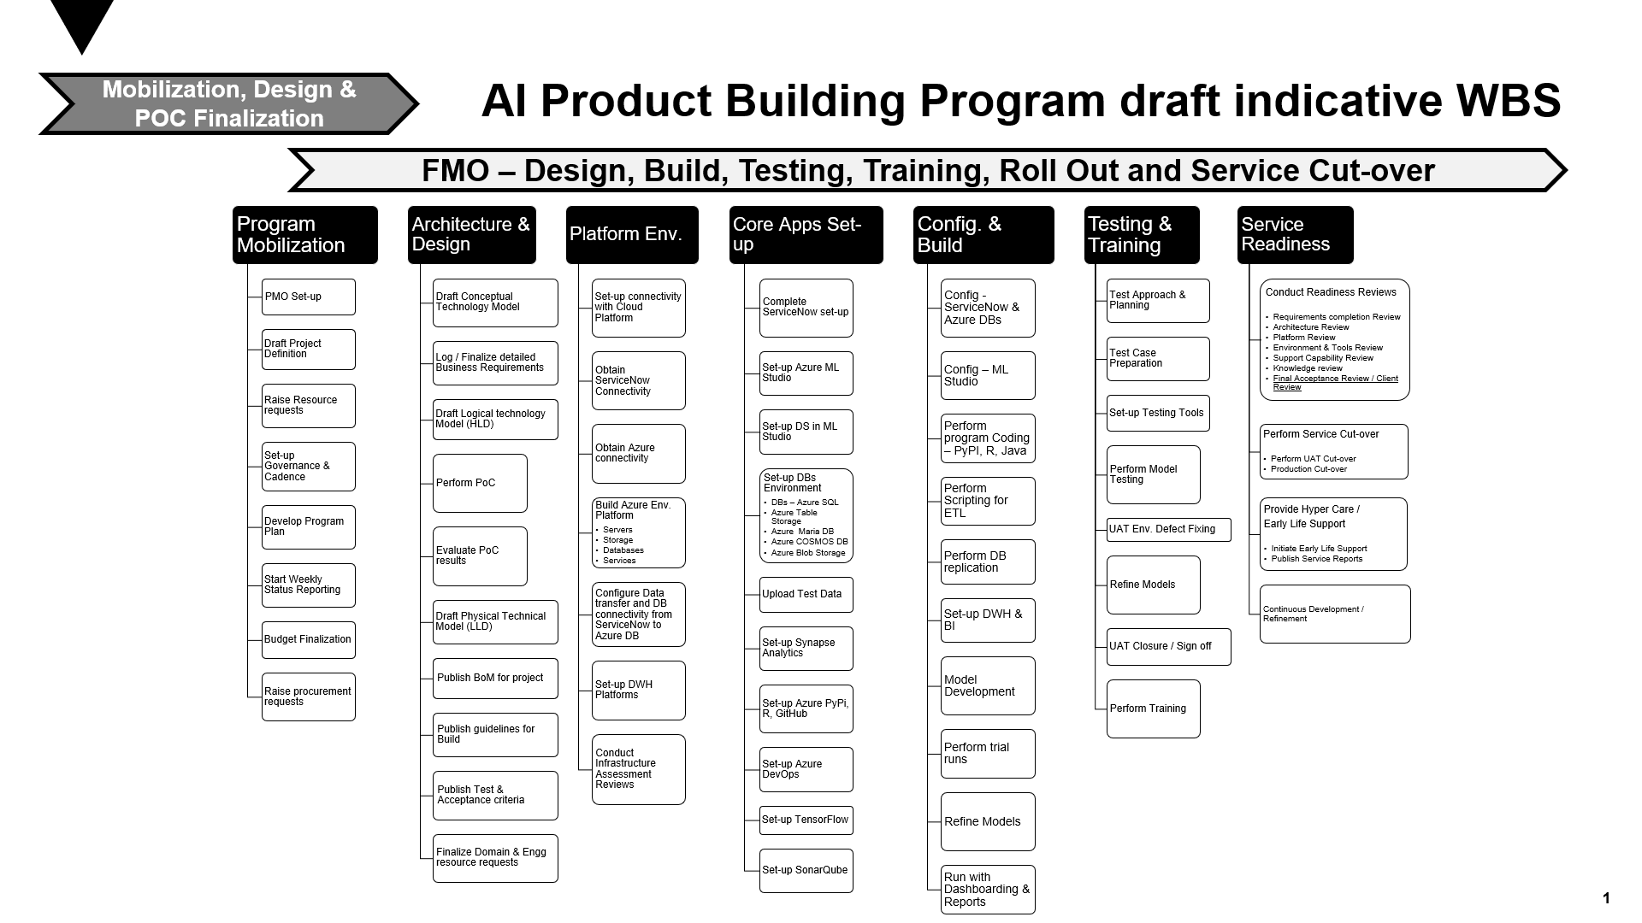

Slide 9
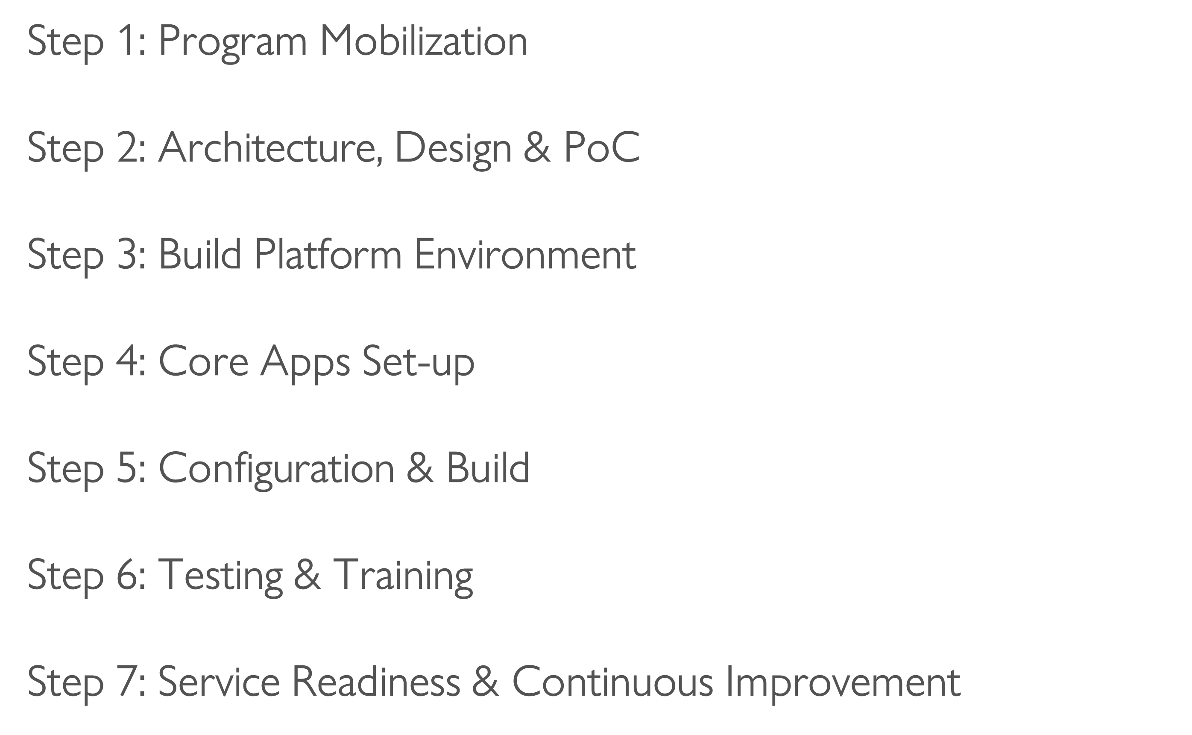
Project Plan & Steps

Slide 10
THREATS & OPPORTUNITIES
AI is rapidly entering health care and serving major roles, from automating drudgery and routine tasks in medical practice to managing patients and medical resources. As developers create AI systems to take on these tasks, several risks and challenges emerge, the risk to patient privacy of data acquisition and AI inference, and more.
Points to look at:-
1. Regulatory Shackles: One of the key regulatory issues that are hampering the acceptance of AI in healthcare is the archaic regulatory infrastructure. Although the technological advancements in the field of healthcare have grown by leaps and bounds, the regulatory infrastructure has failed to keep up.
2. The Opacity Of Processes: While deep learning models and neural networks in AI have proven over time to be perfect than human decision-making, they are often not transparent in terms of revealing how they generated such conclusions. It then becomes a challenge for insurance companies to explain that to the regulators. It has been mentioned that the biggest challenge in using big data, artificial intelligence is that they operate outside the framework of traditional privacy principles. This could now act in a reverse way and expose banks/healthcare/insurance to risks without their knowledge. It could also possibly give rise to hidden biases in decision making since AI has access to data of all the customers.
3.Leakage And Misuse Of Data: Several experts in the U.S. and the U.K. opine that cyber, political and physical threats arise with the growth in the capabilities and reach of AI. Complete transparency while venturing into new AI projects also should be ensured so that banks/insurance companies don’t face reputation risks. Adequate investments should be done on the safe storage of data and prevent it from leakage. EnSure architecture will detect potential hazards in the implementation stage of the project and enable efficient identification—and then execution—of goals and priorities of the organization. Artificial intelligence will soon become the sole determinant of the competitive position of financial institutes and a key element enhancing their competitive advantage.

Slide 11
KEY CHALLENGES & OPPORTUNITIES
Opportunities
To give the best corroborative healthcare solutions that money can buy
Excellent growth
Build Strong expertise to create integrated platforms.
Expand into other verticals & geographies
Challenges
To not be puppet/dominated by Healthcare/Insurance companies to compromise customer needs. Relevant skillsets of AI/Blockchain experts
Angel funding for initial capital.
Clients who don’t want to share information

Slide 12
COMPETITION
All companies providing some parts of the solution like healthcare, financial solutions, customer centric.
Companies like:-
(a) (IIT)-iMediX (Virtual consultations)
(b) Medical professional discovery platforms like Practo
(c) Novartis
(d) Insurance platforms like Policy Bazaar

Slide 13
TARGET CUSTOMER
We intend to target two groups of users here – the insured and the insurance companies.
Insured – Any Indian citizen, who is of eligible age to get insurance is the target market but we will specifically target the head of the family. (Our marketing efforts will be targeted towards appealing to the humane side of – have you ensured the safety of your family?) The ideal customer would be
Age – 25 to 45 years of age
Location – Tier 1 & Tier 2 cities
Income Group – In the tax net and has a pan card
Insurance Companies – The medical insurance companies would be our target market as well and especially those that are facing a large number of claims and seeing a lot of false/fraudulent claims.

Slide 14
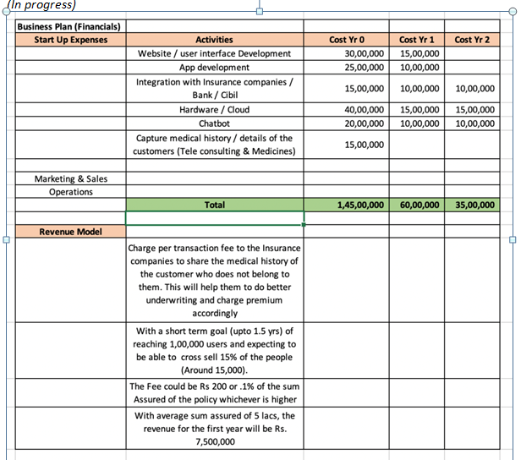
BUSINESS PLAN

Slide 15
THANK YOU

