Slide 1


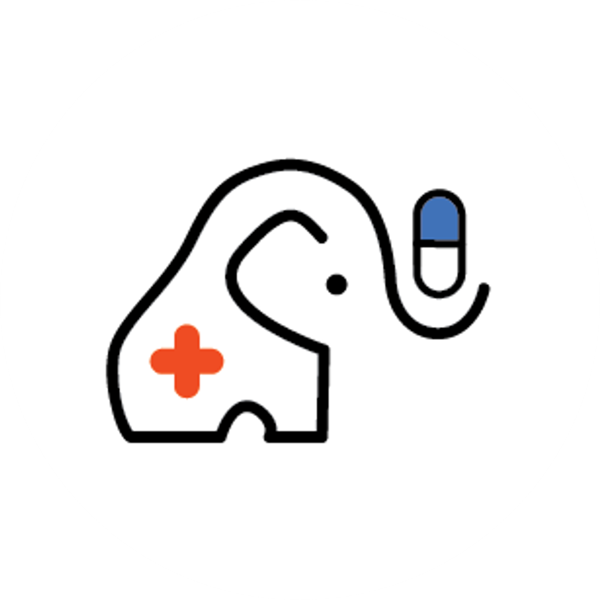

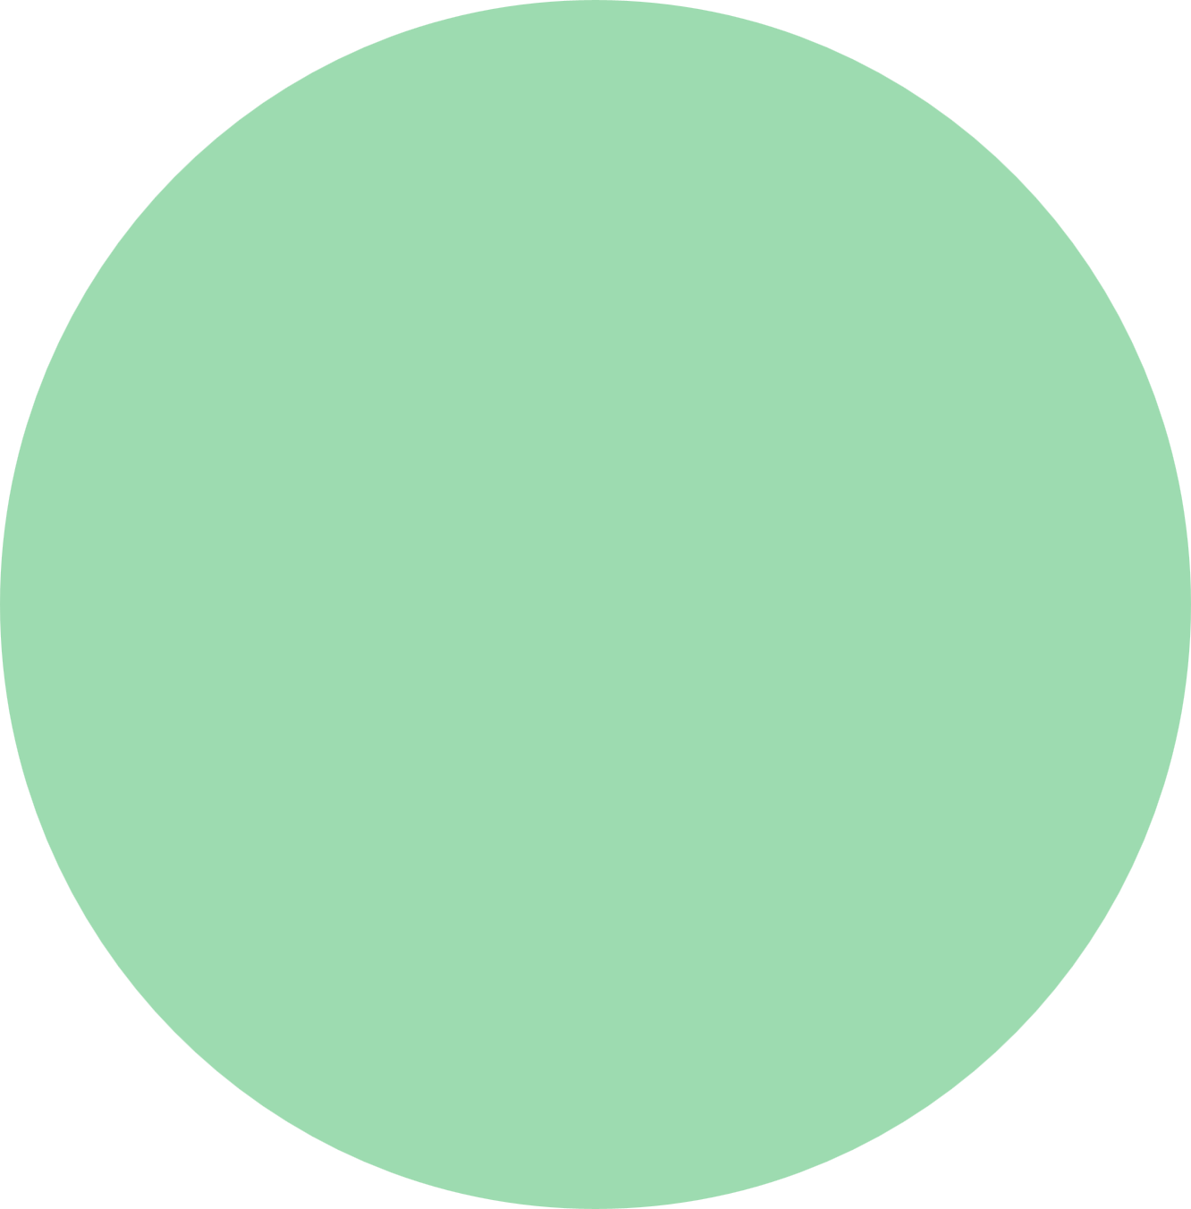
Nurse Ellie
Medication Reminder App that keeps you connected.
Vivian Chiu, Daniel Park, Steven Tran, Vu Pham, Sammar Abbas

Slide 2

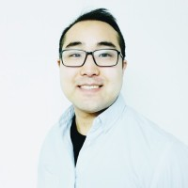
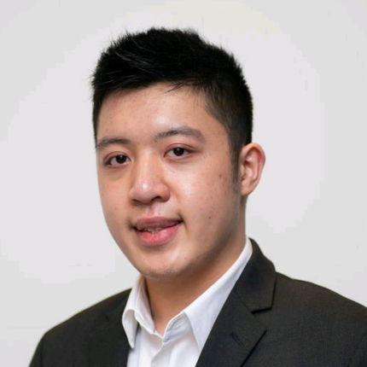
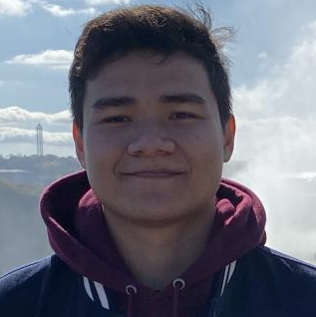
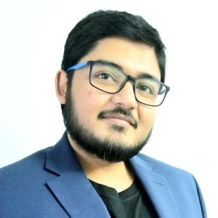
Our Team
Vivian Chiu
Project Lead,
Front-End Developer
Daniel Park
Back-End Developer
Steven Tran
Full Stack Developer
Vu Pham
Back-End Developer
Sammar Abbas
Front-End Developer
My passion is in designing and developing user-friendly solutions to real-world problems.
My passion is in learning and solving problems.
My passion is learning from others and providing help with programming technologies.
My passion in working with new hardware technologies and using JavaScript Frameworks like React and React Native.
I enjoy developing Machine Learning Applications and language of interest is Python
Notes:
I’m Vivian and I worked on the user interfaces for medication management,

Slide 3
Problem Statement
Patients lack health literacy for correct medication adherence, and health professionals need a way of understanding a patient’s medication adherence
Patients lack of correct prescription adherence can cause avoidable health complications and health professionals do not have insight to their patient’s recovery after an appointment
Increased health complications due to incorrect medication consumption, and lack of communication between a patient and their health professional are an issue
A user-friendly application that assists patients to follow their medication regimen responsibly and safely and allow them to communicate with their health professional
Notes:
Problem: Patients lack health literacy for correct medication adherence, and health professionals need a way of understanding if a patient is taking their medication.
Affects: The patients that are not following correct prescription instructions can encounter health issues or life-threatening problems, or health professionals do not have insight to their patient’s recovery after an appointment
The impact of which is: Increased health complications due to incorrect medication consumption, and lack of communication between a patient and their health professional
A successful solution would: A user-friendly app that assists patients to follow their medication regimen responsibly and safely and allow them to communicate with their health professional

Slide 4
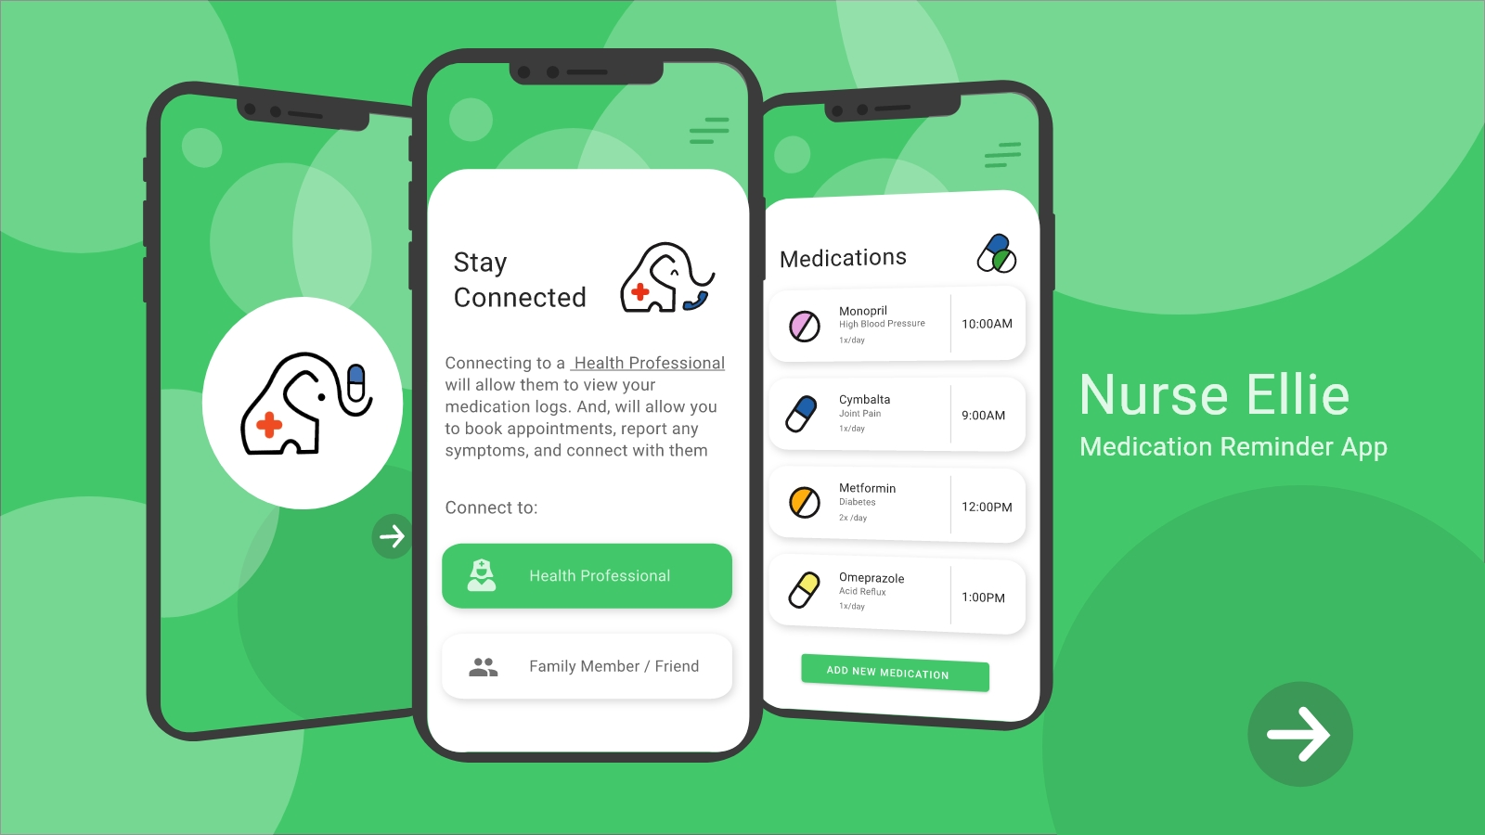
Solution Vision
Product Vision
Notes:
For at-risk individuals taking medication, health professionals and caregivers
Who have difficulty adhering or keeping track of their medication regimen and understanding their regimen
NurseEllie is an Android, iOS, web health services application
That gives health care providers the ability to manage patient’s medication regimen remotely as well as receive and provide real-time feedback
Unlike Pill Reminder & Medication Track – Medisafe
Our product features integrate voice, video and chat communication, remote scheduling, feedback and automated reporting

Slide 5
Our Product Vision
For at-risk individuals taking medication, health professionals and caregivers. Specifically helping those who have difficulty adhering or keeping track of their medication regimen and understanding their regimen.
NurseEllie is an Android and iOS application that gives health care providers the ability to manage patient’s medication regimen remotely as well as receive and provide real-time feedback unlike Pill Reminder & Medication Trackers.

Slide 6
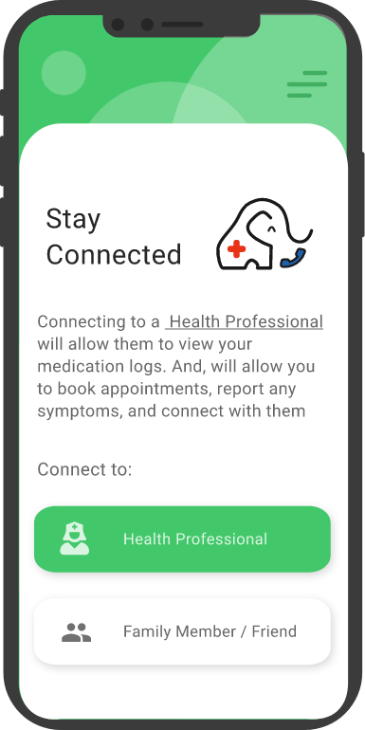

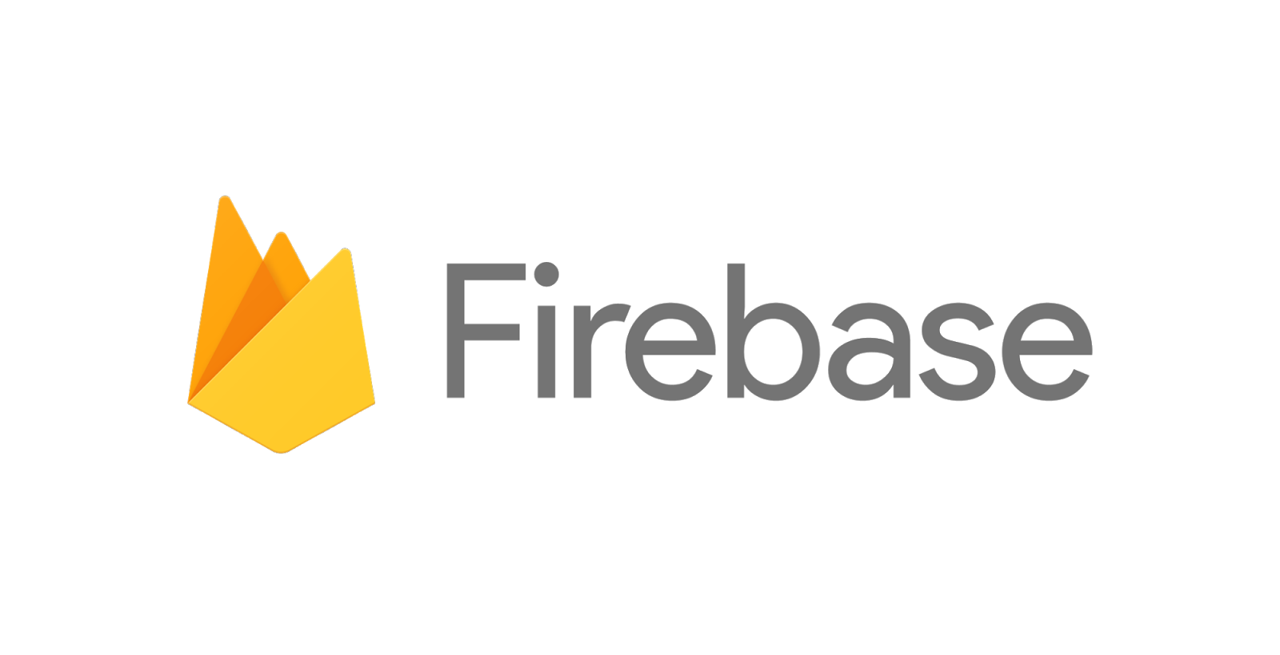
Our Solution Vision
JavaScript
Handlers
Authentication
Cloud Storage
Cloud Functions
React Native Front-End
Notes:
For NurseEllie, We used React Native as a Cross Platform solution as we wanted our application to support Android and iOS.
And we chose to use Google’s Firebase and Firestore for our Authentication and Cloud Storage. As Firebase includes methods for handling data, we used JavaScript to manage these methods for our application.

Slide 7
Planning
Network Diagram, Gantt Chart
Notes:
Planning. We planned out our semester, primarily using a Network Diagram and Gantt Chart.

Slide 8
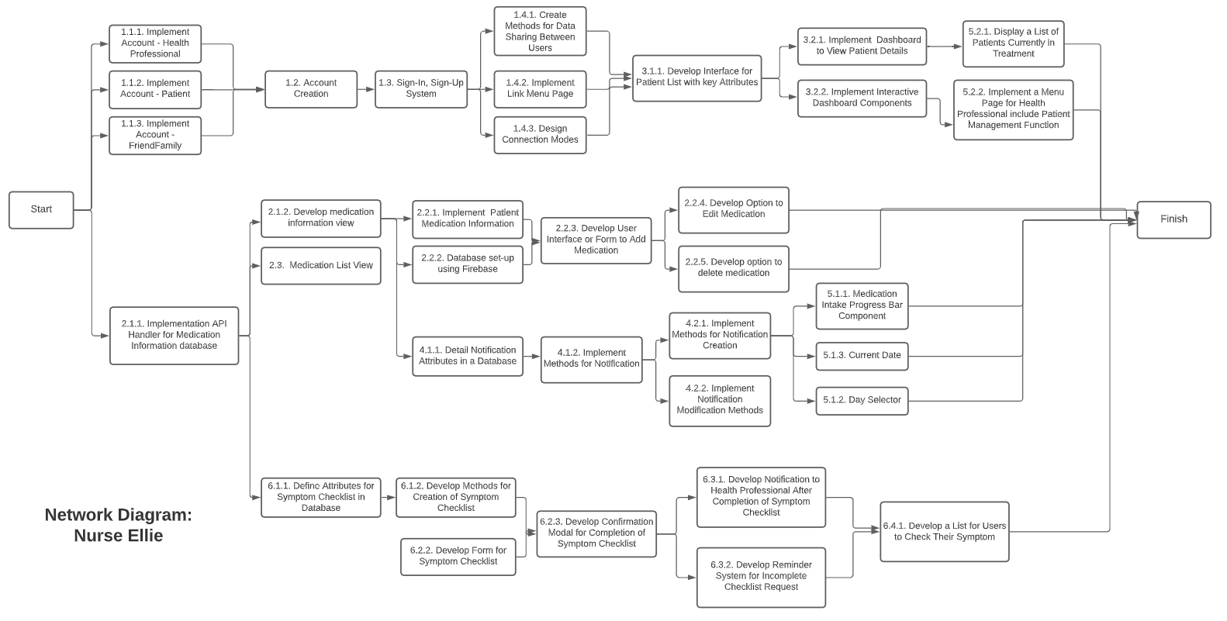
Notes:
We planned out our project for the semester using a Network Diagram to determine dependencies and features that could be worked on in parallel.

Slide 9
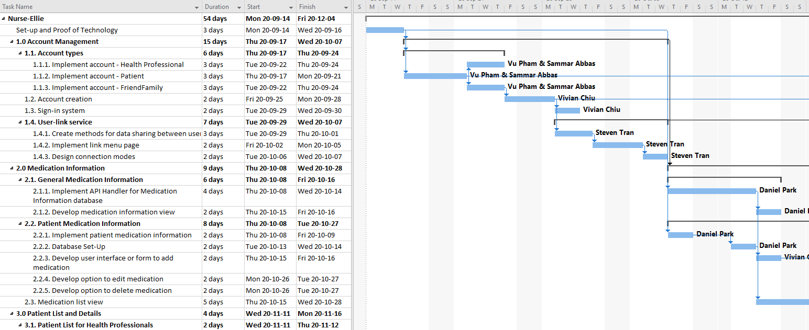
Gantt Chart
Notes:
We organized our deadlines and milestones using MS Projects. Our largest work packages included the features for handling user accounts, linking user accounts, and medication management.

Slide 10
From Use Case to Design
User Connection, Medication Management
Notes:
From Use Case to Design.
Even before developing our application, we had to take our use cases for our project and design a solution.
Here, I will review two of our core use cases: User Connect and Medication Management.

Slide 11
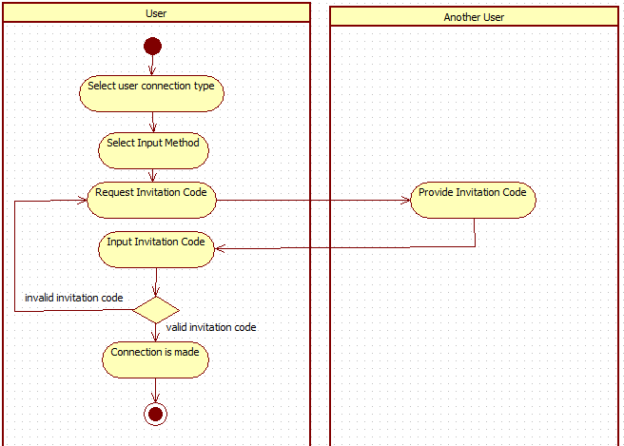
Use Case Diagram for User Connect
Needed a method to connect patients to health professionals
Goal to make it enjoyable to use
Notes:
For our user connect, we needed a method to connect our patients to health professionals. And our goal was to make it a painless process for both users.

Slide 12
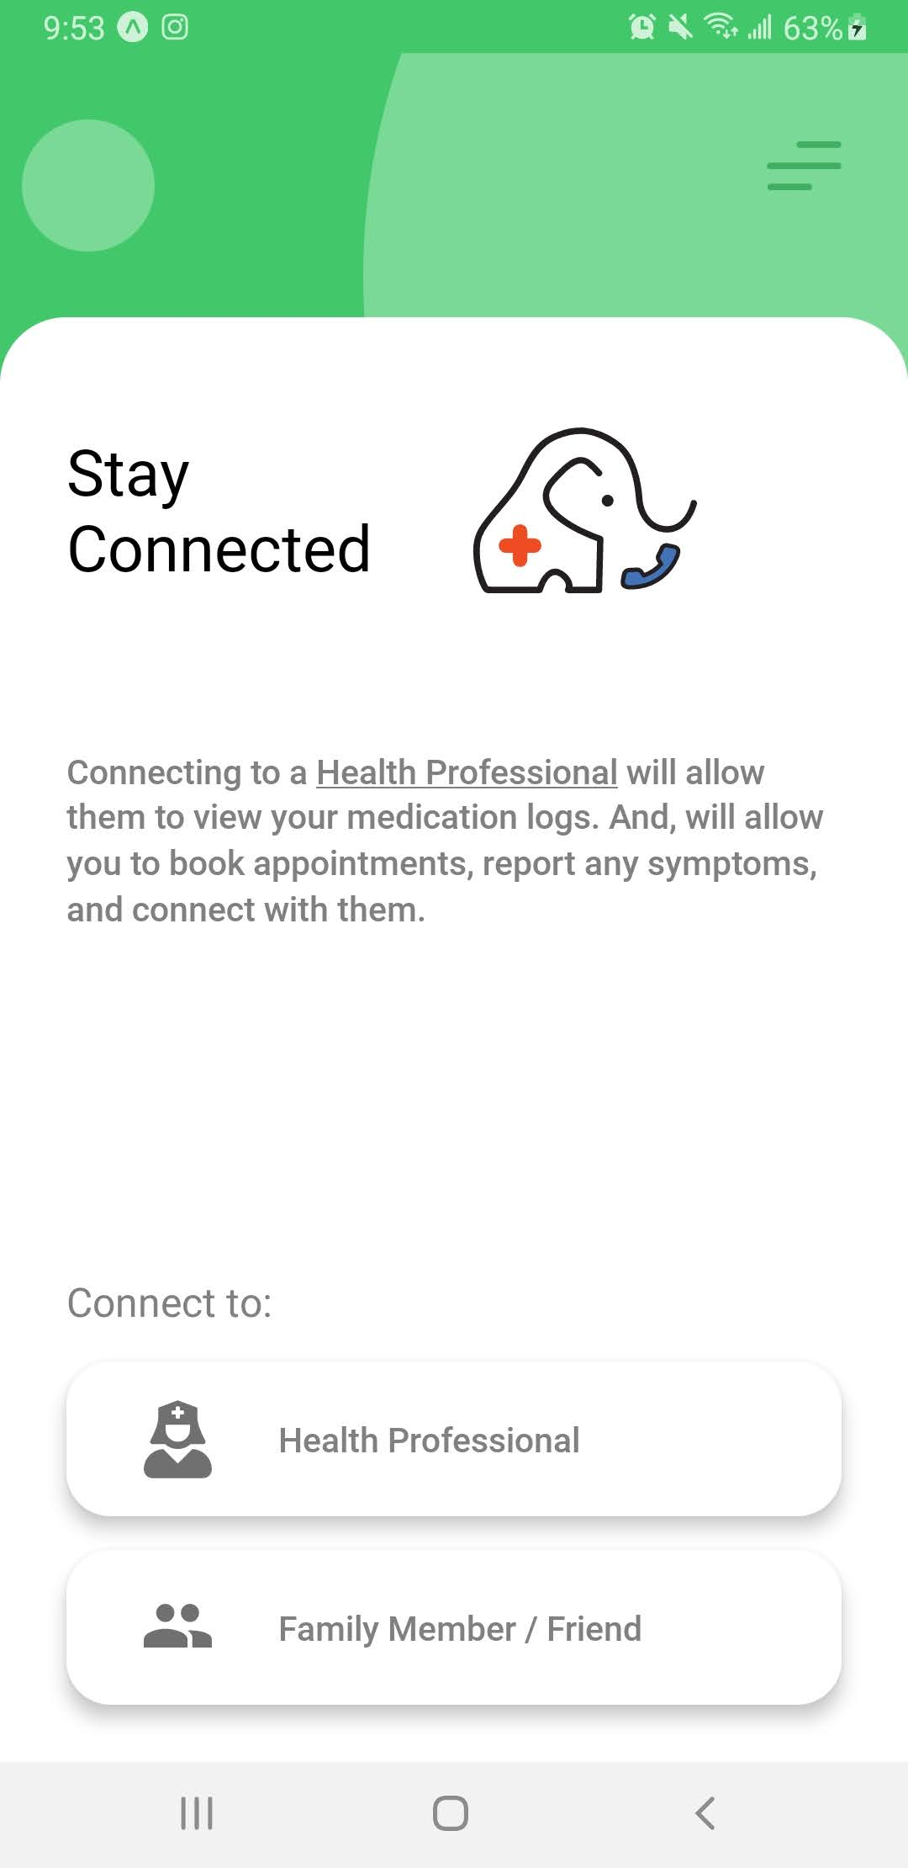
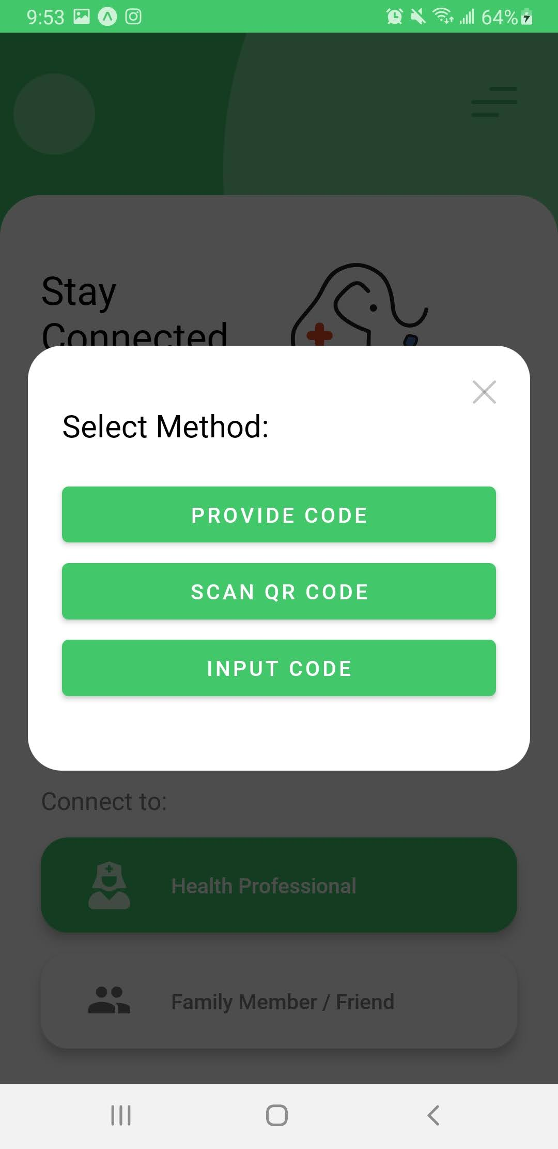
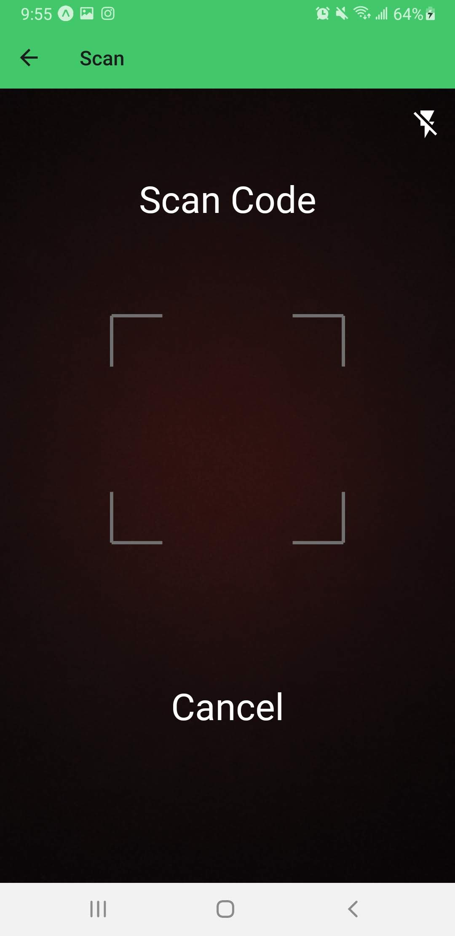
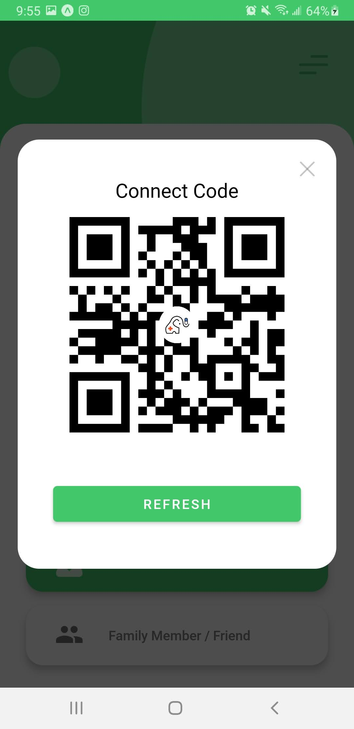
Storyboard for User Connect
User Connect
Connect Methods
QR Scanner
QR Code Generator
Notes:
We designed a user connect which would use qr code scanning and generating to create a user connection.
This would allow patients to connect health professionals, and for health professionals to monitor the medication intake of their patients.

Slide 13
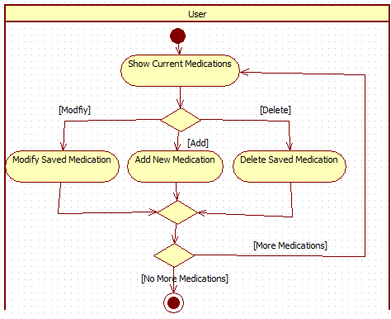
Use Case Diagram for Medication
Core medication management functions
Notes:
For our management medications feature, we needed a method for patients and health professionals to add medications to schedule, edit them as needed, and delete them when they are no longer relevant. The medication management is a core feature as it allows patients to receive medication intake reminders and health professionals to monitor their intake.

Slide 14
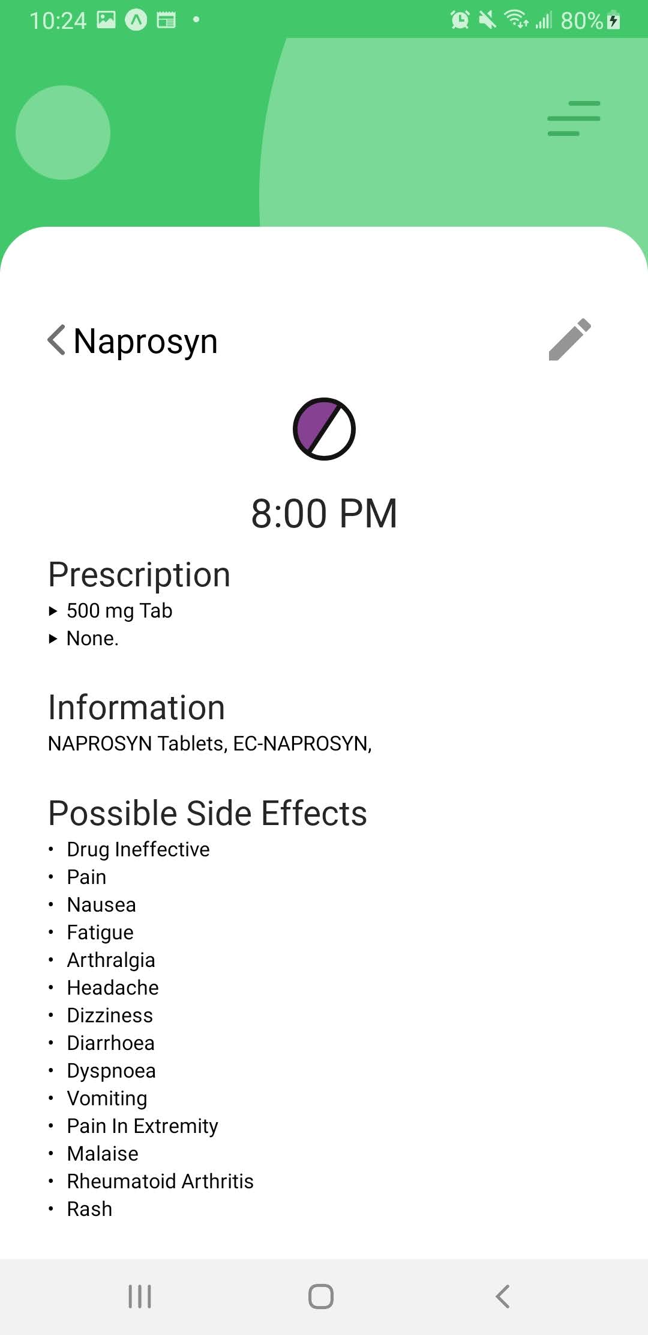
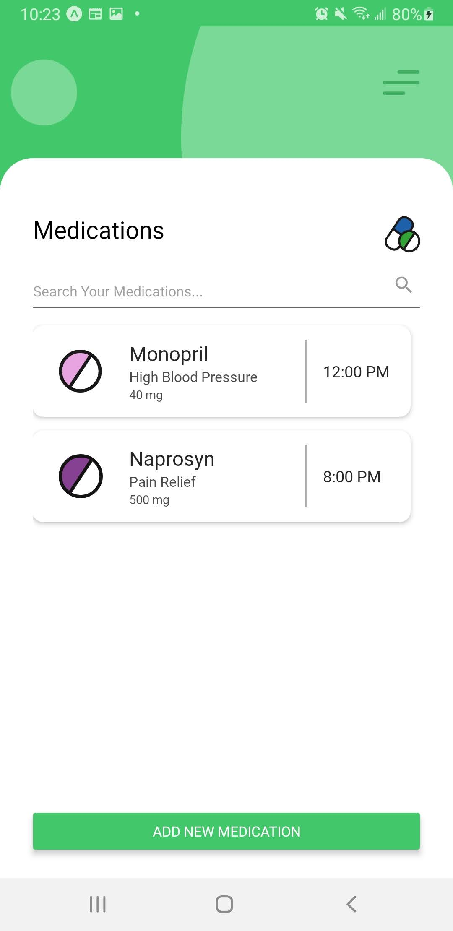
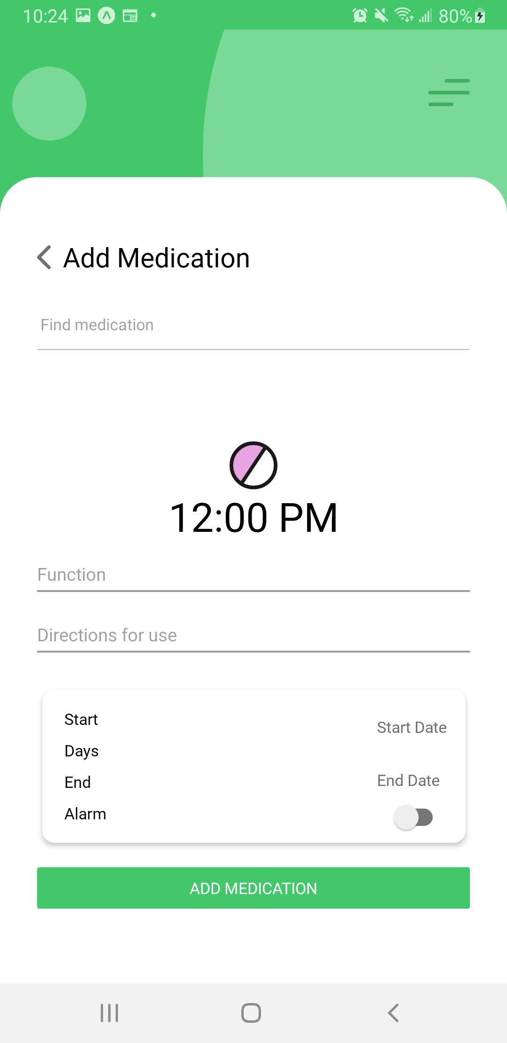
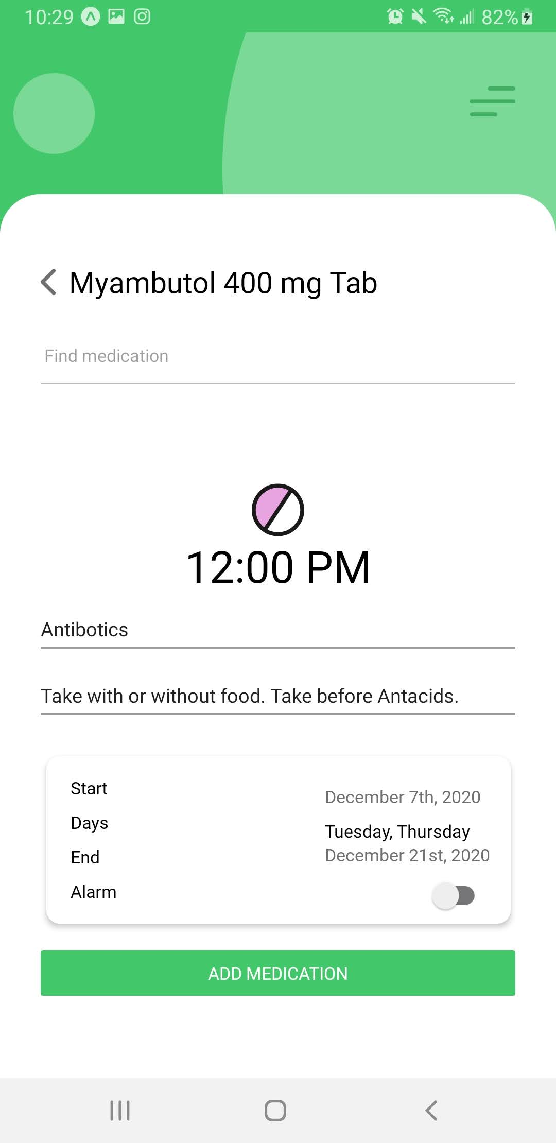
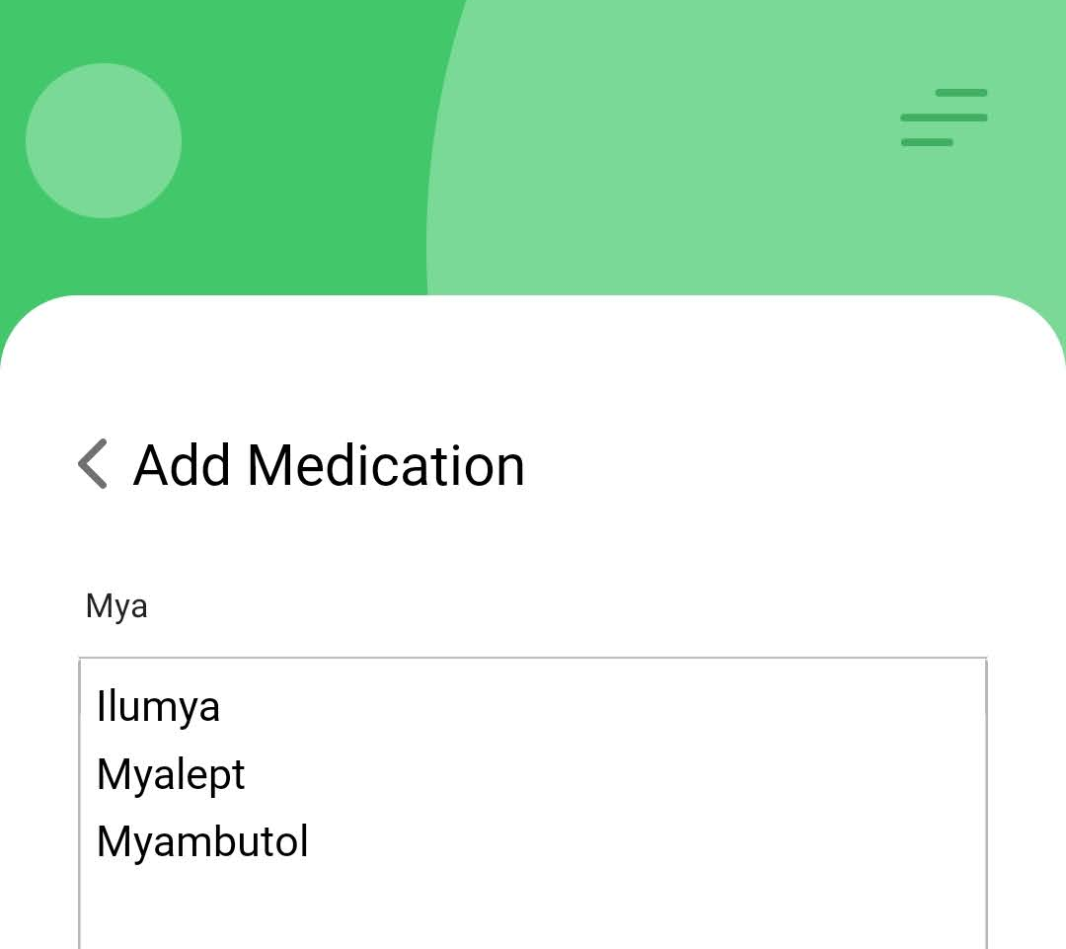
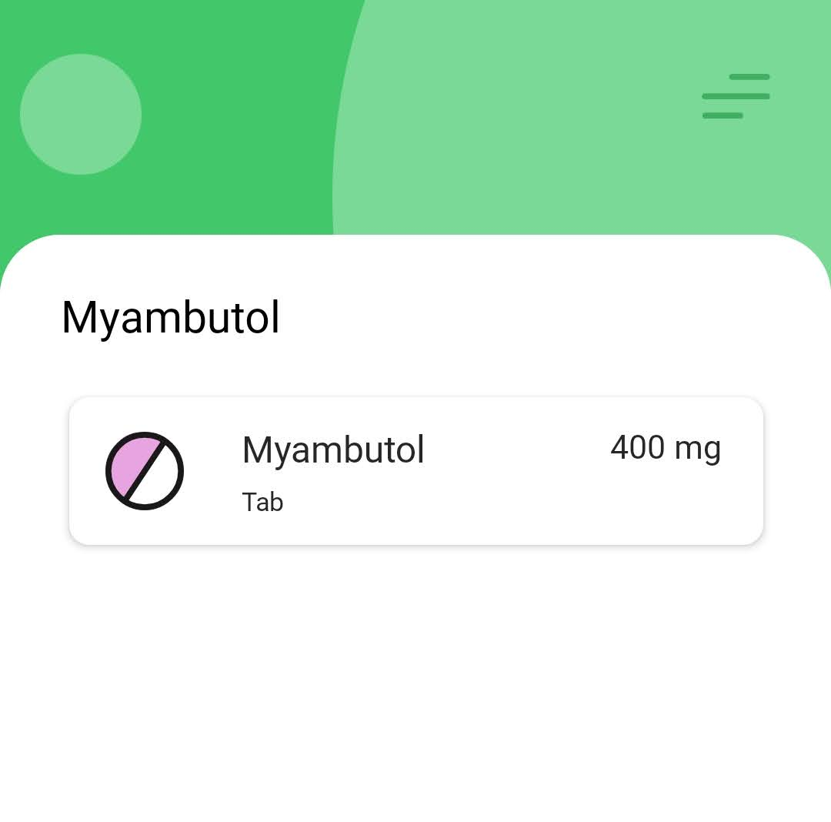
Storyboard for Medication Management
Medication List
Medication Search
Medication Details
Add Medication
Add Medication Form
Notes:
Here, you can see our user flow. Our user would start at the Medication List page and choose to either view details of a single medication or add a new medication.
When a user is adding a new medication, they can search for their medication in a repository and select their notification settings.
On the other hand, a user can view details of a medication including their medication scheduled time, intake instructions, dosage and possible side effects or, choose to make edits.

Slide 15
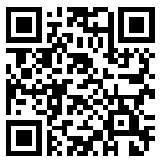
Project Demo
We encourage you to download the ‘Expo’ Application on Google Play or the Apple Store and scan this QR code and try our app!

Slide 16
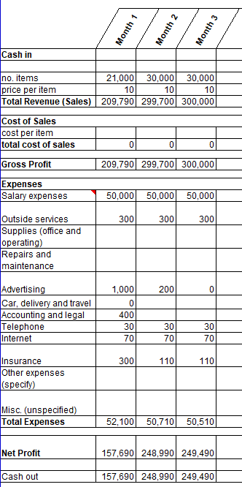
Business Case and Feasibility
Paid Subscription service to Health Professionals
Monthly Subscription for Service with different fees depending on number of Patients
For example,
$9.99/month for 300 patients
$14.99/month for 600 patients
$19.99/month for 900 patients
Notes:
For every 100, 000 Canadians there are 780 Registered Nurses, 190 Physicians, 58 Dentists, 49 Physiotherapists (approx. 1077 not all health professionals included)
(https://www.longwoods.com/product/download/code/19504#:~:text=In%20terms%20of%20health%20workers,each%20occupation%20varies%20over%20time)
37.5 million Canadians, so that’s approximately 403, 875 (approximately 400K) health professionals. So, even if 5% of Health Profesionals (20.1K) use the base-tier of the app.
Our service would stand to make $201,937.5 in just one month.
As we plan to charge based on a subscription model with different tiers depending on the number of patients a health professional connects to, we predict that if 5% of Canada’s health professionals use our application using a base tier at the cost of $9.99. Our application would receive a net profit of approximately $150,000 each month including expenses.

Slide 17
Lessons Learned
From a technological perspective:
Developing NurseEllie required learning different technologies including Firebase, React Native, and many mobile specific interactions
Transitioning/upgrading between Software Development Kits
Using version control (i.e. Git) exercising best practices
However, we also learned:
Working with Project Management Tools on an Agile Workflow (i.e. Kanban Board, Daily Stand Ups)
Onboarding a new team member
Notes:
From a technological perspective, we learned to use a lot of different technologies including Firebase, React Native, and many mobile specific packages and interactions
We learned what it took to transition or upgrade between different Software Development Kits as we transitioned from Expo SDK 38 to 39
And we learned a lot about version control to work collaboratively exercising best practices.
However, we also learned a lot from a project management perspective.
We worked with Project Management Tools with an Agile Workflow (using Github Project’s Kanban board, and attending daily stand ups to share our process
We also experienced onboarding a new member to the team.

Slide 18
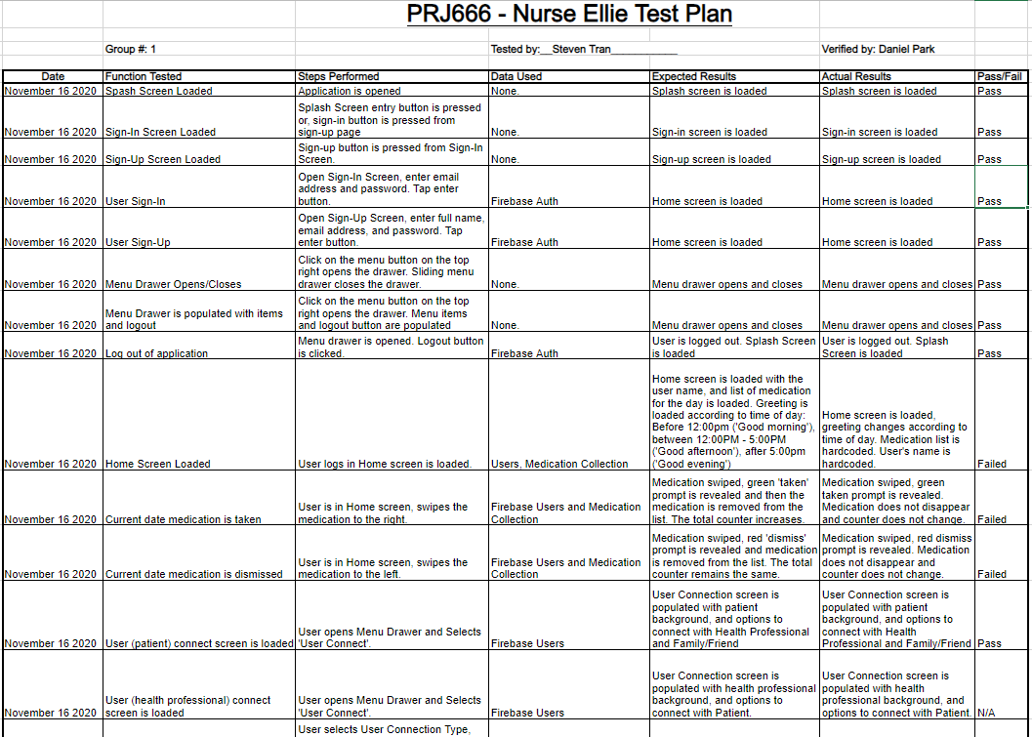
Notes:
Unit Test
Integration Test
System Test
User Acceptance Test

Slide 19
Testing
Performed Unit Testing – completed for all core functionalities of the application
Completed Integration Testing – each time a new feature was implemented to our project
User Acceptance Testing – distributed the application to our friends and family to test and received feedback.

Slide 20
Summary
Included means to manage basic user information for both patients and health professionals
Medication Intake Management features
Patients and Health Professionals to add medication scheduling
Medication Intake Reminders/Notifications
Store basic medication information such as usage and possible side-effect
Methods for providing patient feedback to health professionals
Patient Symptom Checklist
Medication Summary for Health Professionals to see taken and missed medications
Our application was able to deliver the expected features outlined for Phase 1, and even added bonus quality of life features.
Notes:
Phase 1 Scope:
1. Manage basic user information
- User creates account and profile
- Health professional validates or registers patient
2. Manage medication regime
- Health professional adds/deletes prescription medication to/from patient’s regime
- User can add off-the-counter medication to their regime
- User can view list of current medications
- User views information on medication
- User sets medication intake reminder schedule
- User responds to medication intake alert/reminder
3. Record patient feedback
- Patient performs symptom check
- User views missed, late and on-time medication intake
- User shared medication log

Slide 21
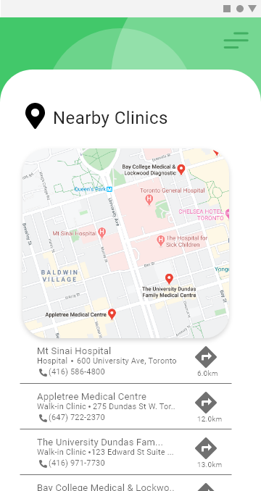
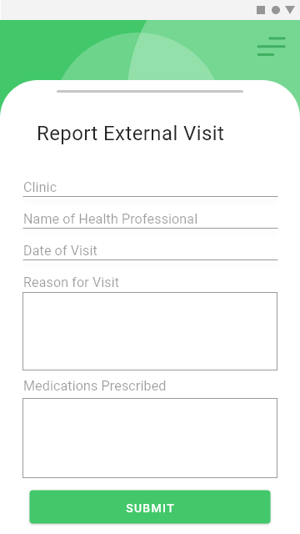
Next Steps
Include paid Health Professional tier application subscription
Include more information that can be shared such as blood-glucose monitoring data
Provide additional medical services support such as searching functionality for near by medical clinics or hospitals
Allow users to report visitation to hospital or alternative clinics to their physicians

Slide 22
Thank you for watching!
Notes:
Thank you for time and we hope you enjoyed our presentation.

