Slide 1
Help autistic kids express their emotional expressions
By Pinky Arunwattanamongkol
arunwann@mail.uc.edu

Slide 2
WHY?
Some autistic kids have been struggling with expressing their emotions with other people.

Slide 3
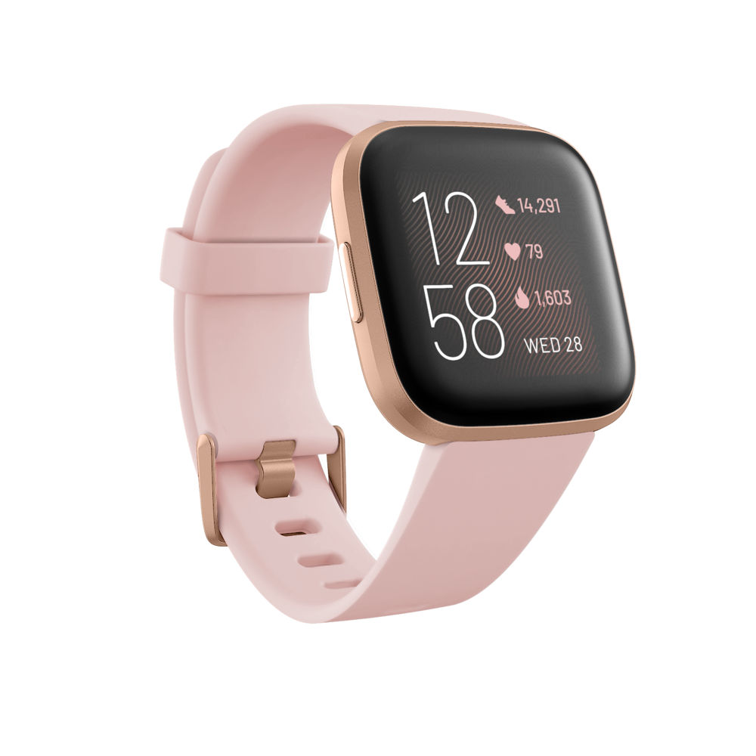
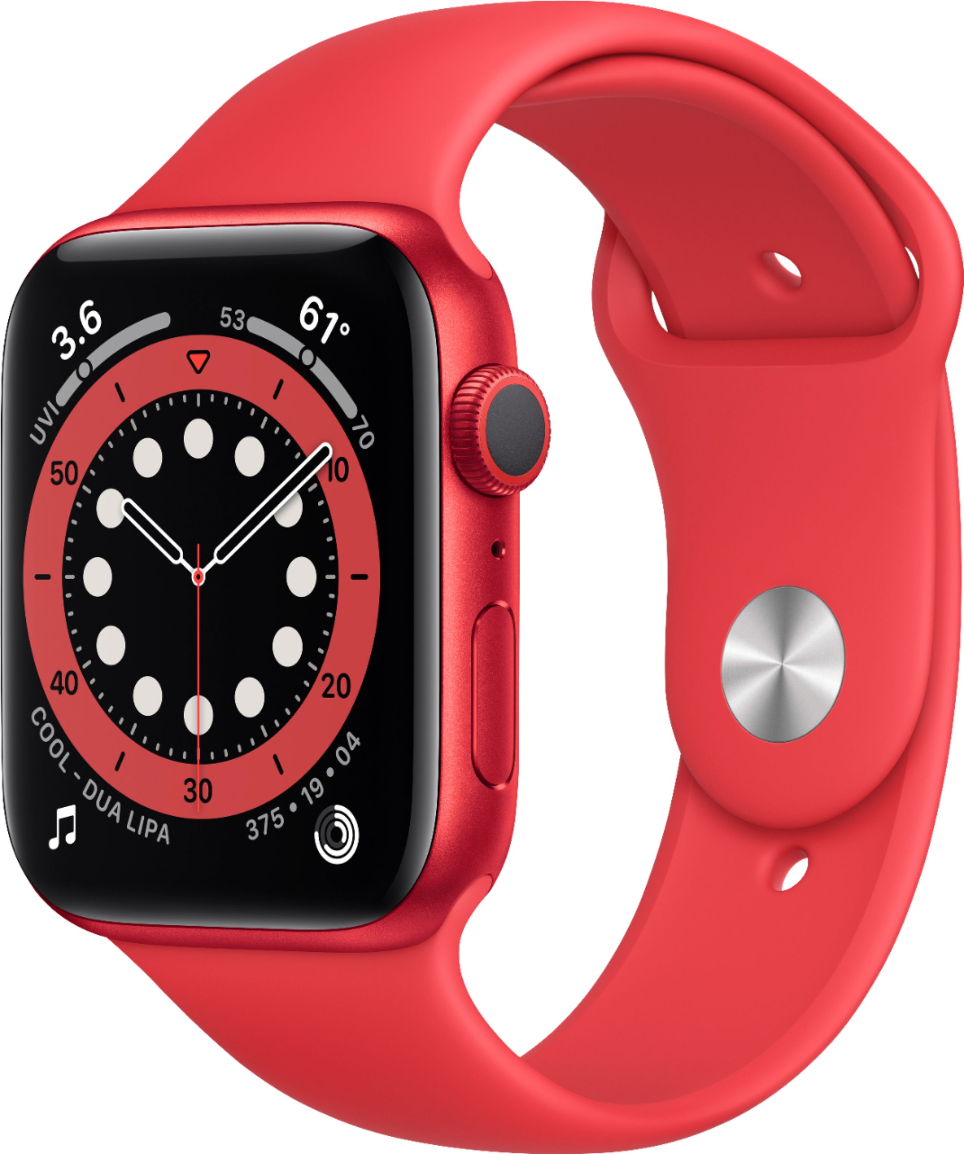
HOW?
Measuring physical data such as heart rate, skin conductance etc. By using smart tech wear (fitbit , apple watch,etc )
Use the data that me have to match with the emotion chart

Slide 4
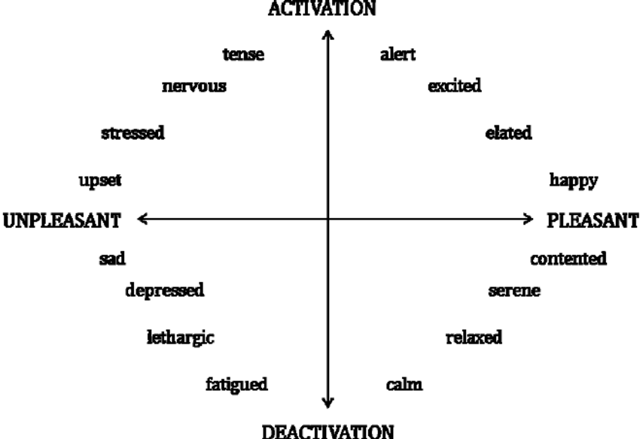

HOW?
Core affect model

Slide 5
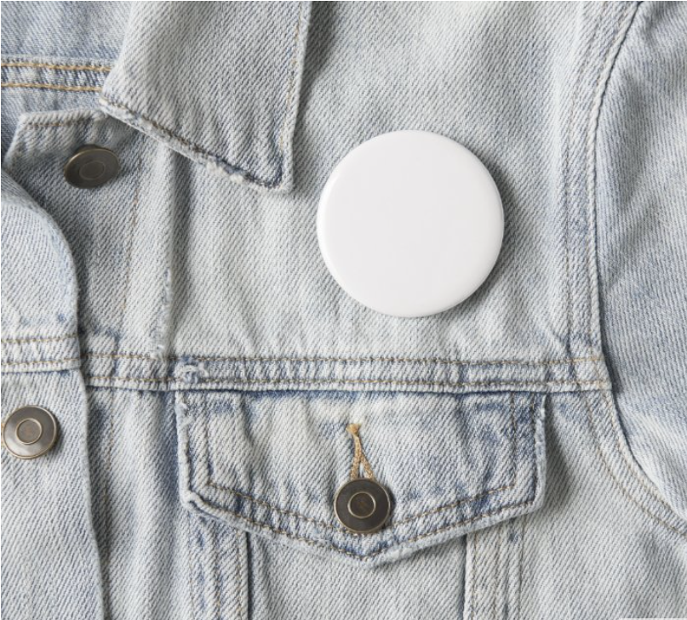
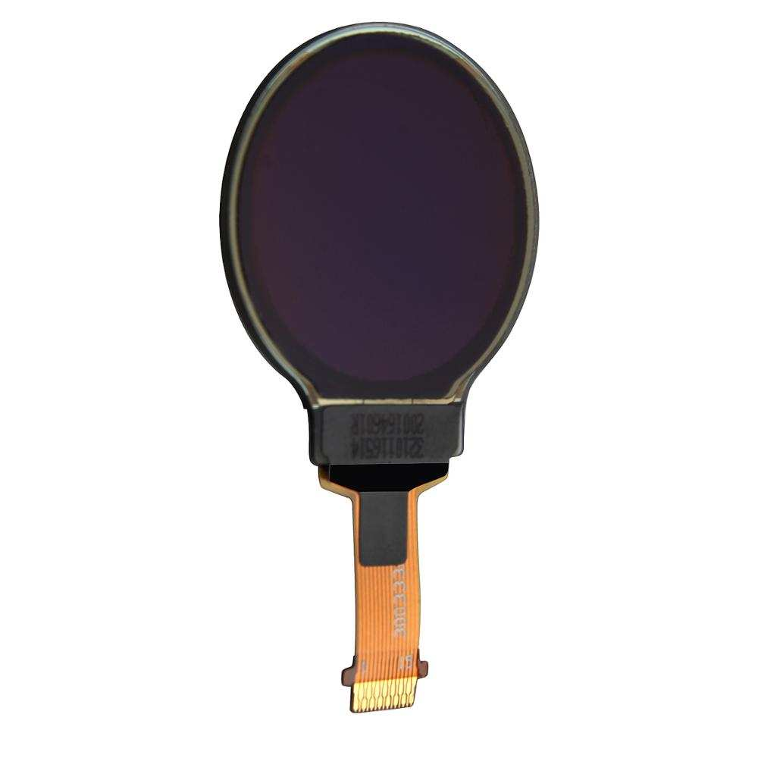

HOW?
+

Slide 6
START
Smart tech wear measuring your physical data
Analyze and compare the result with an emotion chart
Match the emotion result to the emoji
Show the emoji on an LCD pin

Slide 7
Thank you

