Slide 1



A Storage Model for Supporting Figures and
Other Artefacts in Scientic Libraries: the Case Study of Invenio
Piotr Praczyk (1,2), Javier Nogueras-Iso (2), Samuele Kaplun (1), Tibor Simko (1)
(1) CERN, Geneva, Switzerland
(2) Universidad de Zaragoza, Zaragoza, Spain
Berlin, 29.09.2011

Slide 2
Outline
The Invenio and Inspire projects
Old data model
New use cases of storin data
  Figures
  Data preservation
New data model
Uploading data into the repository

Slide 3
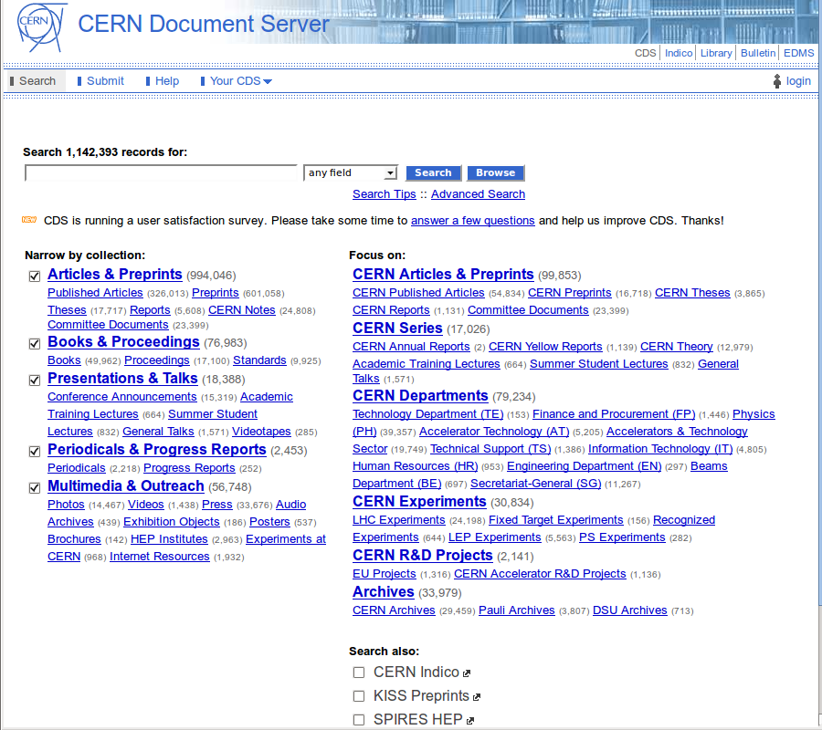
Invenio
Created to be a basis for CERN Document Server
Meta-data represented in MARC

Slide 4
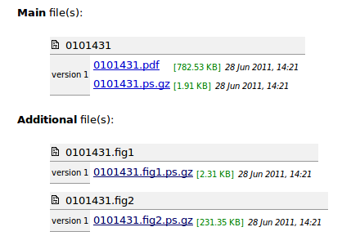
Application layer
<<Python + JavaScript>>
Web interface
<<Python + JavaScript>>
Web interface
(administration)
<<Python>>
Command Line
Interface
Query
Presentation
Users
Manual figures
extraction
Records
Middleware layer
<<Python>>
Records and Objects
Management
<<Python>>
BibSched
<<Python + C>>
Search Engine
<<Python>>
...
Logical model
BibRecord
<<Python>>
BibUpload
<<Python>>
BibIndex
BibObject
…
Storage layer
<<MySQL>>
Search indexes
<<MySQL>>
Metadata (MARC21)
<<Andrew File System>>
Content of objects

Slide 5
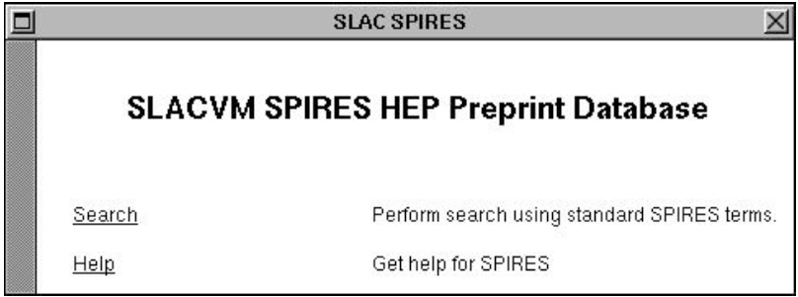
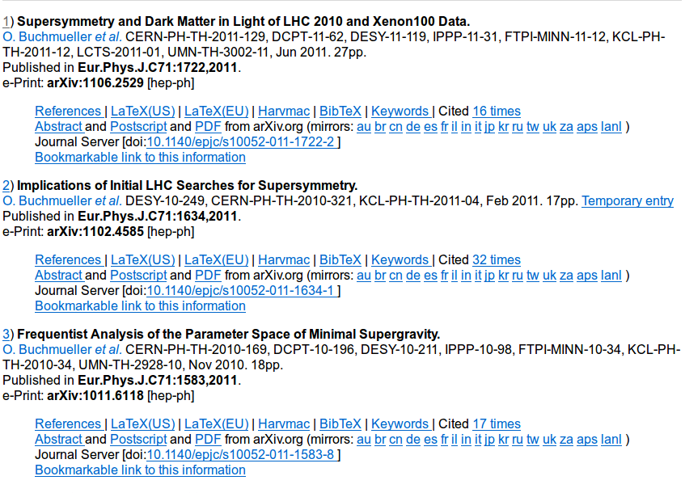
SPIRES
Database of preprints started in 70s
In 90s the first WEB page in USA
Very difficult to maintain, extremely slow

Slide 6
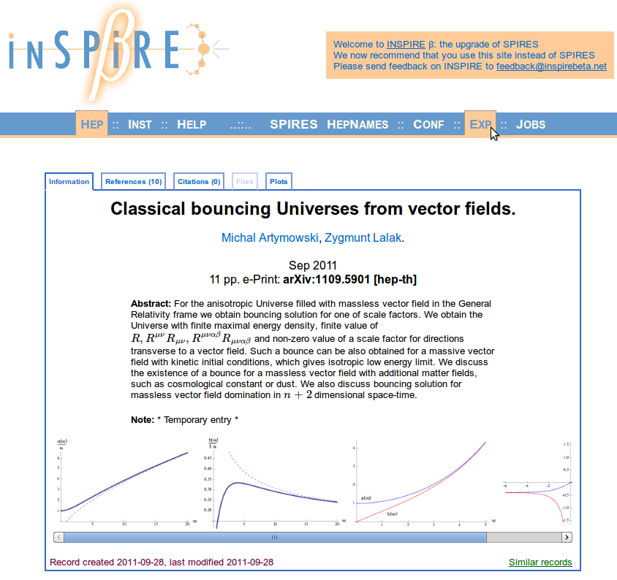
Invenio + SPIRES = INSPIRE
Large community of users
Multiple sources of data (SPIRES, arXiv, diect submissions, publishers)
Nearly 1000000 records

Slide 7
Invenio/INSPIRE
Invenio – digital library software developed at
CERN to manage the repository of documents
created in the institution
SPIRES – The digital library of preprints created at SLAC.
Invenio + SPIRES = INSPIRE

Slide 8
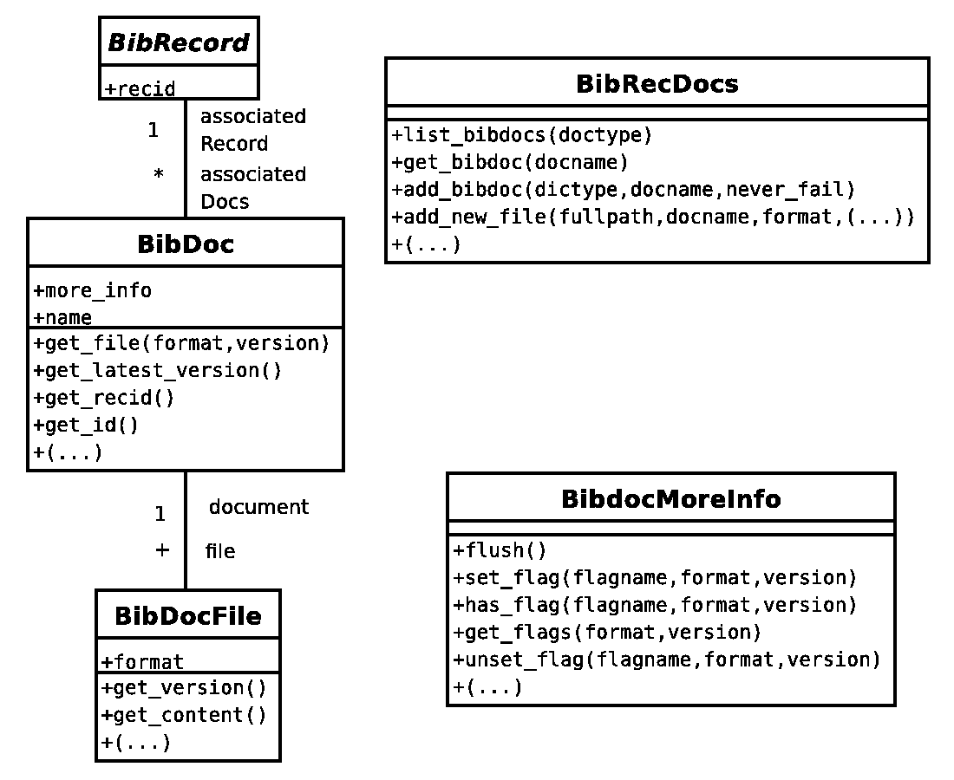
Non-bibliographical data in Invenio
Documents represented as BibDoc instances
Document supports versions and different formats
Internal data stored in a BibdocMoreInfo instance

Slide 9
Non-bibliographical data in Invenio
Internal meta-data stored in a MoreInfo instance
Link between a MARC record and the document
  Every document must belong to exactly one record

Slide 10
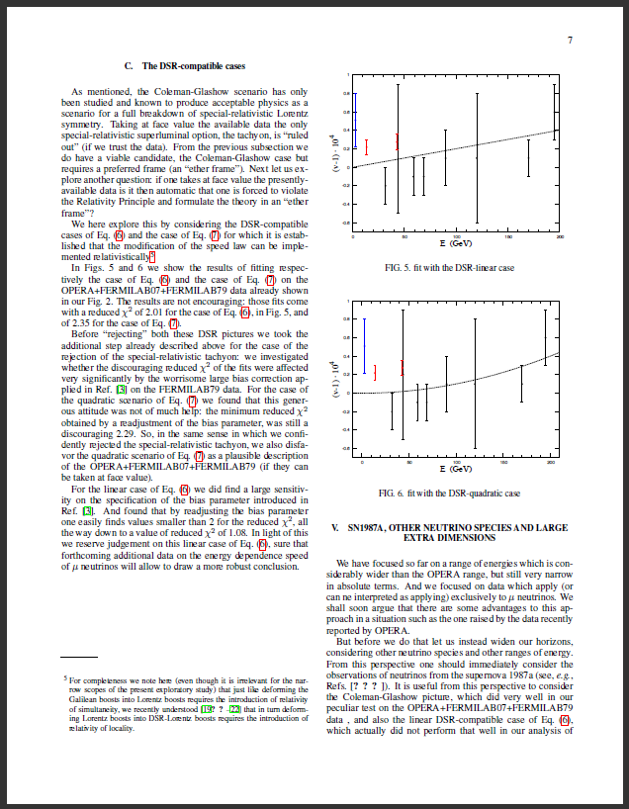
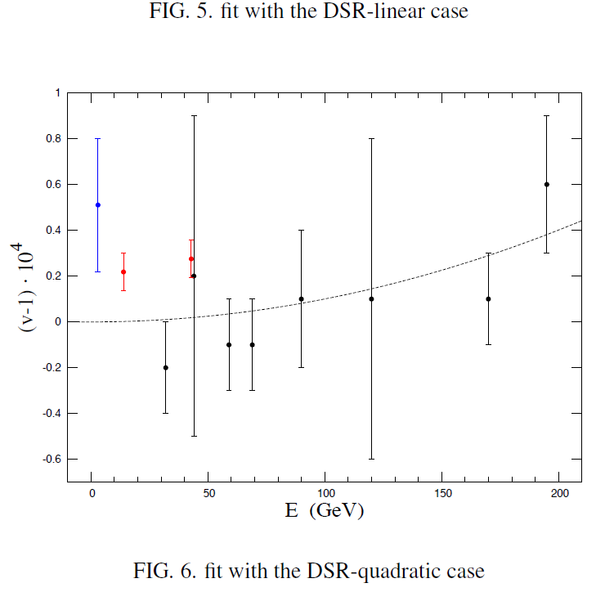
Figures from scientific publications
Automatic extraction
Manual extraction

Slide 11
Figures should exist independently from articles
Some type of meta data should not be presented to users directly
extraction

Slide 12
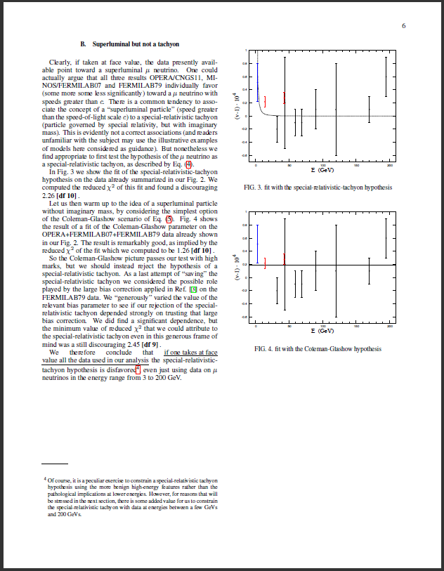
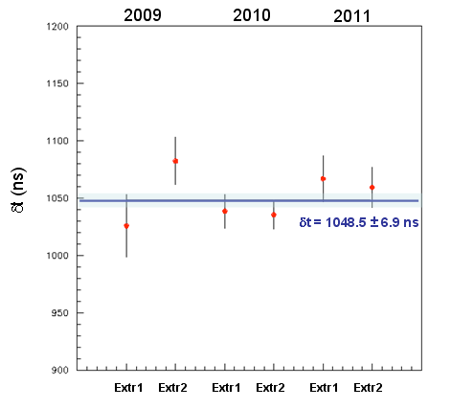
Figures from scientific publications
Extracted from
Extracted from
Figure 1
Describes the same data
Figure 2 (extracted from different publication)

Slide 13
Data-model requirements
Different types of relations between figures (illustrates the same data, is subfigure of...)
Relation of being extracted from a document
Meta-data of figures, different versions of figure, relations between figures, links between figure and document it is extracted from
Storage of more complicated data-types

Slide 14
Examples of meta-data associated with different entities
Figure (the most general meta-data) | Figure version (Appearance related meta-data) | Figure storage format | Relation between figure and document | Relation between two figures
Type of figure | Semantics of a figure | Access permissions | Position of a figure within the original document | Type of relation
Quantities presented on axis (in the case of plots) | Data extracted from figure |  | Caption of a figure within a particular document | <additional type-dependent fields>
Units and scales of axis (in the case of plots) |  |  | References from within text
... |  |  | Figure identifier within a document
New data model and its explanation (10 min)

Slide 15
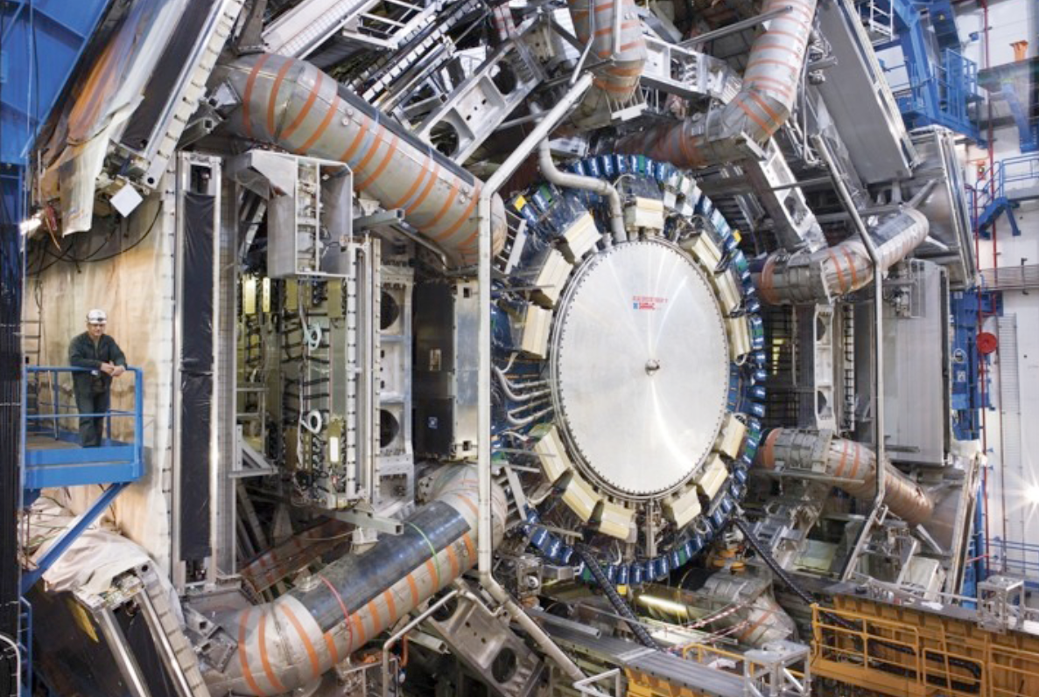
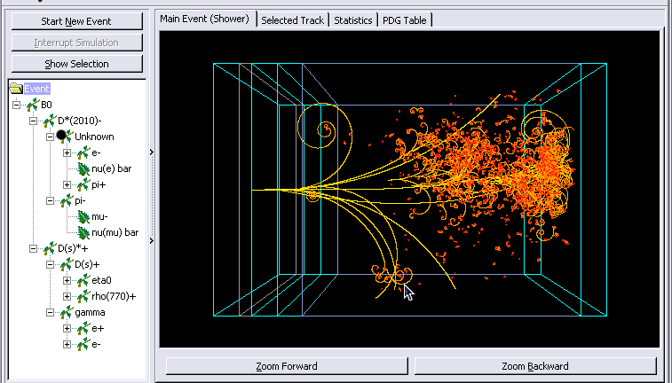
HEP data preservation
Storing raw data
Storing intermediate analysis
Storing additional documentation
Assigning Digital Object Identifiers
Notes:
Why is current model not sufficient for this ?!
- Not sufficient control of versions of documents

Slide 16
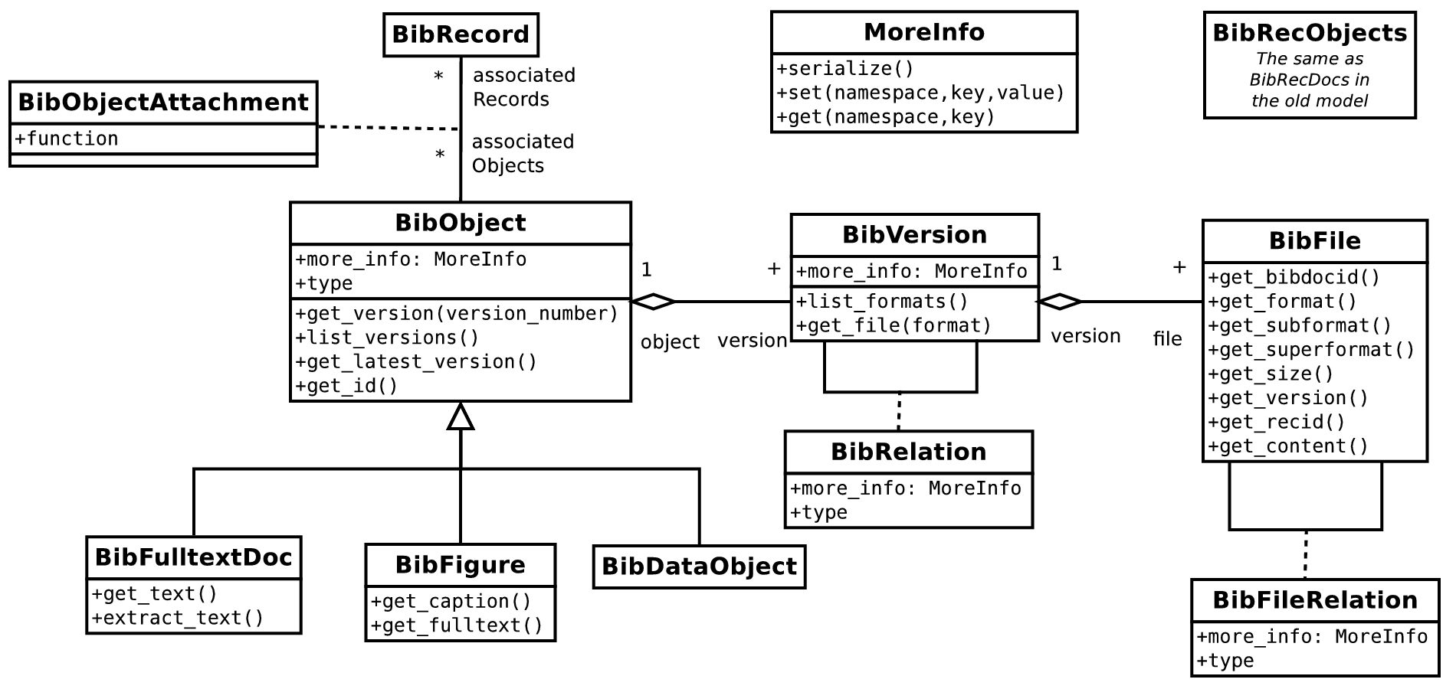
New architecture for storing non-bibliographical objects

Slide 17
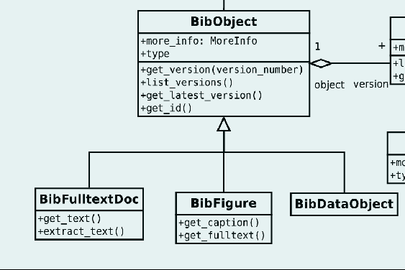
BibObject
Abstract representation of a document
Document-type specific functionalities are implemented by subclasses (defined by modules of Invenio and loaded dynamically)
Identified by a globally-unique identifier and by a name unique in the scope of a bibliographical record

Slide 18
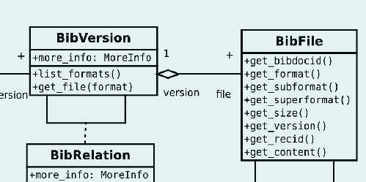
BibVersion, BibFile
Represent increasing specialisation of a document
BibVersion represents a particular revision of an object (corresponding for example to correction of mistakes)
BibFile describes a particular encoding of a version of an object (encapsulates the real file, remembers the format of a file)

Slide 19
BibRelation – link between entities
Allows to describe dependencies and connections between different entities of the data model
Allows specifying an arbitrary type of the relation (for example „is extracted from”, „is the same as” etc...)
Notes:
Include graphics – part of the diagram

Slide 20
MoreInfo: custom meta-data container
Namespace → key → value
Can be attached to any entity (BibObject, BibVersion, BibFile, BibRelation)
Persistently stores a generic dictionaries (every module has their own identified by the namespace)

Slide 21
Data model and figures storage
Data model | Figures
BibObject | Figure
BibObjectVersion | Figure version
BibFile | Particular encoding of a figure
BibRelation | Relation between figure and original document
BibRelation | Relation between two figures

Slide 22
Comparison between data models
 | Old model | New model
Attaching document to a bibliographic record | YES | YES
Attaching the same document to many records | NO | YES
Storing custom data keys in MoreInfo dictionaries | NO | YES
Creating documents not attached to any records | NO | YES

Slide 23
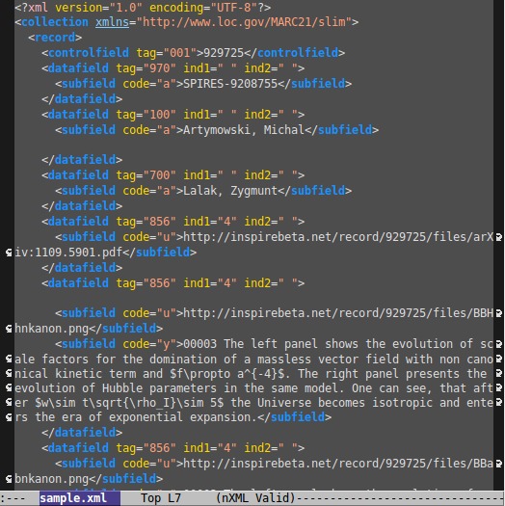
Uploading data to Invenio
New record is encoded in MARC XML
BibUpload is executed adding uploading task to the BibSched queue
BibSched uploads data to the main database

Slide 24
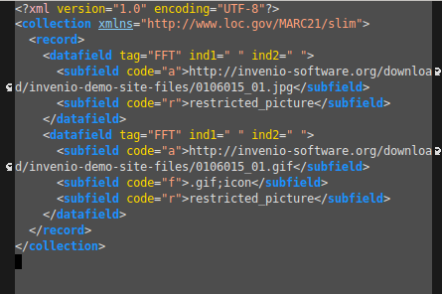
FFT = Fulltext File Transfer
Artificial, interpreted and removed during the BibUpload phase
One entry represents one file
Enforces documents to be attached to a record
subfield | explanation
a | URL of the file to upload
t | Function of the document within the record
f | Format of the file
...
Notes:
Explain better the bibsched processing

Slide 25
Uploading data in new format
New artifficlal MARC XML fields:
  BRT (Uploading and modifying relations between documents)
  MIT (Uploading MoreInfo fields)
  BDR (Attaching existing objects to records)
Open for extension supporting METS

Slide 26
Uploading MoreInfo
Externally (MIT field) or internally (from within FFT/BRT)
Values encoded in Json or serialised Python objects
Semantics completely decoupled from BibUpload modes (insert/replace/correct/...)

Slide 27
Conclusions & outlook
The proposed a model is a flexible approach that facilitates the support of custom objects (figures, data files, software, …)
  Based on it, new applications for searching and accessing digital objects can be developed
Issues to address in the future
  Integration of extended objects within the INVENIO platform
    Search and display information about custom objects
  Need of assigning Digital Object Identiers (DOI) to stored data objects
    To store the persistent state of a data object (management of versions)

Slide 28


Thank you !
http://invenio-software.org/
http://www.projecthepinspire.net/
piotr.praczyk@cern.ch

