Slide 1
The infrastructure for figures in INSPIRE
Piotr Praczyk, CERN 02/02/2012

Slide 2
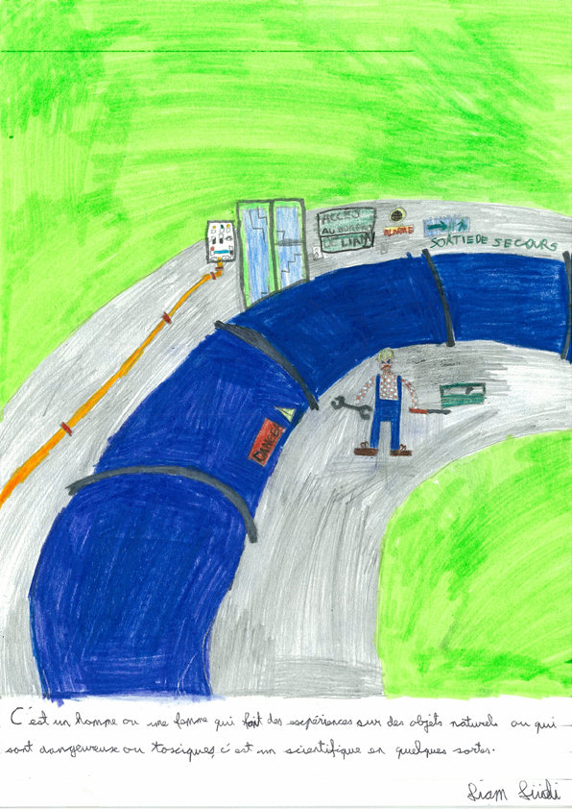
Usage of graphics in scholarly communication
Describe experiments
Summarise large amounts of data
Illustrate relations between results
Present ideas in a schematic manner

Slide 3
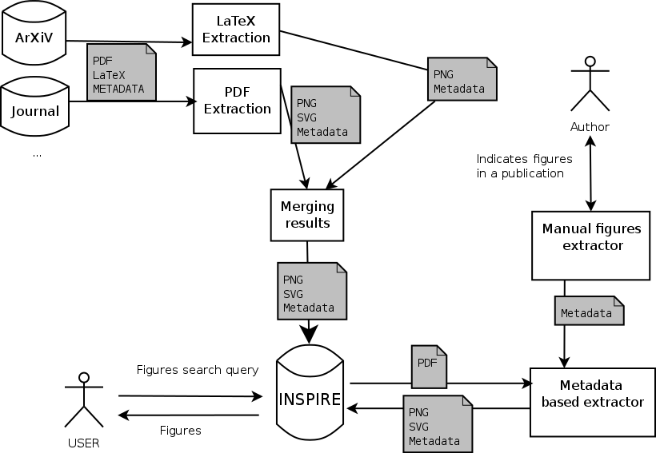
Usage of Plots in Inspire

Slide 4
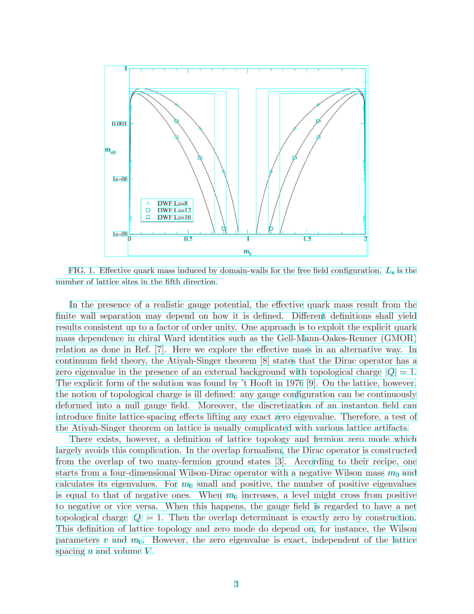
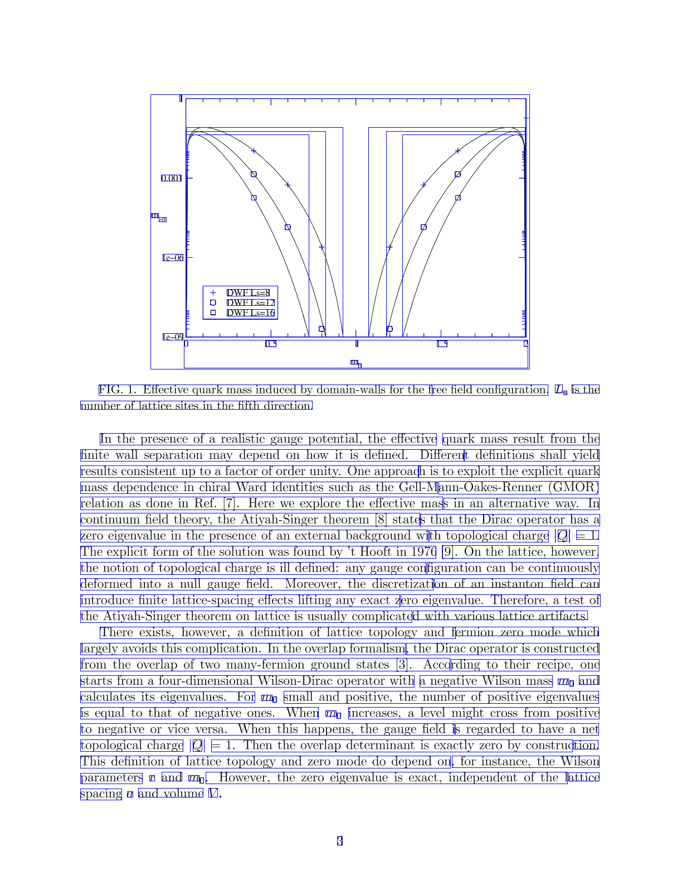
Extracting data from PDF
PDF:
Stream of instructions
Embeded objects
  Fonts
  External objects
Meta-description

Slide 5
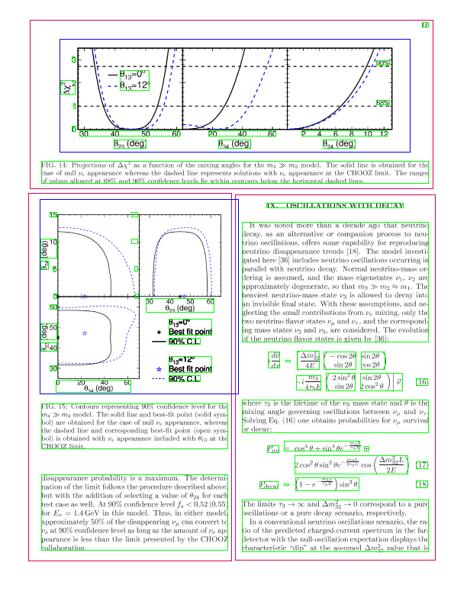
Intermediate steps of the algorithm
Regions of graphics (blue)
  Clustered graphic operations
Regions of text (green)
  Clustered text operations
Elements of page layout (red)

Slide 6
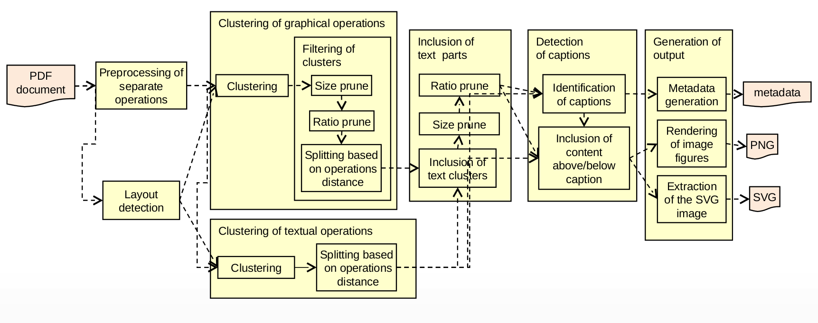
Extraction of figures from PDF

Slide 7
LaTeX extraction
Most of documents are written using LaTeX
Source file is parsed and attached figure files are converted to a standard format

Slide 8
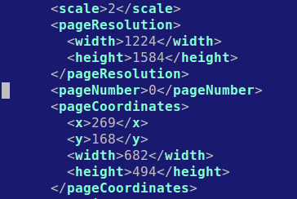

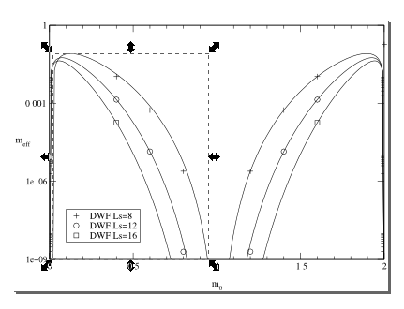

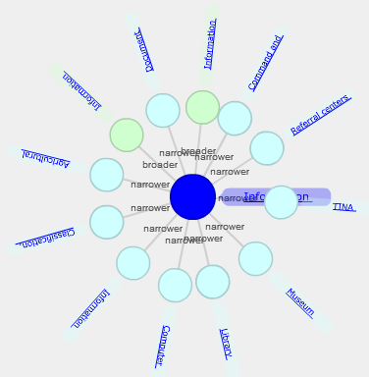

Automatic extraction of figures
Meta-data
Vector + Raster images
Evaluation of the extraction
quality
Merging of results
Acquisition of additional data
(in the future)
Semantic description

Slide 9
Types of extracted meta-data
Boundaries of figures
Boundaries of captions
Text of captions
Graphics in PNG and SVG formats
Places, where figure is referenced
Name of the figure inside a document
Text present inside the figure

Slide 10
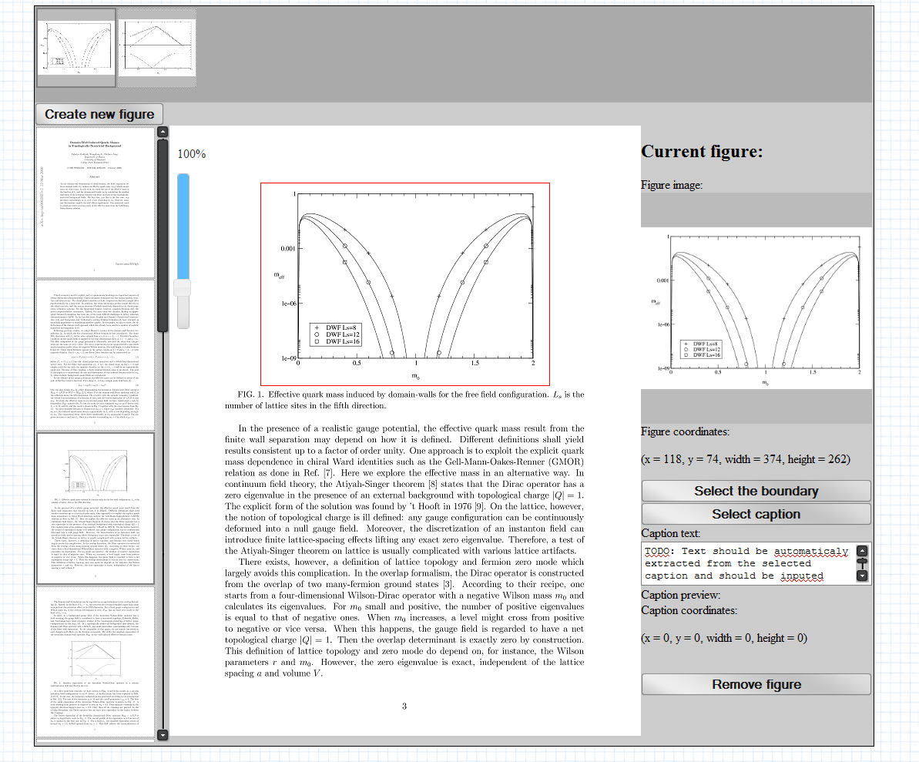
Select Your Figures

Slide 11
Extraction based on metadata
User has already provided position of figures in the document, we need to produce graphical files and upload them

Slide 12
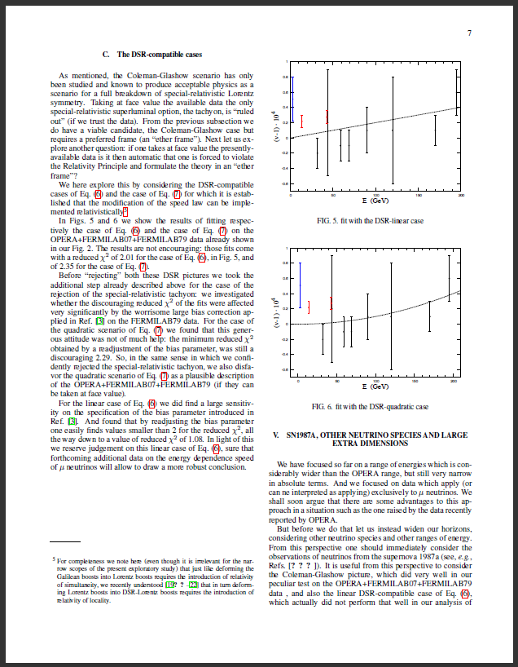
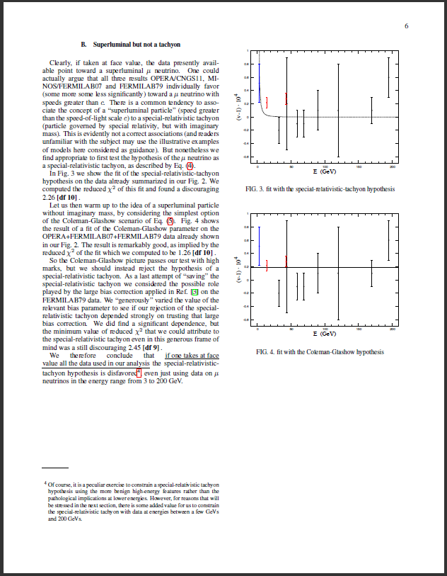
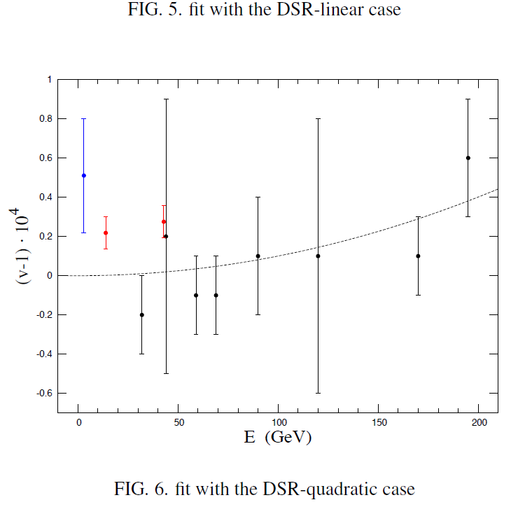
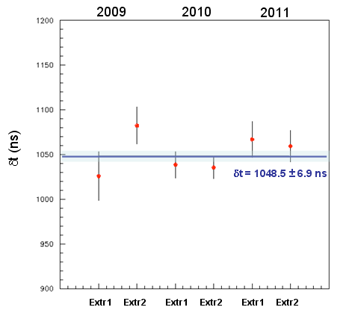
Figures from scientific publications
Extracted from
Extracted from
Figure 1
Describes the same data
Figure 2 (extracted from different publication)

Slide 13
Questions ?

