Slide 1
Integration of HEPData in INSPIRE
Piotr Praczyk CERN, 07.02.2012

Slide 2
Where are we ?
HEPData records are harvested and uploaded into a demo site containing complete INSPIRE
Data is displayed together with records (ugly)

Slide 3
Where do we want to be ?
HEPData record should be harvested and INSPIRE records updated once a day in the production environment
Indexes should be establisehd to enable search
The data should be displayed in a pretty way
There should be format for displaying standalone HEPData records

Slide 4
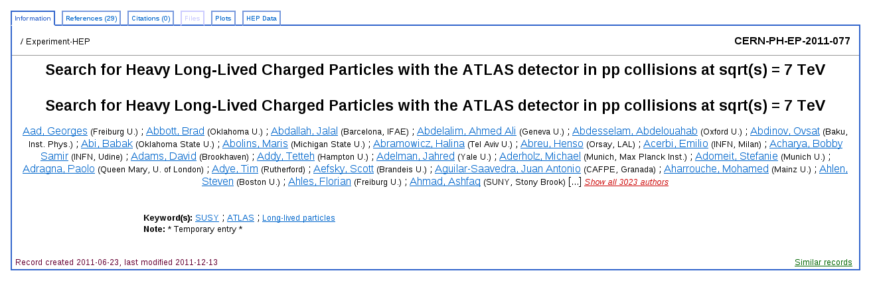
An additional HEPData tab is displayed for records having data attached

Slide 5
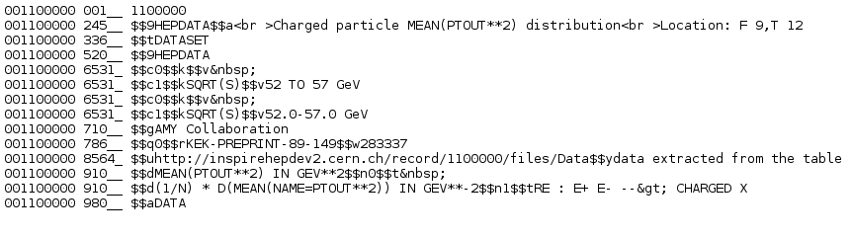
HEPData entries as separate records

Slide 6
The harvesting process
List of all HEPData records is exposed
Harvesting script reads the page once every day and checks which records have changed

Slide 7
The backend

Slide 8
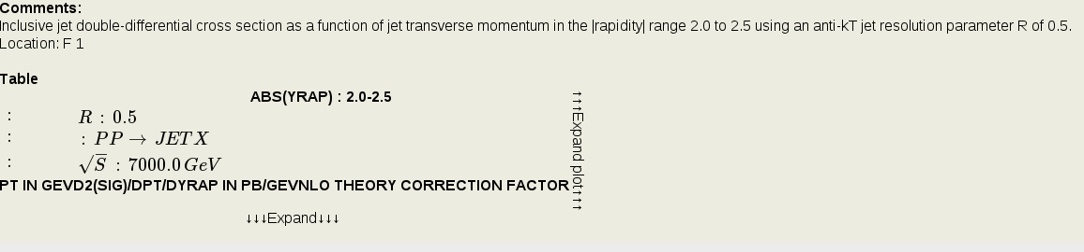
The interface
http://inspirehepdev2.cern.ch/record/902309/hepdata
Data headers
The comment extracted from
HEPData
Expand the graphics
Expand the data
Column headers

Slide 9
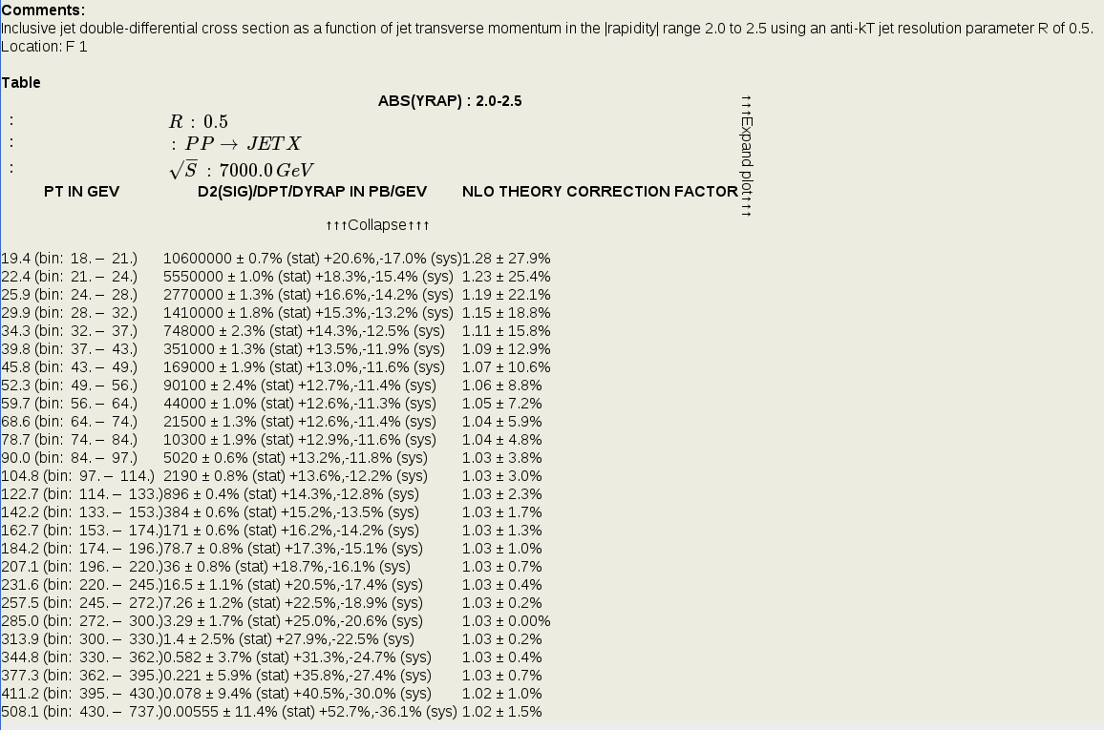

Slide 10
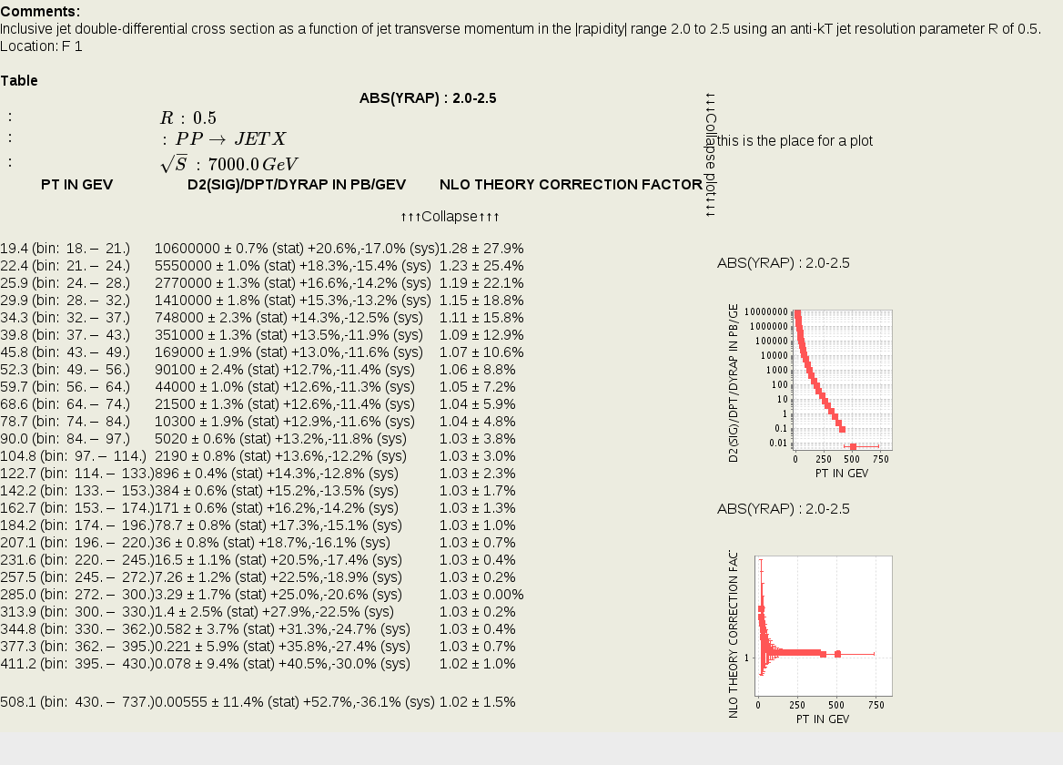
Graphical display axis
Plot summarising all the data
Level of detail axis
}
Plots of separate data columns

Slide 11


Improved display of data headers
The structure of header is parsed and translated into LaTeX
Symbols are replaced using a dictionary (that should be maintained on the HEPData side and harvested together with data)
Javascript plugin renders formulas in the browser

Slide 12
TODO
Establish way of harvesting the dictionaries of symbols (for improved data headers display)
Invent nicer way of breaking long lines of headers/titles
Improve the general look&feel
Create BibFormat for standalone HEPData records
Establish indexes for HEPData search
Invent way to display HEPData entries not connected to publications (virtual records?)

