Slide 1
Component
Receptacle
Interface

Slide 2
JLCF Application Example
compbintf
userinterface
ComponentA
ComponentB

Slide 3
Simple Calculator
additionComponent
INumberCalculator
multipliationComponent
subtractionComponent
divisionComponent
NumberCalculator

Slide 4
Interaction patterns
Asynchronous reply through formal receptacle interface connection
ComponentA
ComponentB
Asynchronous reply through callback
ComponentA
ComponentB

Slide 5
Reconfiguration
ComponentA
ComponentB

Slide 6
Interceptor
Interceptor
chain
ComponentA
ComponentB

Slide 7
Interceptor Remoting
Remoting interceptor
ComponentA
WS provider

Slide 8
Component Remoting
Proxy Component
ComponentA
WS provider

Slide 9
Callback
compbintf
userinterface
CompB
CompA
callback

Slide 10
Queue Processor
External thread
(caller)
Queue Processor
Process item
Proc thread
Input Queue
Insert item
Manipulate data
Internal Data

Slide 11
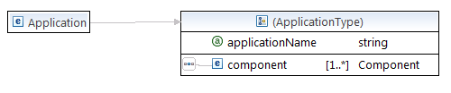
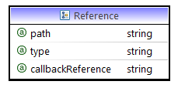
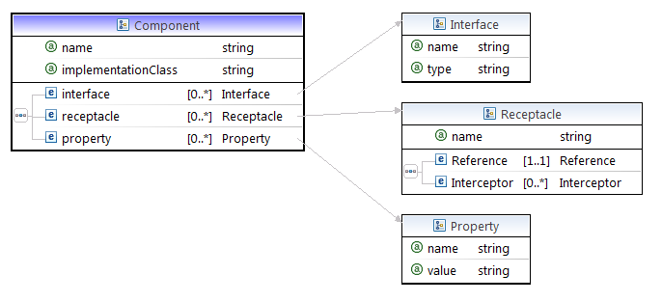

Application Descrpition

Slide 12
JLCFComponent
Used for transparent context passing
IContextManagerReceptacle
IConnectorManager
IReceptacle
IComponentProxy
IContextManagerInterface
POJO
JLCFReceptacle
Receptacle Context Manager
Interface Context Manager
POJO
Interceptors
Component Proxy
Handler
Connector Handler

