Slide 1
JLCF
A Java Lightweight Component Framework
Petros Pissias
December 2012

Slide 2
Agenda
Short introduction on component frameworks
JLCF features and design
Demo

Slide 3
Introduction
Interest in component frameworks
Masters thesis – Dynamic Reconfiguration in OpenCOM (2005)
After programming several months on OpenCOM I was convinced that component frameworks is the way develop complex systems.
IET Software – Framework for quiescence management in support of reconfigurable multi-threaded component-based systems (2008)

Slide 4
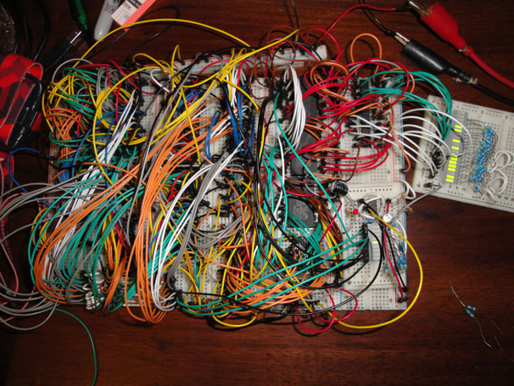
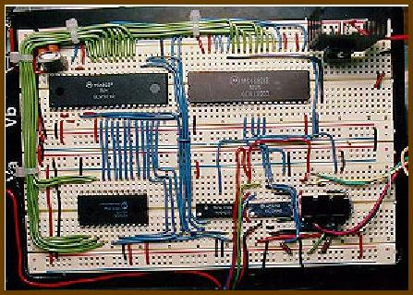
Software Components
Why use a component framework and software components ?

Slide 5
Component definition
Component
Self contained piece of code with well defined interfaces and interface dependencies
What is a component model / framework?
Set of rules for component composition / deployment / implementation / behavior of components / interaction patterns
The framework is the implementation of the model

Slide 6
Rationale for Component based frameworks
By enforcing a strict separation between interface and implementation and by making software architecture explicit, component-based programming can facilitate the implementation and maintenance of complex software systems
1st paragraph of the rationale of the Fractal component framework

Slide 7
Java Lightweight Component Framework
Main properties of JLCF
Focus on clean architectural design patterns
lightweight and easily usable
Technical Features
Composition of components is defined in external configuration file
POJO approach with annotations
Allows custom Interceptors to be placed between component interfaces
Supports Callback interaction pattern
Supports Dynamic reconfiguration

Slide 8
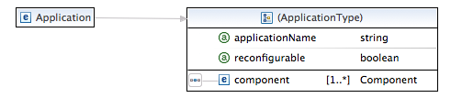
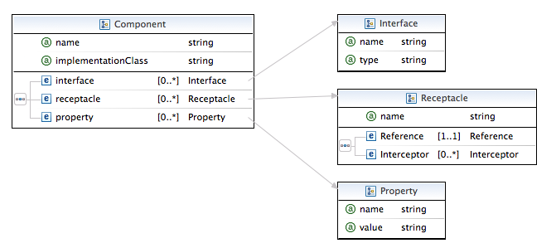
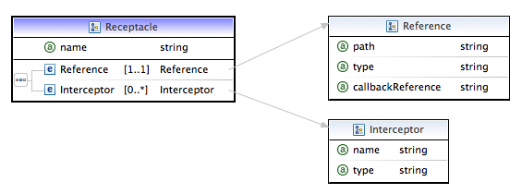
JLCF Application Description

Slide 9
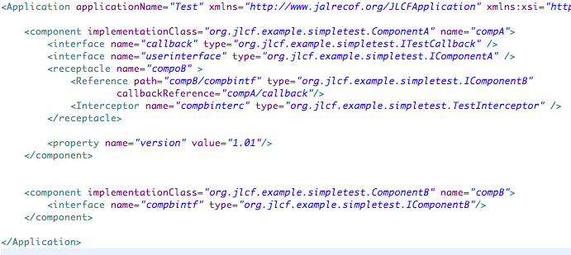
JLCF Application Example

Slide 10
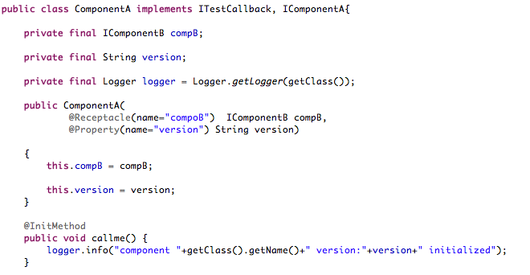
JLCF - Component Implementation Example

Slide 11
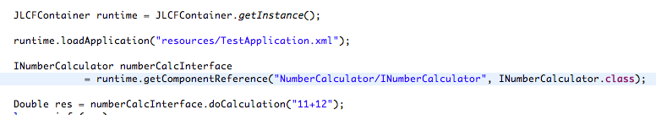
JLCF - Using components

Slide 12

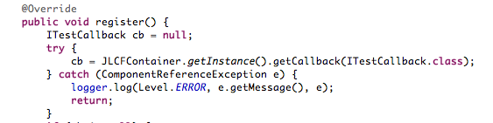
JLCF Callback Example
Callbacks are associated with a call context. Completely transparent to the interface.
Code below shows how to declare and obtain a callback reference

Slide 13
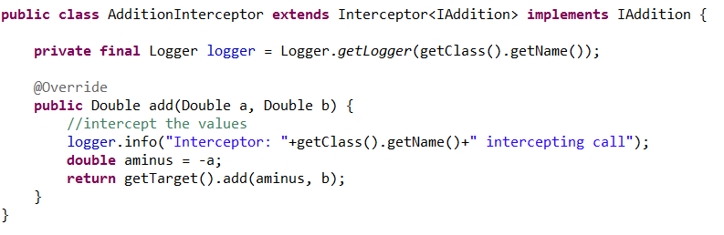
JLCF Interceptors
Interceptors are programmed directly for the target interface and are based on a generic Interceptor.

Slide 14
JLCF core design
Anatomy of a component as seen by the developer and as created framework
Difference between
DI frameworks
and component
frameworks
Used for transparent context passing
POJO
Component Proxy
Connector
Proxy
Connector context manager
Receptacle Wrapper
Interceptors
Receptacle context manager
POJO

Slide 15
JLCF core design
Anatomy of a component as seen by the developer and as created framework
Implements “business” interface to satisfy component constructor. Optionally Contains interceptors
Used for transparent context passing
POJO
Component Proxy
Connector
Proxy
Connector context manager
Receptacle Wrapper
Interceptors
Receptacle context manager
POJO

Slide 16
JLCF core design
Anatomy of a component as seen by the developer and as created framework
Interceptors.
Intercept calls between components.
Used for transparent context passing
POJO
Component Proxy
Connector
Proxy
Connector context manager
Receptacle Wrapper
Interceptors
Receptacle context manager
POJO

Slide 17
JLCF core design
Anatomy of a component as seen by the developer and as created framework
Receptacle & connector context management (callback, encryption)
Used for transparent context passing
POJO
Component Proxy
Connector
Proxy
Connector context manager
Receptacle Wrapper
Interceptors
Receptacle context manager
POJO

Slide 18
JLCF core design
Anatomy of a component as seen by the developer and as created framework
Implement specific algorithms for dynamic reconfiguration.
Used for transparent context passing
POJO
Component Proxy
Connector
Proxy
Connector context manager
Receptacle Wrapper
Interceptors
Receptacle context manager
POJO

Slide 19
JLCF core design
Anatomy of a call
POJO
Component Proxy
Connector
Proxy
Connector context manager
Add context
Receptacle Wrapper
Interceptors
Receptacle context manager
POJO

Slide 20
callbacks and component references
Used for transparent context passing
POJO
Component Proxy
Connector
Proxy
Connector context manager
Receptacle Wrapper
Interceptors
Receptacle context manager
POJO

Slide 21
JLCF Distribution
Distribution Issues
We have to create custom types (serialization)
Application description starts to have dependencies on specific transport
Different interaction patterns by different technologies
Conclusion
We anyway have to explicitly program for distribution
Exclude it from the framework and focus on good design without cutting corners.
Delegate it clearly to the developer
Specific Frameworks do it better

Slide 22
JLCF Distribution
Distribution in JLCF :
1) On interceptors
2) Proxy Components
RMI, WS, CORBA, JMS
Receptacle Wrapper
Interceptors
POJO

Slide 23
JLCF Performance
Pure framework performance:
call void method that does not do any work
Call overhead 4.6 microseconds (28.500 milliseconds for 6.000.000 calls)
Comparison to java void method call not meaningful
6.000.000 void calls take 1 millisecond (28.500 times faster)
Current code contains a lot of debug logging
Realistic performance evaluation:
Method that does something (calculate random and select a byte from a String)
No difference at all in 10.000 calls. Virtually same performance with and without the framework

Slide 24
JLCF Conclusions
Originally it was foreseen just to be a platform for other projects (next slide)
However it is worthy on its own
Simple and yet powerful ☺
Next steps
Document and open source
Seek paper opportunities next year with academic involvement.

