Slide 1
Pre-Talk Checklist (1)
PowerShell Init
cd c:\demo\cdk-talk\
aws --version
$Env:AWS_PROFILE="pittle+demo"
docker --version && docker info -f "{{ .OSType}}"
npm -version && npm list --global --depth 0
cdk bootstrap aws://927861770086/us-west-1
mkdir cdk && cd cdk
cdk init app --language csharp
cd ..\CloudAutoGroup
ls

Slide 2
Bio
Hi I’m Philip and I am a Senior Software Developer on the AWS SDK team building tooling for Dotnet and PowerShell. Very excited to be here with you all today.

Slide 3
Welcome (1)
Visual Studio on Screen
Notes:
Thanks Francois!
I had hoped to start building completly from scratch today, but we have a lot of material to cover, so I’ve already precreated a Solution and added some basic classes.
For the talk today I’ll be focusing mostly on the CDK code, but if you’re interested in seeing how everything was built, or if you want to play with the app yourself, I’ll be posting the full source code to GitHub, and we’ll have a link to that at the end.
So let me start by showing you my environment.
Alt+Tab to PowerShell

Slide 4
Welcome (2)
PowerShell on Screen
Notes:
So real quick, let me run you through this:
I’ve got the AWS Cli installed and I’ve set my aws profile to pittle+demo; that’s where we’ll be deploying today.
Next I’ve got docker installed and running and it’s in Linux mode
The CDK, or at least the command line portion of it,is an NPM plugin, so this next line shows I have NPM installed and the CDK is installed as a global tool
The Cdk has to be bootstrapped once per region. This installs some small assets it will use as a staging ground during deployments.
Finally I used the cdk tooling to scaffold up a project. Cdk currently will generate a full solution, but I only wanted the project, so I moved that by hand into my solution directory and then used the Add Existing Project command to add it into Studio.
So that was the background, let’s had back to Studio
Alt+Tab to Visual Studio

Slide 5
Welcome (3)
Visual Studio on Screen – NuGet Packages open and Solution Explorer
Notes:
So let me show you what we have here. Our application is made up of 4 projects.
So let’s run through each project.
Starting from the bottom is our Web project. This will host the landing page inviting customers to request a quote. It will also host an Admin Dashboard so we can see all of the Requests that have been made.
Above that is a Shared library, this contains our Domain Models as well as a Repository and a Queue Client that will be filling out later.
Then we have our two Serverless Lambda Functions. The Request Quote Api will be called from the Web front end when a user requests a quote. The Api will perform some basic validation and will then put the request on a Queue for the Request Quote Processor to pickup.
The Processor will analyze the data and determine an estimated monthly premium.
(continue on next slide)

Slide 6
Welcome (4)
Visual Studio on Screen – NuGet Packages open and Solution Explorer
Notes:
And the Cdk project at the top is why we’re here today. This is where going to define our AWS hosting infrastructure, all in C#!
And because this is just a Csproj, the first thing I’m going to do is add Project References.
Right Click Cdk/Dependencies -> Add Project References
Our infrastructure is going to take a dependency on each of the projects we have in our Solution
Tick each project box.
That’s going to let us do some cool things like reference class names.
Now that I have the Project References added in I also want to take a quick second to show you the NuGet packages I’ve added to the Solution. As you can see we have a number of packages for the Cdk. Each hosting component we’ll use will have it’s own NuGet package, and those all start with Amazon.CDK.
Below those we have some Lambda packages and some AWS SDK packages.
Then we have some standard dotnet packages from Microsoft, and of course you can’t give a demo without Newtonsoft Json so that’s in there as well.
Alright so let’s dive in.

Slide 7
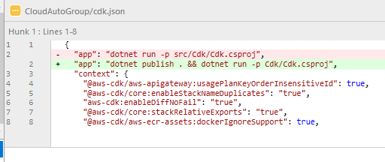
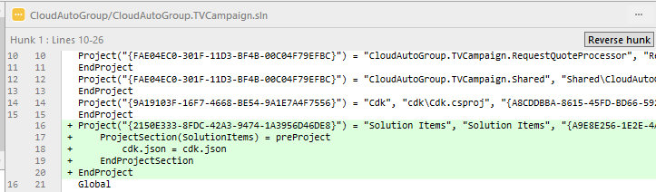
3 Add cdk.json file to solution /fix up
dotnet publish . && dotnet run -p Cdk/Cdk.csproj
Notes:
Open cdk.json
The first thing we need to look at is the cdk.json file. This was generated by the Cdk tooling and it lives at the same directory as the solution file.
This file controls how the Cdk cli tooling functions. We’ll ignore the “context” section; that’s mostly a set of feature flags and we won’t need to change anything. What we’re interested is “app”. This is the command that cdk tooling will execute, which by default will use “dotnet run” to execute our infrastructure project.
I told you I moved the project, so I need to fix that path, the Cdk project is just in cdk
Remove “src” : dotnet run -p Cdk/Cdk.csproj
Now what’s interesting about this is I can also chain commands together. We’re going to want to deploy code assets today so to make things easy on ourselves, we’re also going to run a “dotnet publish” command against the entire solution whenever we go to deploy our infrastructure.
Add “dotnet publish . “
We’ll see how this comes into play a bit later, but for now, we’re done in here.

Slide 8
4a Hardcode aws account and region
ENTER YOUR OWN ACCOUNT
Notes:
Open Cdk/Program.cs
Let’s take a quick look at our entry point. This is just a console application so we’re in Program.cs.
The first thing that happens here is a new App object is created. That’s Cdk boiler plate and we wont do anything more with it.
What’s interesting for us is the TVCampaignStack. This is where our code will live.
Before we dive in though, I want to point out line 32. I went ahead and hard coded my Account and Region here. We’ll look at some different ways to define those later on, but for now I didn’t want to give the impression there was anything magical happening.
Alright, I think we’re ready.
Open TVCampaignStack

Slide 9
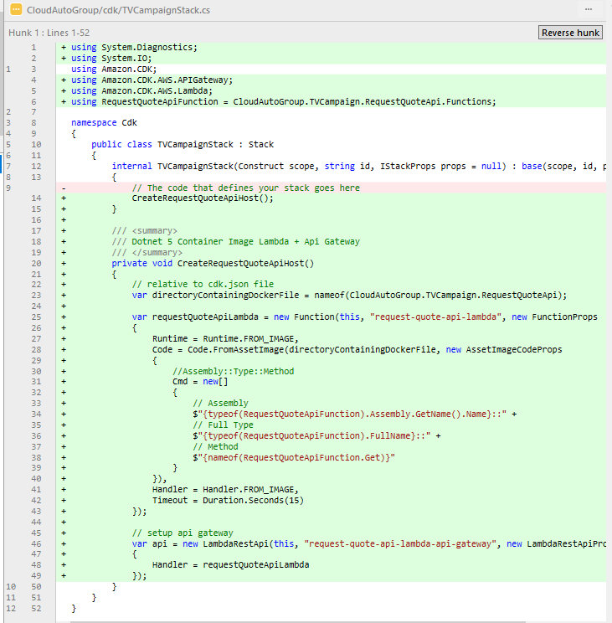
5 CreateRequestQuoteApiHost
using RequestQuoteApiFunction = CloudAutoGroup.TVCampaign.RequestQuoteApi.Functions;
/// <summary>
/// Dotnet 5 Container Image Lambda + Api Gateway
/// </summary>
private void CreateRequestQuoteApiHost()
{
// relative to cdk.json file
var directoryContainingDockerFile = nameof(CloudAutoGroup.TVCampaign.RequestQuoteApi);
var requestQuoteApiLambda = new Function(this, "request-quote-api-lambda", new FunctionProps
{
Runtime = Runtime.FROM_IMAGE,
Code = Code.FromAssetImage(directoryContainingDockerFile, new AssetImageCodeProps
{
//Assembly::Type::Method
Cmd = new[]
{
// Assembly
$"{typeof(RequestQuoteApiFunction).Assembly.GetName().Name}::" +
// Full Type
$"{typeof(RequestQuoteApiFunction).FullName}::" +
// Method
$"{nameof(RequestQuoteApiFunction.Get)}"
}
}),
Handler = Handler.FROM_IMAGE,
Timeout = Duration.Seconds(15)
});
// setup api gateway
var api = new LambdaRestApi(this, "request-quote-api-lambda-api-gateway", new LambdaRestApiProps
{
Handler = requestQuoteApiLambda
});
}
Notes:
Open CdkProj/TVCampaignStack.cs
Highlight comment “// The code that defines your stack goes here”
This is where we will add infrastructure to stand up our website, serverless components, queue and data store. The convention is to add components inside the constructor. But this isn’t a yaml file, this is C#, so we have a lot of code organization options.
I’m going to start by creating a method. This will help us keep this class file organized.
Replace “//The code …” with “CreateRequestQuoteApiHost();”
Now, rather than have you all watch me type this in, I’m going to paste in the implementation of this method.
Paste in implementation of “CreateRequestApiHost();”
Click Visual Studio light bulb to fill in using statements
Add using: “using RequestQuoteApiFunction = CloudAutoGroup.TVCampaign.RequestQuoteApi.Functions;”
(continued on next slide)

Slide 10
5 CreateRequestQuoteApiHost (continued)
using RequestQuoteApiFunction = CloudAutoGroup.TVCampaign.RequestQuoteApi.Functions;
/// <summary>
/// Dotnet 5 Container Image Lambda + Api Gateway
/// </summary>
private void CreateRequestQuoteApiHost()
{
// relative to cdk.json file
var directoryContainingDockerFile = nameof(CloudAutoGroup.TVCampaign.RequestQuoteApi);
var requestQuoteApiLambda = new Function(this, "request-quote-api-lambda", new FunctionProps
{
Runtime = Runtime.FROM_IMAGE,
Code = Code.FromAssetImage(directoryContainingDockerFile, new AssetImageCodeProps
{
//Assembly::Type::Method
Cmd = new[]
{
// Assembly
$"{typeof(RequestQuoteApiFunction).Assembly.GetName().Name}::" +
// Full Type
$"{typeof(RequestQuoteApiFunction).FullName}::" +
// Method
$"{nameof(RequestQuoteApiFunction.Get)}"
}
}),
Handler = Handler.FROM_IMAGE,
Timeout = Duration.Seconds(15)
});
// setup api gateway
var api = new LambdaRestApi(this, "request-quote-api-lambda-api-gateway", new LambdaRestApiProps
{
Handler = requestQuoteApiLambda
});
}
Notes:
There’s only a few statements here, but lets unpack this. First of all, this method is creating the full infrastructure for the Request Quote Api. This is a dotnet 5 web api that we’ll host on Lambda, which is AWS’s Serverless compute offering.
We’re going to deploy our code as a Docker image. And we’re also going to put an AWS Api Gateway in front of the Lambda to open it up for calls from our website.
Starting with the first statement, I need to get the directory that contains the Dockerfile. Because I have a reference to the RequestQuoteApi project, I can use the nameof function to get the string literal for me rather than typing in an actual string.
Now we start to get a bit more serious, we’re defining the Lambda portion of our hosting. The “function“ object comes from the Amazon.CDK.AWS.Lambda nuget package.
Inside FunctionProps you’ll see “Code.FromAssetImage”, here I’m passing in the “directoryContainingDockerFile”. This is going to allow the Cdk to do a number of nice things for us including building and publishing the dockerfile.
And then we set the Cmd property to tell Lambda where our entry point function is so it knows what to actually execute. This takes a special format of Assembly, Type, and Method. This is what really excites me. Because we have that reference to the Request Quote Api project, we’re again able to programmatically get all of this information using typeof and nameof which means we get compile time reference checking to make sure we didn’t fat finger anything. Or if down the line we do a rename, this will help make sure we don’t accidently forget to update our infrastructure.
The final statement down here creates an AWS Api Gateway for us. This class is coming from the CDK ApiGateway nuget package. It is purpose built to work with Lambda, so all we need to do is give it a _reference_ to our lambda function and it’ll take care of the rest for us!
So that’s our first bit of infrastructure code; not too bad. Let’s add some more.

Slide 11
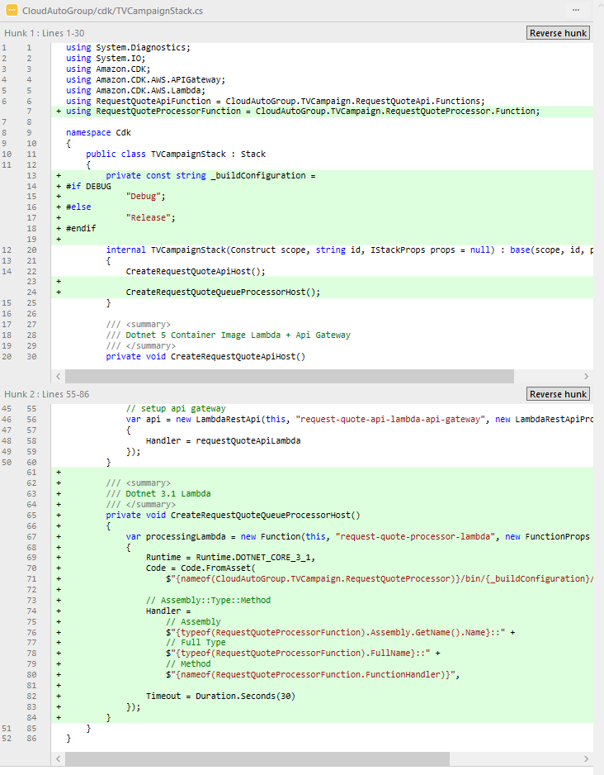
6 CreateRequestQuoteQueueProcessorHost
using RequestQuoteProcessorFunction = CloudAutoGroup.TVCampaign.RequestQuoteProcessor.Function;
private const string _buildConfiguration =
#if DEBUG
"Debug";
#else
"Release";
#endif
CreateRequestQuoteQueueProcessorHost();
/// <summary>
/// Dotnet 3.1 Lambda
/// </summary>
private void CreateRequestQuoteQueueProcessorHost()
{
var processingLambda = new Function(this, "request-quote-processor-lambda", new FunctionProps
{
Runtime = Runtime.DOTNET_CORE_3_1,
Code = Code.FromAsset(
$"{nameof(CloudAutoGroup.TVCampaign.RequestQuoteProcessor)}/bin/{_buildConfiguration}/netcoreapp3.1/publish"),
// Assembly::Type::Method
Handler =
// Assembly
$"{typeof(RequestQuoteProcessorFunction).Assembly.GetName().Name}::" +
// Full Type
$"{typeof(RequestQuoteProcessorFunction).FullName}::" +
// Method
$"{nameof(RequestQuoteProcessorFunction.FunctionHandler)}",
Timeout = Duration.Seconds(30)
});
}
Notes:
Next we’ll create the infrastructure for the Request Quote Queue Processor, and this is going to look quite similar. I’m going to create a new method in the Constructor
CreateRequestQuoteQueueProcessorHost();
This will also be hosted as a Serverless function in Lambda, but it will be processing Queue messages rather than Api requests and we’ll build it on .net core 3.1 for some variety.
I’m going to paste in the method body here …
paste method body
And I having a using Alias to help with readability
paste “using RequestQuoteProcessorFunction = CloudAutoGroup.TVCampaign.RequestQuoteProcessor.Function;”
Let’s take a look here. We’re using the Cdk Function class again. This isn’t using Docker, instead the cdk is going to read directly from the Publish directory. This is why we wanted to modify the cdk.json file earlier to add that dotnet publish command as part of the cdk deploy.
I’ll again be able to use the nameof technique to get the path component. But this time I’ll need to know if we’re building in Debug or Release mode, so let me add this little code snippet to the top:
Insert _buildConfiguration code snippet
Now if we go back to the Handler property we’re again seeing the same Assembly, Full Type, Method for the entry point. And because we have that project reference to the Queue Processor we’re able to build this up without any magic strings!
So that’s our two Serverless Functions; let’s keep going.

Slide 12
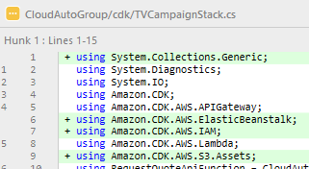
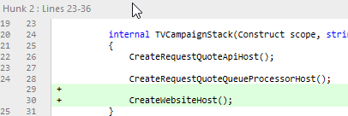
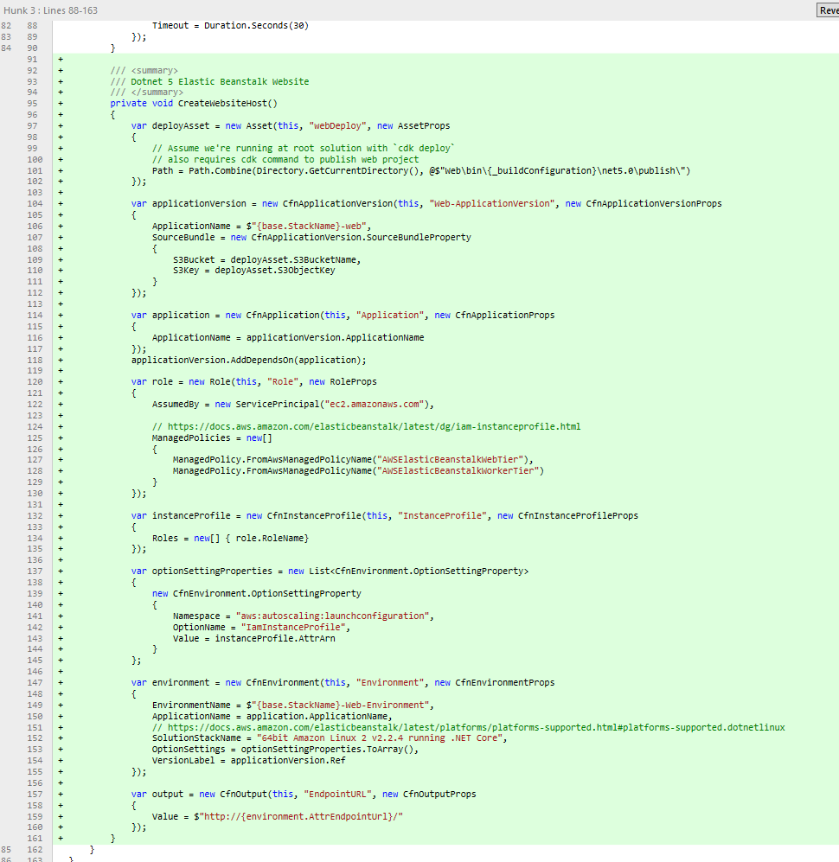
7 CreateWebsiteHost
/// <summary>
/// Dotnet 5 Elastic Beanstalk Website
/// </summary>
private void CreateWebsiteHost()
{
var deployAsset = new Asset(this, "webDeploy", new AssetProps
{
// Assume we're running at root solution with `cdk deploy`
// also requires cdk command to publish web project
Path = Path.Combine(Directory.GetCurrentDirectory(), @$"Web\bin\{_buildConfiguration}\net5.0\publish\")
});
var applicationVersion = new CfnApplicationVersion(this, "Web-ApplicationVersion", new CfnApplicationVersionProps
{
ApplicationName = $"{base.StackName}-web",
SourceBundle = new CfnApplicationVersion.SourceBundleProperty
{
S3Bucket = deployAsset.S3BucketName,
S3Key = deployAsset.S3ObjectKey
}
});
var application = new CfnApplication(this, "Application", new CfnApplicationProps
{
ApplicationName = applicationVersion.ApplicationName
});
applicationVersion.AddDependsOn(application);
var role = new Role(this, "Role", new RoleProps
{
AssumedBy = new ServicePrincipal("ec2.amazonaws.com"),
// https://docs.aws.amazon.com/elasticbeanstalk/latest/dg/iam-instanceprofile.html
ManagedPolicies = new[]
{
ManagedPolicy.FromAwsManagedPolicyName("AWSElasticBeanstalkWebTier"),
ManagedPolicy.FromAwsManagedPolicyName("AWSElasticBeanstalkWorkerTier")
}
});
var instanceProfile = new CfnInstanceProfile(this, "InstanceProfile", new CfnInstanceProfileProps
{
Roles = new[] { role.RoleName}
});
var optionSettingProperties = new List<CfnEnvironment.OptionSettingProperty>
{
new CfnEnvironment.OptionSettingProperty
{
Namespace = "aws:autoscaling:launchconfiguration",
OptionName = "IamInstanceProfile",
Value = instanceProfile.AttrArn
}
};
var environment = new CfnEnvironment(this, "Environment", new CfnEnvironmentProps
{
EnvironmentName = $"{base.StackName}-Web-Environment",
ApplicationName = application.ApplicationName,
// https://docs.aws.amazon.com/elasticbeanstalk/latest/platforms/platforms-supported.html#platforms-supported.dotnetlinux
SolutionStackName = "64bit Amazon Linux 2 v2.2.5 running .NET Core",
OptionSettings = optionSettingProperties.ToArray(),
VersionLabel = applicationVersion.Ref
});
var output = new CfnOutput(this, "EndpointURL", new CfnOutputProps
{
Value = $"http://{environment.AttrEndpointUrl}/"
});
}
Notes:
Lets add hosting for the Web Application next.
I’m going to add a new method to the Constructor called CreateWebsiteHost
CreateWebsiteHost();
I hope you guys see a pattern emerging here. And I’m going to paste in the implementation here
Paste in implementation of “CreateWebsiteiHost();”
Click Visual Studio light bulb to fill in using statements
Now this is a bit more involved than the two Lambda functions we just built. This is instead building up a Elastic Beanstalk, which is AWS’s managed web hosting. It isn’t quite as abstracted as using Lambda, but let’s walk through it quickly and see it’s really not too bad.
First up we’re defining how we’re going to publish our code up to AWS. In this case we’re using an Asset object and that’s coming from the CDK S3 nuget package. And we have to give it a Path so we’ll point it to the Web project’s Publish directory.
After defining how to upload assets, we have some boilerplate plumbing to create a Beanstalk Application and tie in the necessary IAM Roles.
And that brings us to the Beanstalk Environment where we reference the Application, and ApplicationName and define our runtime. We also pass in our definied Option Settings there as well.
This is just a highlevel overview as there is a lot more material I want to get to without focusing specifically on Elastic Beanstalk. But there’s a lot of great resources for deep diving into these various constructs that we’ll highlight at the end.
Though I do want to point out this last line here, this CfnOutpuut object is special. When we go to the command line to run the Cdk, this will output our website’s Url to the Console.
Alright, that’s all of our initial infrastructure. But there’s one more thing we need to do.

Slide 13
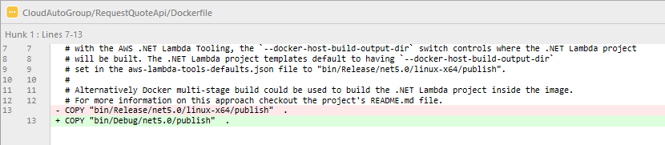
8 Adjust RequestQueueAPI Dockerfile to build on windows (CDK DEPLOY)
COPY "bin/Debug/net5.0/publish" .
Notes:
Open RequestQuoteApi/Dockerfile
The Lambda project templates defaults the Docker file for building on linux, but I’ll be building on Windows. And since this is a prototype I’m going to keep everything in Debug mode.
Replace line with COPY "bin/Debug/net5.0/publish" .
And now we’re ready to deploy our initial hosting infrastructure.

Slide 14
DEPLOY
Notes:
SAVE ALL IN FILES IN SOLUTION!
I’m going to head to the Console as we’re not yet able to start a deployment yet from inside Visual Studio.
I’m going to make sure I’m at the root of my solution where the cdk.json file lives.
dir
And now I can run cdk deploy
cdk deploy
We’ll see a number of things kicking off.
First the Solution is being published with the dotnet publish command that we added to the json file. Once that’s done the Cdk will take over and it’s going to start executing the code in our TVCampaign Stack to generate a Cloud Formation template.
Once the template is generated, we should see a summary of what’s to be deployed.
If there are any Security changes we’ll be prompted to confirm. In our case we’ll be creating new Roles so we’ll definitely get prompted.
Once we confirm we’ll then start see deployment in action. The Docker image for our Quote Request Api will start being processed and will then be uploaded to AWS. Then it will start creating our Lambda Functions and spinning up a Beanstalk Environment.
This will take a few minutes, so I’m going to let this continue to run.
Let’s head back to Visual Studio and keep building out our Application, starting with our Landing Page

Slide 15
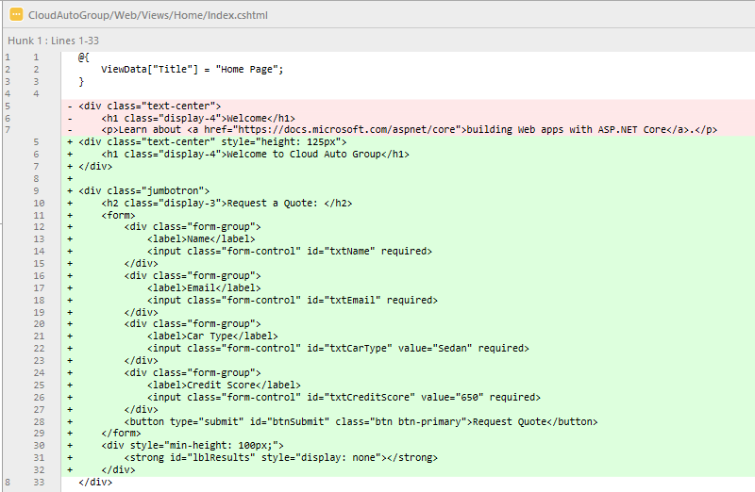
10 Index.html
<div class="text-center" style="height: 125px">
<h1 class="display-4">Welcome to Cloud Auto Group</h1>
</div>
<div class="jumbotron">
<h2 class="display-3">Request a Quote: </h2>
<form>
<div class="form-group">
<label>Name</label>
<input class="form-control" id="txtName" required>
</div>
<div class="form-group">
<label>Email</label>
<input class="form-control" id="txtEmail" required>
</div>
<div class="form-group">
<label>Car Type</label>
<input class="form-control" id="txtCarType" value="Sedan" required>
</div>
<div class="form-group">
<label>Credit Score</label>
<input class="form-control" id="txtCreditScore" value="650" required>
</div>
<button type="submit" id="btnSubmit" class="btn btn-primary">Request Quote</button>
</form>
<div style="min-height: 100px;">
<strong id="lblResults" style="display: none"></strong>
</div>
Notes:
Move quickly

Slide 16
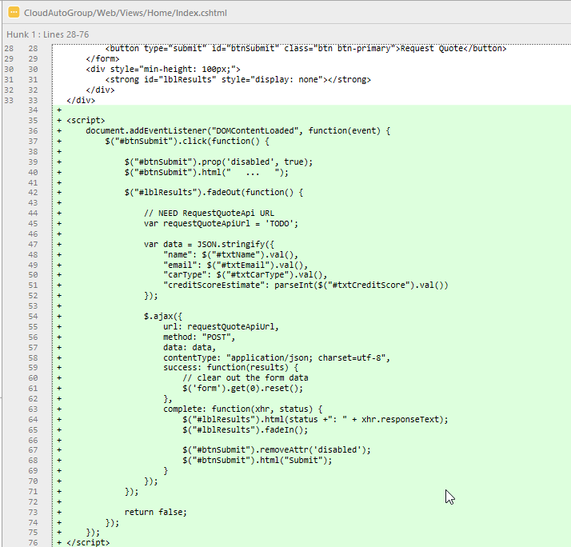
11 Index javascript
<script>
document.addEventListener("DOMContentLoaded", function(event) {
$("#btnSubmit").click(function() {
$("#btnSubmit").prop('disabled', true);
$("#btnSubmit").html(" ... ");
$("#lblResults").fadeOut(function() {
// NEED RequestQuoteApi URL
var requestQuoteApiUrl = 'TODO';
var data = JSON.stringify({
"name": $("#txtName").val(),
"email": $("#txtEmail").val(),
"carType": $("#txtCarType").val(),
"creditScoreEstimate": parseInt($("#txtCreditScore").val())
});
$.ajax({
url: requestQuoteApiUrl,
method: "POST",
data: data,
contentType: "application/json; charset=utf-8",
success: function(results) {
// clear out the form data
$('form').get(0).reset();
},
complete: function(xhr, status) {
$("#lblResults").html(status +": " + xhr.responseText);
$("#lblResults").fadeIn();
$("#btnSubmit").removeAttr('disabled');
$("#btnSubmit").html("Submit");
}
});
});
return false;
});
});
</script>
Notes:
call out TODO, need RequestQuoteApi

Slide 17
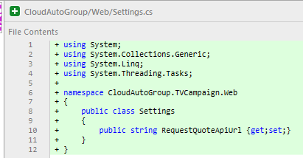
12 Web Settings
public class Settings
{
public string RequestQuoteApiUrl {get;set;}
}
Notes:
We’ll next create the infrastructure for the Request Quote Api ….
TODO

Slide 18
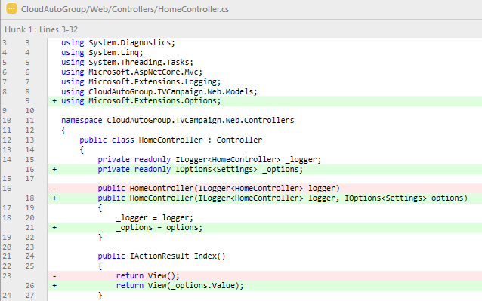
13 DI Settings into Home Controller
private readonly IOptions<Settings> _options;
public HomeController(ILogger<HomeController> logger, IOptions<Settings> options)
{
_logger = logger;
_options = options;
}
return View(_options.Value);
Notes:
TODO

Slide 19
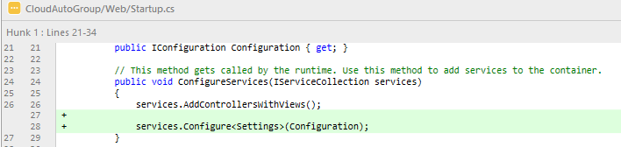
13a Configure Web app to populate Settings
services.Configure<Settings>(Configuration);
Notes:
TODO
Mention Environment Variables will automatically be added to Configuration for us by asp.net framework.

Slide 20
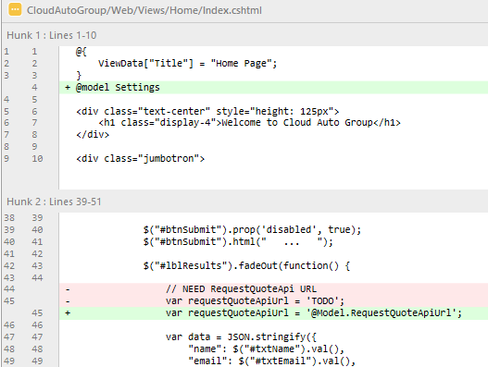
14 Index html: consume settings
@model Settings
var requestQuoteApiUrl = '@Model.RequestQuoteApiUrl';
Notes:
TODO
Mention Environment Variables will automatically be added to Configuration for us by asp.net framework.

Slide 21
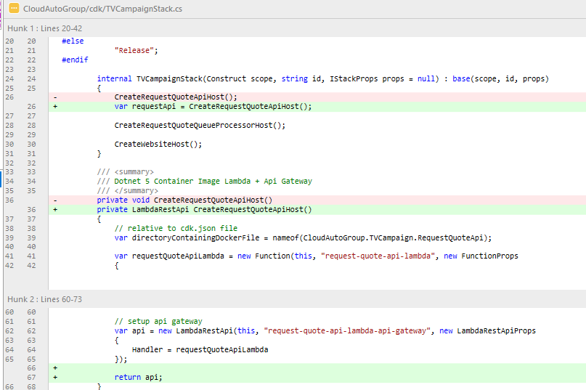
15 CreateRequestApiHost return api
var requestApi = CreateRequestQuoteApiHost();
private LambdaRestApi CreateRequestQuoteApiHost()
return api;
Notes:
So now that the Website is wired up to take the Request Api Url as a setting via an Environment Variable, let’s look at how we can populate it.
The first step is to open our TVCampaignStack
Open cdk/TVCampaignStack.cs
And we’re going to modify the CreateRequestQuoteApiHost method to return the LambdaRestApi its creating.

Slide 22
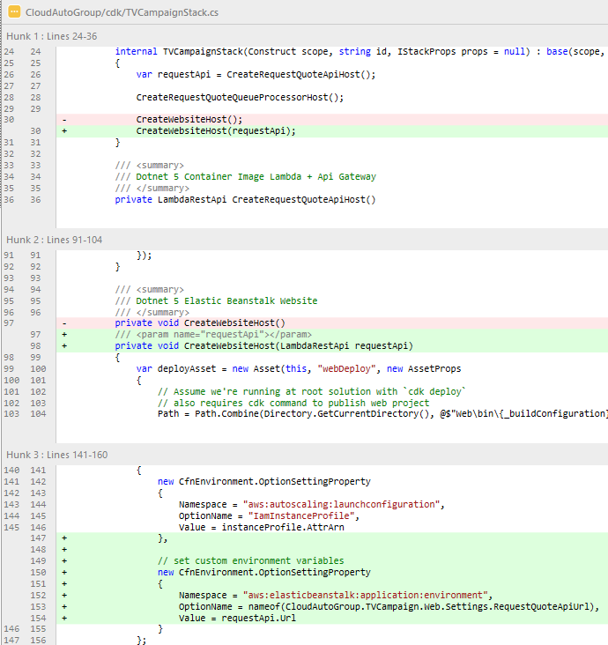
16 Update CreateWebsiteHost() to save requestApi.Url in env variable (CDK DEPLOY)
CreateWebsiteHost(requestApi);
private void CreateWebsiteHost(LambdaRestApi requestApi)
// set custom environment variables
new CfnEnvironment.OptionSettingProperty
{
Namespace = "aws:elasticbeanstalk:application:environment",
OptionName = nameof(CloudAutoGroup.TVCampaign.Web.Settings.RequestQuoteApiUrl),
Value = requestApi.Url
}
Notes:
TODO

Slide 23
DEPLOY
Notes:
TODO

Slide 24
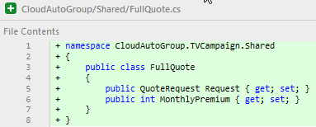
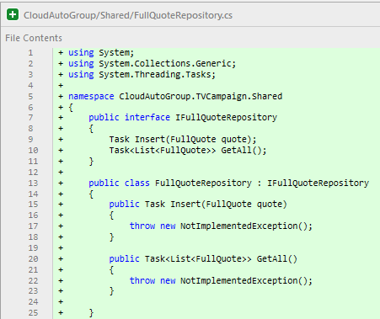
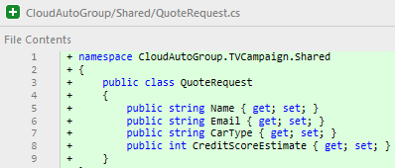
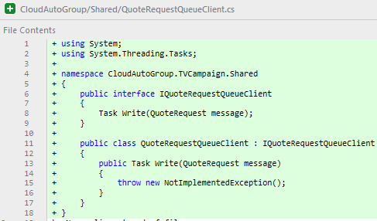
9 Initial Domain Model / Shared Infra Classes
public class FullQuote
{
public QuoteRequest Request { get; set; }
public int MonthlyPremium { get; set; }
}
public interface IFullQuoteRepository
{
Task Insert(FullQuote quote);
Task<List<FullQuote>> GetAll();
}
public class FullQuoteRepository : IFullQuoteRepository
{
public Task Insert(FullQuote quote)
{
throw new NotImplementedException();
}
public Task<List<FullQuote>> GetAll()
{
throw new NotImplementedException();
}
}
public class QuoteRequest
{
public string Name { get; set; }
public string Email { get; set; }
public string CarType { get; set; }
public int CreditScoreEstimate { get; set; }
}
public interface IQuoteRequestQueueClient
{
Task Write(QuoteRequest message);
}
public class QuoteRequestQueueClient : IQuoteRequestQueueClient
{
public Task Write(QuoteRequest message)
{
throw new NotImplementedException();
}
}
Notes:
Next we’re going to build out oour Request Quote Api. This is going to receive the Quote Request from the front end.
I’ve already defined our two Domain Models QuoteRequest
open QuoteRequest.cs
and FullQuote,
open FullQuote.cs
Which has a reference to the original request as well as a Monthly Premium.
I’ve also built out a FullQuoteRepository which will look at later. What the Api needs is this QuoteRequestQueueClient which it will use to enqueuer processing of the Quote Request.
Alright, let’s start building our Api.

Slide 25
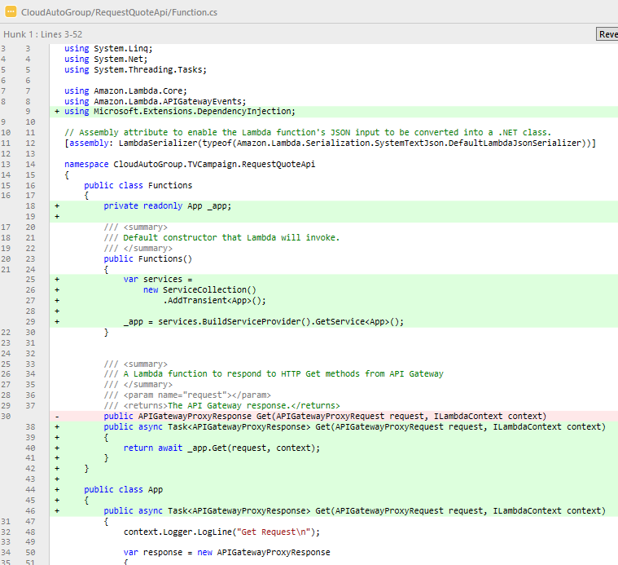
17 Configure request quote api to use DI
public class Functions
{
private readonly App _app;
public Functions()
{
var services =
new ServiceCollection()
.AddTransient<App>();
_app = services.BuildServiceProvider().GetService<App>();
}
public async Task<APIGatewayProxyResponse> Get(APIGatewayProxyRequest request, ILambdaContext context)
{
return await _app.Get(request, context);
}
}
public class App
{
public async Task<APIGatewayProxyResponse> Get(APIGatewayProxyRequest request, ILambdaContext context)
{
context.Logger.LogLine("Get Request\n");
var response = new APIGatewayProxyResponse
{
StatusCode = (int)HttpStatusCode.OK,
Body = "Hello AWS Serverless",
Headers = new Dictionary<string, string> { { "Content-Type", "text/plain" } }
};
return response;
}
}
Notes:
The first thing I like to do for a Lambda function is wire it up to support DI.
I’m going to make a copy of the primary method inside a new class called App, and make it fully async …
paste App
I’ll create a backing App field.
And then I’ll create a new ServiceCollection inside the Functions constructor to build an instance of App. This way App is ready to use DI.

Slide 26
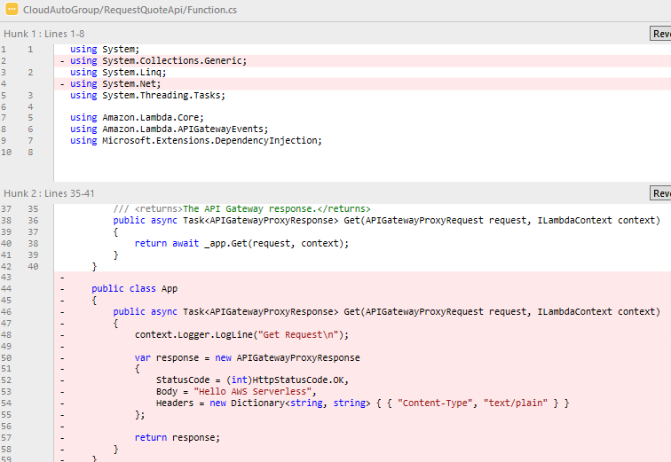
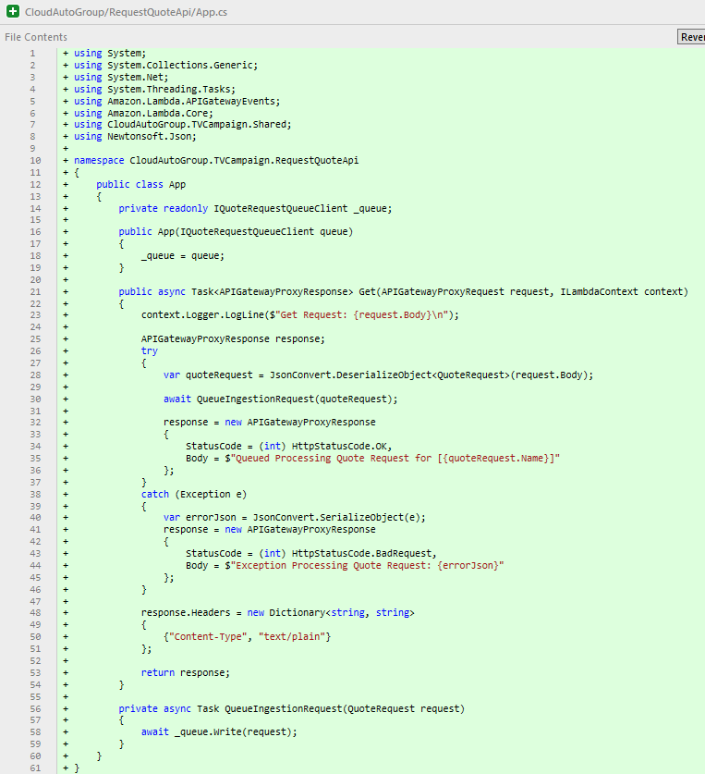
18 Implement request quote api
public class App
{
private readonly IQuoteRequestQueueClient _queue;
public App(IQuoteRequestQueueClient queue)
{
_queue = queue;
}
public async Task<APIGatewayProxyResponse> Get(APIGatewayProxyRequest request, ILambdaContext context)
{
context.Logger.LogLine($"Get Request: {request.Body}\n");
APIGatewayProxyResponse response;
try
{
var quoteRequest = JsonConvert.DeserializeObject<QuoteRequest>(request.Body);
await QueueIngestionRequest(quoteRequest);
response = new APIGatewayProxyResponse
{
StatusCode = (int) HttpStatusCode.OK,
Body = $"Queued Processing Quote Request for [{quoteRequest.Name}]"
};
}
catch (Exception e)
{
var errorJson = JsonConvert.SerializeObject(e);
response = new APIGatewayProxyResponse
{
StatusCode = (int) HttpStatusCode.BadRequest,
Body = $"Exception Processing Quote Request: {errorJson}"
};
}
response.Headers = new Dictionary<string, string>
{
{"Content-Type", "text/plain"}
};
return response;
}
private async Task QueueIngestionRequest(QuoteRequest request)
{
await _queue.Write(request);
}
}
Notes:
Next I’m going to move App to its own file; keep things nice and organized.
And for the sake of time, I’m going to paste in the implementation of this function.

Slide 27
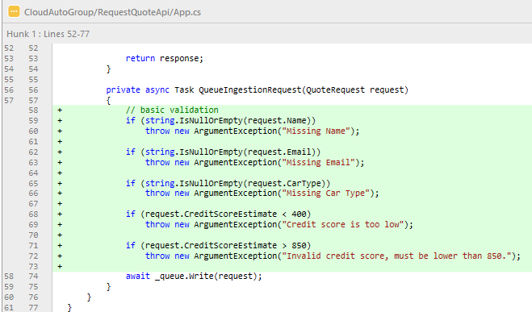
18a Add basic validation to request quote api
// basic validation
if (string.IsNullOrEmpty(request.Name))
throw new ArgumentException("Missing Name");
if (string.IsNullOrEmpty(request.Email))
throw new ArgumentException("Missing Email");
if (string.IsNullOrEmpty(request.CarType))
throw new ArgumentException("Missing Car Type");
if (request.CreditScoreEstimate < 400)
throw new ArgumentException("Credit score is too low");
if (request.CreditScoreEstimate > 850)
throw new ArgumentException("Invalid credit score, must be lower than 850.");
Notes:
TODO

Slide 28
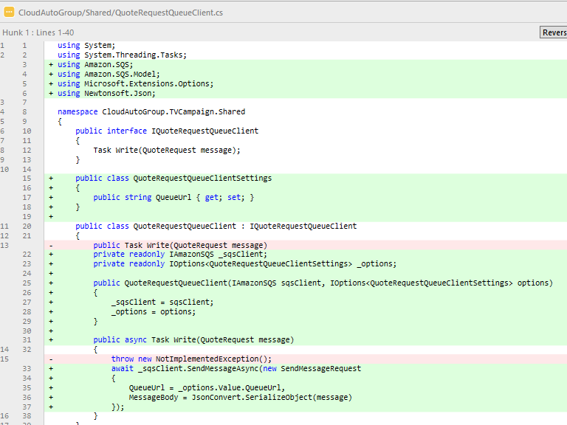
19 Implement QuoteRequestQueueClient
public class QuoteRequestQueueClientSettings
{
public string QueueUrl { get; set; }
}
private readonly IAmazonSQS _sqsClient;
private readonly IOptions<QuoteRequestQueueClientSettings> _options;
public QuoteRequestQueueClient(IAmazonSQS sqsClient, IOptions<QuoteRequestQueueClientSettings> options)
{
_sqsClient = sqsClient;
_options = options;
}
public async Task Write(QuoteRequest message)
{
await _sqsClient.SendMessageAsync(new SendMessageRequest
{
QueueUrl = _options.Value.QueueUrl,
MessageBody = JsonConvert.SerializeObject(message)
});
}
Notes:
TODO
Now that we have our implementation, let’s update the Api Function’s Service Collection

Slide 29
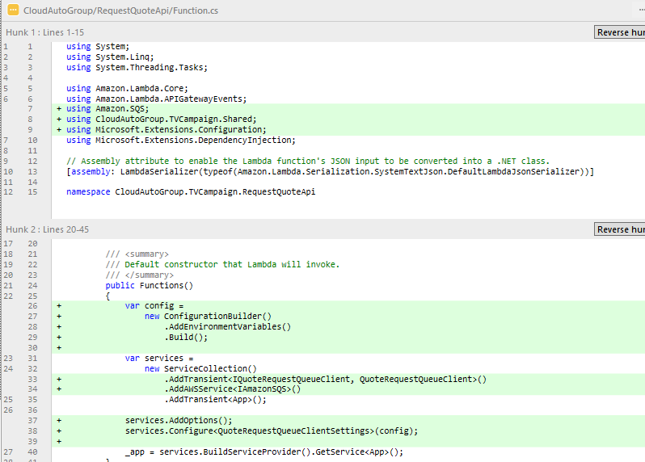
20 wire up di/configuration for request quote api
var config =
new ConfigurationBuilder()
.AddEnvironmentVariables()
.Build();
var services =
new ServiceCollection()
.AddTransient<IQuoteRequestQueueClient, QuoteRequestQueueClient>()
.AddAWSService<IAmazonSQS>()
.AddTransient<App>();
services.AddOptions(); services.Configure<QuoteRequestQueueClientSettings>(config);
Notes:
TODO
Now that we have all of our plumbing in place, we need to actually create our Queue and then find a way populate an Environment Variable so we can populate QuoteRequestQueueClientSettings.
So let’s had to TVCampaignStack.

Slide 30
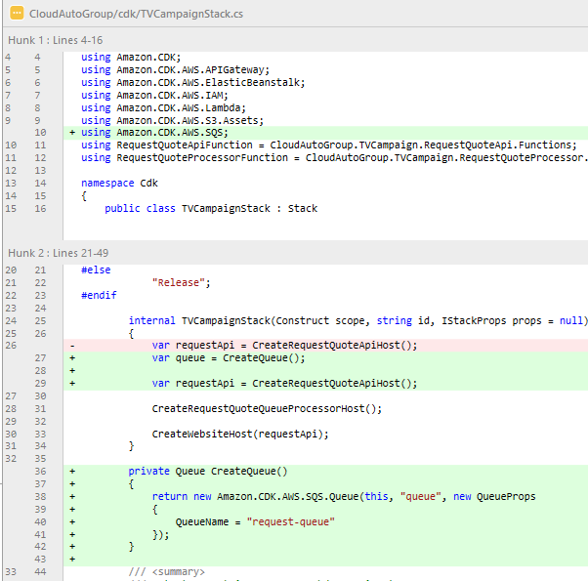
21 CreateQueue
var queue = CreateQueue();
private Queue CreateQueue()
{
return new Amazon.CDK.AWS.SQS.Queue(this, "queue", new QueueProps
{
QueueName = "request-queue"
});
}
Notes:
TODO

Slide 31
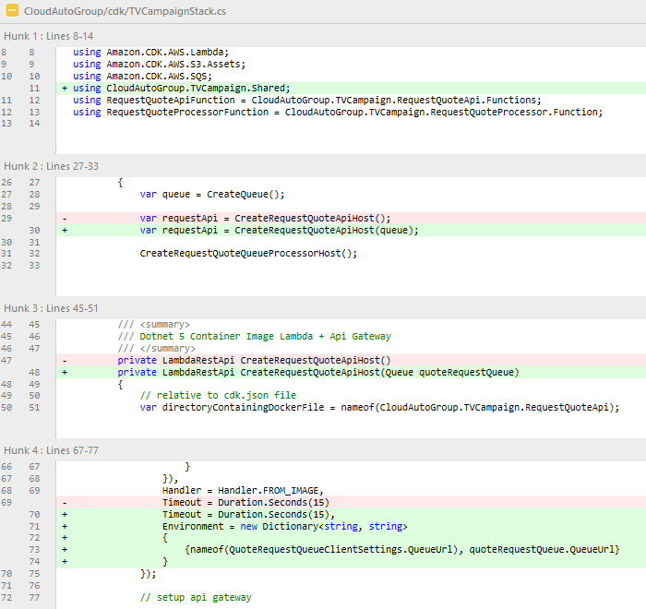
22 save queue url as an env variable inside request api lambda
var requestApi = CreateRequestQuoteApiHost(queue);
private LambdaRestApi CreateRequestQuoteApiHost(Queue quoteRequestQueue)
Timeout = Duration.Seconds(15),
Environment = new Dictionary<string, string>
{
{nameof(QuoteRequestQueueClientSettings.QueueUrl), quoteRequestQueue.QueueUrl}
}
Notes:
TODO

Slide 32
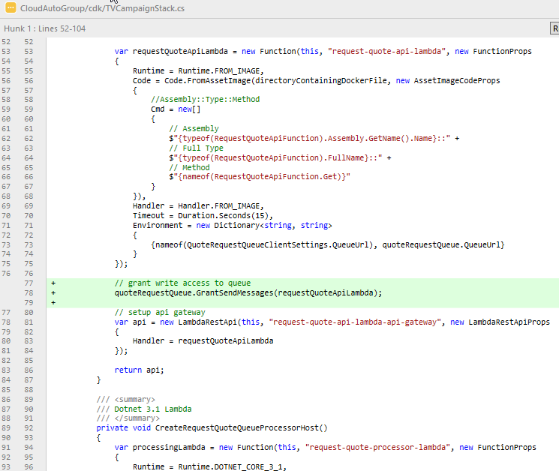
23 grant request quote api permission to write to queue
// grant write access to queue
quoteRequestQueue.GrantSendMessages(requestQuoteApiLambda);
Notes:
TODO

Slide 33
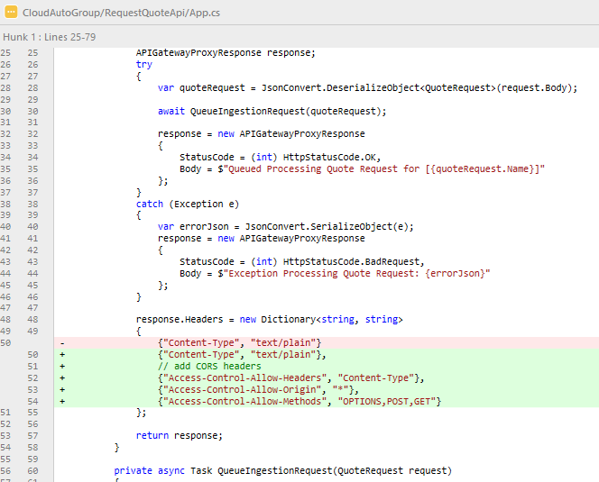
24 Add CORS headers to request quote api
{"Content-Type", "text/plain"},
// add CORS headers
{"Access-Control-Allow-Headers", "Content-Type"},
// In Prod list actual domains, don't use wildcard
{"Access-Control-Allow-Origin", "*"},
{"Access-Control-Allow-Methods", "OPTIONS,POST,GET"}
Notes:
TODO

Slide 34
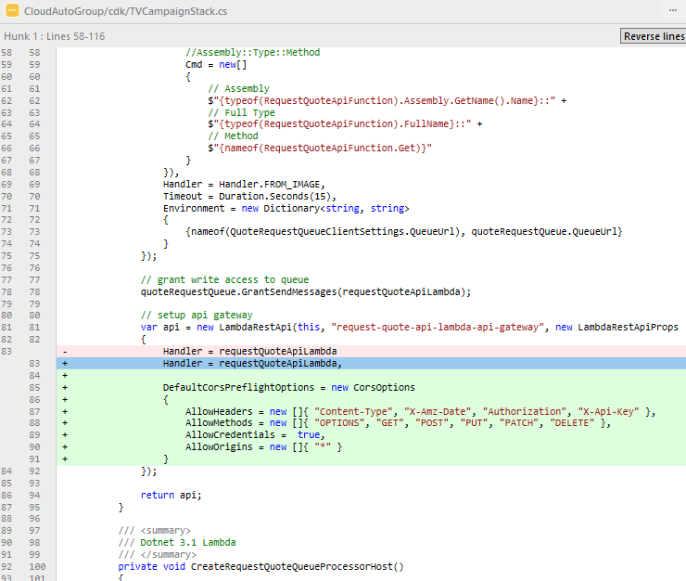
24a add cors headers to api gateway (CDK DEPLOY)
Handler = requestQuoteApiLambda,
DefaultCorsPreflightOptions = new CorsOptions
{
AllowHeaders = new []{ "Content-Type", "X-Amz-Date", "Authorization", "X-Api-Key" },
AllowMethods = new []{ "OPTIONS", "GET", "POST", "PUT", "PATCH", "DELETE" },
AllowCredentials = true,
// In Prod list actual domains, don't use wildcard
AllowOrigins = new []{ "*" }
}
Notes:
TODO

Slide 35
DEPLOY
Notes:
Save all in the Solultion!
WAIT FOR PROMPT OF Change IAM Policies

Slide 36
DEMO
Show Web Site is live
Notes:
Save all in the Solultion!
WAIT FOR PROMPT OF Change IAM Policies

Slide 37
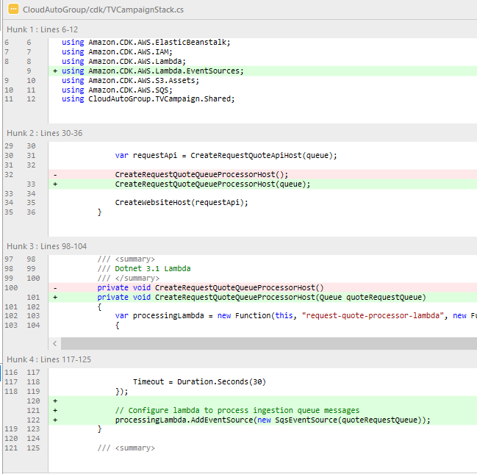
25 Wire up quote processor to listen to queue
CreateRequestQuoteQueueProcessorHost(queue);
private void CreateRequestQuoteQueueProcessorHost(Queue quoteRequestQueue)
// Configure lambda to process ingestion queue messages
processingLambda.AddEventSource(new SqsEventSource(quoteRequestQueue));
Notes:
TODO

Slide 38
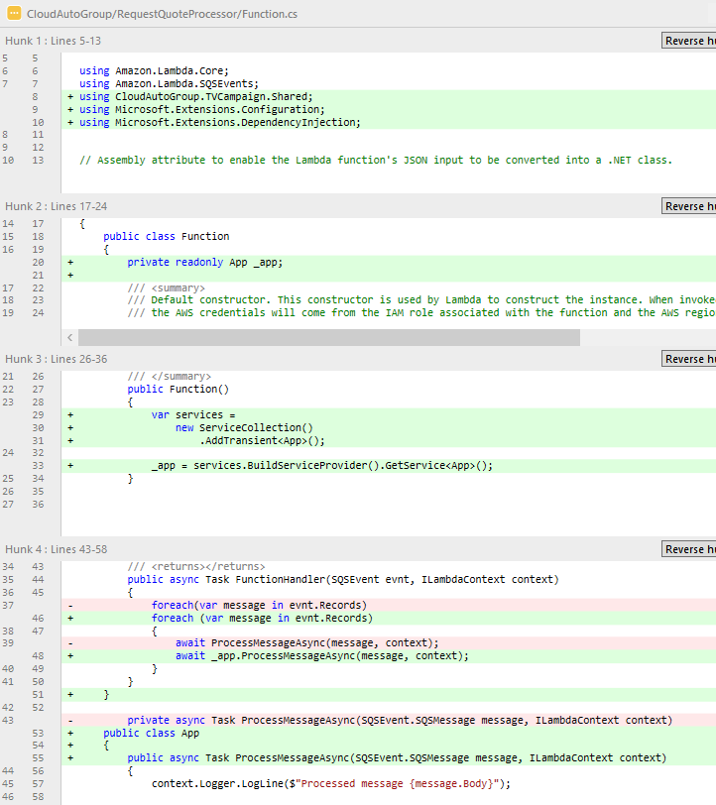
26 Scafold di for quote processor lambda
private readonly App _app;
var services =
new ServiceCollection()
.AddTransient<App>();
_app = services.BuildServiceProvider().GetService<App>();
public async Task FunctionHandler(SQSEvent evnt, ILambdaContext context)
{
foreach (var message in evnt.Records)
{
await _app.ProcessMessageAsync(message, context);
}
}
public class App
{
public async Task ProcessMessageAsync(SQSEvent.SQSMessage message, ILambdaContext context)
{
context.Logger.LogLine($"Processed message {message.Body}");
// TODO: Do interesting work based on the new message
await Task.CompletedTask;
}
}
Notes:
TODO

Slide 39
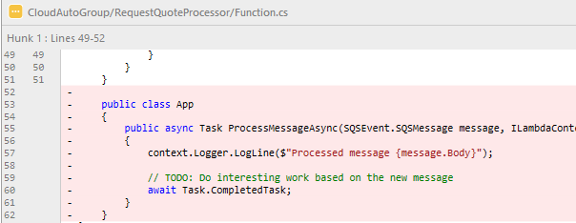
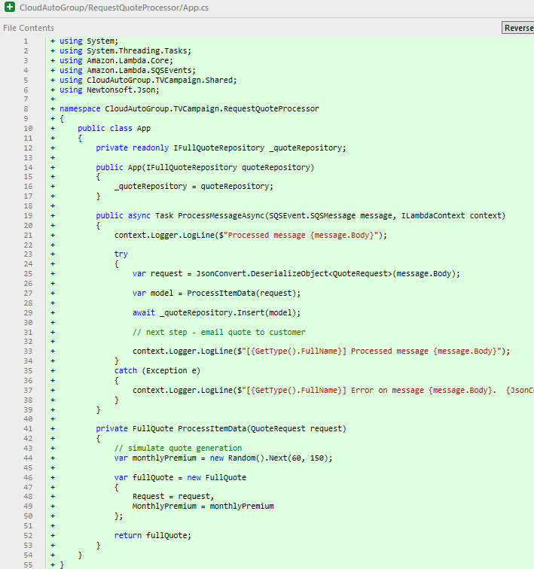
27 Implement quote processor function
public class App
{
private readonly IFullQuoteRepository _quoteRepository;
public App(IFullQuoteRepository quoteRepository)
{
_quoteRepository = quoteRepository;
}
public async Task ProcessMessageAsync(SQSEvent.SQSMessage message, ILambdaContext context)
{
context.Logger.LogLine($"Processed message {message.Body}");
try
{
var request = JsonConvert.DeserializeObject<QuoteRequest>(message.Body);
var model = ProcessItemData(request);
await _quoteRepository.Insert(model);
// next step - email quote to customer
context.Logger.LogLine($"[{GetType().FullName}] Processed message {message.Body}");
}
catch (Exception e)
{
context.Logger.LogLine($"[{GetType().FullName}] Error on message {message.Body}. {JsonConvert.SerializeObject(e)}");
}
}
private FullQuote ProcessItemData(QuoteRequest request)
{
// simulate quote generation
var monthlyPremium = new Random().Next(60, 150);
var fullQuote = new FullQuote
{
Request = request,
MonthlyPremium = monthlyPremium
};
return fullQuote;
}
}
Notes:
TODO

Slide 40
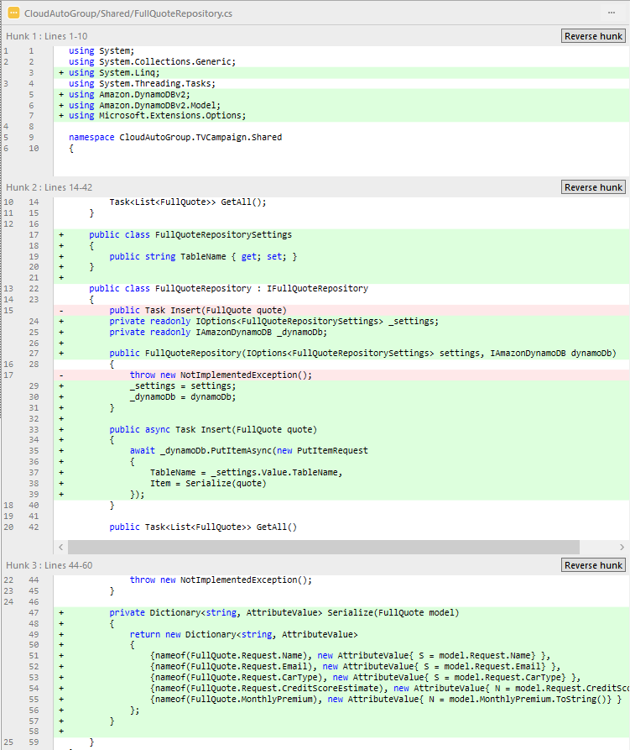
28 Implement FullQuoteRepository.Insert()
public class FullQuoteRepositorySettings
{
public string TableName { get; set; }
}
private readonly IOptions<FullQuoteRepositorySettings> _settings;
private readonly IAmazonDynamoDB _dynamoDb;
public FullQuoteRepository(IOptions<FullQuoteRepositorySettings> settings, IAmazonDynamoDB dynamoDb)
{
_settings = settings;
_dynamoDb = dynamoDb;
}
public async Task Insert(FullQuote quote)
{
await _dynamoDb.PutItemAsync(new PutItemRequest
{
TableName = _settings.Value.TableName,
Item = Serialize(quote)
});
}
private Dictionary<string, AttributeValue> Serialize(FullQuote model)
{
return new Dictionary<string, AttributeValue>
{
{nameof(FullQuote.Request.Name), new AttributeValue{ S = model.Request.Name} },
{nameof(FullQuote.Request.Email), new AttributeValue{ S = model.Request.Email} },
{nameof(FullQuote.Request.CarType), new AttributeValue{ S = model.Request.CarType} },
{nameof(FullQuote.Request.CreditScoreEstimate), new AttributeValue{ N = model.Request.CreditScoreEstimate.ToString()} },
{nameof(FullQuote.MonthlyPremium), new AttributeValue{ N = model.MonthlyPremium.ToString()} }
};
}
Notes:
TODO

Slide 41
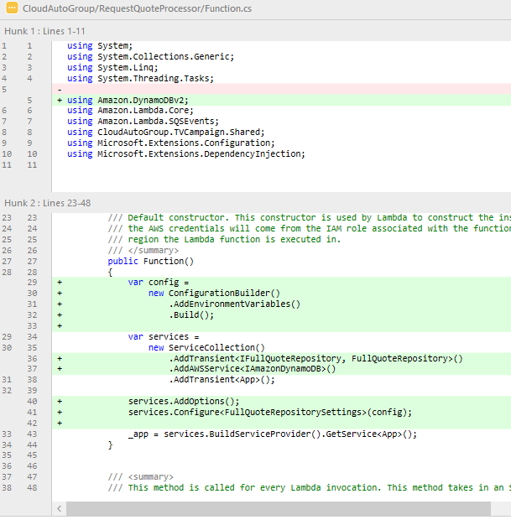
31 Wire up di/configuration for request processor lambda
var config =
new ConfigurationBuilder()
.AddEnvironmentVariables()
.Build();
.AddTransient<IFullQuoteRepository, FullQuoteRepository>()
.AddAWSService<IAmazonDynamoDB>()
services.AddOptions();
services.Configure<FullQuoteRepositorySettings>(config);
Notes:
TODO
Now that we have the plumbing there, we need an actual DataStore. So let’s head to the TVCampaignStack and add one.

Slide 42
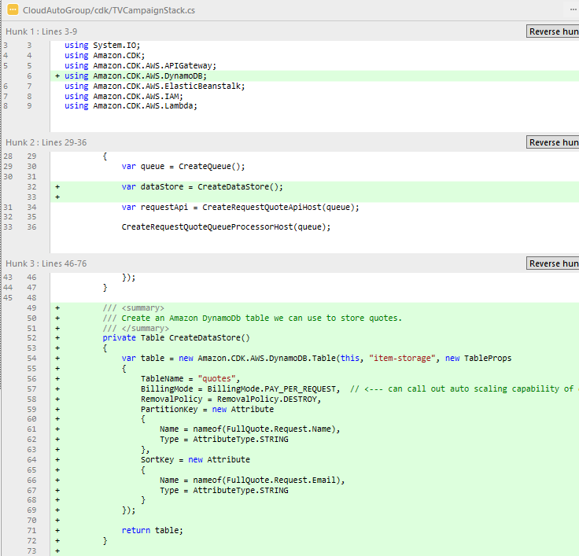
29 Add CreateDataStore() to stack
var dataStore = CreateDataStore();
/// <summary>
/// Create an Amazon DynamoDb table we can use to store quotes.
/// </summary>
private Table CreateDataStore()
{
var table = new Amazon.CDK.AWS.DynamoDB.Table(this, "item-storage", new TableProps
{
TableName = "quotes",
BillingMode = BillingMode.PAY_PER_REQUEST,
RemovalPolicy = RemovalPolicy.DESTROY,
PartitionKey = new Attribute
{
Name = nameof(FullQuote.Request.Name),
Type = AttributeType.STRING
},
SortKey = new Attribute
{
Name = nameof(FullQuote.Request.Email),
Type = AttributeType.STRING
}
});
return table;
}
Notes:
TODO

Slide 43
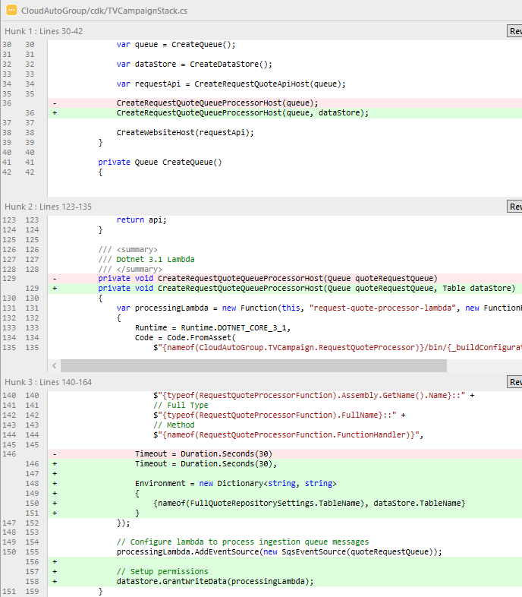
30 Update stack to wire data storage into quote processing lambda
CreateRequestQuoteQueueProcessorHost(queue, dataStore);
private void CreateRequestQuoteQueueProcessorHost(Queue quoteRequestQueue, Table dataStore)
Timeout = Duration.Seconds(30),
Environment = new Dictionary<string, string>
{
{nameof(FullQuoteRepositorySettings.TableName), dataStore.TableName}
}
// Setup permissions
dataStore.GrantWriteData(processingLambda);
Notes:
TODO

Slide 44
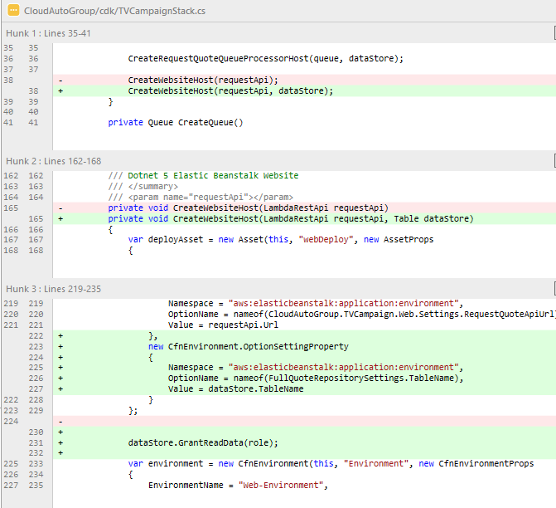
37 Add datastore configuration env variable and permissions to website (CDK DEPLOY)
CreateWebsiteHost(requestApi, dataStore);
private void CreateWebsiteHost(LambdaRestApi requestApi, Table dataStore)
,
new CfnEnvironment.OptionSettingProperty
{
Namespace = "aws:elasticbeanstalk:application:environment",
OptionName = nameof(FullQuoteRepositorySettings.TableName),
Value = dataStore.TableName
}
dataStore.GrantReadData(role);
Notes:
Now the final piece we’re going to build is a Dashboard page to list all Full Quote objects that the Request Processor has saved.
So the Dashboard page is going to need access to the DataStore as well. So, since we’re already in the TVCampaignStack and you guys are picking up on this pattern, let’s get our Dashbaord page, which is hosted in the Website, everything it needs.
do work
Let’s go take a look at the Dashboard page.

Slide 45
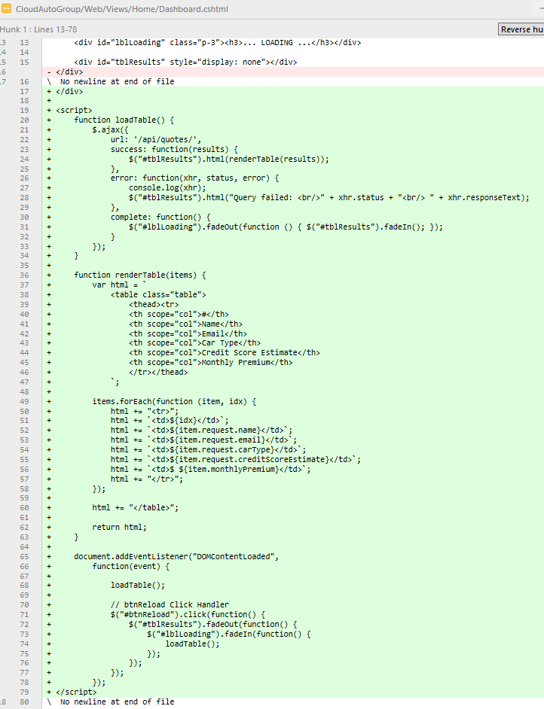
33a dashboard page javascript
<script>
function loadTable() {
$.ajax({
url: '/api/quotes/',
success: function(results) {
$("#tblResults").html(renderTable(results));
},
error: function(xhr, status, error) {
console.log(xhr);
$("#tblResults").html("Query failed: <br/>" + xhr.status + "<br/> " + xhr.responseText);
},
complete: function() {
$("#lblLoading").fadeOut(function () { $("#tblResults").fadeIn(); });
}
});
}
function renderTable(items) {
var html = `
<table class="table">
<thead><tr>
<th scope="col">#</th>
<th scope="col">Name</th>
<th scope="col">Email</th>
<th scope="col">Car Type</th>
<th scope="col">Credit Score Estimate</th>
<th scope="col">Monthly Premium</th>
</tr></thead>
`;
items.forEach(function (item, idx) {
html += "<tr>";
html += `<td>${idx}</td>`;
html += `<td>${item.request.name}</td>`;
html += `<td>${item.request.email}</td>`;
html += `<td>${item.request.carType}</td>`;
html += `<td>${item.request.creditScoreEstimate}</td>`;
html += `<td>$ ${item.monthlyPremium}</td>`;
html += "</tr>";
});
html += "</table>";
return html;
}
document.addEventListener("DOMContentLoaded",
function(event) {
loadTable();
// btnReload Click Handler
$("#btnReload").click(function() {
$("#tblResults").fadeOut(function() {
$("#lblLoading").fadeIn(function() {
loadTable();
});
});
});
});
</script>
Notes:
TODO – nothing fancy here. Ajax Url is easy because we’re calling the quotes api controller hosted inside the website (about to build) as it doesn’t need to scale the same way the request quote api did as it’s not customer facing

Slide 46
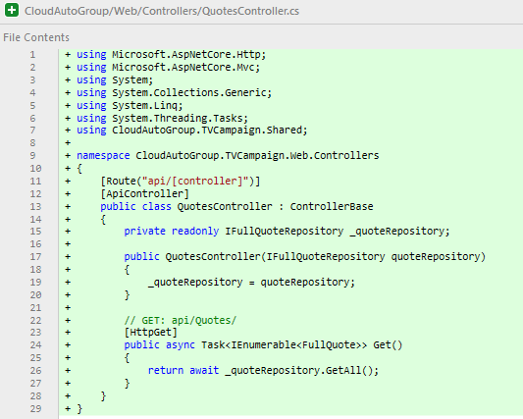
34 Quotes Api Controller
﻿using Microsoft.AspNetCore.Http;
using Microsoft.AspNetCore.Mvc;
using System;
using System.Collections.Generic;
using System.Linq;
using System.Threading.Tasks;
using CloudAutoGroup.TVCampaign.Shared;
namespace CloudAutoGroup.TVCampaign.Web.Controllers
{
[Route("api/[controller]")]
[ApiController]
public class QuotesController : ControllerBase
{
private readonly IFullQuoteRepository _quoteRepository;
public QuotesController(IFullQuoteRepository quoteRepository)
{
_quoteRepository = quoteRepository;
}
// GET: api/Quotes/
[HttpGet]
public async Task<IEnumerable<FullQuote>> Get()
{
return await _quoteRepository.GetAll();
}
}
}
Notes:
TODO

Slide 47
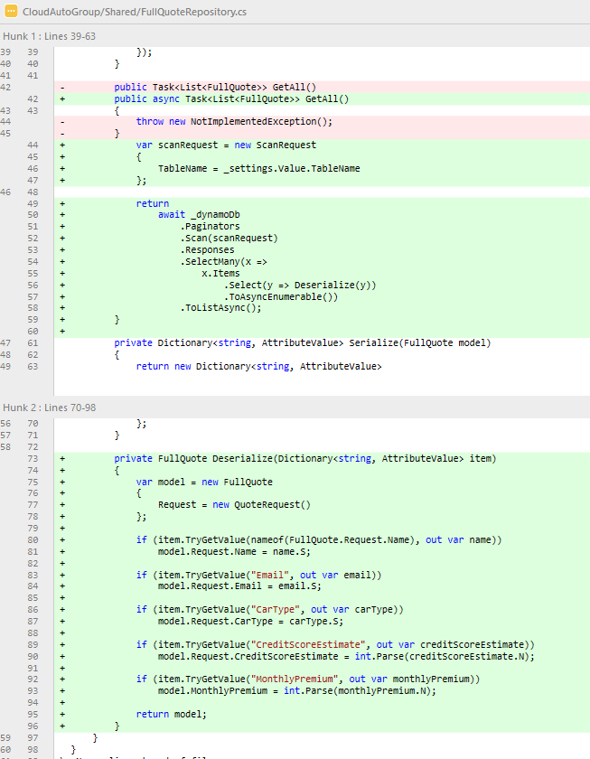
35 Implement FullQuoteRepository
public async Task<List<FullQuote>> GetAll()
{
var scanRequest = new ScanRequest
{
TableName = _settings.Value.TableName
};
return
await _dynamoDb
.Paginators
.Scan(scanRequest)
.Responses
.SelectMany(x =>
x.Items
.Select(y => Deserialize(y))
.ToAsyncEnumerable())
.ToListAsync();
}
private FullQuote Deserialize(Dictionary<string, AttributeValue> item)
{
var model = new FullQuote
{
Request = new QuoteRequest()
};
if (item.TryGetValue(nameof(FullQuote.Request.Name), out var name))
model.Request.Name = name.S;
if (item.TryGetValue("Email", out var email))
model.Request.Email = email.S;
if (item.TryGetValue("CarType", out var carType))
model.Request.CarType = carType.S;
if (item.TryGetValue("CreditScoreEstimate", out var creditScoreEstimate))
model.Request.CreditScoreEstimate = int.Parse(creditScoreEstimate.N);
if (item.TryGetValue("MonthlyPremium", out var monthlyPremium))
model.MonthlyPremium = int.Parse(monthlyPremium.N);
return model;
}
Notes:
TODO

Slide 48
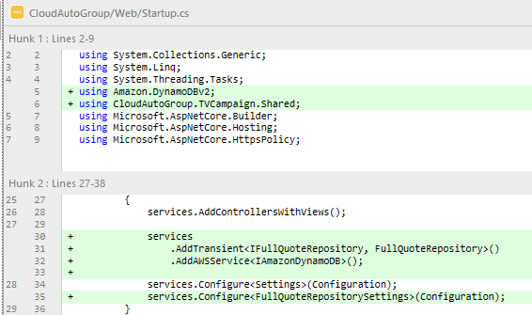
36 Add di for quotes api controller
services
.AddTransient<IFullQuoteRepository, FullQuoteRepository>()
.AddAWSService<IAmazonDynamoDB>();
services.Configure<FullQuoteRepositorySettings>(Configuration);

Slide 49
DEPLOY
Notes:
Save all in the Solultion!
cdk deploy --require-approval never

Slide 50
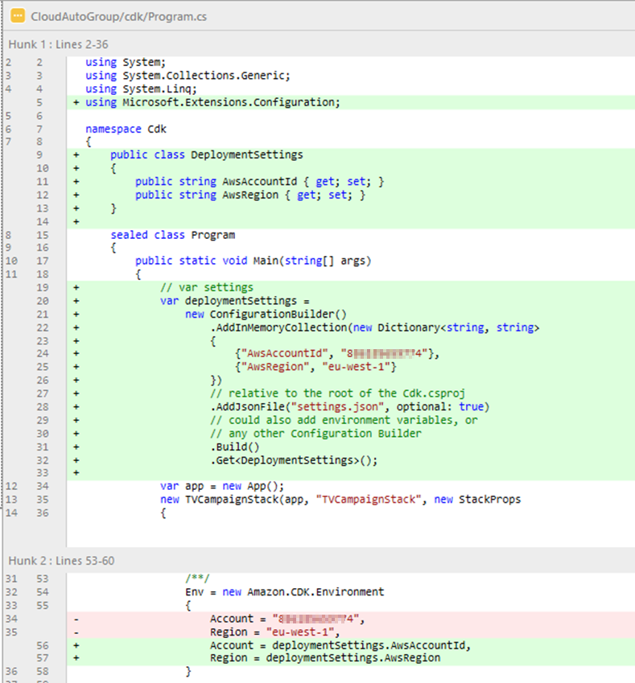
38 (bonus) - .net configuration in cdk
public class DeploymentSettings
{
public string AwsAccountId { get; set; }
public string AwsRegion { get; set; }
}
// var settings
var deploymentSettings =
new ConfigurationBuilder()
.AddInMemoryCollection(new Dictionary<string, string>
{
{"AwsAccountId", “ENTER YOUR ACCOUNT ID"},
{"AwsRegion", "us-west-1"}
})
// relative to the root of the Cdk.csproj
.AddJsonFile("settings.json", optional: true)
// could also add environment variables, or
// any other Configuration Builder
.Build()
.Get<DeploymentSettings>();
Account = deploymentSettings.AwsAccountId,
Region = deploymentSettings.AwsRegion
Notes:
TODO

Slide 51
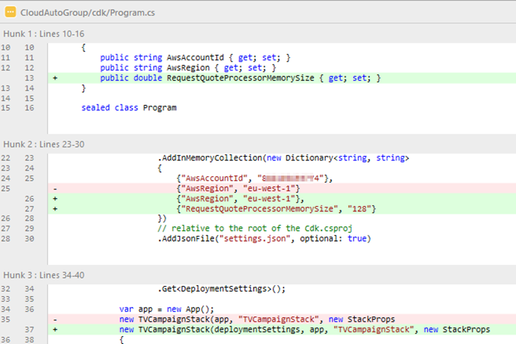
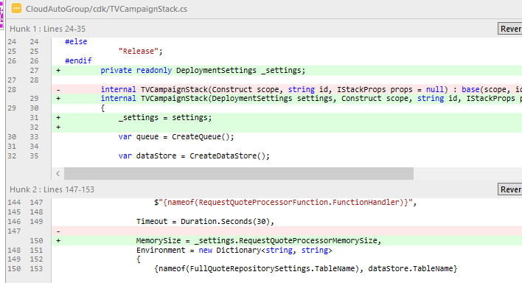
39 (bonus) use deploymentSettings.RequestQuoteProcessorMemorySize
public double RequestQuoteProcessorMemorySize { get; set; }
,
{"RequestQuoteProcessorMemorySize", "128"}
new TVCampaignStack(deploymentSettings, app, "TVCampaignStack", new StackProps
private readonly DeploymentSettings _settings;
internal TVCampaignStack(DeploymentSettings settings, Construct scope, string id, IStackProps props = null)
: base(scope, id, props)
{
_settings = settings;
MemorySize = _settings.RequestQuoteProcessorMemorySize,
Notes:
Describe, but don’t implement

Slide 52
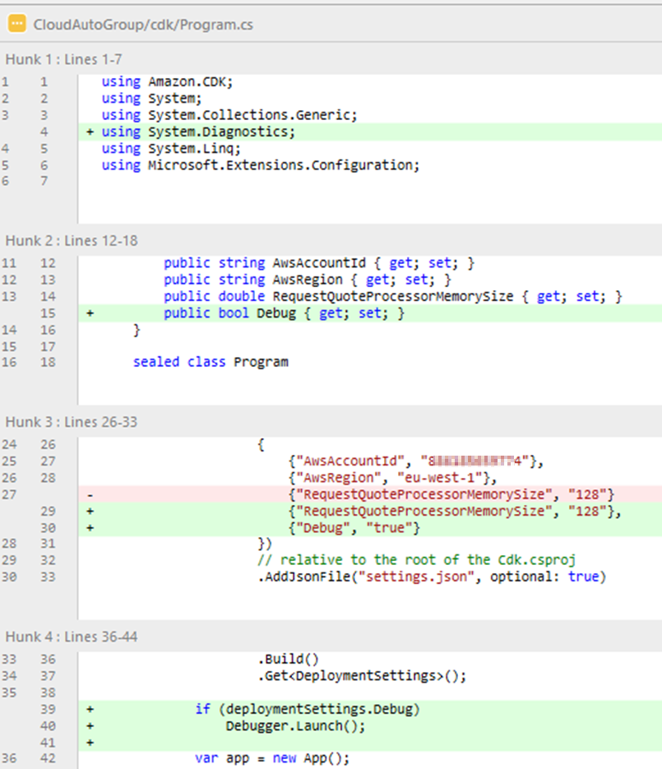
40 (bonus) - launch a debugger
public bool Debug { get; set; }
,
{"Debug", "true"}
if (deploymentSettings.Debug)
Debugger.Launch();
Notes:
TODO

Slide 53
DEMO
Show full walkthrough of application
Notes:
TODO
Next will build a dashboard page.

Slide 54
41 Bonus - send 'ding' email. infra + code in joint commit
https://github.com/ppittle/cdk-talk/commit/9f06ee41785fdb38bdf4b3d48bdbfd9605fee2c2
Notes:
TODO

