Slide 1
BIA600C Keyword Survey
Professor Brian Mueller
AJ (Jungho Park)

Slide 2
Analysis Goals
Understand what topics were covered in each and every lectures
Generate visualization with respect to different granularity of data

Slide 3
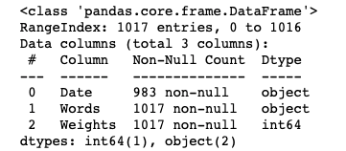
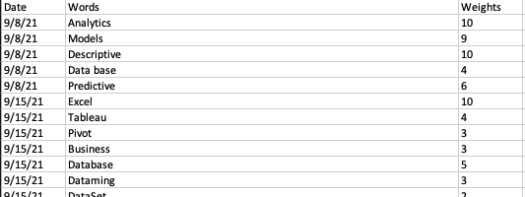
Data Description
26 survey data, 1017 entries
Data collection
Keyword collection from students with weights
Data description & constraints
Date: Lecture dates from Sept 8th to Nov 10th (10 entries)
Words: keywords related to each lecture date
Too many typos, similar words..
Weights: Scale of [1, 10]

Slide 4


How many unique instances?
Date: 10 lectures
Keywords: 459 words
Weights: [1,10]
Discrete instead of continuous
** Too much unique instances.. what should we do?
Filter top-n results
Data preprocessing & feature engineering
In this case, to get lower granularity from the data
To visualize..

Slide 5
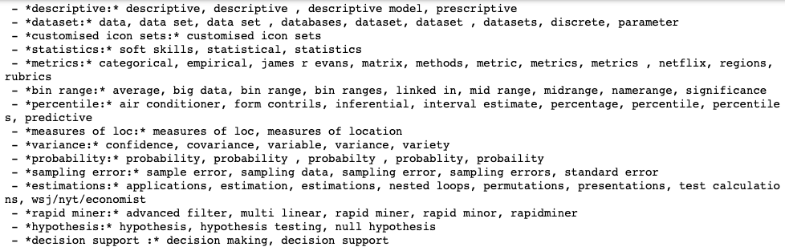
Preprocessing
Let’s get some lower granular data
459 unique | ex) [confidence, covariance, variable, variance, variety]
Methods
Natural language processing
Calculate similarity by implementing various functions
Cosine similarity
Euclidean distance
Levenshtein distance
Levenshtein distance
Levenshtein distance is a string metric for measuring the difference between two sequences.
Levenshtein distance clustering
84 unique | ex) Variance
Manual clustering
8 unique | ex)Statistics

Slide 6
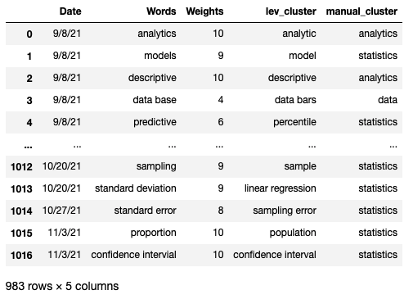
Final dataset

Slide 7
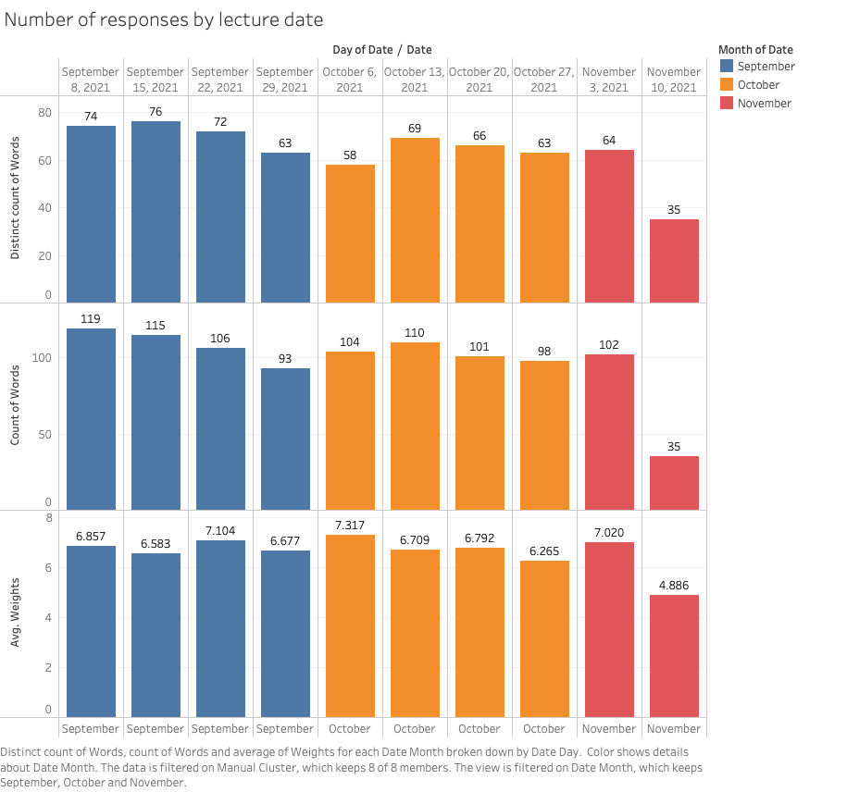
Visualization

Slide 8
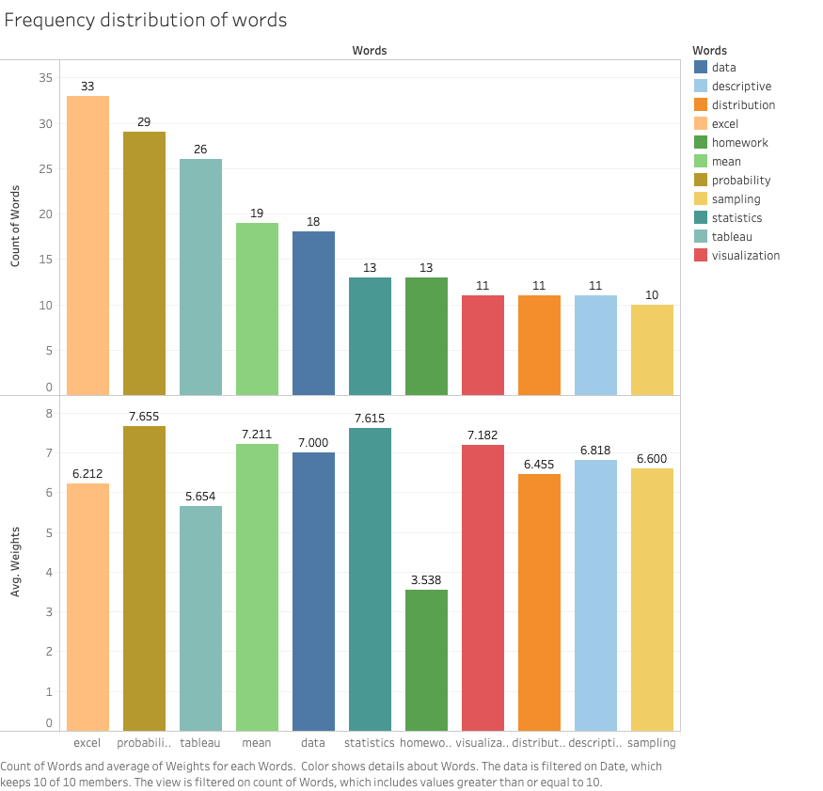

Slide 9
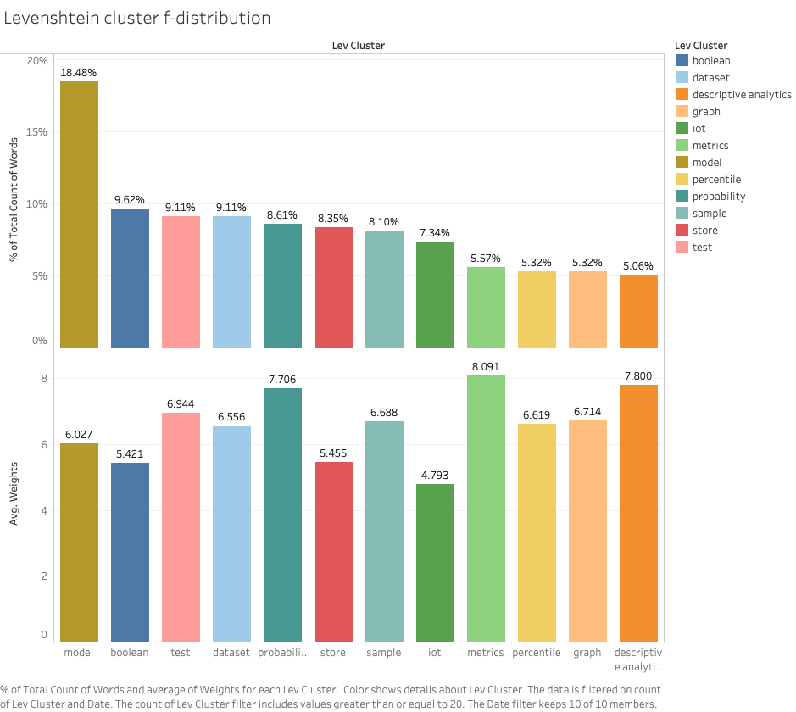
Highest frequency
- *model:* excel, homework, hotel, median, mode, model, modeling, models, ordinal, projects
Highest avg. weight
- *metrics:* categorical, empirical, james r evans, matrix, methods, metric, metrics, metrics , netflix, regions, rubrics

Slide 10
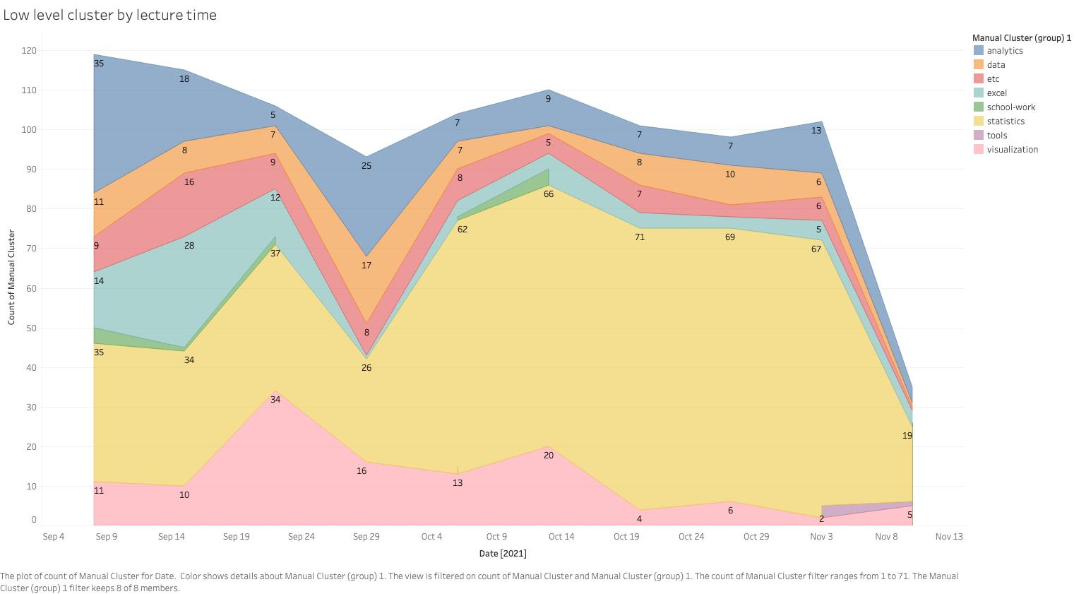

Slide 11
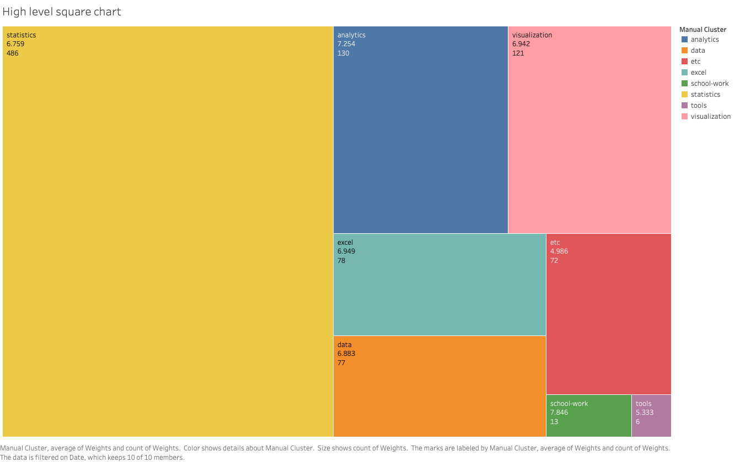

Slide 12
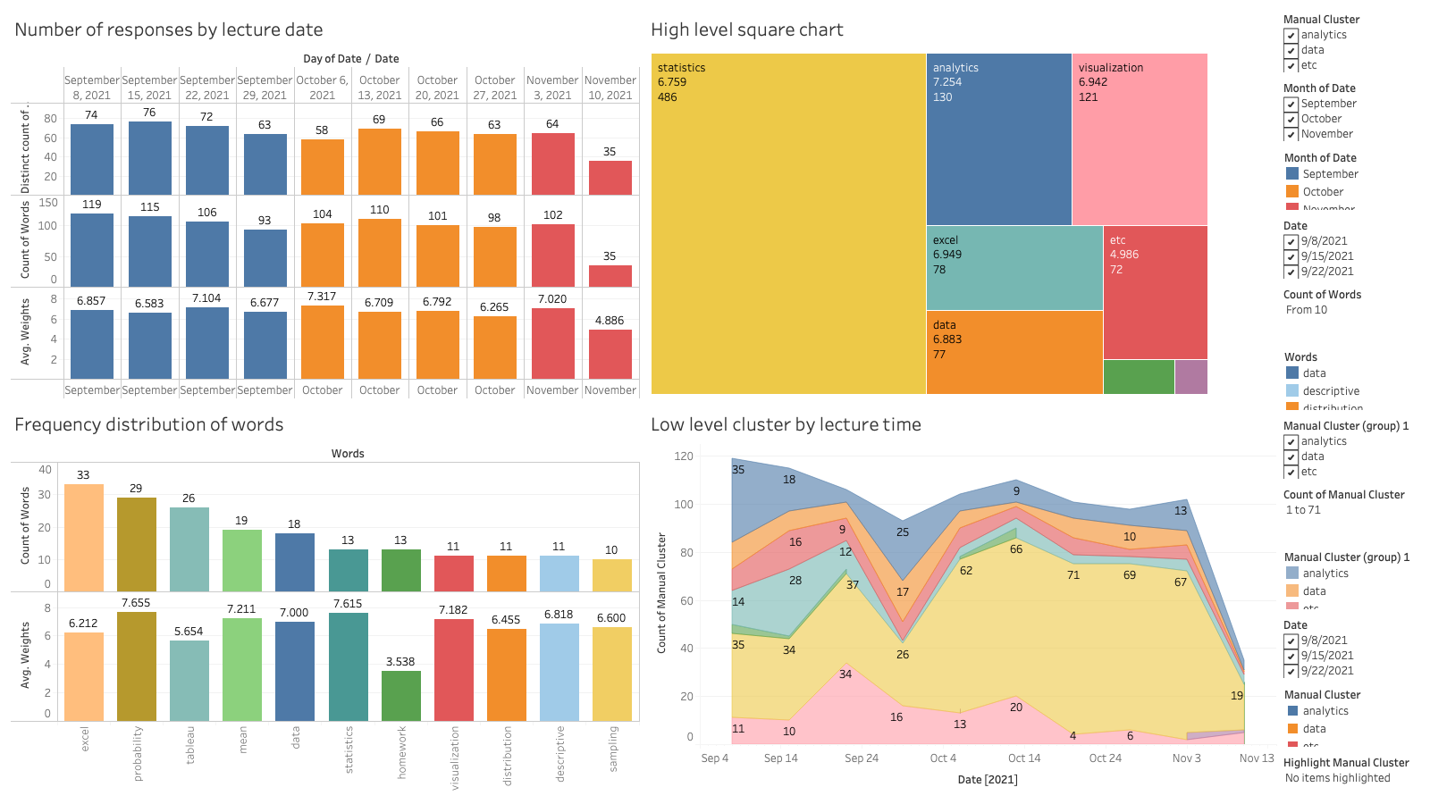
Dashboard

Slide 13
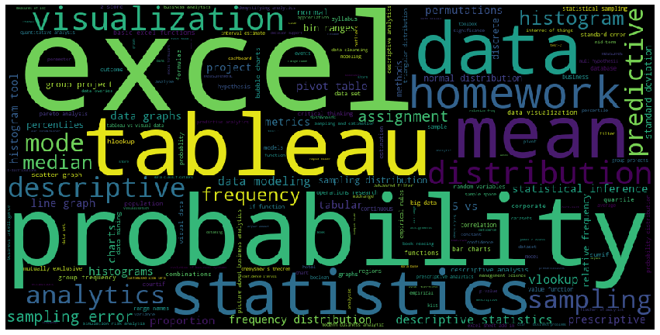
Word Cloud
Frequency distribution (words)

Slide 14
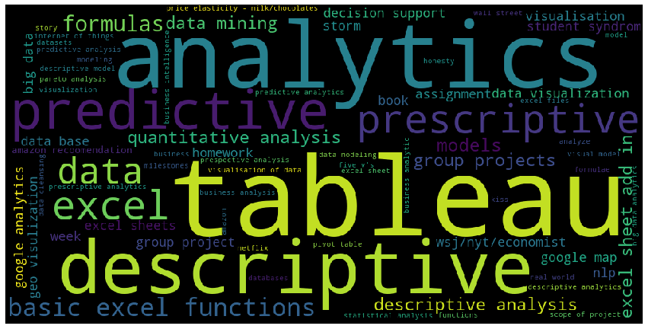
Word cloud
9/8

Slide 15
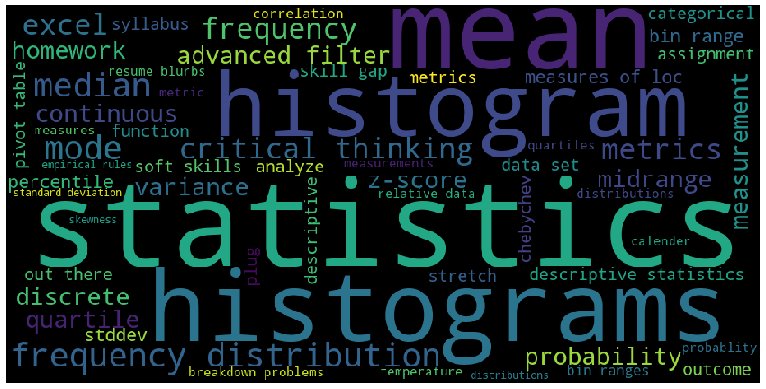
Word cloud
10/6

Slide 16
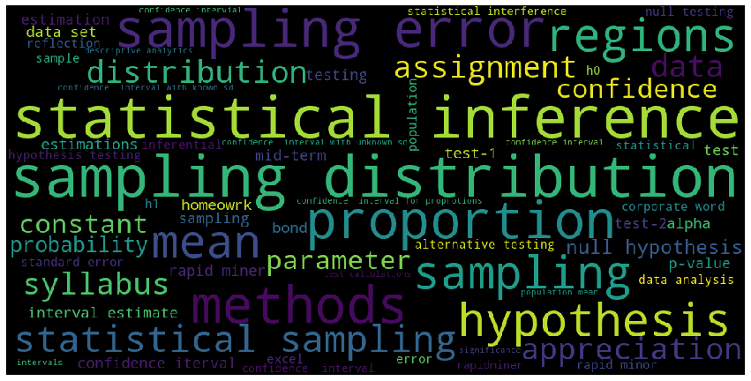
Word cloud
11/3

Slide 17
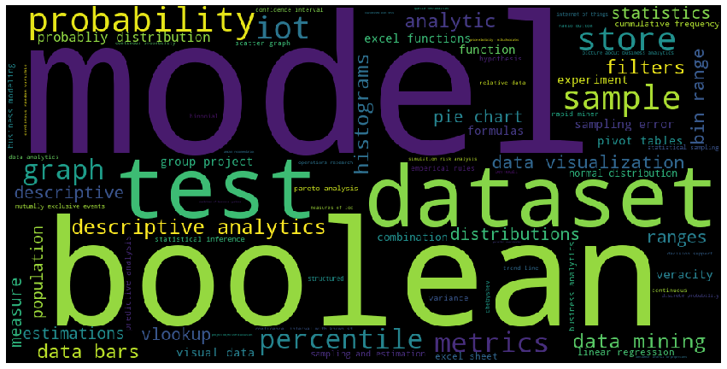
Word cloud
Lev clustering

Slide 18
Remarks
Students’ response shows they mutually agree on topics shared on each lecture
Small % difference on counts vs. unique
By referencing high and low granularity:
Excel, Statistics & Probability, Tableau -> most frequent keywords with high weights
Students care about homework! :)
Understand BIA600C’s topic flow
Analytic concepts -> excel -> visualization -> statistics
Topic related to ‘Data’ is constantly appearing occasionally
From October, Statistics has been the most weighted topic

Slide 19
Thanks!

