Slide 1
03_10_PowerPoint
File created on: 24/8/2022 AD 22:39:24 GMT+7

Slide 2
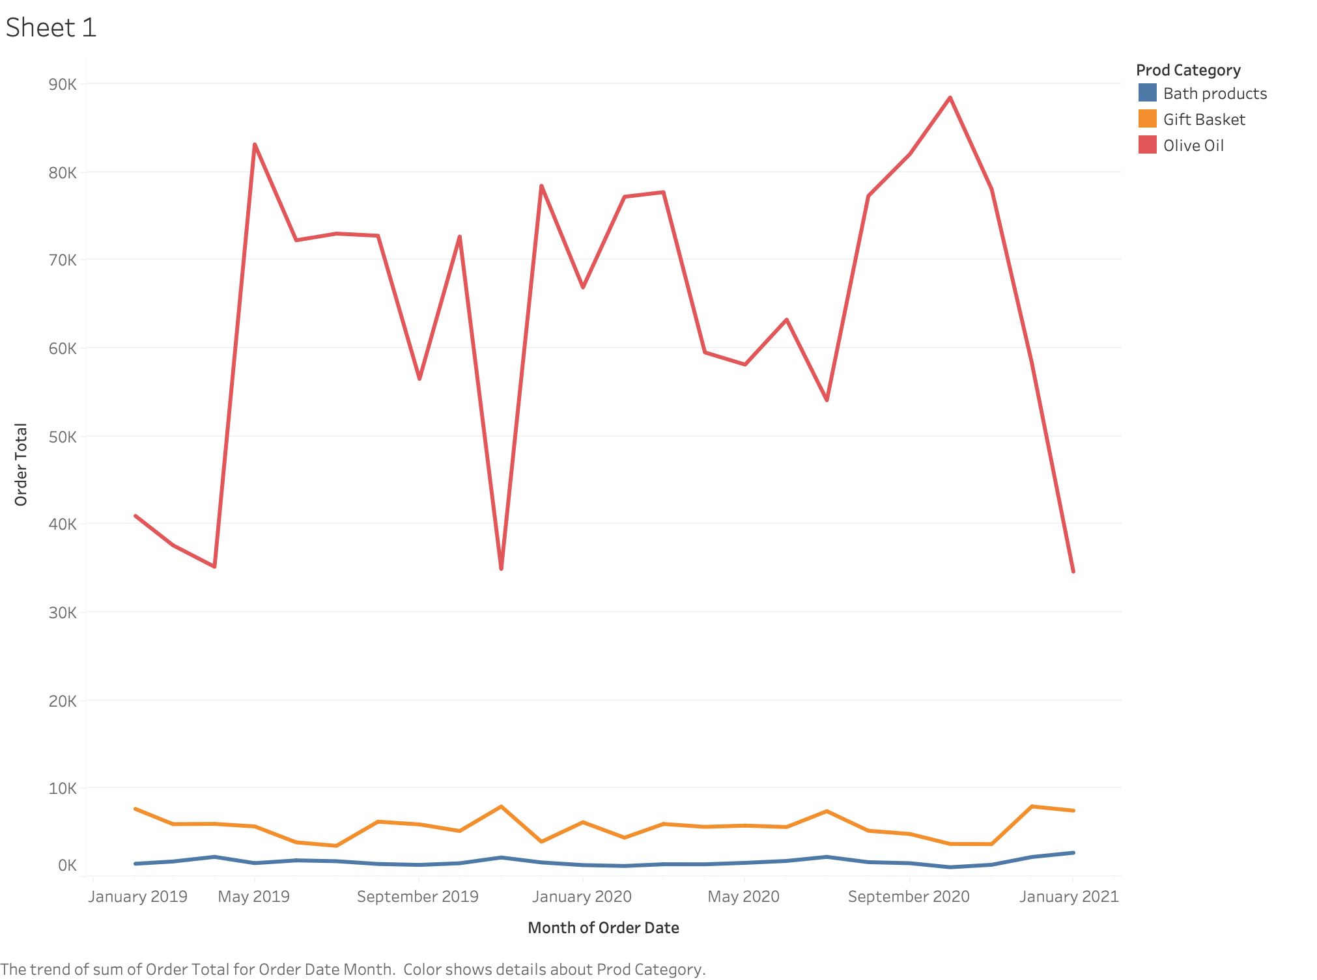

Slide 3
