Slide 2
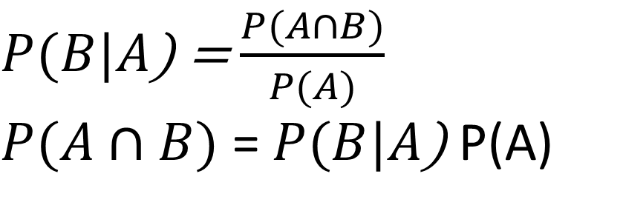
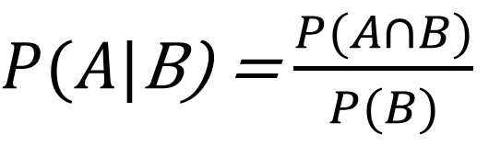

$P(A|$B) = $\frac{P(A∩B)}{P(B)}$
$P(B|A$) = $\frac{P(A∩B)}{P(A)}$
$P(A∩B)$ = $P(B|A$) P(A)
$P(A|$B) $=\frac{P(B|A)P(A)}{P(B)}$

Slide 3



$P(c|\overset{⃑}{x}$) $=\frac{P(\overset{⃑}{x}|c)P(c)}{P(\overset{⃑}{x})}$
$P(垃圾訊息|優惠=1$,特價=1)$=\frac{P(優惠=1,特價=1|垃圾訊息)P(垃圾訊息)}{P(優惠=1,特價=1)}$
$P(c|\overset{⃑}{x}$) $=\frac{P(\overset{⃑}{x}|C_{s})P(c)}{P\left(C_{s}\right)P(\overset{⃑}{x}|C_{s})+P\left(C_{h}\right)P(\overset{⃑}{x}|C_{h})}$
$P(垃圾訊息|優惠=1$,特價=1)$=\frac{P(優惠=1,特價=1|垃圾訊息)P(垃圾訊息)}{P(優惠=1,特價=1|垃圾訊息)+P(優惠=1,特價=1|非垃圾訊息)}$
$P\left(優惠=1 | 垃圾訊息\right)∗P\left(特價=1 | 垃圾訊息\right)+P\left(優惠=1 | 非垃圾訊息\right)∗P(特價=1|非垃圾訊息$)

Slide 4
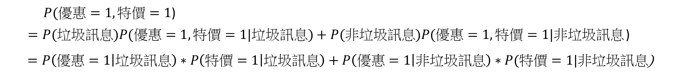
$P(優惠=1,特價=1$)
$=P(垃圾訊息)P(優惠=1,特價=1|垃圾訊息)+P(非垃圾訊息)P(優惠=1,特價=1|非垃圾訊息$)
$=P\left(優惠=1 | 垃圾訊息\right)∗P\left(特價=1 | 垃圾訊息\right)+P\left(優惠=1 | 非垃圾訊息\right)∗P(特價=1|非垃圾訊息$)

Slide 5

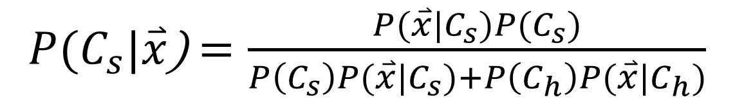

$P(c|\overset{⃑}{x}$) $=\frac{P(\overset{⃑}{x}|c)P(c)}{P(\overset{⃑}{x})}$
$P(C_{s}|\overset{⃑}{x}$) $=\frac{P(\overset{⃑}{x}|C_{s})P(C_{s})}{P\left(C_{s}\right)P(\overset{⃑}{x}|C_{s})+P\left(C_{h}\right)P(\overset{⃑}{x}|C_{h})}$

Slide 6
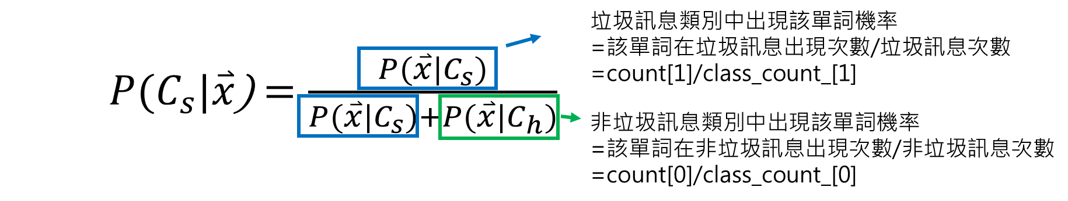
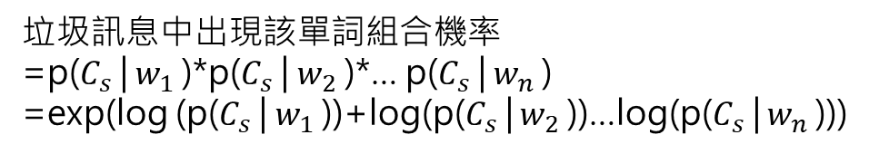

垃圾訊息中出現該單詞組合機率
=p($C_{s}$| $w_{1}$)*p($C_{s}$| $w_{2}$)*… p($C_{s}$| $w_{n}$)
=exp(log (p($C_{s}$| $w_{1}$))+log(p($C_{s}$| $w_{2}$))…log(p($C_{s}$| $w_{n}$)))
$P(C_{s}|\overset{⃑}{x}$) $=\frac{P(\overset{⃑}{x}|C_{s})}{P(\overset{⃑}{x}|C_{s})+P(\overset{⃑}{x}|C_{h})}$

Slide 7
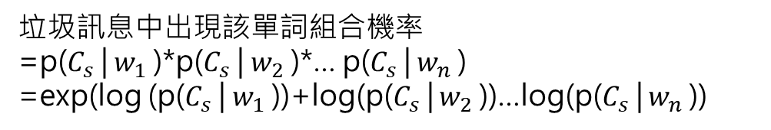
垃圾訊息中出現該單詞組合機率
=p($C_{s}$| $w_{1}$)*p($C_{s}$| $w_{2}$)*… p($C_{s}$| $w_{n}$)
=exp(log (p($C_{s}$| $w_{1}$))+log(p($C_{s}$| $w_{2}$))…log(p($C_{s}$| $w_{n}$))

Slide 8
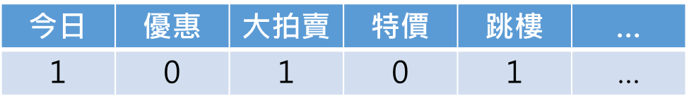
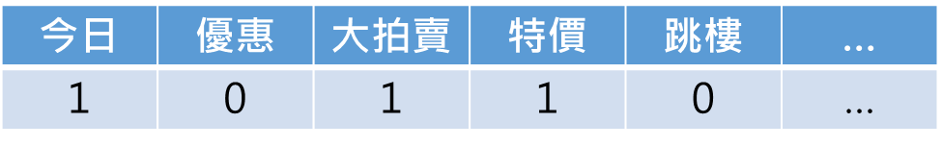
今日 | 優惠 | 大拍賣 | 特價 | 跳樓 | …
1 | 0 | 1 | 0 | 1 | …

Slide 9
Confusion matrix
實際
 | 非垃圾訊息 | 垃圾訊息
非垃圾訊息 | 957 | 15
垃圾訊息 | 2 | 141
預測
Precision (957+141)/(957+15+2+141) = 98.48%
Recall 141/(15+141)= 90.38%

Slide 10
垃圾郵件機率 | 訊息
1 | Update_Now - Xmas Offer! Latest Motorola, SonyEricsson & Nokia & FREE Bluetooth! Double Mins & 1000 Txt on Orange.
1 | You are awarded a SiPix Digital Camera! call 09061221061 from landline. Delivery within 28days. T Cs Box177. M221BP. 2yr warranty. 150ppm. 16 . p p£3.99
1 | Urgent -call 09066649731from Landline. Your complimentary 4* Ibiza Holiday or £10,000 cash await collection SAE T&Cs PO BOX 434 SK3 8WP 150ppm 18+
1 | Get the official ENGLAND poly ringtone or colour flag on yer mobile for tonights game! Text TONE or FLAG to 84199. Optout txt ENG STOP Box39822 W111WX £1.50
1 | We tried to contact you re our offer of New Video Phone 750 anytime any network mins HALF PRICE Rental camcorder call 08000930705 or reply for delivery Wed

Slide 11
