Slide 1


Sahabat Finansial Keluarga Anda
Dipersembahkan oleh generICT

Slide 2
generICT
Sprint 1:
Endah
Hani
Iqbal
Umy

Slide 3
USER STORIES

Slide 4
General User
Mendaftar
Melihat General Home Page
Pencarian product
Rincian Product
Harga barang
Sisa kredit
Perbandingan
Harga
Kondisi barang

Slide 5

Registered User
Mengoper Kredit
Mengambil Kredit
Verifikasi Akun
Profile
Edit profile
Seleksi barang
Input barang
Edit Barang
Status transaksi
Login
Metode pembayaran
Jadwal
Logout

Slide 6
Tim Pengesahan
Transaksi
Penjadwalan
Pengesahan

Slide 7
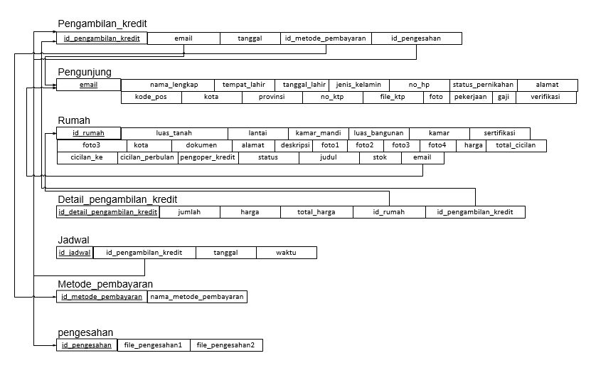
Relationship Diagram

Slide 8
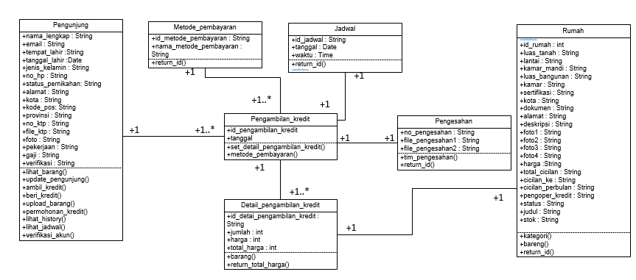
Class Diagram

Slide 9
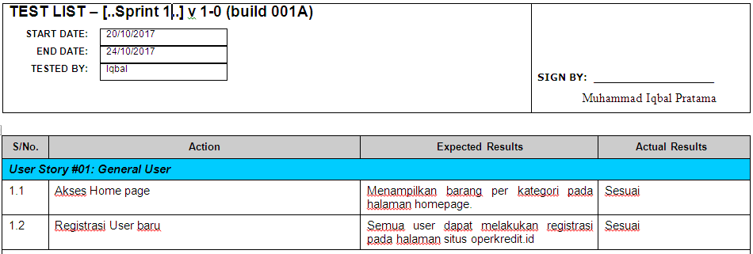
User Acceptance Testing

Slide 10
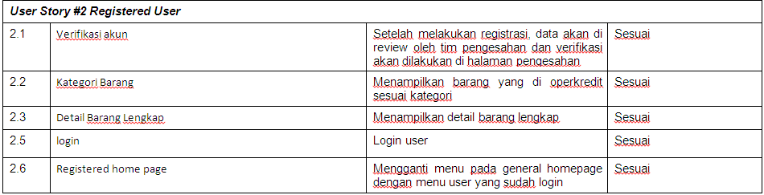
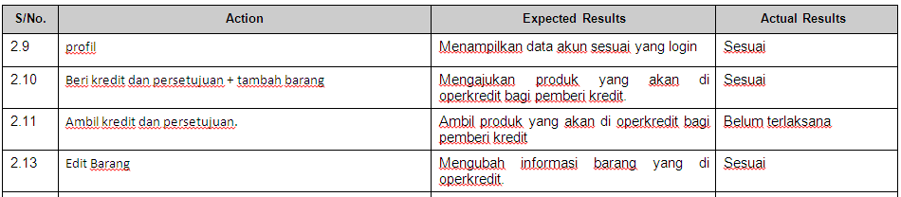
User Acceptance Testing (continue)

Slide 11
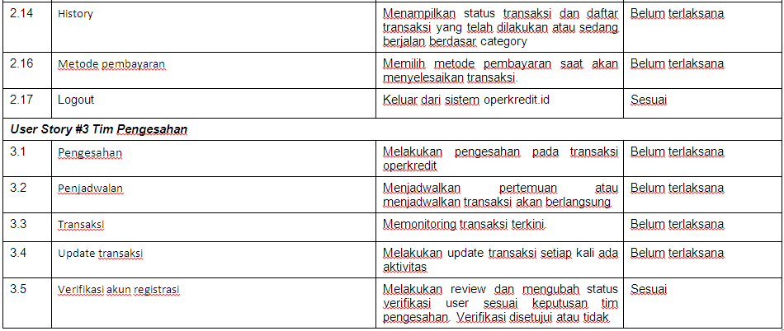
User Acceptance Testing (continue)

Slide 12
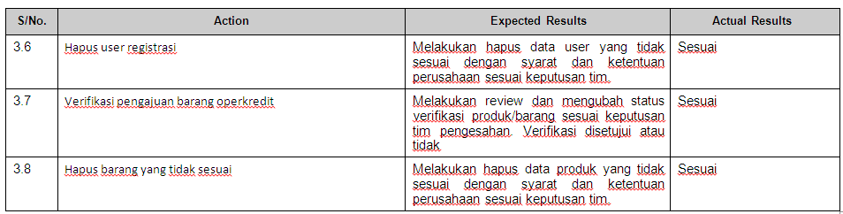
User Acceptance Testing (continue)

Slide 13
Referensi
https://github.com/blinkbink/operkredit
https://www.lucidchart.com/pages/uml/class-diagram
http://elearning2.uai.ac.id/

