Slide 1
Multi-Cloud MERN Platform
One shop, three clouds: Terraform, keyless CI/CD, automatic failover and disaster recovery across GCP, Azure and AWS
Rishav Mukhopadhyay
HeroVired DevOps Capstone · Problem Statement #5 — Multi-Cloud Deployment and Management with Terraform
github.com/ppmcad16a-cloud-platform
Notes:
≈ 20 s. Introduce yourself and the project in one sentence: a real microservice shop that runs in three clouds, built entirely as code, which keeps serving customers when a whole cloud fails.

Slide 2
PROBLEM STATEMENT #5
The problem and what had to be proven
1 Deploy to AWS, Azure and GCP with Terraform
“
Managing resources across AWS, Azure and GCP is complex and error-prone, especially when trying to keep configurations consistent and fail over across clouds.
2 Automate infrastructure + configuration with reusable modules
3 Load balancing and automatic failover between clouds
Scoring
Implementation 75 % · Documentation 15 % · Cost optimisation 10 %
4 Disaster recovery — data in every cloud, tested restores
5 Monitoring, alerts and cost visibility
Multi-Cloud MERN Platform · HeroVired Capstone #5
2
Notes:
≈ 45 s. The task: one Terraform-based system that runs an application in all three big clouds, keeps them consistent, fails over automatically, recovers data and shows health and cost. These five goals are the structure of the rest of the talk — each one has a slide with evidence.

Slide 3
ARCHITECTURE
One shop, three clouds, one front door
Shoppers
▪ Primary: GKE (Mumbai) serves every shopper
▪ Standbys: complete copies that sleep — like a stopped EC2 instance — and wake in minutes
▪ Front door: first healthy cloud in the order gcp → azure → aws
▪ 6 services, 3 languages: React · Node.js · Java 21 · Python
▪ Same everything: one Helm chart, one image, one monitoring module in all clouds
Cloudflare DNS · TLS Full (strict) · Load Balancer · health check /api/health every 60 s
▼ serving
▼ if GCP fails
▼ if GCP + Azure fail
GCP · GKE
PRIMARY · always on
Azure · AKS
STANDBY · stopped
AWS · EKS
STANDBY · 0 nodes
· Envoy Gateway → 6 services
· Jenkins (CD) · central Grafana
· Prometheus · Loki · OpenCost
· Secret Manager · Artifact Registry
· Envoy Gateway → 6 services
· Prometheus · Loki · OpenCost
· Key Vault · ACR
· NLB → Envoy Gateway → 6 services
· Prometheus · Loki · OpenCost
· SSM Parameter Store · ECR
MongoDB Atlas own user + fixed IP per cloud
Encrypted backups GCS · Azure Blob · S3
Clouds never talk to each other — no VPN. Each has its own vault, registry and backups.
Multi-Cloud MERN Platform · HeroVired Capstone #5
3
Notes:
≈ 60 s. Walk the picture top-down: shoppers hit Cloudflare, which sends them to the first healthy cloud. GCP is the primary and also hosts Jenkins and the central Grafana. Azure and AWS are complete copies that sleep — like a stopped EC2 instance — so they cost almost nothing but are ready. Every cloud uses its own vault, registry and backup bucket; only the database is shared.

Slide 4
WHAT IT IS BUILT WITH
Technology stack
Application
Infrastructure as code
React · Node.js gateway, catalog, notification · Java 21 Spring Boot identity · Python Flask commerce
Terraform 1.16 — 13 stacks: bootstrap, foundation, cluster, add-ons per cloud + global
Kubernetes
Global traffic
GKE · AKS · EKS, one Helm chart for all services, Envoy Gateway (Gateway API)
Cloudflare DNS, TLS Full (strict), Load Balancer, Zero Trust Access, Worker
Secrets
CI / CD
Secret Manager · Key Vault · SSM Parameter Store via External Secrets + workload identity
GitHub Actions reusable workflows, Trivy, gitleaks, OIDC → Jenkins in GKE
Observability
Automation & DR
Prometheus, Alertmanager, Loki, Alloy, OpenCost, central Grafana, Slack
Ansible session playbooks · mongodump + age → GCS, S3, Azure Blob
Multi-Cloud MERN Platform · HeroVired Capstone #5
4
Notes:
≈ 45 s. Don't read the slide. Point out: three languages on purpose (a polyglot platform), Terraform for absolutely everything including DNS and database users, and that the same tools run identically in every cloud.

Slide 5
INFRASTRUCTURE AS CODE + AUTOMATION
Everything is code — and a session is one command
bootstrap
state bucket · GitHub OIDC trust · budget
once
1 preflight tools · logins · IP
2 GKE · AKS · EKS in parallel
foundation
registry · vault · backup bucket · identities · GKE egress IP
permanent
3 global DNS · LB · Atlas
cluster
network · NAT · Kubernetes · node pool
per session
4 per cloud add-ons → shop → health
1 command
13 stacks
add-ons
Envoy · External Secrets · monitoring · Jenkins
per session
ansible-playbook up.yml / down.yml
each with its own versioned remote state
global
Cloudflare DNS/LB/Access · Atlas users · shared secrets
per session
▪ Guarded: session start may only create/update, teardown only delete
▪ Safe teardown: stops if a load balancer or disk would be orphaned
Multi-Cloud MERN Platform · HeroVired Capstone #5
5
Notes:
≈ 60 s. Four layers per cloud with different lifetimes. The expensive parts — clusters, add-ons, global routing — exist only during a working session. up.yml creates all three clusters in parallel; down.yml removes them. Every Terraform apply goes through a guard: plan, check the type of every change, apply exactly that plan — a surprise delete or replace stops the run.

Slide 6
SECURITY & LEAST PRIVILEGE
Keyless by design — no stored cloud credentials
Who | Proves identity with | May only…
GitHub Actions | OIDC, main branch + repo id | push to its own image repo
Failover workflow | OIDC | start AKS / resize node group — nothing else
Jenkins (GKE) | k8s token federated to Azure, AWS | deploy in namespace mern
Backup job | workload identity | write-only to backup buckets
Restore drill | workload identity | read-only; scratch DB only
External Secrets | workload identity | read its own cloud's vault
Secrets
live only in each cloud's vault; synced by External Secrets; never in git
Network doors
origins accept only Cloudflare IPs · cluster APIs only admin + GKE IP · DB only cluster IPs
Supply chain
actions pinned to SHAs · Trivy + gitleaks gates · immutable tags · same digest everywhere
Found in testing: a manual 0.0.0.0/0 entry on the Atlas allow-list from early development — removed; now only Terraform-managed cluster IPs.
Multi-Cloud MERN Platform · HeroVired Capstone #5
6
Notes:
≈ 60 s. The key message: there is not a single long-lived cloud key in this project. Every robot proves who it is with a short-lived token and can do exactly one job — the backup identity can write a backup but cannot even read one. Mention the honest finding: the final test uncovered an old 0.0.0.0/0 entry on the database allow-list, which was removed.

Slide 7
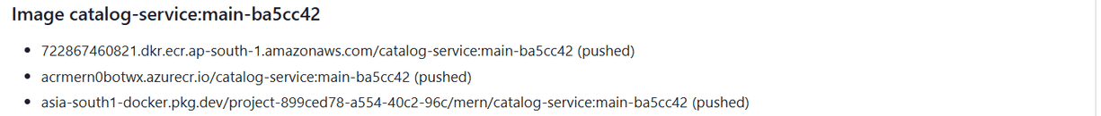
CI/CD
One merge → three clouds, with gates and rollback
PR
merge
push
Jenkins
Slack
tests · coverage · gitleaks · Trivy
keyless login to 3 clouds
same digest → ECR · ACR · GAR
GCP → Azure → AWS, smoke test each
live in gcp, azure, aws
Evidence from the final test — GitHub run summary and Slack
4 min 57 s
Jenkins: live in all three clouds
0 failed
requests during a deploy (zero-downtime probe, 29 Oct)
Multi-Cloud MERN Platform · HeroVired Capstone #5
7
Notes:
≈ 75 s. Follow one change: a pull request runs tests and two security scanners; merging builds ONE image and pushes the same digest to all three registries without any stored key; Jenkins then rolls it out one cloud at a time with a smoke test after each. A failure rolls that cloud back and stops, so the others keep the old version. Rolling updates with readiness probes mean no request fails during a deploy. If a registry is down, CI still pushes to the others and waits with the deploy.

Slide 8
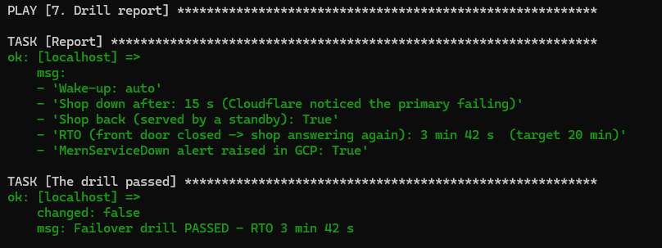
HIGH AVAILABILITY & FAILOVER
GCP goes down → standbys wake themselves
0:00
GCP front door closed
(both standbys asleep)
3:42
shop answers again,
served by the AWS standby
shop unavailable
0:15
Cloudflare marks GCP unhealthy
→ Worker → GitHub Actions
> 6:00
Azure still starting
(AKS start is slower)
3 min 42 s
Keyless wake-up: roles may only start AKS / resize the EKS node group.
Design rule: the rescue does not run in the cloud that fails.
recovery time, automatic (target 20 min)
Multi-Cloud MERN Platform · HeroVired Capstone #5
8
Notes:
≈ 75 s. The drill closed GCP's front door while both standbys were asleep. Cloudflare noticed within 15 seconds and told a Cloudflare Worker, which started a GitHub workflow; that workflow woke Azure and AWS using identities that can only start them. AWS answered first, and the shop was back after 3 minutes 42 seconds — with nobody touching anything. The design rule: the thing that rescues GCP does not run in GCP.

Slide 9
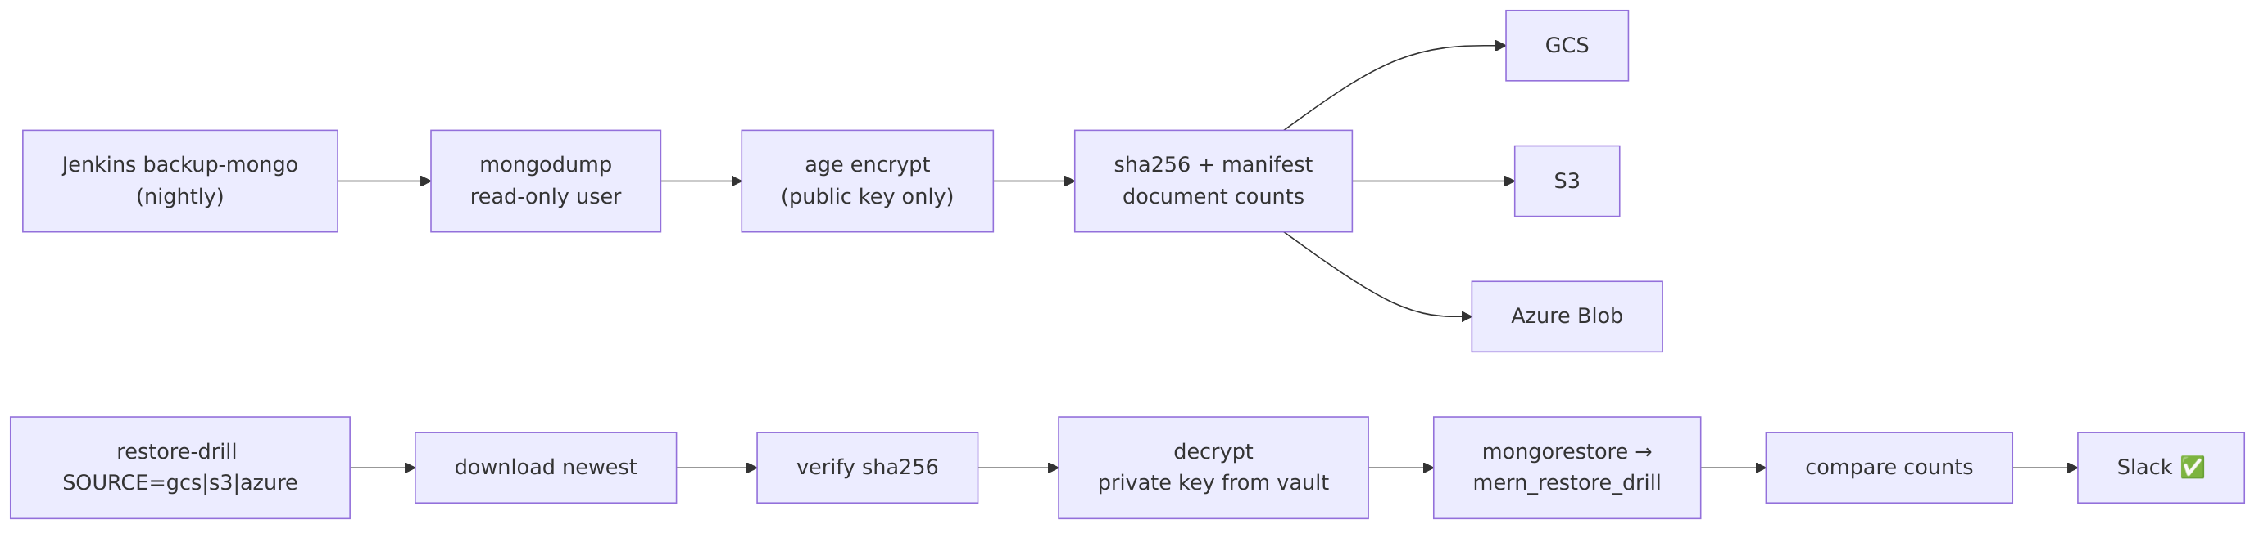
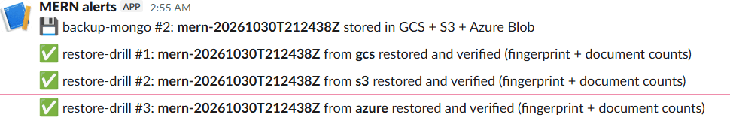
BACKUPS & RESTORE DRILLS
Disaster recovery that is proven, not assumed
3 / 3
copies restored and verified (GCS, S3, Azure)
0 read
rights for the backup identity — write-only
≤ 24 h
RPO with nightly backups
Multi-Cloud MERN Platform · HeroVired Capstone #5
9
Notes:
≈ 50 s. Every night the database is dumped with a read-only user, encrypted with a public key — so the backup job can never decrypt anything — fingerprinted, and stored in all three clouds. The restore drill downloads the newest copy from each cloud, checks the fingerprint, decrypts it with the private key from the vault and restores into a scratch database, comparing every collection's document count. All three passed.

Slide 10
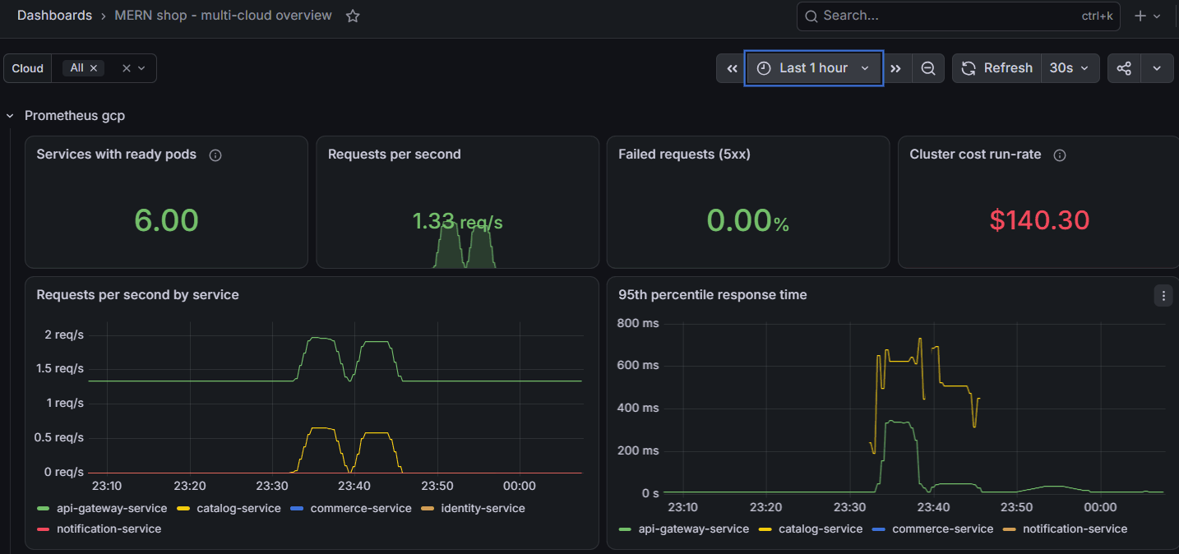
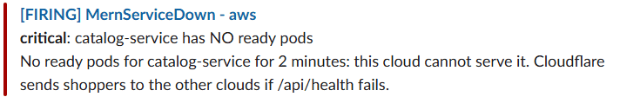
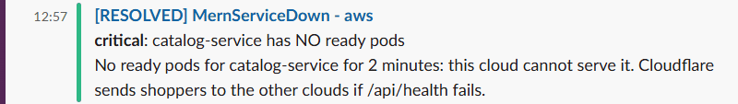
MONITORING & ALERTING
One pane of glass for three clouds
Alert test: catalog-service removed in AWS
▪ Per cloud: Prometheus, Loki, OpenCost from one versioned module (v1.1.0) ·
▪ Central Grafana: 3 × Prometheus + 3 × Loki through Cloudflare Access ·
▪ Alerts: MernServiceDown, error rate, latency, restarts + Cloudflare pool health → Slack
Multi-Cloud MERN Platform · HeroVired Capstone #5
10
Notes:
≈ 50 s. Each cluster runs its own Prometheus, Loki and OpenCost, installed from the same tagged module so the rules are identical. The central Grafana shows all three clouds side by side. In the test we removed one service in AWS: within three minutes Slack had the MernServiceDown alert and the Cloudflare pool alert — and the RESOLVED message after we restored it. Alerts come from each cloud directly, so they still work if GCP is down.

Slide 11
COST OPTIMISATION
≈ US $17 for a month of running three clouds
US $ per month
AWS
$6.76
Azure
₹349.61 ≈ $4.2
GCP
₹474.75 (credits)
Atlas M0
$0
▪ Clusters only during sessions
▪ Standbys asleep: −60 % node cost
▪ Budgets + alerts in every cloud
▪ Teardown refuses to orphan LBs/disks
24/7 bars: node run-rates from OpenCost (GCP $140, AWS $131, Azure $81). “Sessions only” = the real October bill for all three clouds.
Multi-Cloud MERN Platform · HeroVired Capstone #5
11
Notes:
≈ 60 s. Cost is 10 % of the marks, so be concrete. Running all three clouds around the clock would cost about 350 dollars a month in nodes alone. The stopped-standby model cuts that by 60 %. And because we only run clusters during working sessions, the real bill for a whole month of building and testing was about 17 dollars. Budgets with e-mail alerts sit on every account, and the teardown refuses to finish while a load balancer or disk would be left behind — the classic silent cost.

Slide 12
RESULTS
Final end-to-end test — everything at once
What the test taught us
Session start (3 clusters in parallel)
Shop in 3 clouds, shared data
▪ Expired SSO login and a changing home IP → documented recovery steps
▪ One GitHub CDN address unreachable from the ISP → measure, don't guess
▪ Disruption budgets stall a scale-to-zero → drain with eviction disabled
▪ An AWS load balancer outlived its controller → teardown safety stop caught it
▪ Old 0.0.0.0/0 on the database allow-list → removed
✔ failed=0 · 23 min
✔ 6/6 ready ×3
CI → CD, one merge
Alert → Slack → resolved
✔ live ×3 · 4:57
✔ ≈ 3 min
Backup + restore from 3 clouds
Automatic failover
✔ 3/3 passed
✔ RTO 3:42
Multi-Cloud MERN Platform · HeroVired Capstone #5
12
Notes:
≈ 60 s. In one final session we ran every scenario end to end; all six passed. Be honest about what went wrong — the panel values it: an expired AWS login, the home IP changing between Wi-Fi and hotspot, an unreachable GitHub download server, a slow AWS scale-to-zero and a load balancer that survived its controller. Each one was caught by a safety check, and each one is now in the runbook.

Slide 13
HONEST SCOPE
Limitations and possible improvements
Known limitations
Possible improvements
▪ One shared Atlas M0 database — protected by 3-cloud backups, not live replication
▪ Terraform applied through guarded Ansible, not a GitHub Actions pipeline
▪ Jenkins + central Grafana live in the primary (break-glass deploy covers outages)
▪ Waking a standby takes minutes — a deliberate cost trade-off
▪ Chat (Socket.IO) keeps state in memory → 1 replica
▪ Fix standby sleep (drain + wait) and AWS load-balancer teardown order
▪ Terraform plan/apply in GitHub Actions (identities already exist)
▪ Multi-region Atlas for live cross-cloud data
▪ Move CD and central Grafana out of the primary cloud
▪ GitHub App instead of a personal token · Redis for Socket.IO · WAF rules
Multi-Cloud MERN Platform · HeroVired Capstone #5
13
Notes:
≈ 40 s. Name the limitations before the panel does. The biggest is the shared database: data is safe in three clouds, but not replicated live. Then show that each limitation has a concrete improvement.

Slide 14
Thank you — questions?
Live demo on request: shop in three clouds · a merge that deploys itself · failover drill
Code & handbook: github.com/ppmcad16a-cloud-platform (core-cloud-platform → docs)
Shop (during sessions): https://rishavmukhopadhyay.store
Notes:
≈ 15 s. Offer the live demo if a session is running (start up.yml 40 minutes before). Good backup answers: why multi-cloud (no single provider outage stops the shop), why stopped standbys (cost vs. a few minutes of RTO), why a shared database (consistency, free tier; mitigated by backups).

