Slide 1
Hypothesis
Is there any correlation between our country growth and the Mexican searches?
Question
There is no correlation
Null Hypothesis

Slide 2

Methodology
Adolescent fertility rate (births per 1,000 women ages 15-19)
Agriculture, forestry, and fishing, value added (% of GDP)
CO2 emissions (metric tons per capita)
Domestic credit provided by financial sector (% of GDP)
Electric power consumption (kWh per capita)
GNI, PPP (current international $)
Gross capital formation (% of GDP)
High-technology exports (% of manufactured exports)
Income share held by lowest 20%
Industry (including construction), value added (% of GDP)
Inflation, GDP deflator (annual %)
Primary completion rate, total (% of relevant age group)
Tax revenue (% of GDP)
Total debt service (% of exports of goods, services and primary income)

Slide 3


Methodology
Real states
Art
Shoppings
Food
Finances
Health
People
Home
Informatics
Cars
Beauty
Internet
Games
Travels
Books
Reference
Law
Pets
Communities
Science
Business
News Hobbies
Sports
Jobs

Slide 4
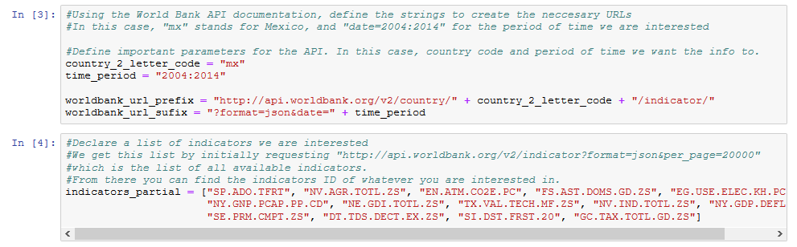
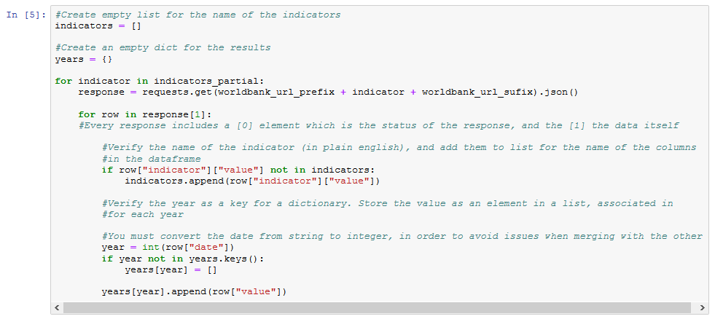
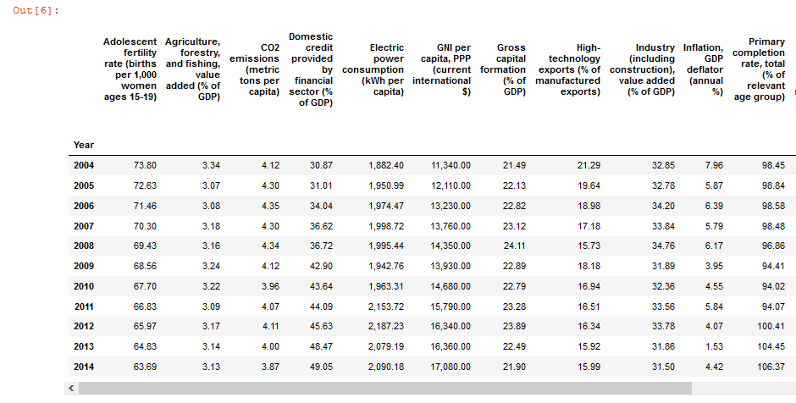
Methodology
API

Slide 5

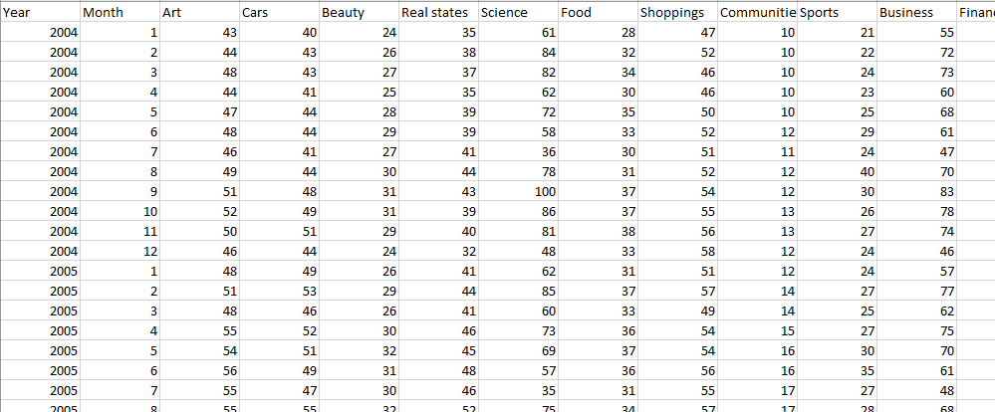
Methodology
CSV

Slide 6
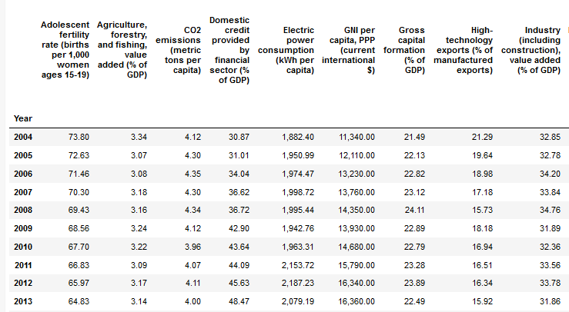
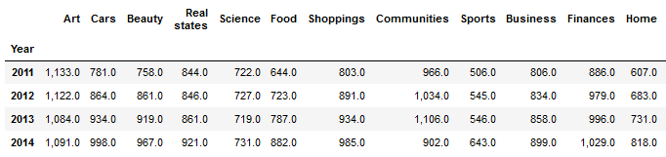
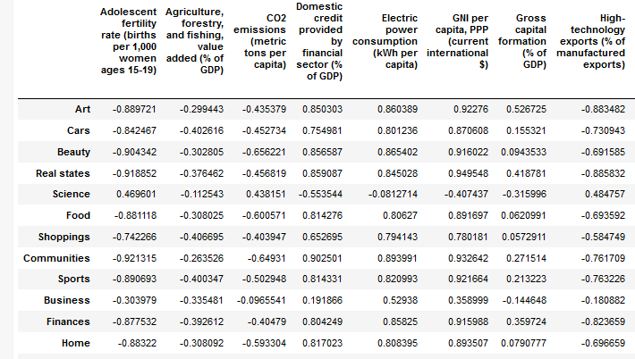
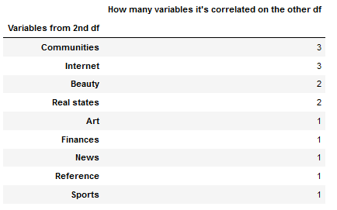
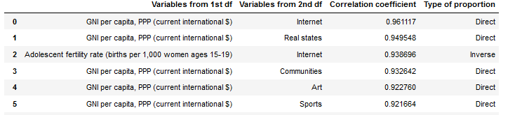
Methodology
Cleaning

Slide 7
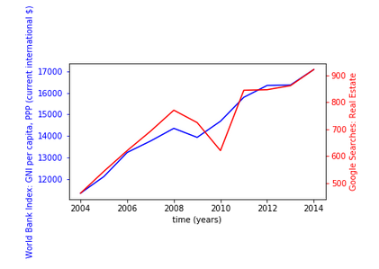
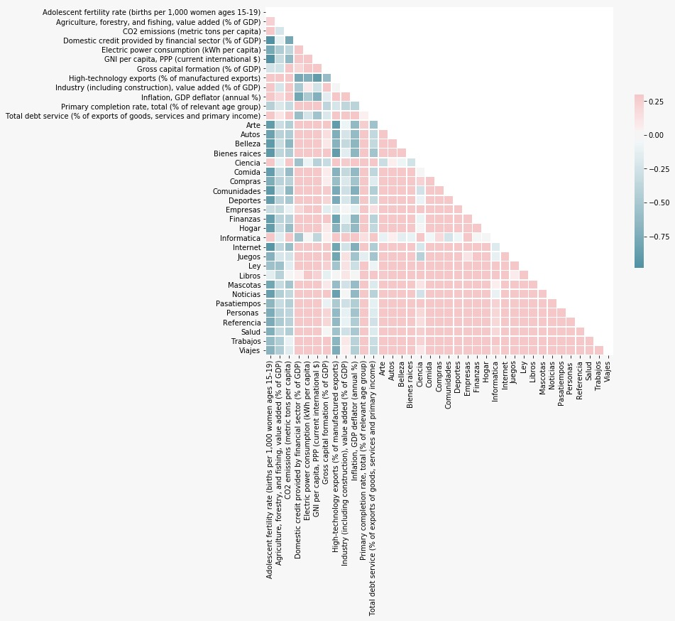
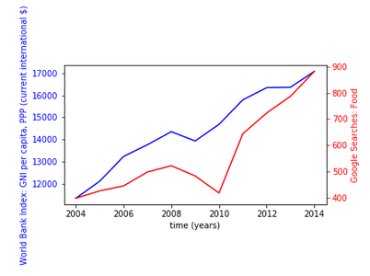
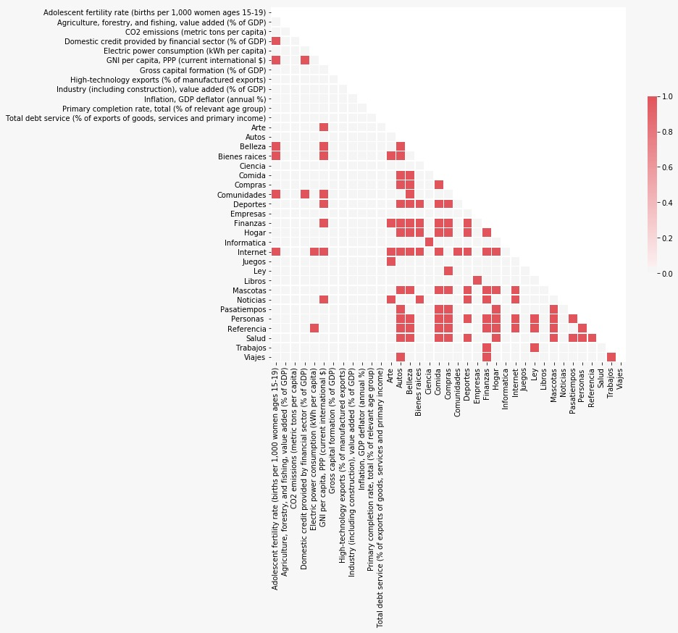
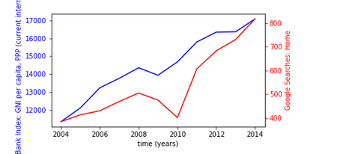
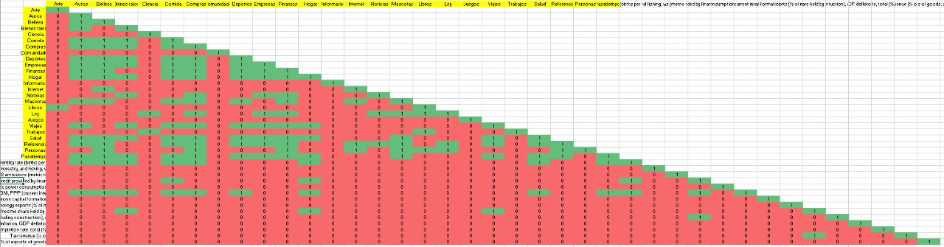
Methodology
Ploting

