Slide 1

ENHANCING INVENTORY CONTROL TO PREVENT
EXPIRED GOODS USING SIX SIGMA
Prajakta Pohare
Harish Darne
Sachin Chaudhary
Faith Mutinda
Sindu Kandula
Dr. Jaby Mohammed
Illinois State University

Slide 2

INTRODUCTION
For many people, school pantries are vital resources, but the presence of expired goods seriously compromises their efficacy and safety.
The total effect of this difficulty on the health and well-being of those who depend on these resources is a cause for concern.

Slide 3
PROBLEM STATEMENT
The presence of expired goods in school pantries compromises efficacy and safety, posing risks to the health and well-being of recipients.

Slide 4
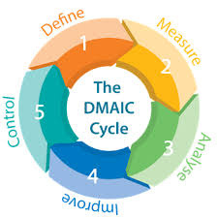
DISCUSSION
Six Sigma will be used to improve the process and reduce expired products. Quality strategy DMAIC uses data to improve processes. A key component of Six Sigma, which reduces business process variability and defects to boost performance.

Slide 5
DEFINE
PROJECT DEFINATION & CURRENT STATE ASSESSMENT AND GOALS
Scope: Focus on improving inventory management and volunteer training.
Key Stakeholders: Pantry managers, volunteers, recipients, and local community.

Slide 6
Current Challenges: Lack of systematic tracking, inefficient stock rotation, risk of expired food distribution.
Goals:
Implement a digital inventory management system.
Achieve 90% usage of perishables before half their shelf life.
Reduce expired stock by 50% within a year.
KPIs: Reduction in expired items, improved customer satisfaction scores, enhanced operational efficiency.

Slide 7
SIPOC FRAMEWORK FOR SCHOOL STREET FOOD PANTRY
Suppliers: Food banks, supermarkets (Midwestern, Sam's Club), local donors.
Inputs: Donated food items, funds, volunteer efforts, inventory management tools.
Process : Donation receiving, evaluation, storage & sorting, distribution.
Outputs: Safe food distribution, reduced waste, satisfied customer.
Customers: Students, volunteers, pantry managers, community.

Slide 8
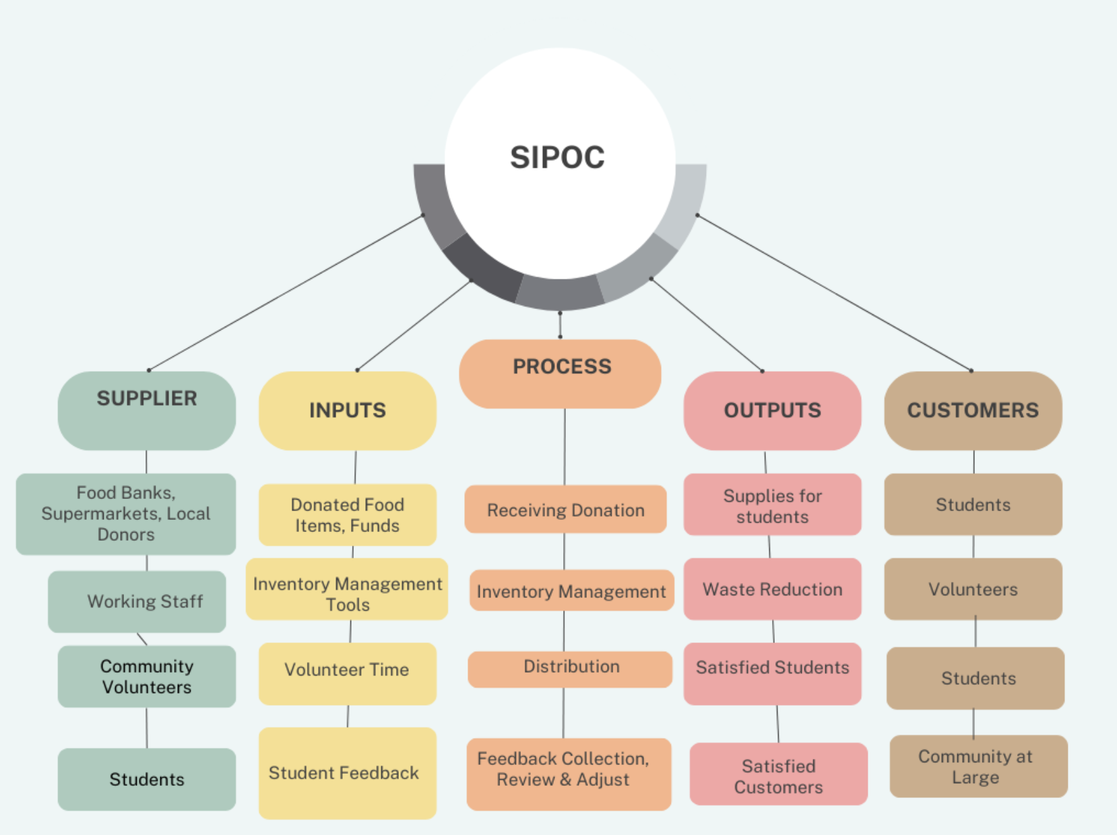

Slide 9
UNDERSTANDING STAKEHOLDER NEEDS - VOC ANALYSIS & PROCESS IMPROVEMENTS AND KEY INSIGHTS
Pantry Managers: Concerns about inventory management and minimizing waste.
Volunteers: Need for better training and clearer procedures on expiration monitoring.
Recipients: Emphasis on food safety, quality, and transparency in handling.

Slide 10
Key Requirements: Reliability, transparency, and efficiency in food distribution.
High-Level Process Steps: Donation assessment, logging, sorting, inventory checks, distribution preparation, handout, feedback loop.
Efficiency Opportunities: Automate inventory and distribution processes.
Waste Reduction: Stricter stock rotation and plans for near-expiry products.
Stakeholder Engagement: Enhance communication with all parties for improved operation and satisfaction.

Slide 11
MEASURE
Objective: To quantify the performance of the current process and gather pertinent data to set a baseline for addressing the problem of old food in School Street Food Pantry.
Key Components:
Data Collection Methods:
Inventory Records
Physical Inventory Counts
Information from Suppliers
Pantry Operations Logs
Recipient Feedback
Key Metrics (KPIs):
Expired Items Percentage
Metrics for Reducing Waste
Distribution Efficiency
Data Analysis Approaches:
Quantitative Analysis
Root Cause Analysis
Discrepancy Identification
Recipient Feedback Analysis

Slide 12
DATA COLLECTION METHODS
Inventory Records: Reviewing historical inventory records to identify expired goods and quantify their frequency.
Physical Inventory Counts: Conducting manual counts of old food in the pantry to validate inventory records and assess accuracy.
Information from Suppliers: Gathering data from suppliers regarding delivery schedules and expiration dates of donated items.
Pantry Operations Logs: Analyzing records and logs related to inventory management, product distribution, and handling processes to identify trends and challenges.
Recipient Feedback: Soliciting input from pantry users to assess food quality, freshness, and instances of receiving expired items.

Slide 13
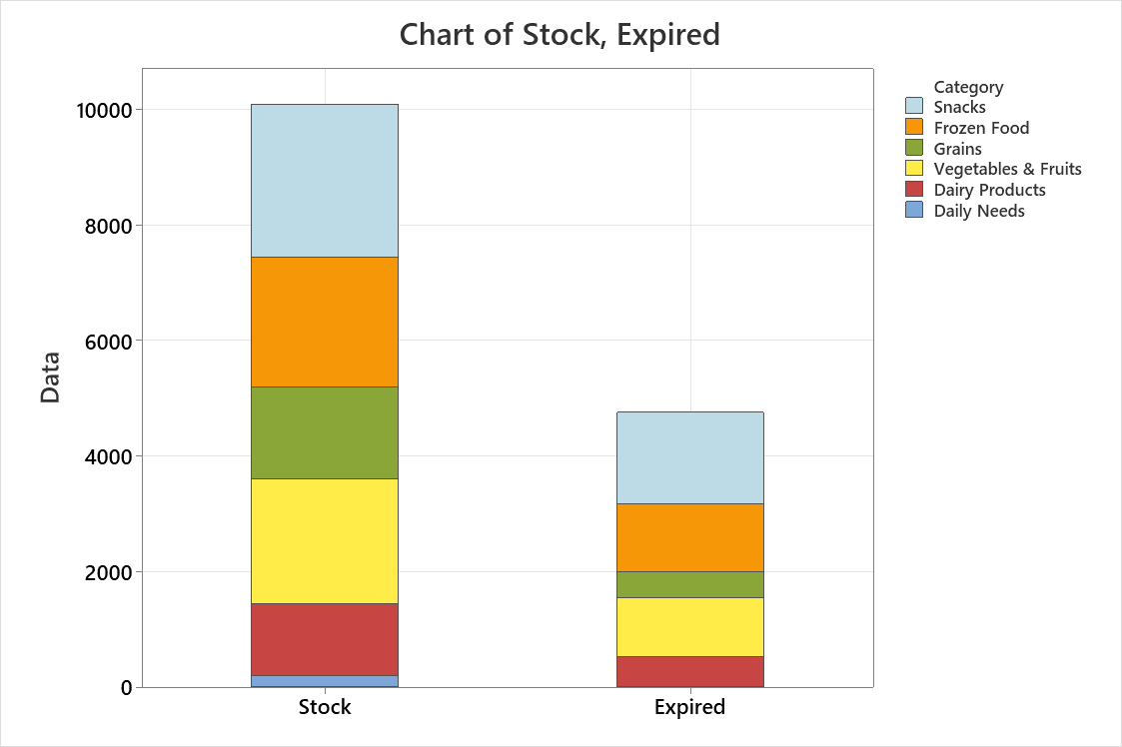

Slide 14
ANALYZE
The Analyze stage of Six Sigma DMAIC is crucial to identify the causes of high product expiration rates in pantries.
This requires methodically reviewing and analytical tools.
Frozen foods and snacks expire faster.
About 52% of frozen food and 60% of snacks expire each month.
This phase of our study analyzes and reviews Measure stage data to determine the causes of these higher expiry rates.

Slide 15
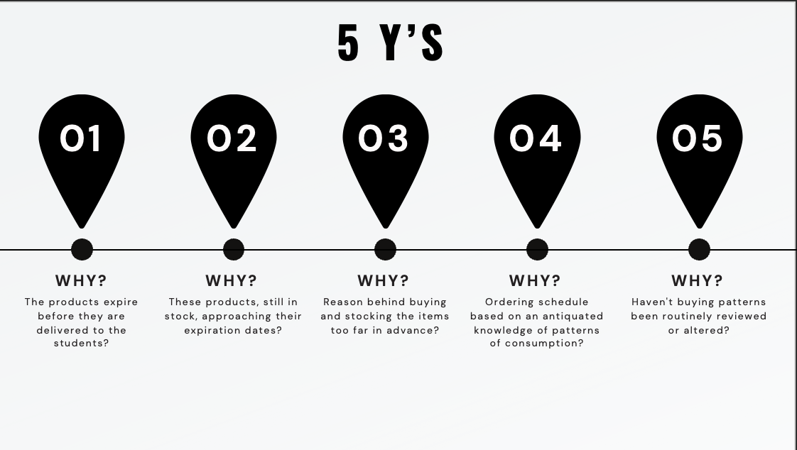

Slide 16
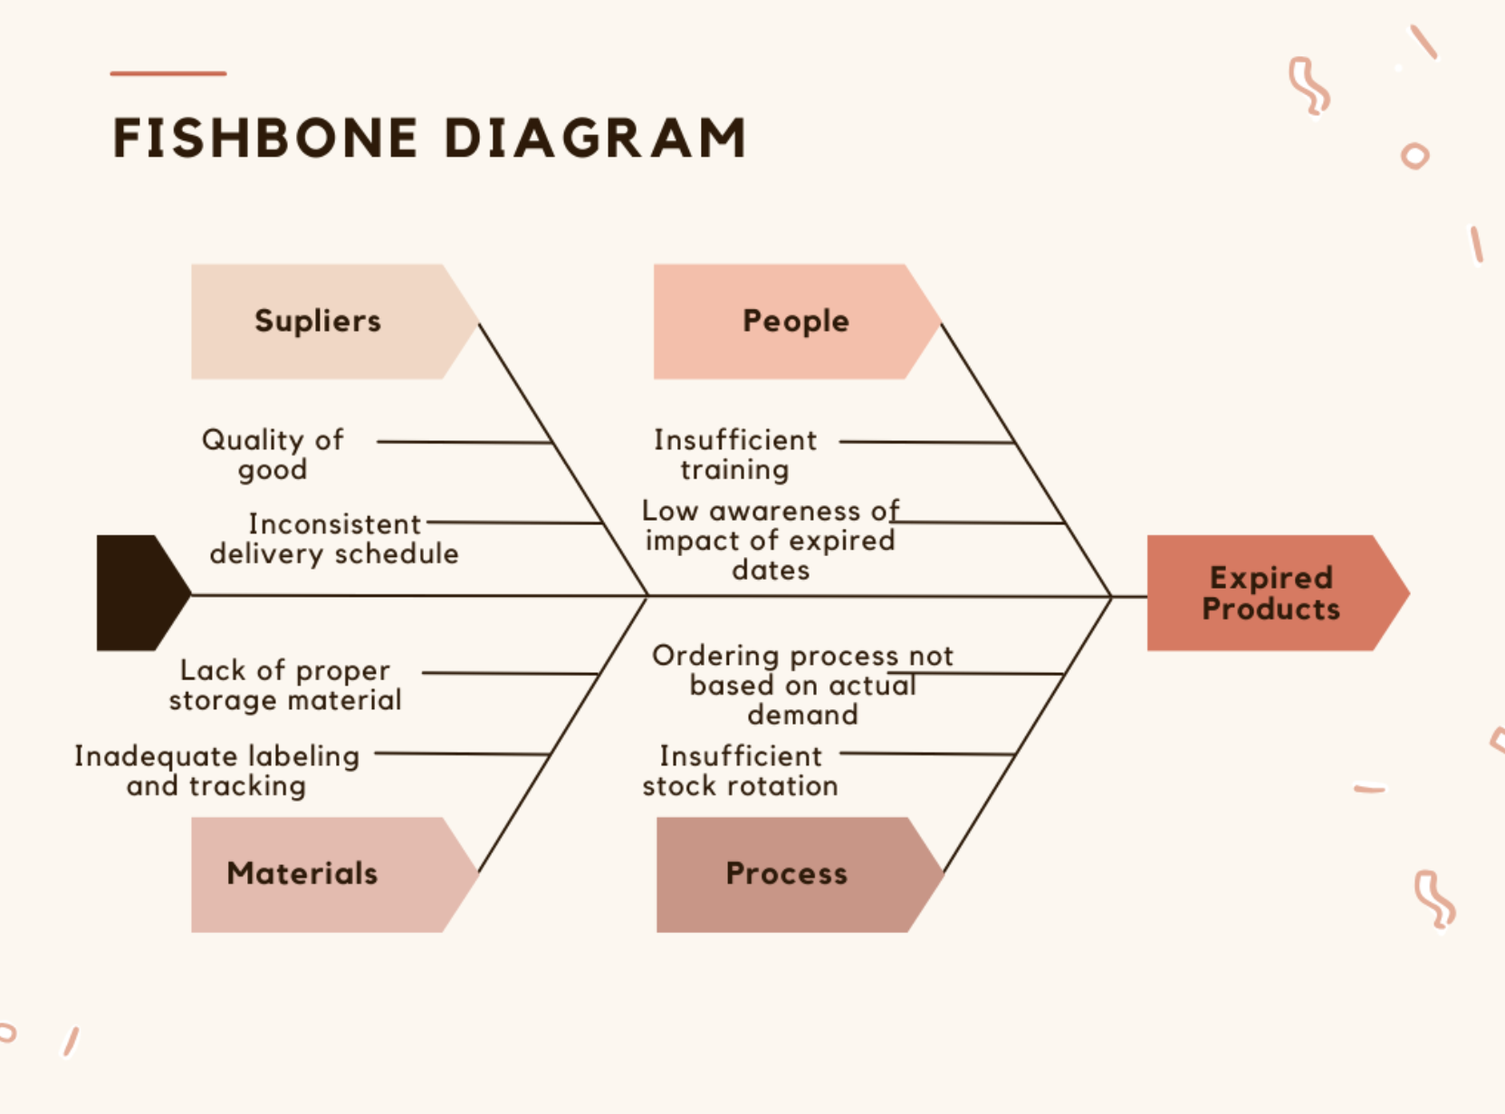

Slide 17
IMPROVE
Applying 5S and FMEA to address expired goods in the school pantry.
Redesigning processes by eliminating non-value-adding steps.
Key issues: inventory management, ordering, storage, and communication.
Engaging stakeholders, training staff, and piloting improvements.
Implementing targeted solutions to prevent defects.

Slide 18
THE 5S METHODOLOGY
Sort | Conduct a thorough inventory audit to identify all items in the pantry. Remove any expired, damaged, or unusable items from the inventory immediately. Establish clear criteria for determining which items should be kept or discarded.
Set in Order | Organize the remaining inventory in a systematic and logical manner. Group similar items together and assign specific locations for each category. Use labels and signage to clearly identify different sections
Shine | Implement a regular cleaning schedule to maintain cleanliness and orderliness in the pantry. Encourage volunteers to clean and organize the pantry during downtime. Address any issues promptly
Standardize | Develop standardized procedures for inventory management, including regular audits and checks for expiration dates. Train volunteers on proper sorting, organizing, and cleaning techniques. Document all procedures and make them easily accessible to all pantry staff and volunteers.
Sustain | Foster a culture of continuous improvement and waste reduction within the pantry. Regularly review performance metrics and identify areas for further improvement. Encourage feedback from volunteers and pantry users to identify any issues or concern

Slide 19
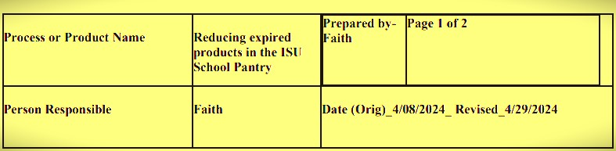
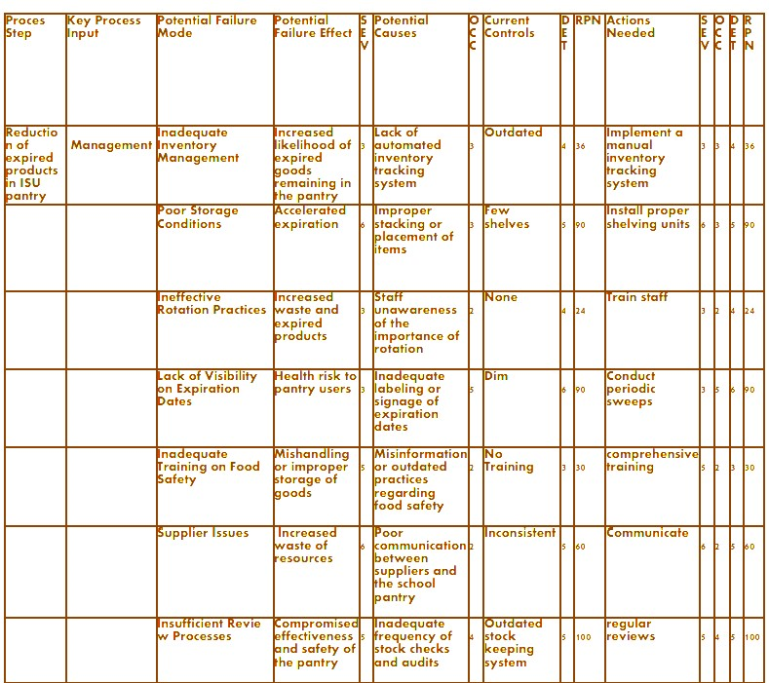

Slide 20

This FMEA analysis signifies that some failure modes pose very big risks to the success of the project.
In this scenario, we intend to;
Prioritize Mitigation Actions focused on reducing the severity of potential consequences.
Monitor and evaluate.
Regularly reassess the RPN of the highest-risk failure mode
Iterative Improvement: continuously review.

Slide 21
CONTROL
To ensure the sustainability of improvements in reducing expired products in school pantries.
It is crucial for institutionalizing changes and preventing regression to prior process states.
This approach maintains performance and lays the groundwork for continuous future improvements.

Slide 22
Key Components:
Standard Operating Procedures (SOPs): Implement SOPs for efficient inventory management and distribution.
Continuous Monitoring: Use SPC and audits for continuous inventory monitoring.
Continuous Training and Communication: Provide ongoing training and maintain open communication.
Technology Use: Leverage technology to enhance inventory tracking.
Risk Management: Regularly update risk management strategies.
Performance Reviews: Assess KPIs to ensure continuous improvement.

Slide 23
CONCLUSION
Used Six Sigma DMAIC to improve inventory management and ordering.
Focused on staff training, inventory tracking, and ordering to reduce expirations.
Ensured long-term success through control plans, training, and monitoring.
Achieved reduced waste, improved food safety, and higher satisfaction.

Slide 24
THANK YOU

