Slide 1
2018 KNU Linear algebra – Final project
Movie Recommendation system based on genre preference
By
Young Ha
Junseong Hong

Slide 2
Introduction
Data
Results
CONTENTS

Slide 3

Introduction
There are so many movies! Which movie will be more interesting to me?

Slide 4
2. Data

Slide 5

Data
We used the data from movielens

Slide 6
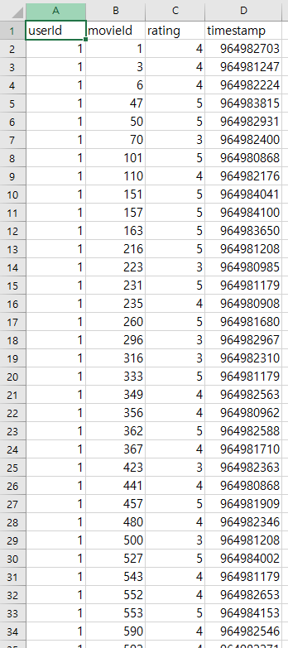
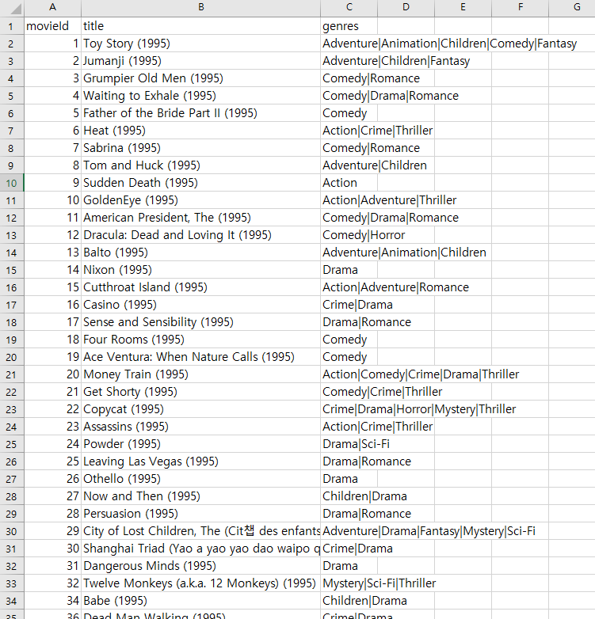
Data
Like this:

Slide 7
3. Results

Slide 8
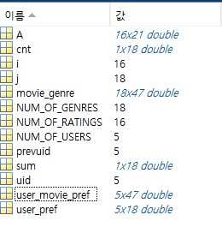
Variables
The variables used in the calculation process are as follows:
User_pref : Matrix of preference for specific genres of users
Movie_genre : A matrix of the genre (1 the movie belongs to that genre, otherwise 0)
User_movie_pref : Users' preference matrix for movies

Slide 9
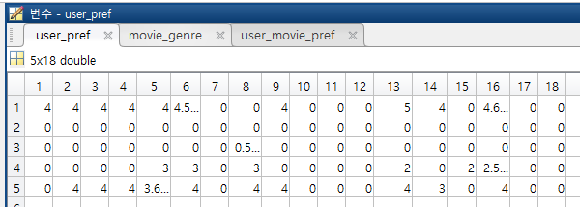
User_pref
Each entry means the average ratings of a user about a genre
Row means each user
Column represents each genre

Slide 10
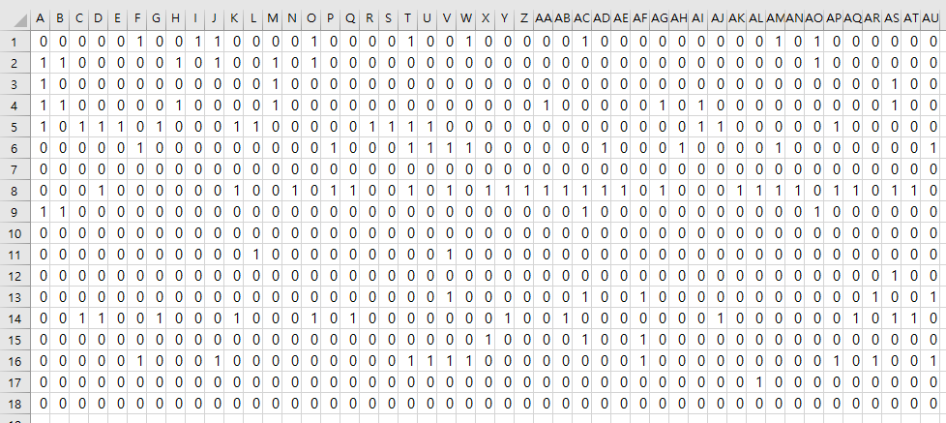
Movie_genre
Row means each genre
Column represents all movies
(1 the movie belongs to that genre, otherwise 0)

Slide 11
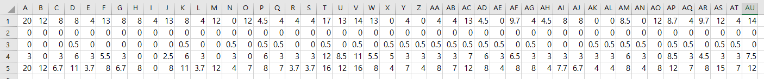
User_movie_pref
We can find it by the product of User_pref and Movie_genre
A(a, b) means the estimated preferences of user a about the movie b

Slide 12
Thank you

