Slide 1
Bashing Into Forensics
With Dr. Phil

Slide 2
About Phil (quick version)
Linux user since the beginning
Software developer turned security guy, turned forensics guy
Currently a Professor of Digital Forensics and Cybersecurity at Bloomsburg University
Also known to fly planes and helicopters, teach in same, build aircraft, and skydive

Slide 3
Motivation for this talk
One day in my Advanced Linux class…
  Going through Python forensics scripts from my book
  Thought “I wonder if we could do this using just bash?”
  If so, what would the performance be like

Slide 4
The first script find-files.py
This script uses Python magic library to search through a filesystem image and find files of a specified type
Fairly simple script
  Uses only magic, optparse, re, and os libraries
  Originally in Python 2, but converted to Python 3
  Object-oriented

Slide 5
First crack at bash script
Try to emulate Python script as closely as possible
Use the file utility
Create an array of items to find and corresponding keywords to grep through file results
Use dd to grab the correct sector(s)

Slide 6
Results
Very slow :-(
Searching a small image for a single file type took hours
The Python script completed this task in 18 minutes
What was the problem?
  dd
  Had to open file, scan, read, and close with each sector

Slide 7
On to iteration number 2
If only there was an easy way to read a file sector by sector in bash
There isn’t!
Solution:
  Alter bash script to build command line to call small Python script
  Python script just read a sector and performed search

Slide 8
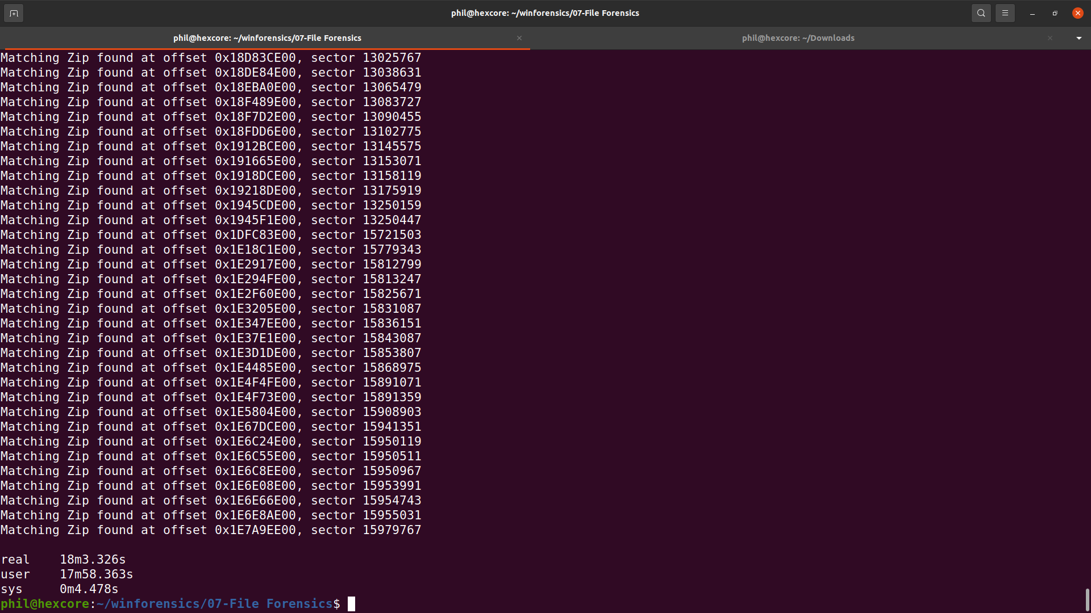
Results = Success!
Original Python script running against 19 GB image for one file type

Slide 9
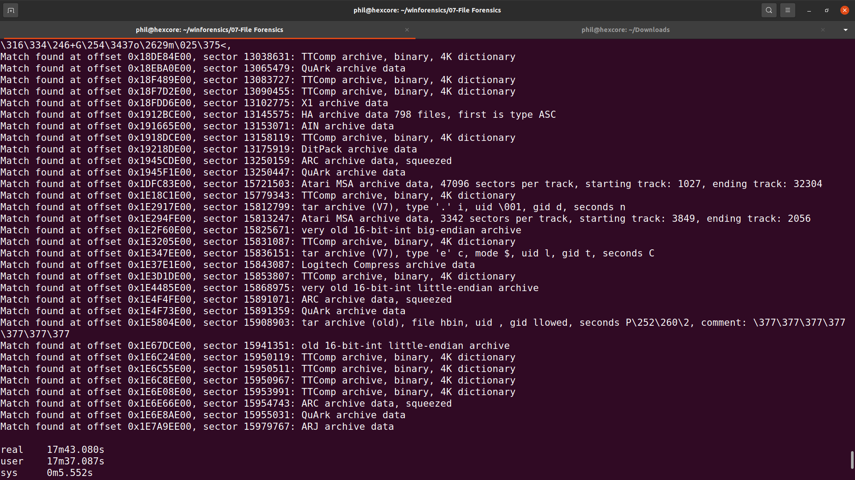
Results = Success!
Hybrid script running against 19 GB image for one file type

Slide 10
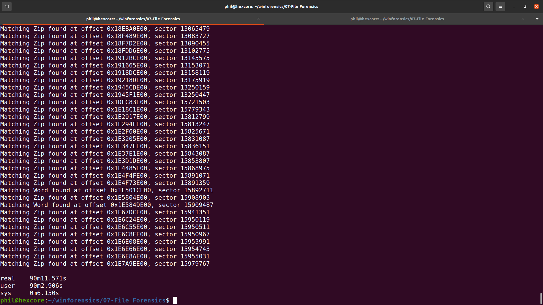
Results = Success!
Original Python script running against 19 GB image for six file types

Slide 11
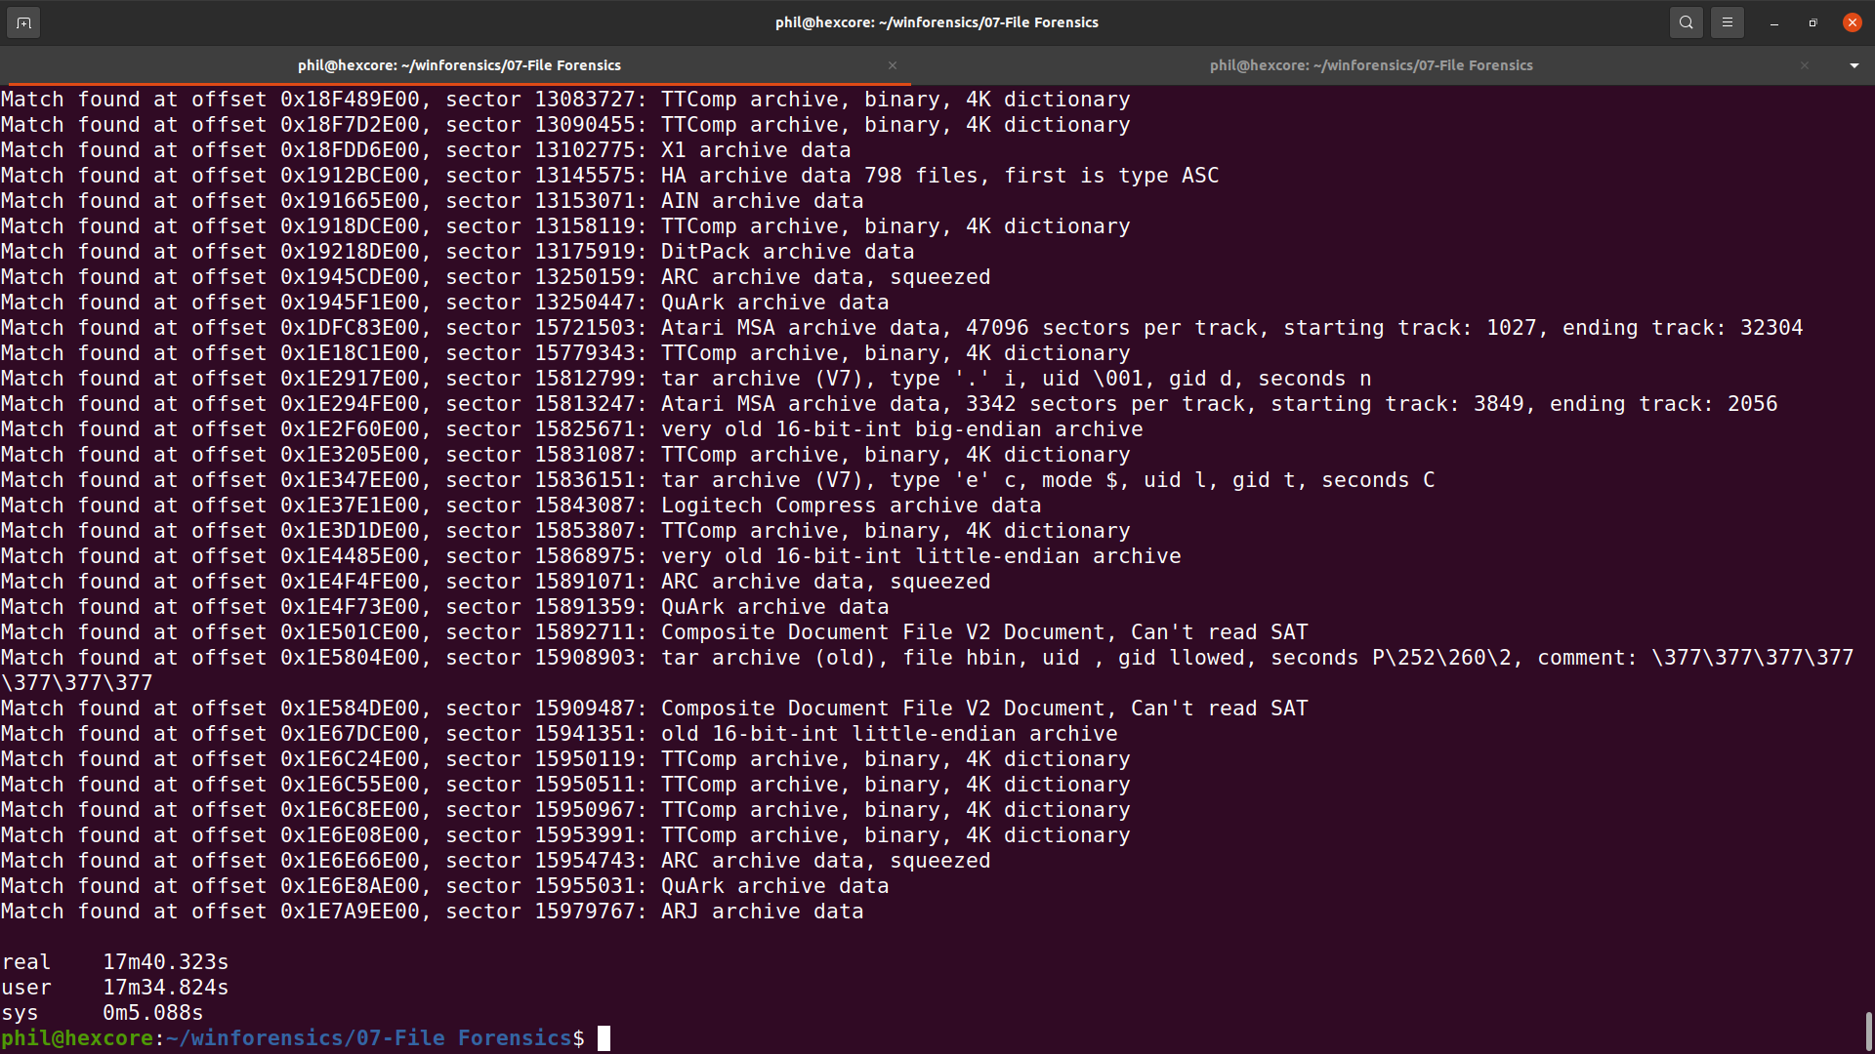
Results = Success!
Hybrid script running against 19 GB image for six file types

Slide 12
But wait, there’s more...
I thought it would be fun to try to use grep for this
Really didn’t love the hybrid script idea
Built up a regular expression to use for grep call
Didn’t use the file utility
  Used Gary Kessler’s file signatures instead

Slide 13
First problem
How do you get binary strings into grep?
  Easy use $’\xd0\xcf\x11\xe0’

Slide 14
Second problem
Greping a binary file
Solution
egrep –byte-offset –only-matching –text “$grepString” “$imageFilename”

Slide 15
Third problem
Offsets are in ugly decimal
Hard to see if on a sector boundary
Solution pipe results to awk:
egrep –byte-offset –only-matching –text “$grepString” “$imageFilename” | awk -F ‘:’ ‘{printf “Match found at offset %x : {%s}\n”, $1, $2}’

Slide 16
Fourth problem
Some of the search strings aren’t printable
Makes it hard to see what is found when searching for multiple types
Solution: use sed to make it readable
egrep –byte-offset –only-matching –text “$grepString” “$imageFilename” | awk -F ‘:’ ‘{printf “Match found at offset %x : {%s}\n”, $1, $2}’ | sed -e $'s/\xd0\xcf\x11\xe0\xa1\xb1\x1a\xe1/Office Document/' | sed -e $'s/\x50\x4b\x03\x04\x14/Office XML Document or zip file/'

Slide 17
Fifth problem
Several false positives
  Especially zip files with a two character signature
Solution: use grep to eliminate results not on sector boundary
egrep –byte-offset –only-matching –text “$grepString” “$imageFilename” | awk -F ‘:’ ‘{printf “Match found at offset %x : {%s}\n”, $1, $2}’ | sed -e $'s/\xd0\xcf\x11\xe0\xa1\xb1\x1a\xe1/Office Document/' | sed -e $'s/\x50\x4b\x03\x04\x14/Office XML Document or zip file/' | egrep ‘00 : ‘

Slide 18
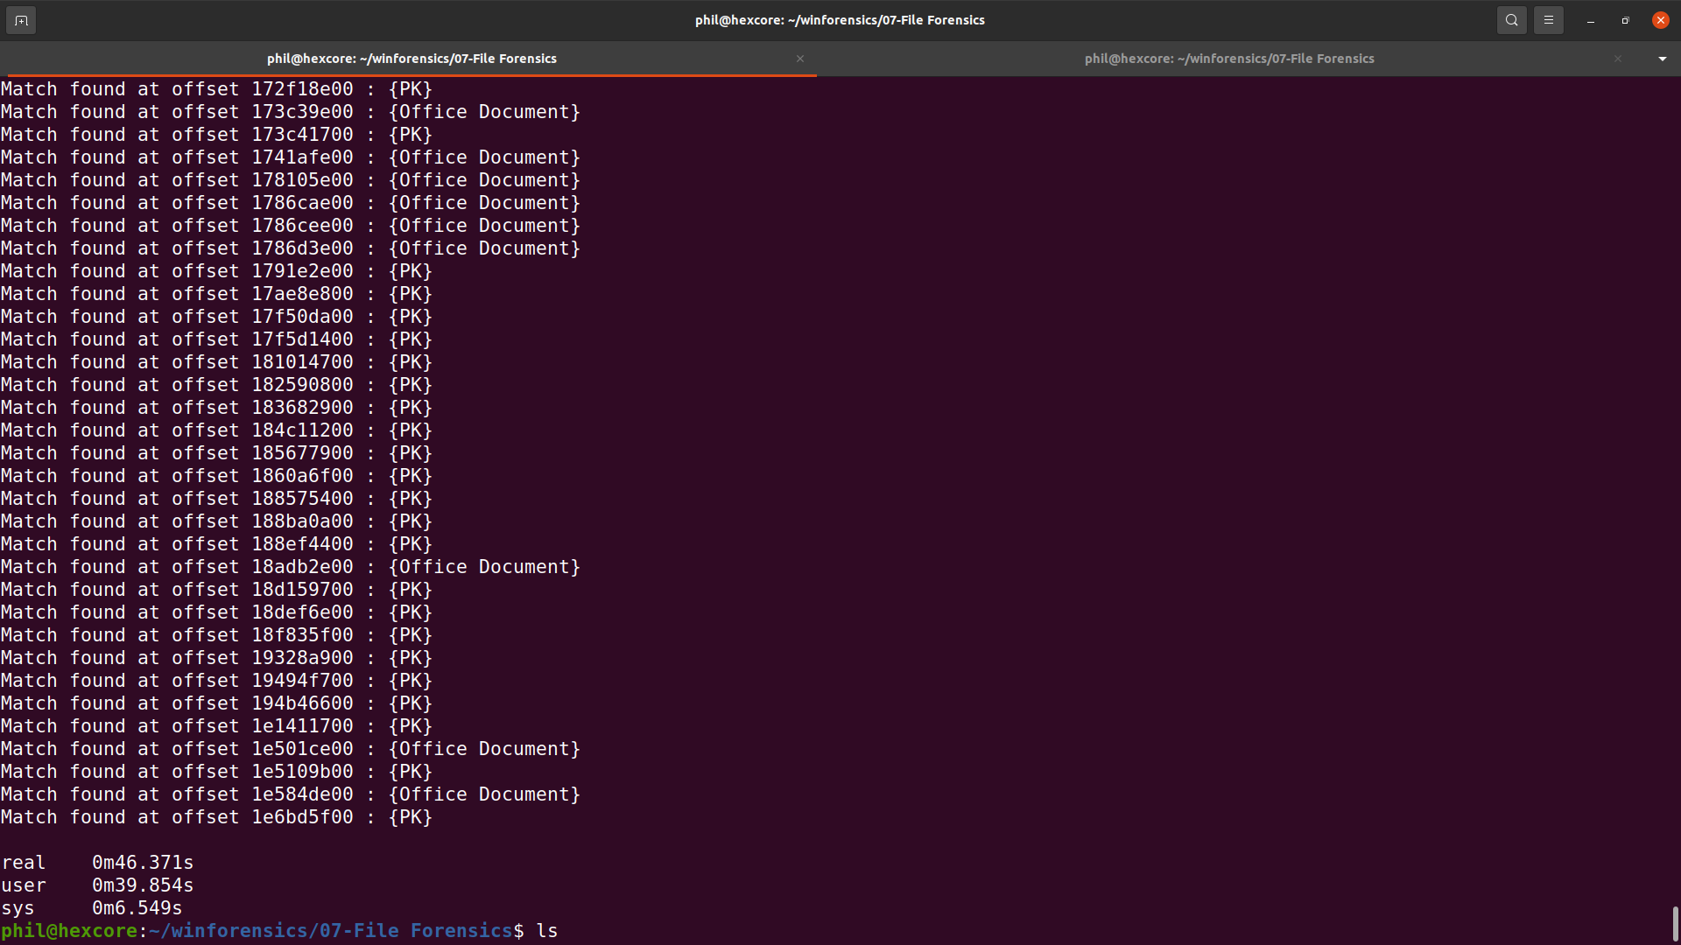
Results
Looking for six different file types

Slide 19
One last script
If you want the full details that file provides we can now use the location we found
It’s a one-liner:
dd bs=512 count=4096 skip=$(("$1"/512)) if="$2" 2>/dev/null | file - 2>/dev/null

Slide 20
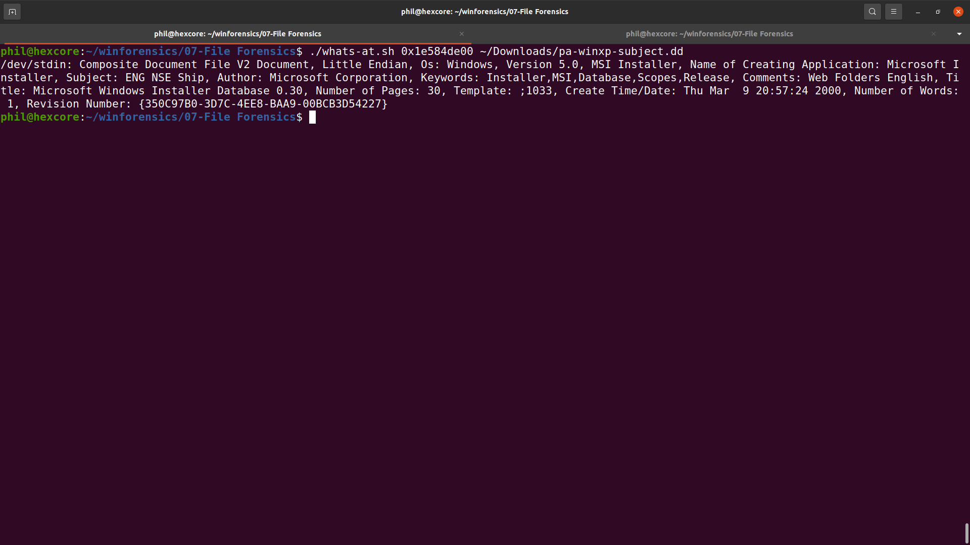
Sample Results

Slide 21
Questions?

