Slide 1
Bashing Into Forensics a
Workshop
With Dr. Phil

Slide 2
About Phil (quick version)
Linux user since the beginning
Software developer turned security guy, turned forensics guy
Currently a Professor of Digital Forensics and Cybersecurity at Bloomsburg University
Also known to fly planes and helicopters, teach in same, build aircraft, and skydive

Slide 3
Motivation for this talk
One day in my Advanced Linux class…
  Going through Python forensics scripts from my book
  Thought “I wonder if we could do this using just bash?”
  If so, what would the performance be like

Slide 4
Mounting Images
Image files are easily mounted on Linux systems
Linux supports virtually every type of file system which makes it ideal for forensics
Mount command syntax:
sudo mount -o ro,noatime,loop,offset=$((startSector*512)),sizelimit=$((sectors*512)) <imageFile> <mountPoint>

Slide 5
Sample Images
https://facstaff.bloomu.edu/ppolstra/windows-images/cybermen.img.gz
https://facstaff.bloomu.edu/ppolstra/windows-images/pa-win7-subject.dd.gz

Slide 6
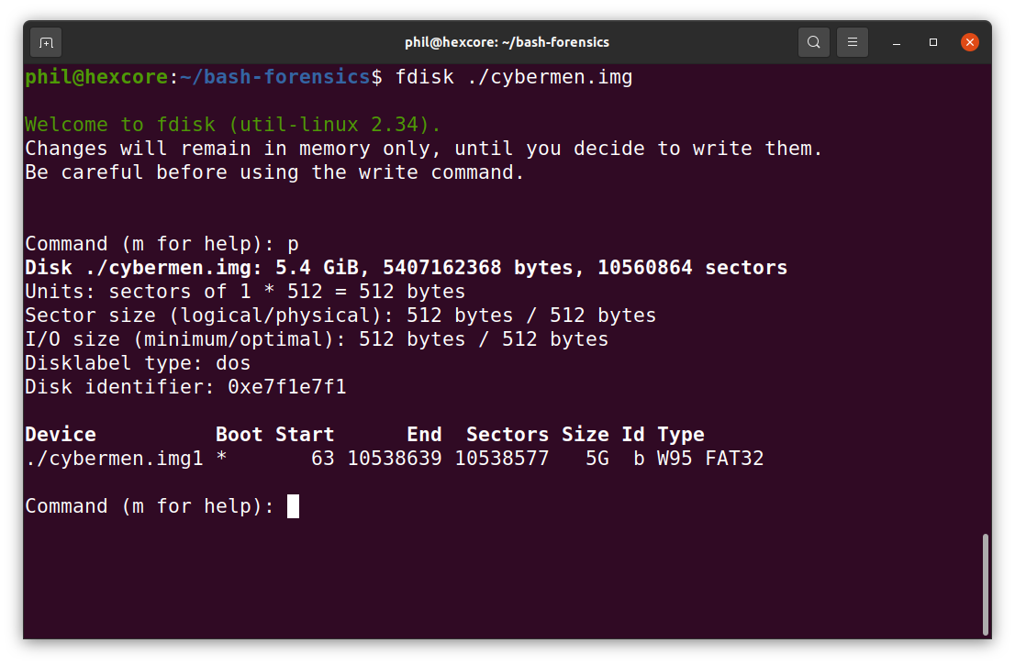
Manually mounting an image
Find starting sector
Fdisk <image file>
P to print partition table

Slide 7
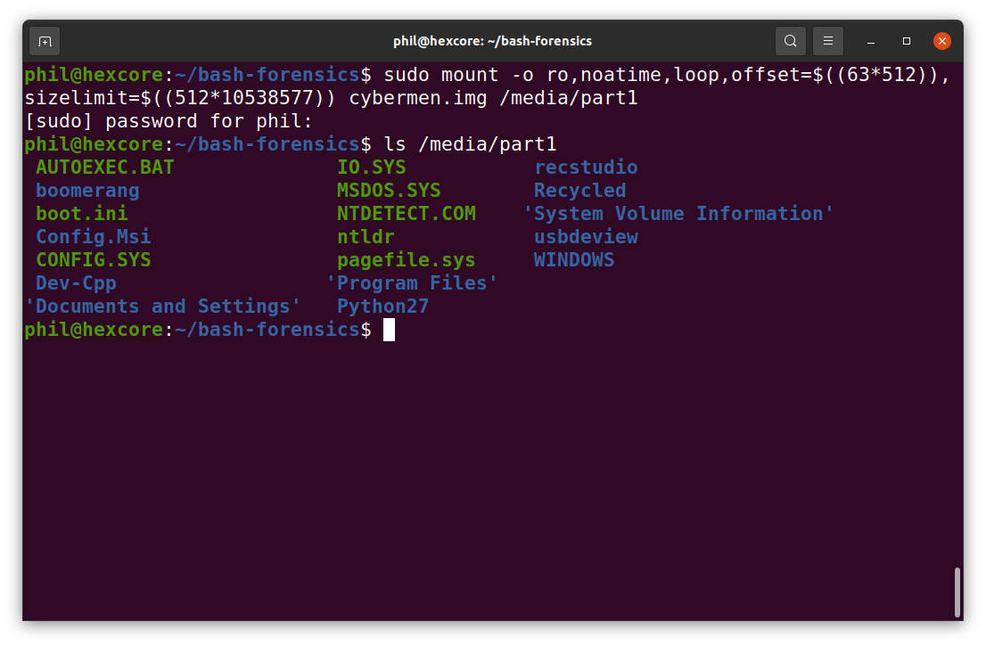
Manually mounting an image
Now Mount it

Slide 8
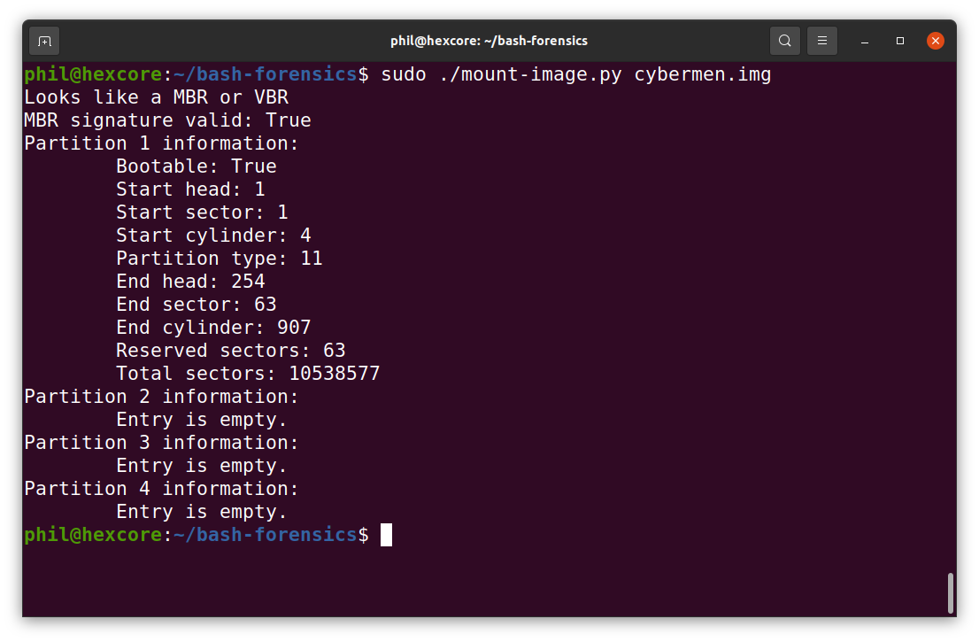
Mounting an image with Python

Slide 9
The first problem mismatched extensions
Much like a Pennsylvania politician, Windows is brain dead when it comes to handling files of various types
Relies solely on file extension
Changing the file extension allows information to be hidden
Linux has a great utility called “file” that will tell you what a file really is
A script to detect mismatched extensions is easily created

Slide 10
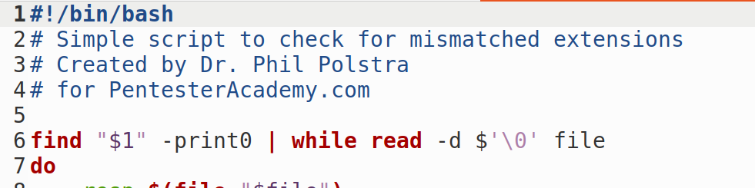
Issue #1 – Spaces in Filenames
Windows users (and Windows itself) tend to do silly things like put spaces in filenames
This creates problems when iterating over files
Solution:

Slide 11
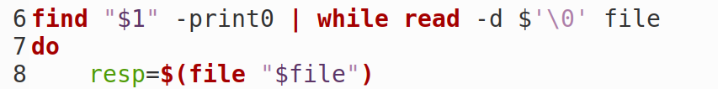
Issue #2 – Using file to get info
We must capture the results from file to see what a file truly is
Solution:

Slide 12
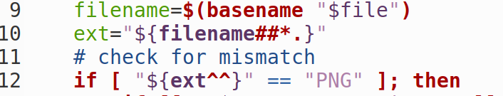
Issue #3 – Inconsistent use of case
We must capture the results from file to see what a file truly is
Solution:

Slide 13
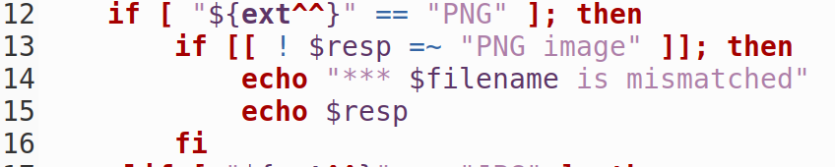
Issue #4 – Searching through results
File will often output a lot of information about a file, not just the file type
We need to hone in on the relevant parts
Solution:

Slide 14
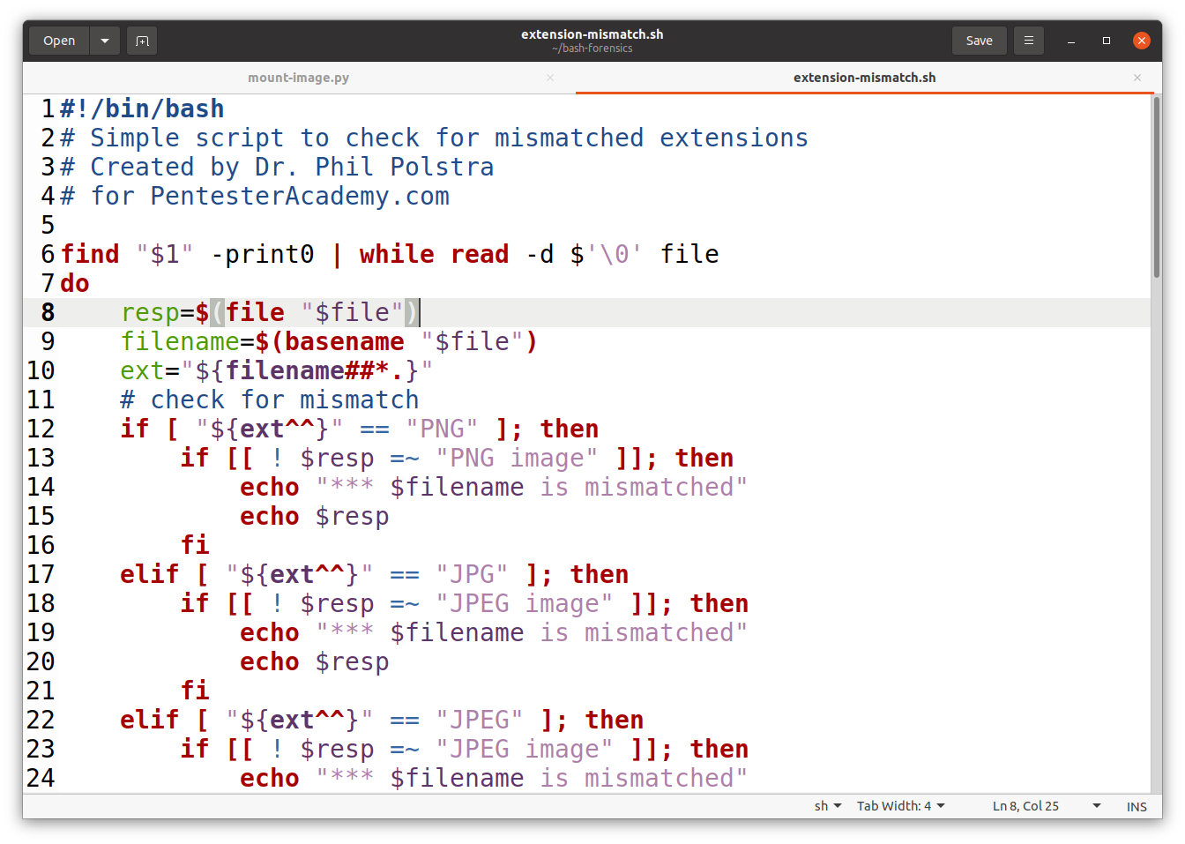
Putting it together

Slide 15
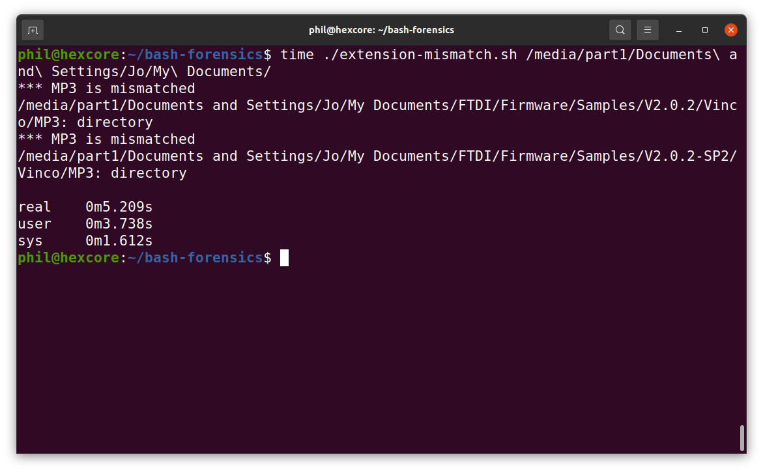
Putting it together

Slide 16
What about finding files?
We should be able to do something similar in order to find files of a given type or types in a mounted image
We will once again use file
This time we don’t care about extensions, just need to determine keywords to search for in file results

Slide 17
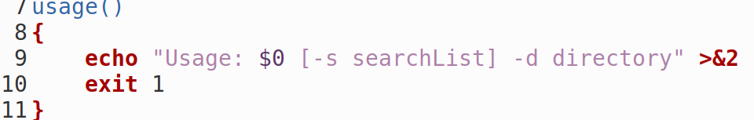
Issue #1 – Make sure people know how to use script
We accept a comma separated list of types to search
We also need the starting directory
Create a usage function to display if the user enters something invalid
Solution:

Slide 18
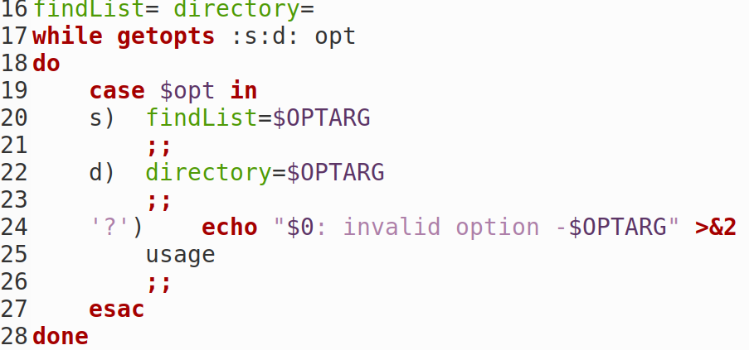
Issue #2 – Parse command line arguments
Use getopts to make this easy
Solution:
s

Slide 19

Issue #3 – Create an array of types to search for
Bash has support for arrays
Solution:

Slide 20
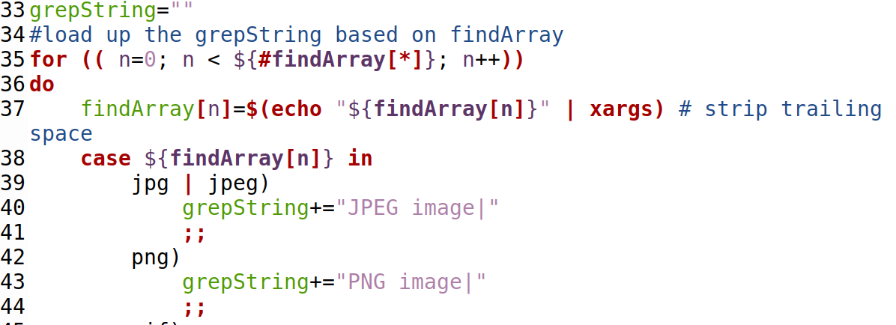
Issue #4 – Create a Grep string
Solution:

Slide 21

Issue #5 – Trailing | in Grep string
Solution:

Slide 22
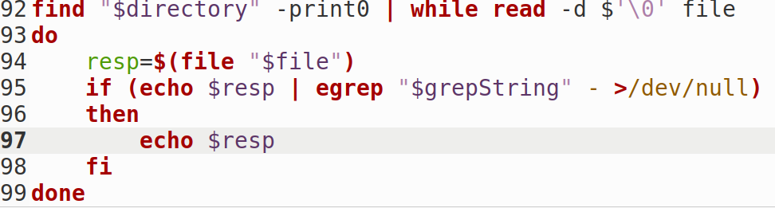
Now do the search
Solution:

Slide 23
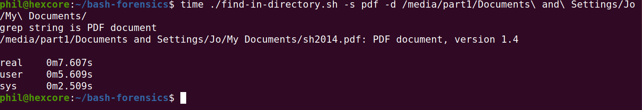
Now do the search

Slide 24
Let’s go about this a different way
Now that we have written a couple of scripts to work with mounted images, let’s see what we can do working with image files directly
What follows is essentially file carving

Slide 25
File Carving
Advantages
  Will find files that are deleted
  Requires no knowledge of the file system
Disadvantages
  Only works with contiguous (non-fragmented) files
  May get numerous false positives
  Need to manually read the file signatures
  Need to find the end of the file manually
  Doesn’t provide all the info that file does

Slide 26
The third script find-files.py
This script uses Python magic library to search through a filesystem image and find files of a specified type
Fairly simple script
  Uses only magic, optparse, re, and os libraries
  Originally in Python 2, but converted to Python 3
  Object-oriented

Slide 27
First crack at bash script
Try to emulate Python script as closely as possible
Use the file utility
Create an array of items to find and corresponding keywords to grep through file results
Use dd to grab the correct sector(s)

Slide 28
Results
Very slow :-(
Searching a small image for a single file type took hours
The Python script completed this task in 18 minutes
What was the problem?
  dd
  Had to open file, scan, read, and close with each sector

Slide 29
On to iteration number 2
If only there was an easy way to read a file sector by sector in bash
There isn’t!
Solution:
  Alter bash script to build command line to call small Python script
  Python script just read a sector and performed search

Slide 30
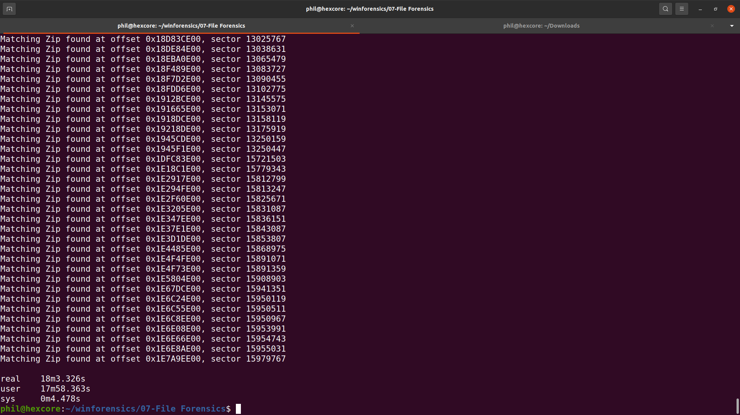
Results = Success!
Original Python script running against 19 GB image for one file type

Slide 31
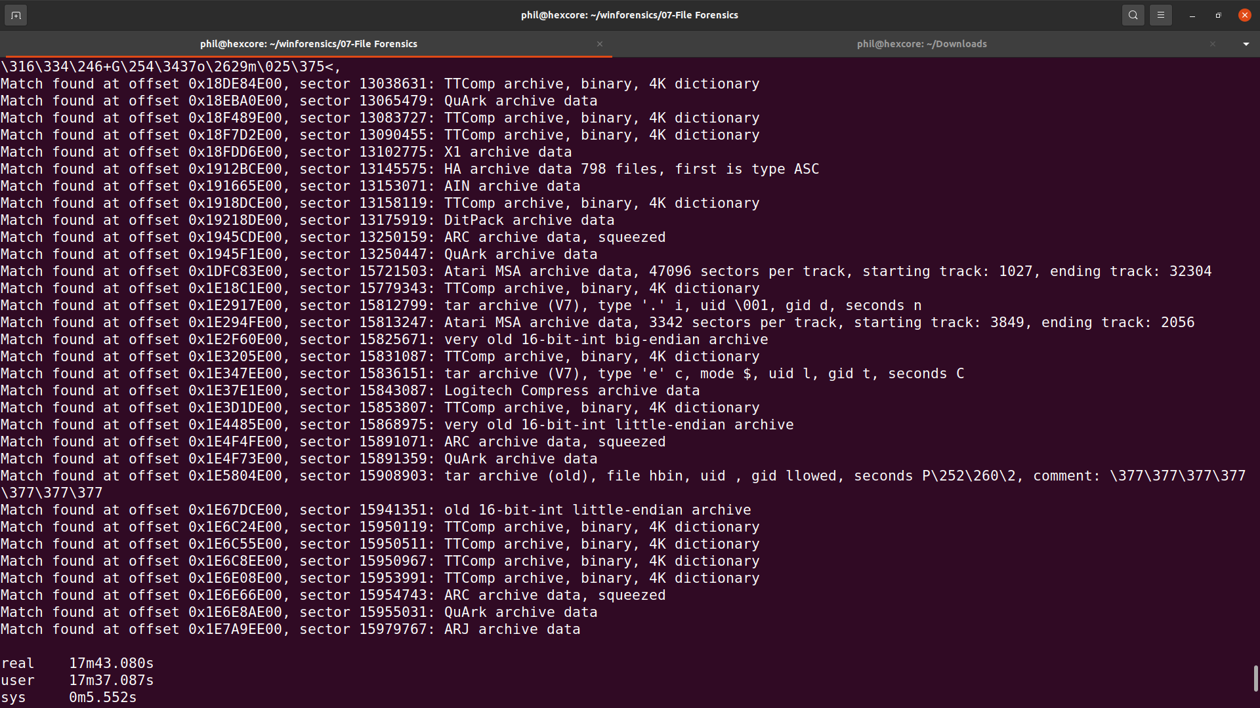
Results = Success!
Hybrid script running against 19 GB image for one file type

Slide 32
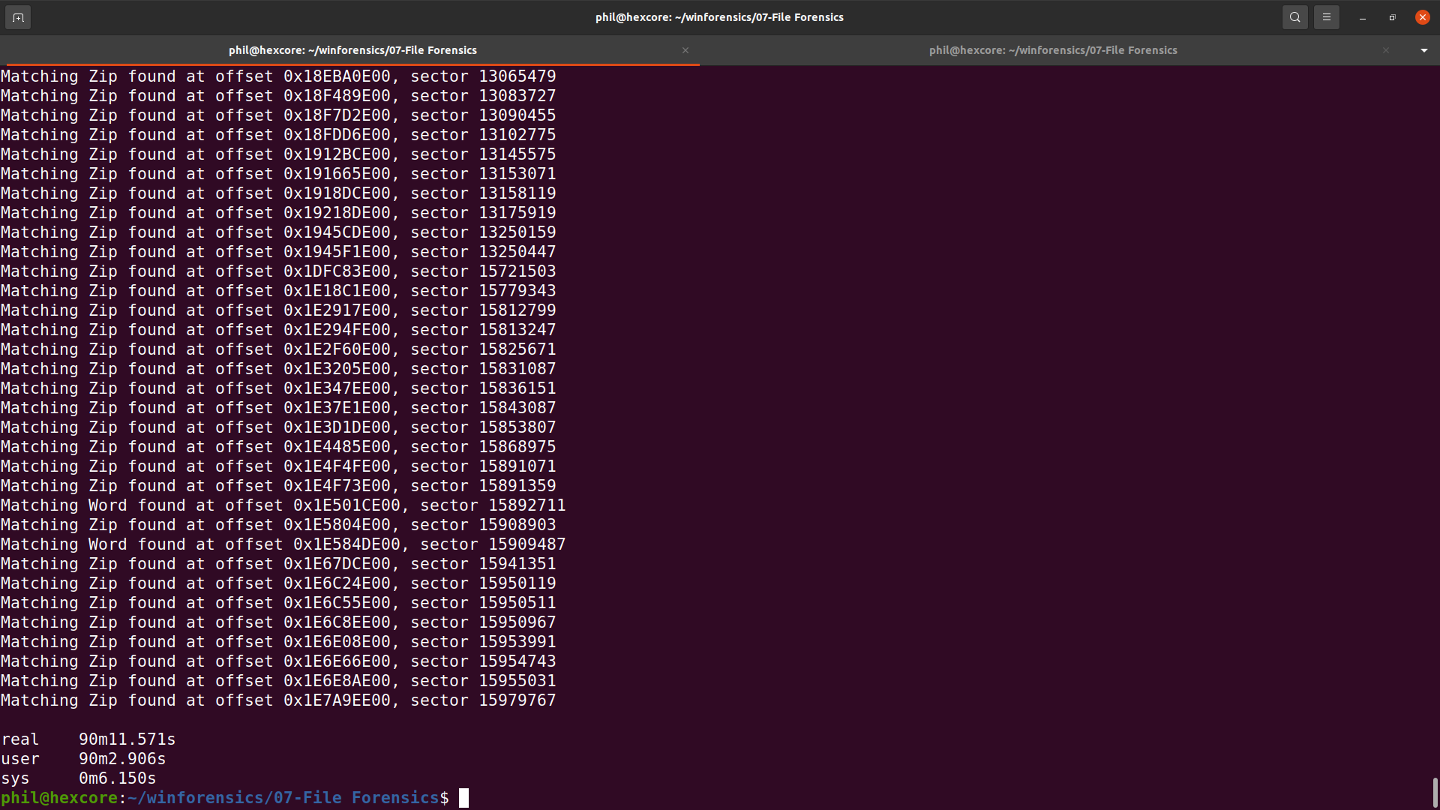
Results = Success!
Original Python script running against 19 GB image for six file types

Slide 33
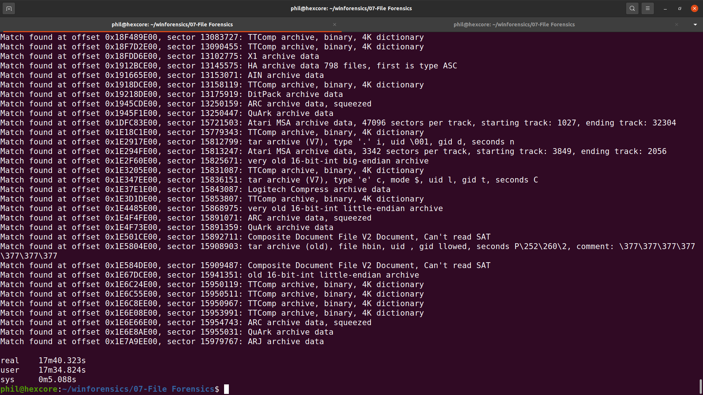
Results = Success!
Hybrid script running against 19 GB image for six file types

Slide 34
But wait, there’s more...
I thought it would be fun to try to use grep for this
Really didn’t love the hybrid script idea
Built up a regular expression to use for grep call
Didn’t use the file utility
  Used Gary Kessler’s file signatures instead

Slide 35
First problem
How do you get binary strings into grep?
  Easy use $’\xd0\xcf\x11\xe0’

Slide 36
Second problem
Greping a binary file
Solution
egrep –byte-offset –only-matching –text “$grepString” “$imageFilename”

Slide 37
Third problem
Offsets are in ugly decimal
Hard to see if on a sector boundary
Solution pipe results to awk:
egrep –byte-offset –only-matching –text “$grepString” “$imageFilename” | awk -F ‘:’ ‘{printf “Match found at offset %x : {%s}\n”, $1, $2}’

Slide 38
Fourth problem
Some of the search strings aren’t printable
Makes it hard to see what is found when searching for multiple types
Solution: use sed to make it readable
egrep –byte-offset –only-matching –text “$grepString” “$imageFilename” | awk -F ‘:’ ‘{printf “Match found at offset %x : {%s}\n”, $1, $2}’ | sed -e $'s/\xd0\xcf\x11\xe0\xa1\xb1\x1a\xe1/Office Document/' | sed -e $'s/\x50\x4b\x03\x04\x14/Office XML Document or zip file/'

Slide 39
Fifth problem
Several false positives
  Especially zip files with a two character signature
Solution: use grep to eliminate results not on sector boundary
egrep –byte-offset –only-matching –text “$grepString” “$imageFilename” | awk -F ‘:’ ‘{printf “Match found at offset %x : {%s}\n”, $1, $2}’ | sed -e $'s/\xd0\xcf\x11\xe0\xa1\xb1\x1a\xe1/Office Document/' | sed -e $'s/\x50\x4b\x03\x04\x14/Office XML Document or zip file/' | egrep ‘00 : ‘

Slide 40
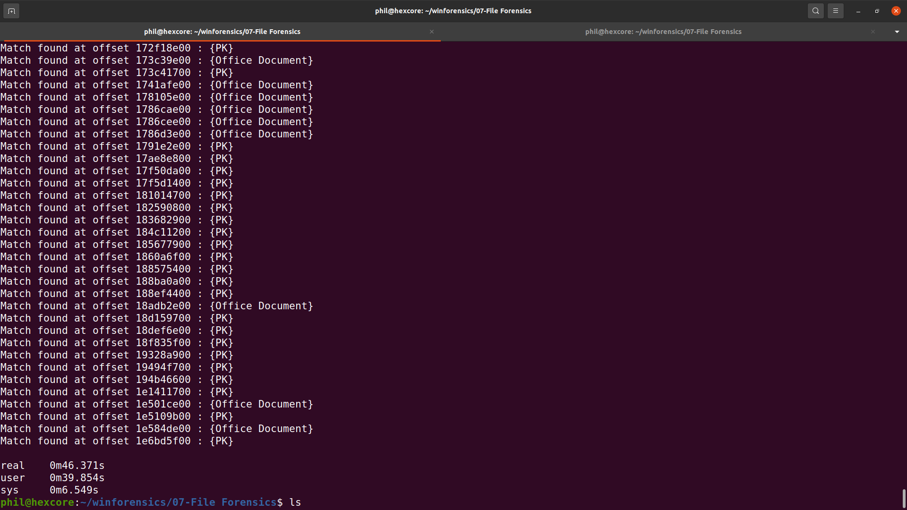
Results
Looking for six different file types

Slide 41
One last script
If you want the full details that file provides we can now use the location we found
It’s a one-liner:
dd bs=512 count=4096 skip=$(("$1"/512)) if="$2" 2>/dev/null | file - 2>/dev/null

Slide 42
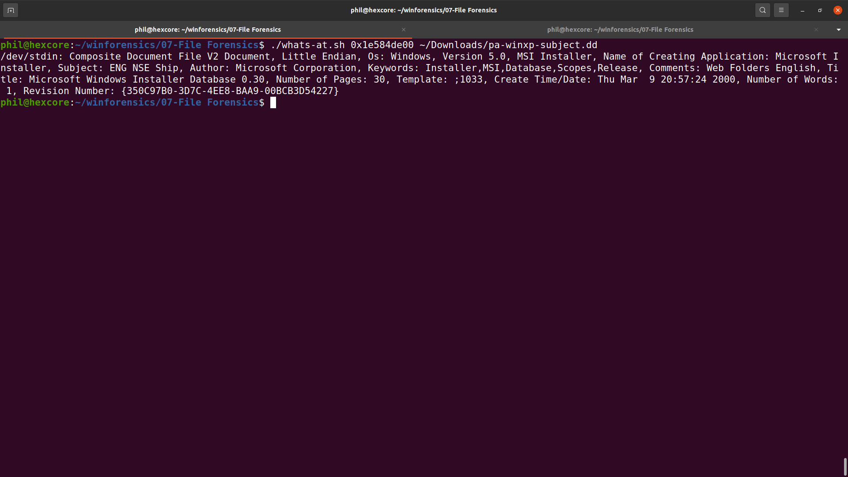
Sample Results

Slide 43
Questions?

