Slide 1
Scala for Juniors
and
Junior Seniors

Slide 2

The purpose
I’m mentoring a couple of internal Scala courses in DataArt.
And I have to tell the same stuff to different people. Over and over again.

Slide 3
The purpose
I had a project where I had to share my knowledge of Scala with more experienced colleagues. So, this talk is for:
Juniors
Junior Seniors

Slide 4
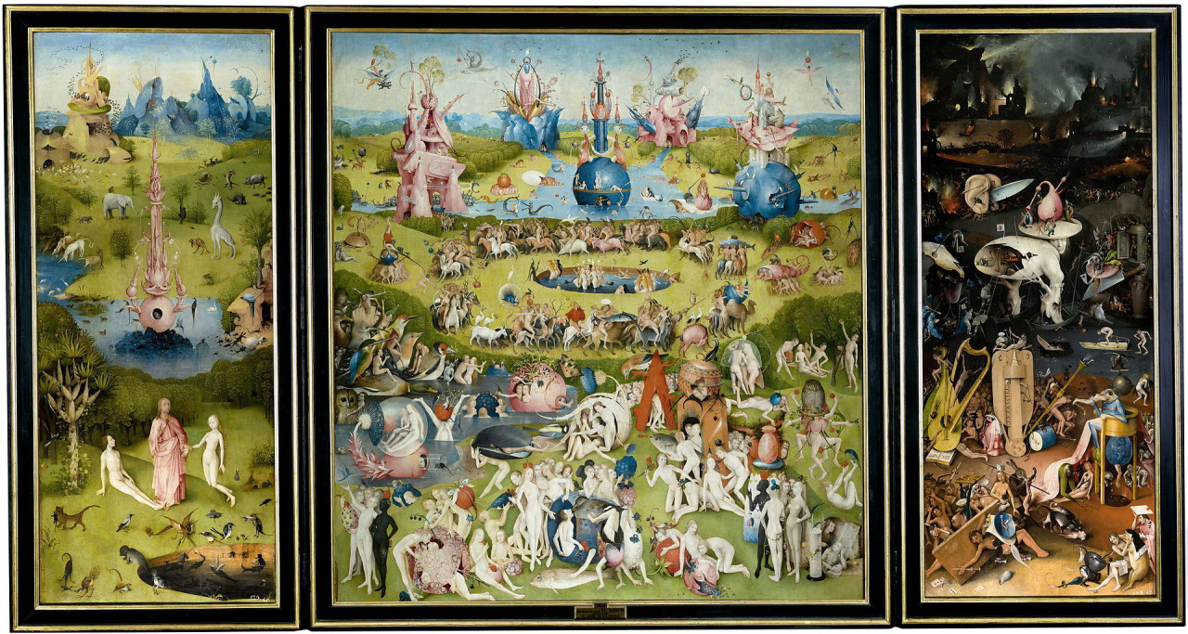
About this talk
3Kladia Leizerovich
Hieronymus Bosch “A visual guide to the Scala language

Slide 5
Part I Functional

Slide 6

Expressions

Slide 7
Expressions
Say, we have a sequence with votes…
val votes = Seq(("scala", 1),
("java", 4),
("scala", 10),
("scala", 1),
("python", 10))

Slide 8
Expressions
Ok, Let’s sort it out...
votes.groupBy(_._1).map{case (which, counts) =>
(which, counts.foldLeft(0)(_ + _._2))
}.toSeq.sortBy(_._2).reverse
* Some people prefer to pack their stuff into a single-line statements

Slide 9
Expressions
A little bit better
val orderedVotes = votes
.groupBy(_._1)
.map { case (which, counts) =>
(which, counts.foldLeft(0)(_ + _._2))
}.toSeq
.sortBy(_._2)
.reverse

Slide 10
Expressions
A way better
val votesByLang = votes groupBy { case (lang, _) => lang }
val sumByLang = votesByLang map { case (lang, counts) =>
val countsOnly = counts map { case (_, count) => count }
(lang, countsOnly.sum)
}
val orderedVotes = sumByLang.toSeq
.sortBy { case (_, count) => count }
.reverse

Slide 11

...

Slide 12
Don’t use return
The return keyword is not “optional” or “inferred”; it changes the meaning of your program, and you should never use it.
tpolecat
A return expression, when evaluated, abandons the current computation and returns to the caller of the method in which return appears.
All the examples are came from this post:
https://tpolecat.github.io/2014/05/09/return.html

Slide 13
Don’t use return
// Add two ints, and use this method to sum a list
def add(n: Int, m: Int): Int = n + m
def sum(ns: Int*): Int = ns.foldLeft(0)(add)
scala> sum(33, 42, 99)
res0: Int = 174
// Same, using return
def addR(n: Int, m: Int): Int = return n + m
def sumR(ns: Int*): Int = ns.foldLeft(0)(addR)
scala> sumR(33, 42, 99)
res1: Int = 174

Slide 14
Don’t use return
// Inline add and addR
def sum(ns: Int*): Int =
ns.foldLeft(0)((n, m) => n + m)
scala> sum(33, 42, 99)
res2: Int = 174 // alright
// inlined addR
def sumR(ns: Int*): Int =
ns.foldLeft(0)((n, m) => return n + m)
scala> sumR(33, 42, 99)
res3: Int = 33 // um.

Slide 15

Type aliasing

Slide 16
Type aliasing [in C]
The canonical and unreadable definition of signal function:
void
(*signal(int sig, void (*func)(int)))(int);
// typedef comes to resque:
typedef void (*sighandler_t)(int);
sighandler_t
signal(int signum, sighandler_t handler);

Slide 17
Type aliasing [in ML]
(* Ocaml *)
type suit = Club | Diamond | Heart | Spade;;
Union and intersection types
(* OCaml *)
type intorstring = Int of int | String of string;;
(* SML *)
datatype intorreal = INT of int | REAL of real
// Dotty
type IntOrString = Int | String

Slide 18
Type aliasing [in Scala]
You have an “action-like function” () => Unit. Action will be appropriate name for it.
You want to get abstraction over
Collection[Collection, Collection[Ups...]]
You wish to add an additional semantic information to existing type
Map[Username, Key] // is better than
Map[String, String]

Slide 19

Assignment

Slide 20
Assignment
val address = ("localhost", 80)
address: (String, Int) = (localhost, 80)
val (host, port) = address
host: String = localhost
port: Int = 80

Slide 21
Assignment
// works for lists
val first::rest = List(1,2,3,4,5)
first: Int = 1
rest: List[Int] = List(2, 3, 4, 5)
// and case classes too
val p @ Person(name, age) = alexander

Slide 22

Options

Slide 23


Slide 24
Options
if (option.isEmpty)
default
else
// NoSuchElementException could happen
option.get

Slide 25
Options
def process
(item: Option[Item]): Option[UpdItem] = ???
// Item => UpdItem
Option[List[T]]
// Either, Try in case of error otherwise
// it can be empty

Slide 26
Options
// 1
option getOrElse default
//2
val ox = Some(1)
val oy = Some(2)
val oz = Some(3)
for { x <- ox; y <- oy; z <- oz }
yield x + y + z

Slide 27

Lists

Slide 28
Lists
Options have get, Lists have…
// for empty list
init: UnsupportedOperationException
head: NoSuchElementException
last: NoSuchElementException
tail: UnsupportedOperationException
* In the same situations even Haskell does the same thing

Slide 29

Don’t call ...
There is no need to call those methods. Why?
They impose danger
You can avoid that

Slide 30

Tuples

Slide 31
Tuples
Case classes can do 99% of the job
Good as anonymous temporary storage
Hlists can be a good alternative
Are good with type aliasing
In some languages, like Erlang they appeared before Records*
* In Erlang records are represented as tuples

Slide 32
Tuples
I’ve just said that tuples are good with type aliasing. They are:
type Point = (Double, Double)
def drawLine(x: Point, y: Point): Line = ???

Slide 33
Dont use _1, _2
If you wish to access one of the elements you should use pattern matching instead. It is the most idiomatic way of doing things. Even in non functional languages:
# Python
(ip, hostname) = ("127.0.0.1", "localhost")

Slide 34
Dont use _1, _2
And of course functional:
(* OCaml *)
let third (_, _, elem) = elem
%% Erlang
Third = fun ({_Fst, _Snd, Thrd}) -> Thrd end.
-- Haskell
third (_, _, x) = x

Slide 35
Tuples
trait Rectangle {
def topLeft: Point
}
val (x0, y0) = rectangle.topLeft
// inside lambda
points foreach { case (x, y) =>
println(s"x: ${x}, y: ${y}")
}

Slide 36
Another usage of tuples...
-- Let’s define a map function
map :: (a -> b) -> [a] -> [b]
-- pattern matching function’s signature
-- argument is an empty list:
map _ [] = []
-- x:xs could be more idiomatic in Haskell
map fun (head:tail) = fun head : map fun tail

Slide 37
Another usage of tuples...
def
map [A, B] (f: A => B, l: List[A]): List[B] =
(f, l) match {
case (f, Nil) =>
Nil
case (f, head::tail) =>
f(head) :: map(f, tail)
}

Slide 38

Underscore

Slide 39
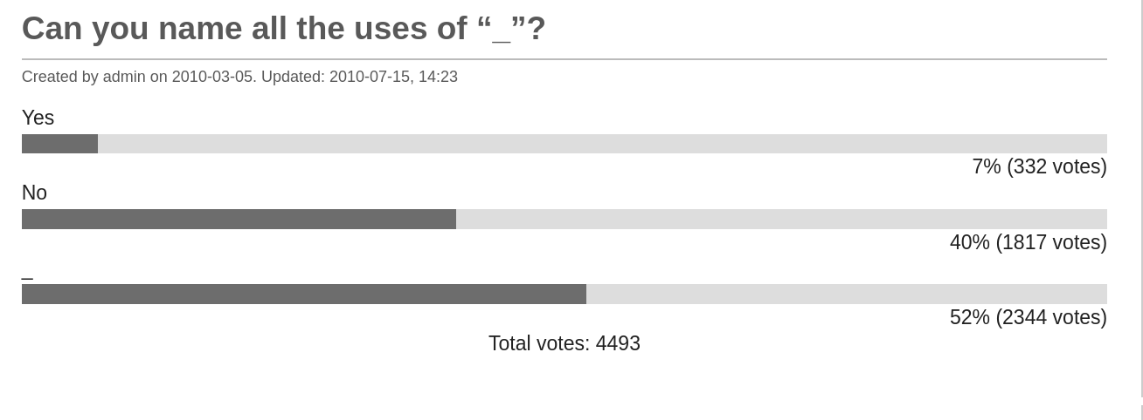
Underscore
** I counted 14. Still think that I’m missed something

Slide 40
Underscore
Which one is better?
def weight(tree: CodeTree): Int = tree match {
case Fork(_, _, _, weight) => weight
case Leaf(_, weight) => weight
}
def weight(tree: CodeTree): Int = tree match {
case Fork(left, right, chars, weight) => weight
case Leaf(char, weight) => weight
}

Slide 41
Part II _

Slide 42

Null

Slide 43
Initialize your values
You can do it in both Java and Scala (but it doesn’t mean that you should:
// Greet the most powerfull exception of
// all times
class MyClass {
String uninitialized;
}
class MyClass {
var uninitialized: String = _
}

Slide 44
Do not use null
Always initialize values
Wrap incoming Nullables into Options
Do not return null: use Option, Either, Try instead
Use lazy if you want to delay initialization
If you see null – get rid of it before your colleagues bring the ‘specialized’ language

Slide 45
Do not use null
And if it is not possible, use Null Object pattern:
sealed trait User
case class Admin extends User
case class SuperUser extends User
case class NullUser extends User

Slide 46

Overloading

Slide 47
Overloadings
I see this pretty often:
case class Monster
(pos: Position, health: Int, weapon: Weapon) {
def this(pos: Position) =
this(pos, 100, new Claws)
def this(pos: Position, weapon: Weapon) =
this(pos, 100, weapon)
}

Slide 48
Overloadings
Ok, but what about …?
case class Monster(
pos: Position,
health: Short = 100,
weapon: Weapon = new Claws
)
val aMonster = Monster (
Position(300, 300, 20), weapon = new Bazooka)

Slide 49

Overloadings [Operators]
If you do it. Give them meaningful names. The operator below is usually called Maculay Culkin (after that kid):
scala>
(3.some |@| 5.some) {_ + _}
res18: Option[Int] = Some(8)
Scala> val f = ({(_: Int) * 2} |@|
{(_: Int) + 10}) {_ + _}
f: Int => Int = <function1>
* Well, it has a name: applicative builder

Slide 50

Getters and Setters

Slide 51
Don’t generate getters/setters
import scala.beans.{BooleanBeanProperty, BeanProperty}
class MotherInLaw {
// She can change her name… probably
@BeanProperty var name = "Megaera"
// She likes them in huge numbers
@BeanProperty var numberOfCatsSheHas = 5
// But some things will never change
@BooleanBeanProperty val jealous = true
}

Slide 52
Don’t generate getters/setters
// works for case classes too
import scala.beans.BeanProperty
// It’s just an example
// Don’t make case classes mutable
case class Dino (
@BeanProperty name: String,
@BeanProperty var age: Int
)

Slide 53
Playing with a dinosaur
// It’s not that old
val barney = Dino("Barney", 29)
barney.setAge(30)
barney.getAge
// res4: Int = 30
barney.getName
// res14: String = Barney

Slide 54
Playing with a dinosaur
// And crash if we use the setter
barney.setName(“Wierdo”)
<console>:15: error: value setName is not a member of Dino
barney.setName

Slide 55

Case Classes

Slide 56
Case Classes
Don’t make them mutable unless you have strong reasons behind
case class
Person(var name: String, var age: Int)

Slide 57
Case Classes
Don’t create update methods:
case class Person(name: String, age: Int){
def updatedAge(newAge: Int) =
Person(name, newAge)
def updatedName(newName: String) =
Person(newName, age)
}

Slide 58
Case Classes
And use copy instead
// age updated – new instance created
person.copy(age = 32)

Slide 59
Case Classes
Don’t make them big (bigger than, say.. 7 elements)
// You can do it, but it doesn’t mean you should
case class AlphabetStat (
a: Int, b: Int, c: Int, d: Int, e: Int, f: Int,
g: Int, h: Int, i: Int, j: Int, k: Int, l: Int,
m: Int, n: Int, o: Int, p: Int, q: Int, r: Int,
s: Int, t: Int, u: Int, v: Int, w: Int, x: Int,
y: Int, z: Int
)
* The limit is still present: 256 elements

Slide 60
Case Classes
Use lenses to update deeply nested data.
case class Address(street: String,
city: String,
postcode: String)
case class Person
(name: String, age: Int, address: Address)

Slide 61
Case Classes
Use lenses to update deeply nested data:
val person = Person(
"Joe Grey",
37,
Address("Southover Street",
"Brighton", "BN2 9UA")
)

Slide 62
Case Classes
Use lenses to update deeply nested data:
import shapeless._
val streetLens = lens[Person].address.street
val street = streetLens.get(person)
// "Southover Street"
val person1 = streetLens.set(person)("Montpelier Road")
// person1.address.street == "Montpelier Road"

Slide 63

Enums Reinvented

Slide 64
Enums Reinvented
I see this pattern pretty often:
object Weekdays {
val MONDAY = 0
// guess what will be there
}

Slide 65
Enums Reinvented
ADT could be used instead:
sealed trait TrafficLight
case object Green extends TrafficLight
case object Yellow extends TrafficLight
case object Red extends TrafficLight
case object Broken extends TrafficLight

Slide 66
Enums Reinvented
ADT benefits:
def whatTheLightIs(tl: TrafficLight): Unit =
tl match {
case Red =>
println("No cars go!")
case Green =>
println("Don't stop me now!")
case Yellow =>
println("Ooohhh you better stop!")
}

Slide 67
Enums Reinvented
I see this pattern pretty often:
warning: match may not be exhaustive.
It would fail on the following input: Broken
tellWhatTheLightIs: (tl: TrafficLight)Unit
* Broken works as a Null Object there

Slide 68
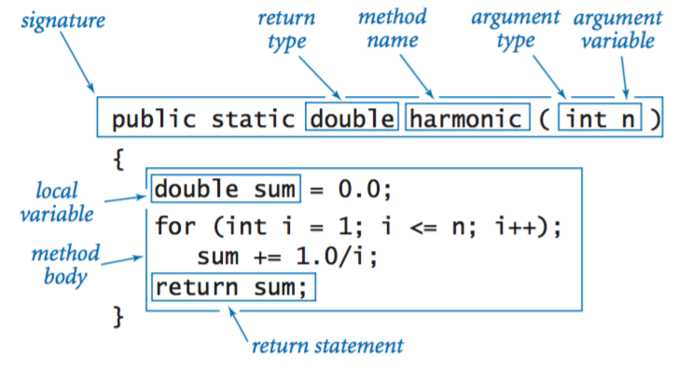
Function signatures

Slide 69
Function signatures
Consider the following example:
PrettyPrinter.print(text, 1, true)
def
print(text: String, copies: Int, wrapWords: WordWrap)
// The named parameters applied to Integers
// Still can be applied to booleans
print(text, copies = 1, WordWrap.Enabled)
* In similar situations, in Java we use Builders

Slide 70

Collections API

Slide 71
Collections API
Pavel Fatin did it better in his article “Scala Collections Tips and Tricks”. All those inspections are applied to IntelliJ IDEA. By the way all examples were taken from that article.
I encourage you to read it. Even if you may find it a bit repetitious.
https://pavelfatin.com/scala-collections-tips-and-tricks/

Slide 72
Collections API
// Sucks
seq.length > 0
seq.length != 0
seq.length == 0
// Rocks
seq.nonEmpty
seq.nonEmpty
seq.isEmpty

Slide 73
Collections API
list.size = 0 // sucks
list.isEmpty // rocks
!list.empty // sucks
list.nonEmpty // rocks
tvs.filter(tv => !tv.supportsSkype) // sucks
tvs.filterNot(tv => tv.supportsSkype) // rocks

Slide 74
Collections API
// size is called via implicit and works slower
array.size // sucks
array.length // rocks
// sucks
seq.length > n
seq.length < n
seq.length == n
seq.length != n
// Rocks
seq.lengthCompare(n) > 0
seq.lengthCompare(n) < 0
seq.lengthCompare(n) == 0
seq.lengthCompare(n) != 0

Slide 75
_ extends App
// What’s wrong here?
object Main extends App {
println(
"Hello World: " + (args mkString ", "))
}
// Until you write concurrent application

Slide 76
_ extends App
It should be noted that this trait is implemented using the DelayedInit functionality, which means that fields of the object will not have been initialized before the main method has been executed.
Use App with caution
(Since version 2.11.0) DelayedInit semantics can be surprising. Support for App will continue. See the release notes for more details: https://github.com/scala/scala/releases/tag/v2.11.0-RC1

Slide 77
Thank you

Slide 78
Q / A

