Slide 1

ScalaCheck
explained

Slide 2

Introduction

Slide 3

Property-based testing
∀x ∈ ℝ: x ≠ 0 ⟹ x² > 0
A property (in a mathematical sense of it) is:
rule or law
A black box feature
An output validation for all possible inputs

Slide 4
Property-based testing
∀x ∈ ℝ: x ≠ 0 ⟹ x² > 0
That’s how it looks in ScalaCheck:
Prop.forAll { x: Double =>
(x != 0) ==> (x * x > 0)
}

Slide 5
Junit 4 Theories
@RunWith(Theories.class)
public class UserTest {
@DataPoint // good sample
public static String GOOD_USERNAME = "optimus";
@DataPoint // bad sample
public static String USERNAME_WITH_SLASH = "optimus/prime";
@Theory
public void filenameIncludesUsername(String username) {
assumeThat(username, not(containsString("/")));
assertThat(new User(username).configFileName(),
containsString(username));
}
}

Slide 6
Junit 4 Theories
Drawbacks:
No shrinking
@DataPoints should be created manually
The absence of Scala DSL syntax ;)

Slide 7
Property-based testing
Pros and Cons:
Less code compared to traditional assertion-based approach
Gives you higher level of abstratcion: We care only about our input and the conditions
Shrinking
Some classes are hard to test via traditional assertion-based mechanism because it’s hard to decompose their behavior to small unit tests

Slide 8
Property-based testing
Pros and Cons:
Sensetive to slow code
False sense of security
Insensitive to corner cases
Uniformed distribution of test inputs

Slide 9
Use cases:
Input sensitive code
FSMs and state-dependent code*
Parsers (that’s what I use ScalaCheck for)
Data processors:
  Validators
  Classificators
  Agregators
  Sorters
Spark RDD, Hadoop mappers and reducers
Implementing custom collections
* Commands are not covered in this talk, sorry. But now you know that ScalaCheck supports stateful tesing

Slide 10
ScalaCheck features:
Compact library less than 20 .scala files
No extra dependencies required
It’s not using java.util.Random
Support for ScalaJs and Dotty
Integration with Specs2 and ScalaTest
* java.util.Random sucks as any other LCG
** LCG stands for Linear congruential generator
*** and it still suck

Slide 11
First stepes
<dependency>
<groupId>org.scalacheck</groupId>
<artifactId>scalacheck_2.12</artifactId>
<version>1.13.4</version>
</dependency>
* If you’re using Scala 2.12 use the latest version of ScalaCheck

Slide 12
Integration
Scalacheck can be integrated with:
Scalatest
Specs2
Sbt

Slide 13
Specs2
class SampleTest
extends Specification with ScalaCheck {
"Addition" should {
"should be commutative" in {
Prop.forAll { (x: Int, y: Int) =>
x + y == y + x
}
}
}
}

Slide 14
ScalaTest I
Prop.checkers can not use matchers syntax
import org.scalatest.junit.JUnitSuite
import org.scalatest.prop.Checkers
import org.scalacheck.Arbitrary._
import org.scalacheck.Prop._
class MySuite extends JUnitSuite with Checkers {
@Test
def testConcat() {
check((a: List[Int], b: List[Int]) =>
a.size + b.size == (a ::: b).size)
}
}

Slide 15
ScalaTest II
If you GeneratorDrivenPropertyChecks trait:
forAll { (n: Int, d: Int) =>
whenever (d != 0 && d != Integer.MIN_VALUE
&& n != Integer.MIN_VALUE) {
val f = new Fraction(n, d)
if (n < 0 && d < 0 || n > 0 && d > 0)
f.numer should be > 0
else if (n != 0)
f.numer should be < 0
else
f.numer should be === 0
f.denom should be > 0
}
}

Slide 16
The default way
Create an object that extends Properties
import org.scalacheck.Properties
import org.scalacheck.Prop.forAll
object StringSpec extends Properties("String") {
property("concat") =
forAll { (a: String, b: String) =>
(a+b).length > a.length &&
(a+b).length > b.length
}
}

Slide 17
Sbt
For example, you may add the following parameters to your build.sbt
testOptions in Test += Tests.Argument(
TestFrameworks.ScalaCheck, "-maxSize", "5",
"-minSuccessfulTests", "33", "-workers", "1",
"-verbosity", "1"
)

Slide 18
Properties

Slide 19
Prop.forAll
Universal quantifier. You can test all properties manually. To do it you can run Prop.check command
val p = Prop.forAll { x: Double =>
(x != 0) ==> (x * x > 0)
}
p.check
+ OK, passed 100 tests.

Slide 20
Preconditions
Precoditions allow you to filter input data:
val p = Prop.forAll { x: Double =>
(x != 0) ==> (x * x > 0)
}
import Prop.propBoolean
To activate this feature

Slide 21
Constant properties
The predefined (constant) properties
- Prop.undecided
- Prop.falsified
- Prop.proved
- Prop.passed
- Prop.exception(e: Throwable)

Slide 22
Prop.throws
Checks whether exception is thrown:
import org.scalacheck.Prop.throws
val p = forAll { x: Int =>
throws(classOf[ArithmeticException])(x / 0)
}

Slide 23
Prop.exists
Looks for at least one input value where property is correct.
When found, property becomes proved.
val p1 = Prop.exists { x: Int =>
(x % 2 == 0) && (x > 0)
}
p.check
+ OK, proved property.
> ARG_0: 2109213606

Slide 24
Ask for impossible
Looks for at least one input value where property is correct.
When found property becomes proved.
import org.scalacheck.Gen
val p1 = Prop.exists(posNum[Int]) { x: Int =>
(x % 2 == 0) && (x < 0)
}
p.check
! Gave up after only 0 passed tests. 501 tests were discarded.

Slide 25
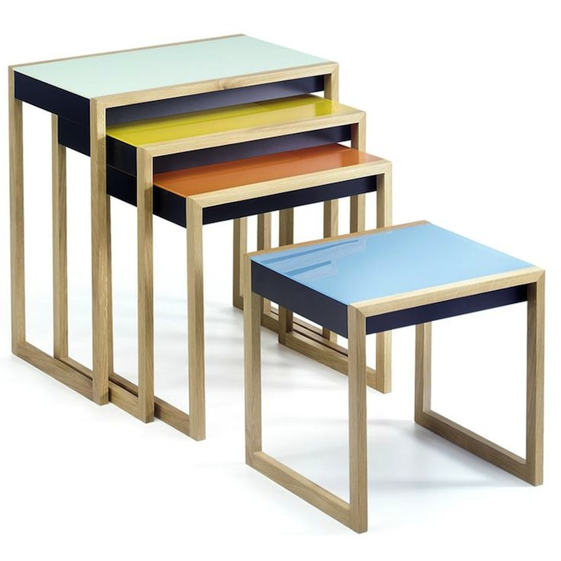
ForAll/Exist nesting
Prop.forAll and Prop.exist can be nested to each other:
val intsum = forAll { x: Int =>
forAll { y: Int =>
(x + y).isInstanceOf[Int]
}
}

Slide 26

Round-trip properties
Looks for at least one input value where property is correct.
When found property becomes proved.
def neg(a: Long) = -a
val negatedNegation = forAll { n: Long =>
neg(neg(n)) == n
}
val negatedNegation = forAll { list: List[Int] =>
list.reverse.reverse == list
}

Slide 27
Round-trip properties
Work great for reversable functions, like:
Decoders / Encoders / Compressors / Decompressors
Parsers
sealed trait AST
def parse(s: String): AST = ...
// adding variative whitespaces and tabs
def pretty(ast: AST): String = ...
val astGen: Gen[AST] = ...
forAll(astGen) { ast =>
parse(pretty(ast)) == ast
}

Slide 28

Reference implementation

Slide 29
Labels
You can add labels to your properties and generators (for both entities labels work the same way)
val p = Prop.forAll(
Gen.choose(0, 100) :| "x variable",
'y |: Gen.choose(0, 100)
) { case (x, y) =>
x + y == y + x
}

Slide 30
Labels
You can add labels to your properties and generators (for both entities labels work the same way)
String or Symbol
val p = Prop.forAll(
Gen.choose(0, 100) :| "x variable",
'y |: Gen.choose(0, 100)
) { case (x, y) =>
x + y == y + x
}
Before and after a
generator

Slide 31
Makes reports readable
val p = Prop.forAll(
Gen.choose(0, 100) :| "x variable",
'y |: Gen.choose(0, 100)
) { case (x, y) =>
x + y != y + x
}
! Falsified after 0 passedtests.
> x variable: 0
>xvariable_ORIGINAL: 70
>y:0
>y_ORIGINAL: 25

Slide 32

Generators

Slide 33
Gen
All generators are subclasses of Gen:
sealed abstract class Gen[+T] {
def apply(prms: Gen.Params): Option[T]
...
}
val arbitraryInteger: Gen[Int] =
Arbitrary.arbitrary[Int]
val sample: Option[Int] =
aribtraryInteger.sample
Sample method is pretty helpful during generator
developement

Slide 34
Create your own generators
val coordGen = for {
i <- arbitrary[Int]
j <- arbitrary[Int]
} yield (i, j)
val even =
arbitrary[Long] map (_ * 2)

Slide 35
Gen.frequency
val russianLettersInText = Gen.frequency(
(9, 'о'),
(9, 'а'),
(8, 'е'),
(7, 'и'),
(6, 'н')
//.. the rest ones
)

Slide 36
Filtering
Properties allow filtering. There’s Gen.filter method that allows you to do it. But, it’s an alias for Gen.suchThat
val evenOct =
Gen.choose(0, 7).suchThat(_ % 2 == 0)
Filtering works the same way as preconditions, So if you are to restrictive:

Slide 37

Filtering / suchThat
SuchThat and filter may produce empty generators. It may be a problem for small data sets, compositional generators and
println(evenOct.sample)
// None
// Not again
println(evenOct.sample)
// None
// Got it
println(evenOct.sample)
// Some(2)

Slide 38
Retry until
RetryUntil works the same way as suchThat but there’s an exception: It’s trying:
val evenOct =
Gen.choose(0, 7).retryUntil(_ % 2 == 0)
println(evenOct.sample)
// Some(6)
println(evenOct.sample)
// Some(4)
println(evenOct.sample)
// Some(2)

Slide 39
Arbitrary
You can generate Arbitrary for vast majority of types from the standard library.
import org.scalacheck.Arbitrary.arbitrary
// built-in types
val integer = arbitrary[Int]
val string = arbitrary[String]
// standard containers
val listgen = arbitrary[List[Int]]
val optgen = arbitrary[Option[Int]]

Slide 40
Arbitrary
If you’d like to have your type available in arbitrary, you should add an implicit. Let’s illustrate that:
sealed trait LED
case object Red extends LED
case object Blue extends LED
case object Green extends LED
// Let's create a generator for that type
val ledGenerator: Gen[LED] =
Gen.oneOf(Red, Green, Blue)

Slide 41
Arbitrary
If you’d like to have your type available in arbitrary, you should add an implicit. Let’s illustrate that:
implicit val arbLed: Arbitrary[LED] =
Arbitrary(ledGenerator)
Arbitrary.arbitrary[LED].sample
// Some(Green)

Slide 42
Gen.resultOf
Can help you with case classes:
case class Coord(x: Double, y: Double)
// создаем генератор при помощи resultOf
val genCoord = Gen.resultOf(Coord)
// помещаем его в Arbitrary
implicit val arbCoord = Arbitrary(genCoord)

Slide 43
Arbitrary use:
Arbitrary can be used not only inside generators, but
inside properties too:
val prop = Prop.forAll { coord: Coord =>
// verifying one of coord properties
}
Here we don’t need to pass generator explicitly.
The same can be applied for LED
val prop2 = Prop.forAll { led: LED =>
// checking led state?
}

Slide 44
Built-in generatrors
Scalacheck has a number of built-in generators:
Constants
Numbers
Characters
Strings
Functions (function0)
Collections

Slide 45
Constants
Gen.const works implicitly on any constant that is put
on a place where an instance of generator is expected
val const: Gen[Int] = Gen.const(2)

Slide 46
Number generators
// for positive numbers
val pos: Gen[Double] = Gen.posNum[Double]
// for negative numbers
val neg: Gen[Long] = Gen.negNum[Long]
// boundaries
val range = Gen.choose(0, 7)
// generates a number in given bounds with
// special weight for zero, and `specials`
val smartRange = Gen.chooseNum (
minT = 2, maxT = 10, specials = 9, 5
)

Slide 47
Character generatrors
- Gen.alphaUpperChar
- Gen.alphaLowerChar
- Gen.alphaChar
- Gen.numChar
- Gen.alphaNumChar
// will generate string like A4 or B2
val coord = for {
letter: Char <- Gen.alphaUpperChar
number: Char <- Gen.numChar
} yield s"$letter$number"

Slide 48
String generators
Gen.alphaStr
Gen.alphaLowerStr
Gen.alphaUpperStr
Gen.numStr
Gen.identifier
// Strings
val stringsGen = for {
key <- Gen.identifier
value <- Gen.numStr
} yield (key take 8, value take 2)

Slide 49
Functions
ScalaCheck allows you to generate functions of type Function0:
import Arbitrary.arbitrary
// In our case: () => Int
val f = Gen.function0(arbitrary[Int])

Slide 50
Optionals / Streams
Gen.some("cash")
// Some(cash)
Gen.option("cash")
// None
// Some(cash)
val steam =
Gen.infiniteStream(Gen.choose(0,1))

Slide 51
Lists / Maps
By default ScalaCheck generates huge lists, this
Changed by altering the size option with Gen.resized
Gen.listOf(3) map (_ take 5)
// List(3, 3, 3, 3, 3)
Gen.listOfN(5, Gen.posNum[Double]).
map (_ take 5)
Gen.nonEmptyListOf(Gen.alphaChar).
map (_ take 5)

Slide 52
Lists / Maps
By default ScalaCheck generates huge lists, this
Changed by altering the size option with Gen.resized
- Gen.nonEmptyMap
- Gen.mapOf
import Arbitrary._
val tupleGen = for {
i <- arbitrary[Short]
j <- arbitrary[Short]
} yield (i, j)
Gen.mapOfN(3, tupleGen) map (_ take 2)
// Map(10410 -> -7991, -19269 -> -18509)
The methods Gen.nonEmptyMap and Gen.mapOf are also supported

Slide 53
ContainerOf
ScalaCheck allows you to create a generator which is abstract over the container type. But not it’s kind:
def containerOf[C[_],T](g: Gen[T])(
implicit evb: Buildable[T,C[T]],
evt: C[T] => Traversable[T]
): Gen[C[T]]
Gen also contains methods like containerOfN and nonEmptyContainer.
So if you have a List type * ⟶ *, it will work fine. But, if you
Have a map, which is * ⟶ * ⟶ * you need something more powerful, like:

Slide 54
Buildable
There’s even more abstract mechanism for container creation:
def mapOf[T,U](g: => Gen[(T,U)]) =
buildableOf[Map[T,U],(T,U)](g)
Gen also contains methods like buildableOfN and nonEmptyBuildable.

Slide 55
Gen.sized
Gen.size accepts a lambda expression as its only parameter:
import org.scalacheck.Gen._
def genNonEmptySeq[T](genElem:Gen[T]):Gen[Seq[T]]=
sized { size =>
for {
listSize <- choose(1, size)
list <- containerOfN[Seq,T](listSize, genElem)
} yield list
}

Slide 56

Gen.resize
And now we can create a generator
val intVector =
genNonEmptySeq(Arbitrary.arbitrary[Int])

Slide 57
Gen.resize
And now we can create a generator
val intVector =
genNonEmptySeq(Arbitrary.arbitrary[Int])
But how can we use it?

Slide 58
Gen.resize
And now we can create a generator
val intVector =
genNonEmptySeq(Arbitrary.arbitrary[Int])
But how can we use it?
forAll(Gen.resize(5, intVector)) { list =>
list.length <= 5
}

Slide 59
Gen.resize
And now we can create a generator
val intVector =
genNonEmptySeq(Arbitrary.arbitrary[Int])
But how can we use it?
forAll(Gen.resize(5, intVector)) { list =>
list.length <= 5
}
+OK, passed100tests.

Slide 60

Recursive
Generators

Slide 61

trait IntTree
case class Leaf (value: Int)
extends IntTree
case class Node (children: Seq[IntTree]) extends IntTree

Slide 62
trait IntTree
case class Leaf (value: Int)
extends IntTree
case class Node (children: Seq[IntTree]) extends IntTree
def treeGen: Gen[IntTree] =
Gen.oneOf(leafGen, nodeGen)
def leafGen: Gen[Leaf] =
arbitrary[Int].map(value => Leaf(value))
def nodeGen: Gen[Node] =
Gen.listOf(treeGen).map(children => Node(children))

Slide 63

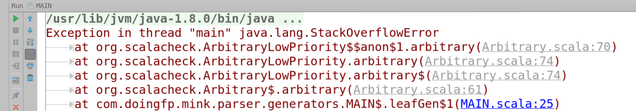

Slide 64
One step back
Ok, it is possible to have infinite lists, why we shouldn’t try
trees?
def treeGen: Gen[IntTree] = Gen.lzy {
Gen.oneOf(leafGen, nodeGen)
}

Slide 65
One step back
Ok, it is possible to have infinite lists, why we shouldn’t try
trees?
def treeGen: Gen[IntTree] = Gen.lzy {
Gen.oneOf(leafGen, nodeGen)
}
> println(treeGen.sample)

Slide 66
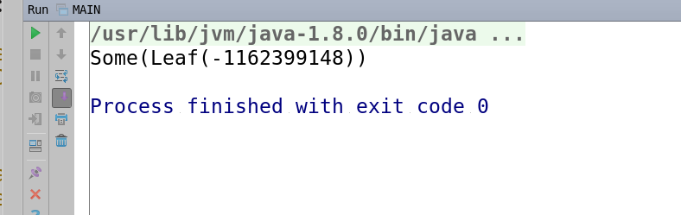
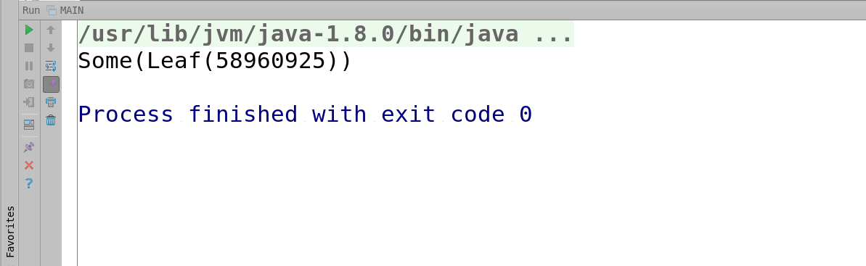
Looks nice...

Slide 67

Hit me baby one more time

Slide 68

Gladly

Slide 69

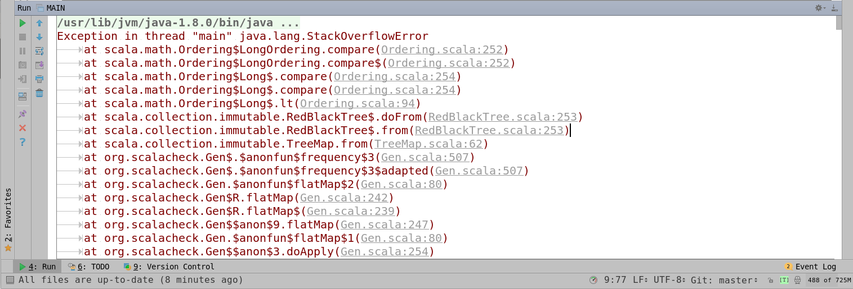

Slide 70
Gen.sized/resize
We’re limiting the depth of the resulting structure, by using Gen.sized/Gen.resize each time. We have to use them because the generator doesn’t know on which level it is.
def nodeGen: Gen[Node] = sized { size =>
choose(0, size) flatMap { currSize =>
val nGen =
resize(size / (currSize + 1), treeGen)
listOfN(currSize, nGen)
.map(children => Node(children))
}
}

Slide 71
It’s good now
Some(Node(List(Leaf(-1), Leaf(1304717632), Leaf(-2147483648), Node(List()), Leaf(1), Node(List(Leaf(-2147483648))), Node(List(Node(List()))), Node(List(Leaf(2147483647))), Leaf(2147483647), Node(List()), Leaf(0), Leaf(-1750110354), Leaf(0), Node(List(Leaf(-1))), Node(List(Node(List()))), Leaf(0), Leaf(-1), Leaf(1967483186), Node(List(Leaf(-2147483648), Node(List()))), Node(List(Leaf(-2147483648), Leaf(2058213520))), Node(List()), Leaf(2147483647), Node(List()), Node(List(Leaf(-2079347422), Leaf(194400272))), Leaf(1126460201), Leaf(-1), Node(List(Node(List()))), Node(List(Leaf(-480566545))), Node(List(Leaf(-2147483648))), Leaf(1166542327), Node(List(Node(List()))), Leaf(-7168943), Leaf(0), Leaf(-1), Leaf(-2147483648), Leaf(941502756), Leaf(-676474906))))

Slide 72
Stats
You can use Prop.classify to get some statistitcs:
forAll { n: Double =>
classify (n % 2 == 0, "even", "odd") {
classify (n < 0, "neg", "pos") {
classify(n == 0, "zero") {
n + n == 2 * n
}
}
}
}
+ OK, passed 100 tests.
> Collected test data:
36% neg, odd
28% neg, even
24% pos, odd
12% pos, even

Slide 73

Shrinking

Slide 74
Shrinking
ScalaCheck is not that smart. Shrinking algorithms are programmed manually for each Data type. You can also avoid shrinking by using forAllNoShrink.
trait Shrink[T] {
def shrink(x: T): Stream[T]
}
scala.collection.immutable.Stream[T]
implicit val shrink: Shrink[MyType] =
Shrink({
case x => //...
})

Slide 75

ScalaCheck is good but..

Slide 76
That’s it.
Thank you

