Slide 1

CORBA Programming
Arjang Fahim Ph.D.
Spring 2019

Slide 2
CORBA Programming
The common Object Request Broker Architecture (CORBA), allows clients to invoke operations on distributed objects (as defined by their IDL)
Clients that use CORBA have no concern for their location, the programming language of remote service, its OS, hardware platform or communication protocols (TCP/IP, IPX etc)
CORBA is support framework of applications, libraries and services for making distributed procedure calls.
CORBA's strength is that it allows platform and programming language interoperability. The interface between the client and server is defined by the CORBA IDL language which can be processed to produce code to support a variety of languages and platform

Slide 3
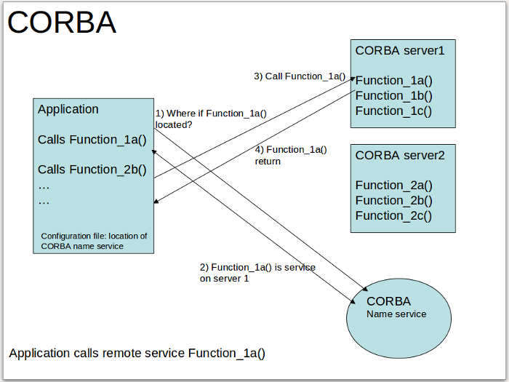
CORBA Programming
The common Object Request Broker Architecture (CORBA), allows clients to invoke operations on distributed objects (as defined by their IDL)
1- Applicationcalls Function_1a()
2- CORBA name service locates Function_1a() on “server 1”
3- Application requests a call to Function_1a() on “server 1”
4- Execution of Function_1a() on “server 1” returns a function return value and returns an argument list

Slide 4
CORBA Programming
The common Object Request Broker Architecture (CORBA), allows clients to invoke operations on distributed objects (as defined by their IDL)
1- Applicationcalls Function_1a()
2- CORBA name service locates Function_1a() on “server 1”
3- Application requests a call to Function_1a() on “server 1”
4- Execution of Function_1a() on “server 1” returns a function return value and returns an argument list

