Slide 1
Research and Application of Urban
Land Use Change Detection
Milestone 1 Review Meeting
汇报人：Team 12 日期： 2025/4/20

Slide 2
目录
1
Project Introduction
CONTENTS
2
Requirement Analysis
3
Work Report
4
Future Plan

Slide 3
Project Introduction
01

Slide 4
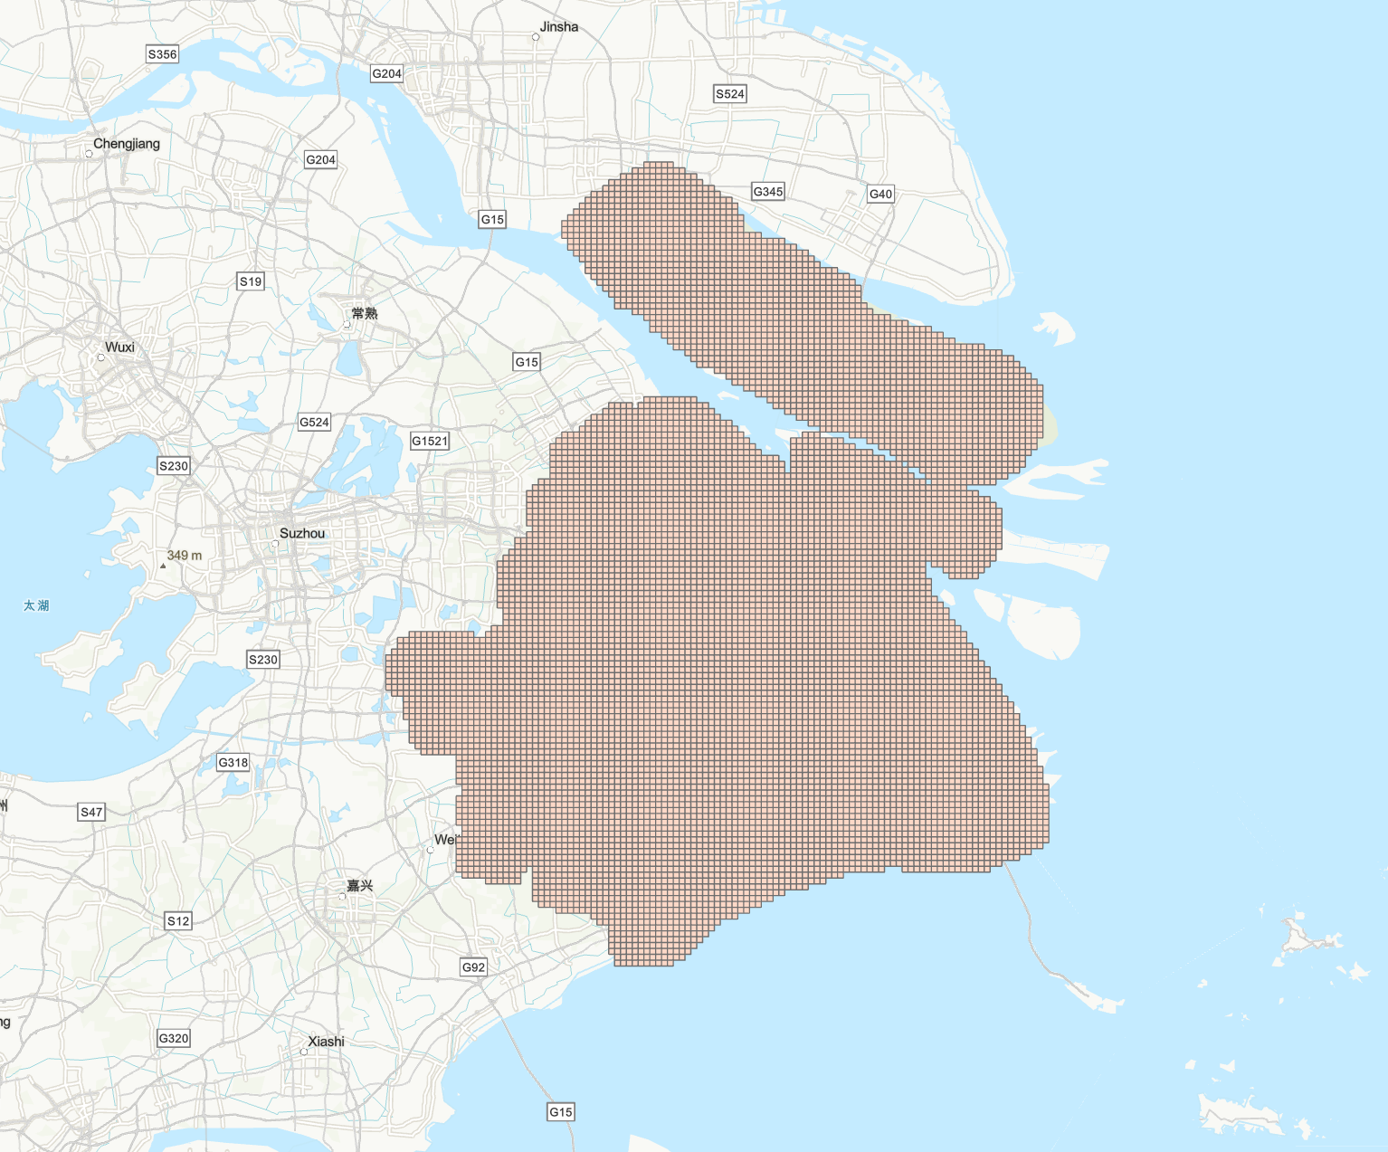
Introduction
This project proposes an innovative application of Kolmogorov-Arnold Networks (KAN) to analyze and predict urban light and heat distributions across Shanghai's gridded spatial data.
By leveraging the interpretable architecture of KAN models, we aim to uncover complex nonlinear relationships between urban morphological factors (e.g., building density, vegetation cover) and environmental outcomes (surface temperature, nightlight intensity) at high spatial resolution.

Slide 5
Background
应用场景（Application Scenarios）:
➢ 长三角一体化与G60科创走廊建设背景下，面向城市更新的多源遥感影像时空融合驱动的城市用地智能变化检测
➢ Under the backdrop of the Yangtze River Delta integration and the construction of the G60 Science and Technology Innovation Corridor, intelligent detection of urban land use changes driven by spatiotemporal fusion of multi-source remote sensing imagery for urban renewal.
➢ 城市更新监测、土地利用监测、城市蓝绿动态评估、城市扩张评估、城市规划、灾害监测等多个领域
➢ Urban renewal monitoring, land use monitoring, dynamic assessment of urban blue and green spaces, urban expansion evaluation, urban planning, and disaster monitoring, among other fields

Slide 6
Requirement Analysis
02

Slide 7
Requirement Source
This project cooperates with the urban planning department, is built based on real demand scenarios, and solves key problems in urban light and heat renewal monitoring
1. Policies, regulations and urban planning standards
Respond to national/local policy requirements:
Mitigation of heat island effect
Green lighting planning
Sustainable development goals
2. Scientific decision-making driven by technological development
The interpretability advantage of the KAN model
Urban planners rely on experience to make decisions that are easily questioned and require quantitative evidence support. At the same time, the "black box" characteristics of traditional models make it difficult for planners to understand the relationship between variables and cannot effectively adjust strategies. Interpretability is the advantage of the KAN model
Acceptance criteria:
The system needs to provide interpretable function output to help planners intuitively understand the mechanism.
The system needs to enhance the credibility of the conclusions by comparing the accuracy of KAN with the baseline model (such as a significant improvement in R²).

Slide 8
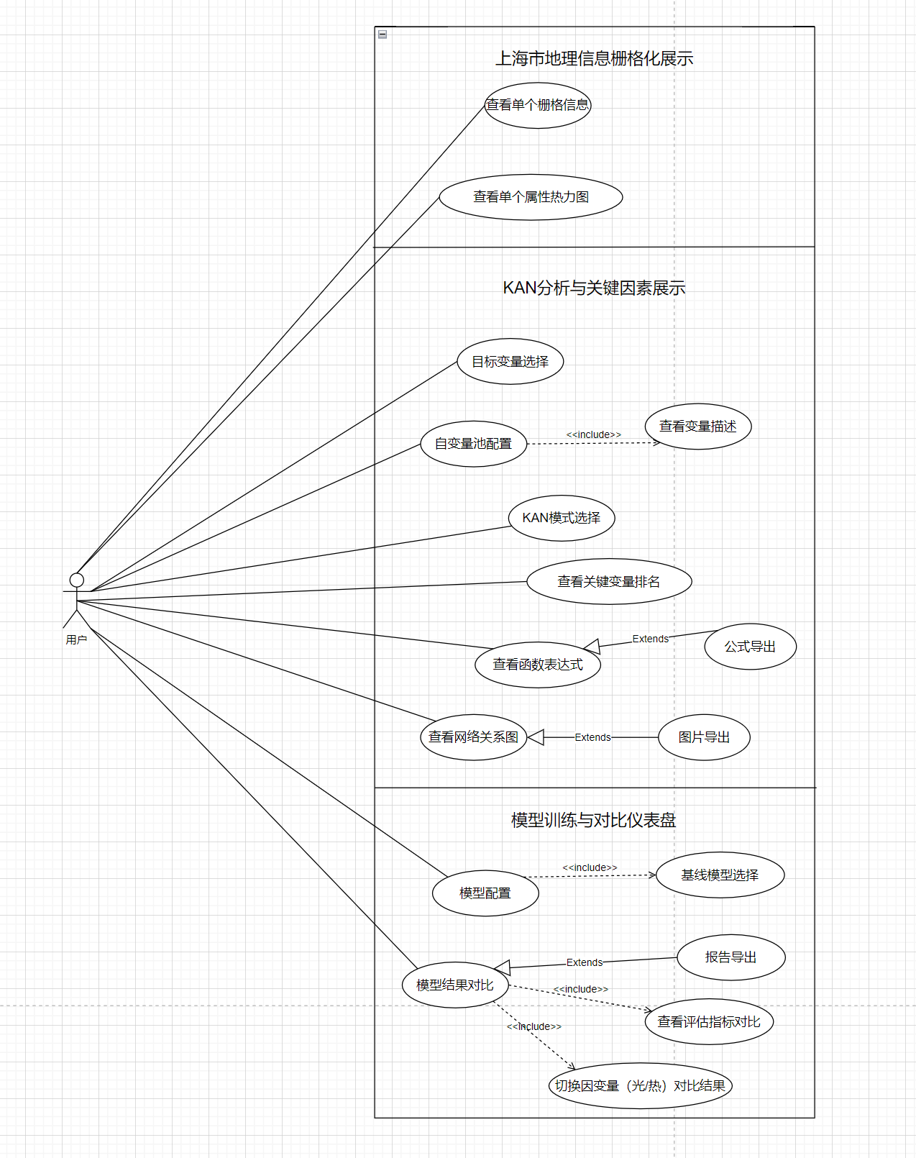
总用例图

Slide 9
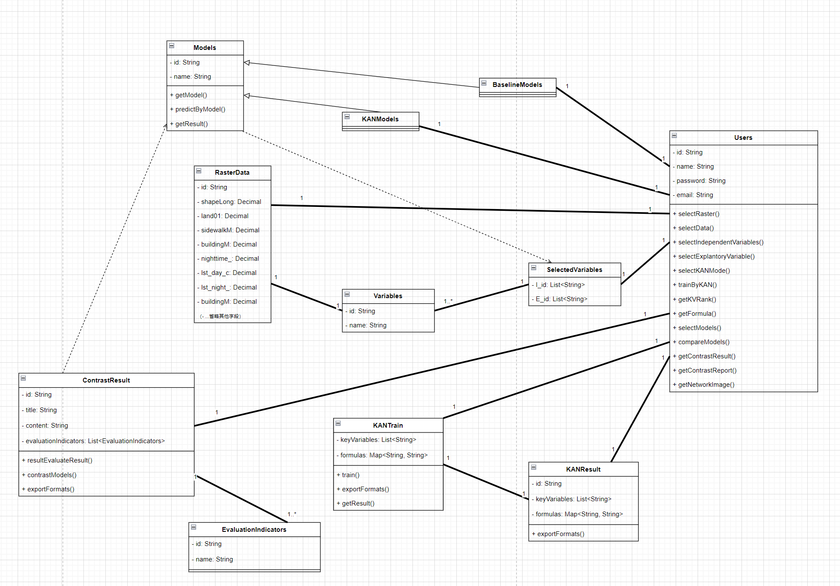
总类图

Slide 10
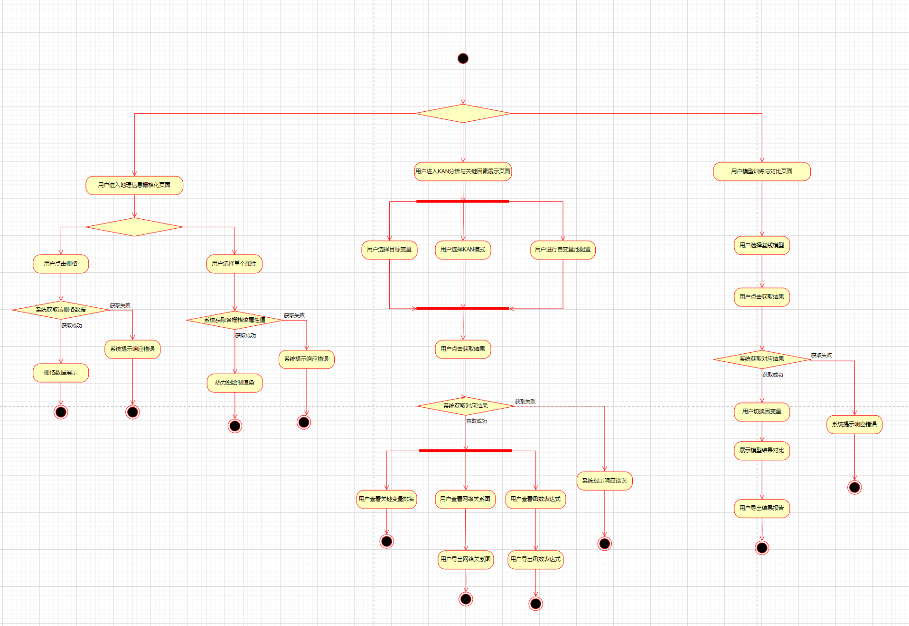
活动图

Slide 11
Work Report
03

Slide 12
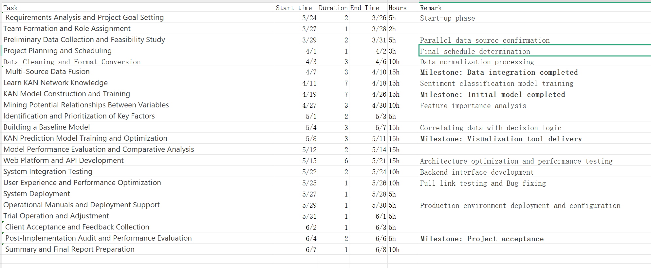
Project Schedule

Slide 13
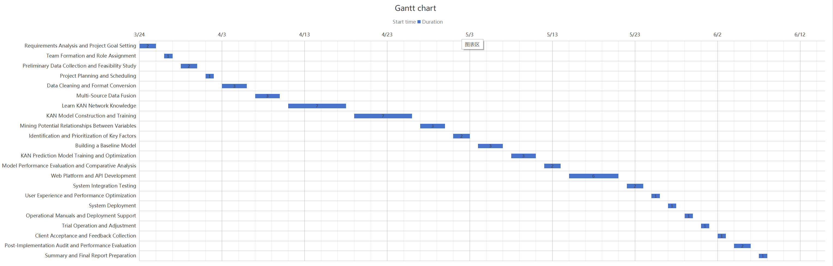
Gantt Chart

Slide 14
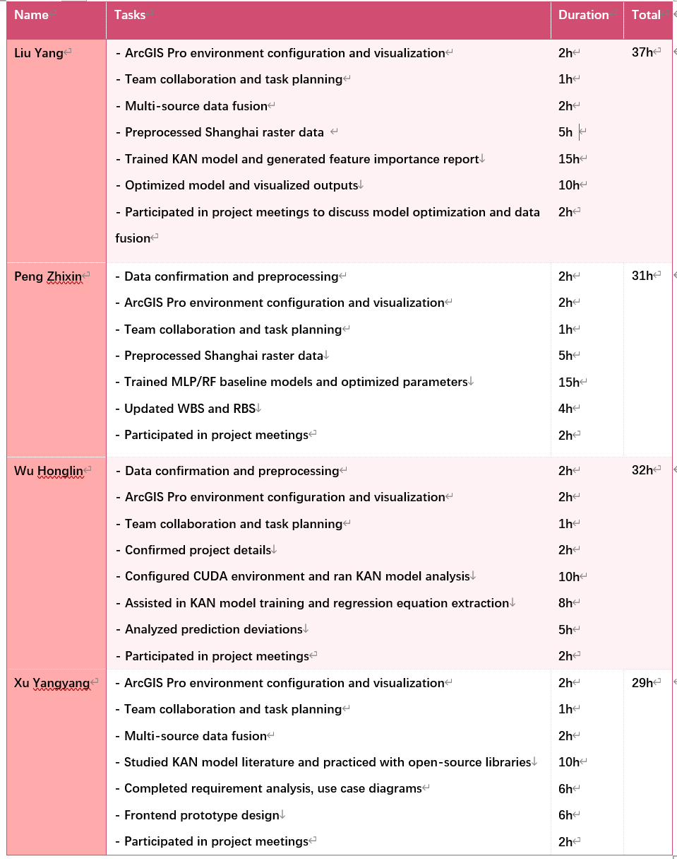
Personal Report

Slide 15
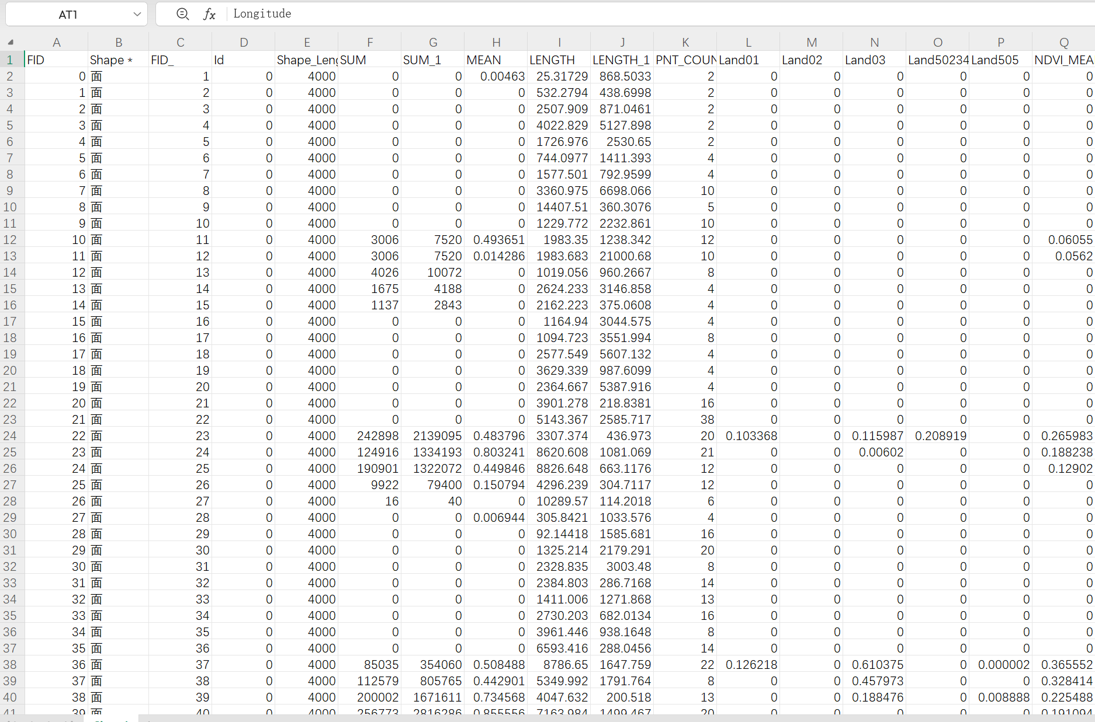
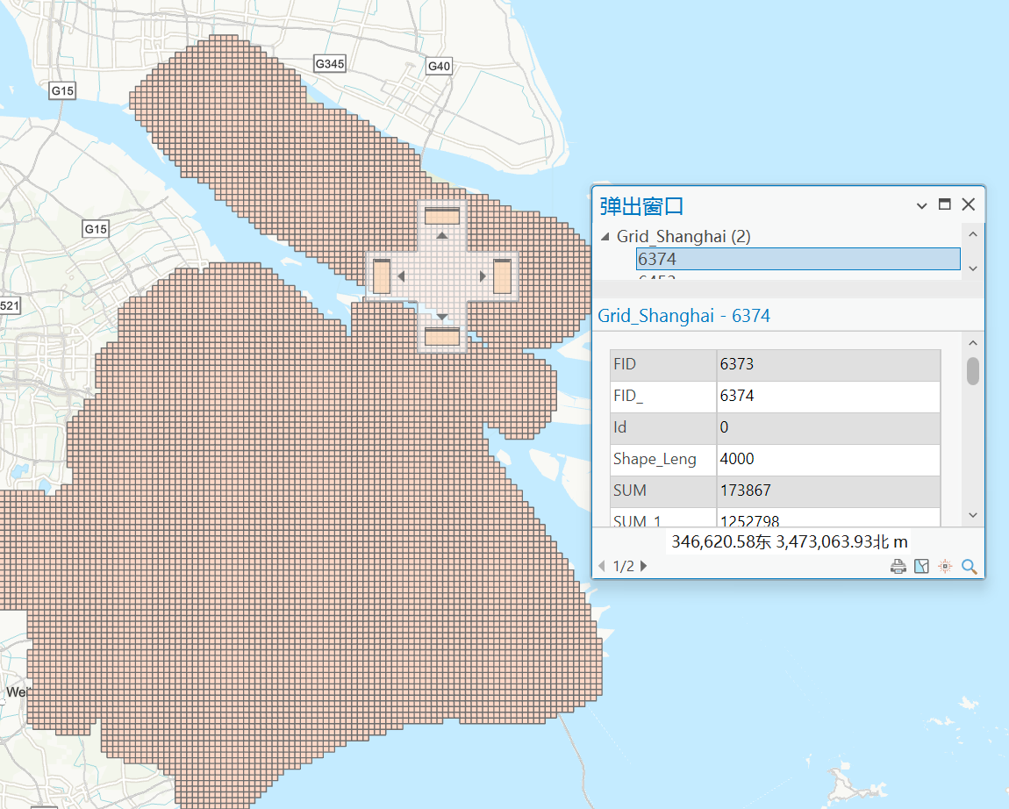
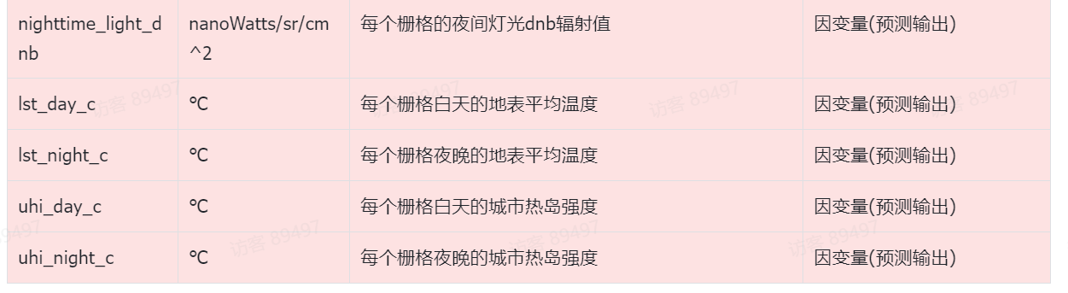
Milestone
Two weeks ago, we completed the processing, exporting and displaying of Shanghai city data. With ARCGIS PRO software, we can intuitively display the detailed data of each small grid in Shanghai. Exporting to Excel file makes it easier to use the panda library for deep learning.

Slide 16
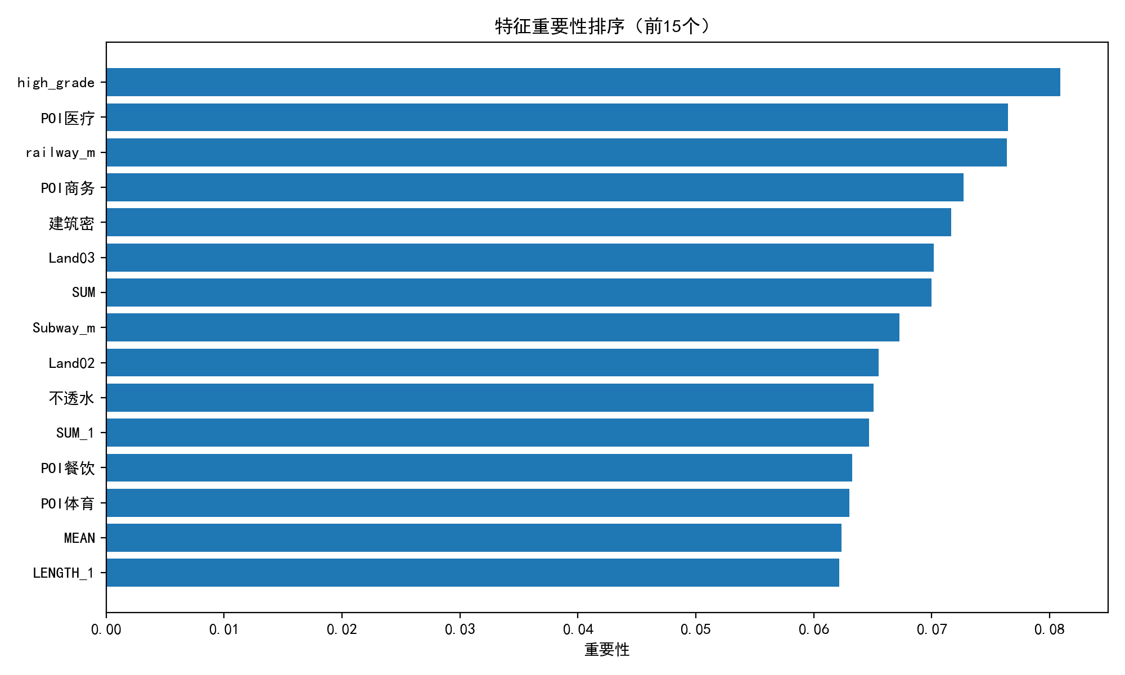
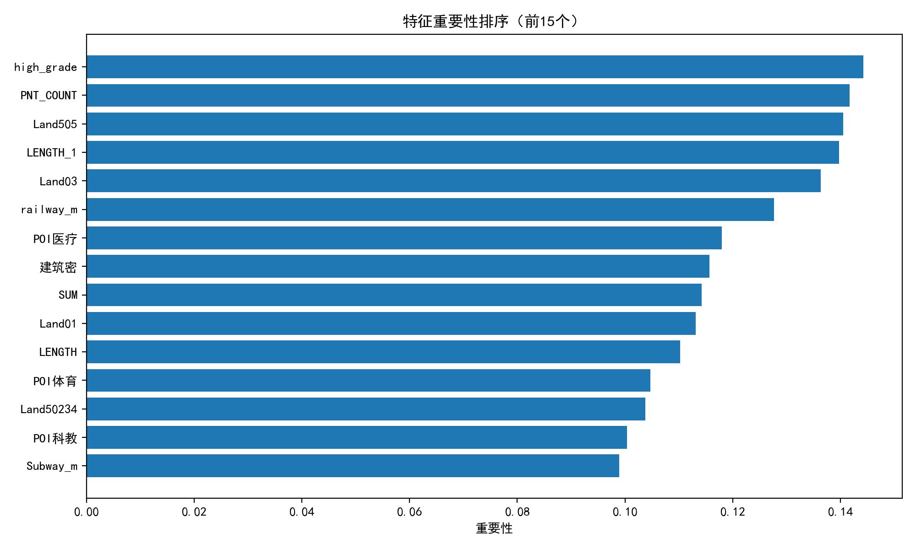
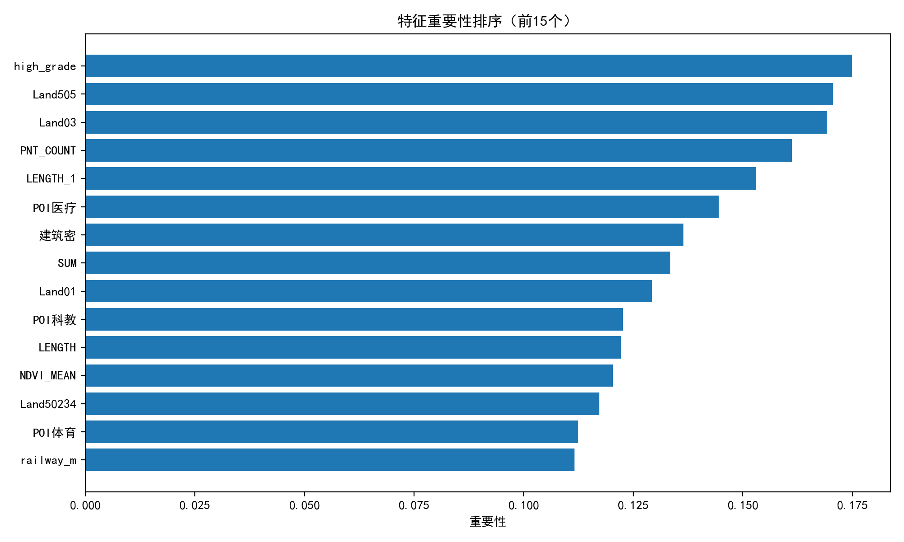
Milestone
In the past two weeks, we have successfully used the KAN neural network to screen out the 15 most important independent variables for three results, namely, the nighttime light radiation value, the average surface temperature during the day, and the average surface temperature at night for each grid.

Slide 17
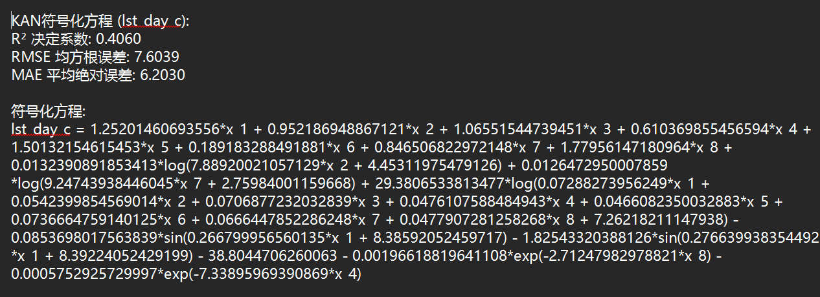
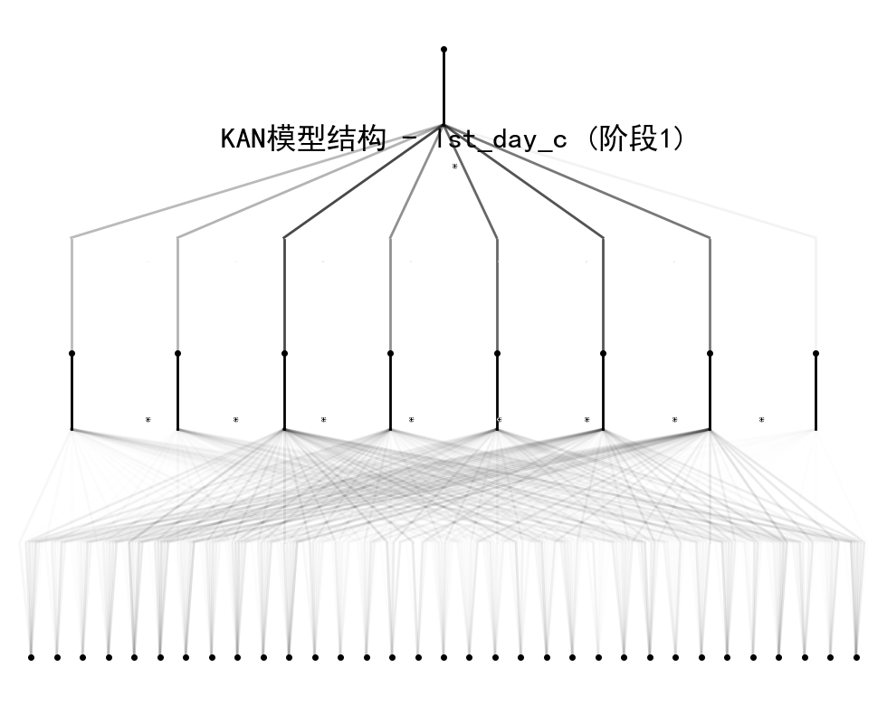
Milestone
Moreover, we have preliminarily obtained the KAN calculation formulas for each dependent variable and the corresponding KAN network model diagram, which further deepened our understanding of the algorithm and laid the foundation for subsequent optimization.

Slide 18
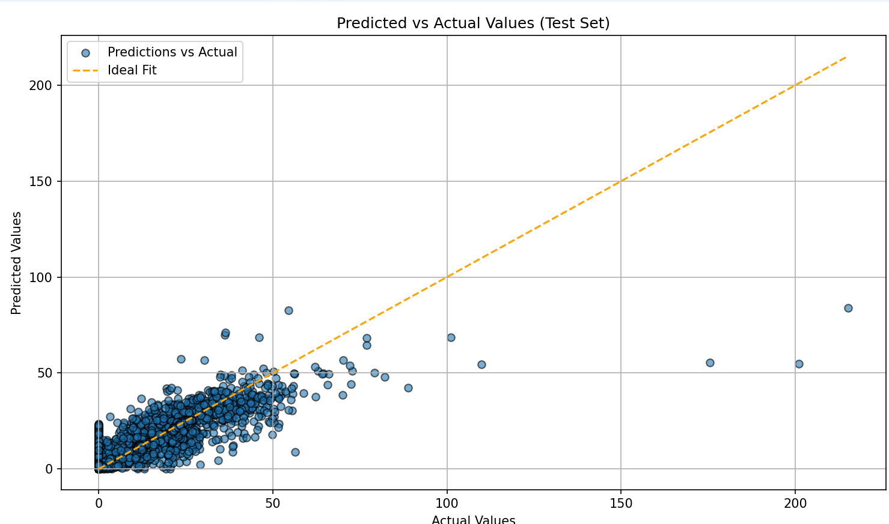
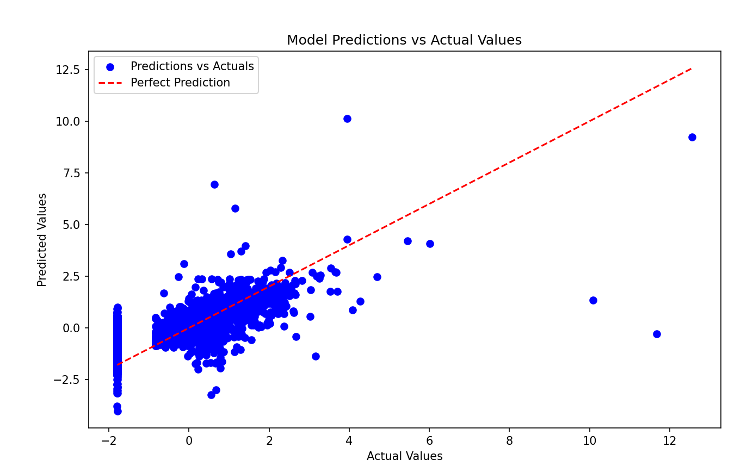
Milestone
At the same time, in order to further verify the superiority of the KAN neural network. We wrote two baselines based on MLP and random forest as reference indicators for the improvement of KAN performance and interpretability, and clarified the direction of subsequent optimization.

Slide 19
Future Plan
04

Slide 20
Future Plan
Build a front-end visualization web platform to display the prediction results of photothermal dependent variables (Peng Zhixin, Liu Yang).
Convene project meetings regularly to clarify task division and ensure smooth execution of plans (all members).
Model optimization and training
Data visualization and display
Project development and collaboration
Team communication and coordination
Study efficient training algorithms to reduce KAN model training time (Liu Yang, Wu Honglin).
Continue to optimize KAN model and improve prediction accuracy (Wu Honglin).
Improve project modeling and participate in KAN model algorithm design and training (Xu Yangyang).
Build the back-end architecture of the final display platform (Wu Honglin).
Promote data fusion solutions to ensure data security and privacy protection (all members).

Slide 21
Thanks for Listening

