Slide 1
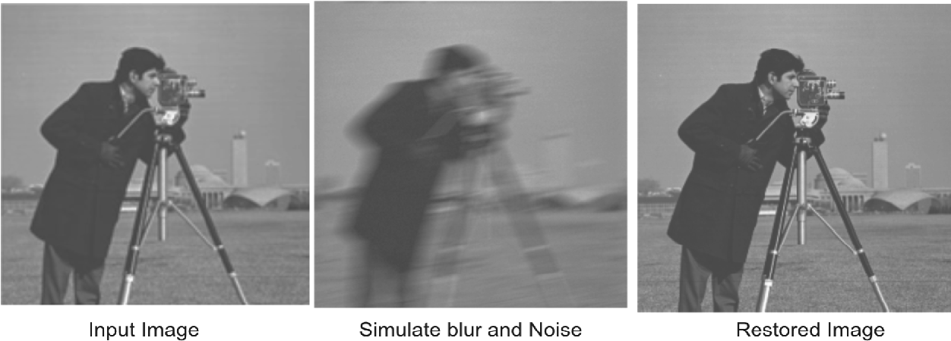
Image Deblurring
By Caleb Kim and Xuhong Lin

Slide 2
Blurring Methods
Gaussian Blur
Motion Blur
2 Parameters:
hsize - The kernel size determines the size of the filter or convolution kernel applied to the image.
2. Sigma – the higher sigma is, the more smoothing there is (and visa versa)
2 Parameters:
length – Length of motion blur
2. theta - Angle of motion blur in degrees
We will measure how good the deblurring methods are with PSNR and MSE
MSE: represents the cumulative squared error between the compressed and the original image
PSNR: represents a measure of the peak error.

Slide 3
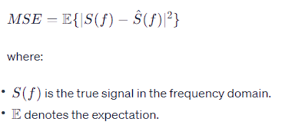
Wiener Filter
works on the assumption that additive noise is a stationary random process, independent of pixel location
minimizes the square error between the original and reconstructed images.
The Wiener filter minimizes the MSE
We used deconvwnr() for this.

Slide 4
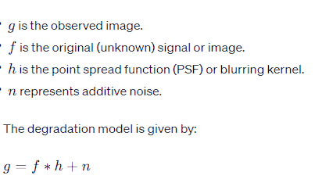
Blind Deconvolution
recovers a sharp image from a blurred and noisy one, without exact knowledge of how the image was blurred
aims to estimate both the original signal and the blurring function simultaneously.
We used deconvblind() for this problem.

Slide 5
Landweber Algorithm
The Landweber Algorithm is an iterative optimization method commmonly used for solving linear inverse problems, including image deblurring.​
f(n+1) is the new approximation from previous f(n)
G is the blurred image
N is the number of iterations
H is the blur function, PSF
β is a constant that controls the sharpening quantity
MATLAB conv2() will scale the image intensity, need to normalize back to [0,1]
β controls the converge speed
Small β won't converge to optimal solution
Big β will diverge the result

Slide 6


Slide 7
What did we learn?
Each filter is very situational depending on whether or not there is a pre-known PSF and how much noise is present in the blurred picture.

