Slide 1


SMART INDIA HACKATHON 2025
Problem Statement ID – SIH25031 Problem Statement Title- Crowdsourced Civic Issue Reporting and Resolution System Theme- Clean & Green Technology PS Category- Software Team ID- T047 Team Name - Saathi

Slide 2



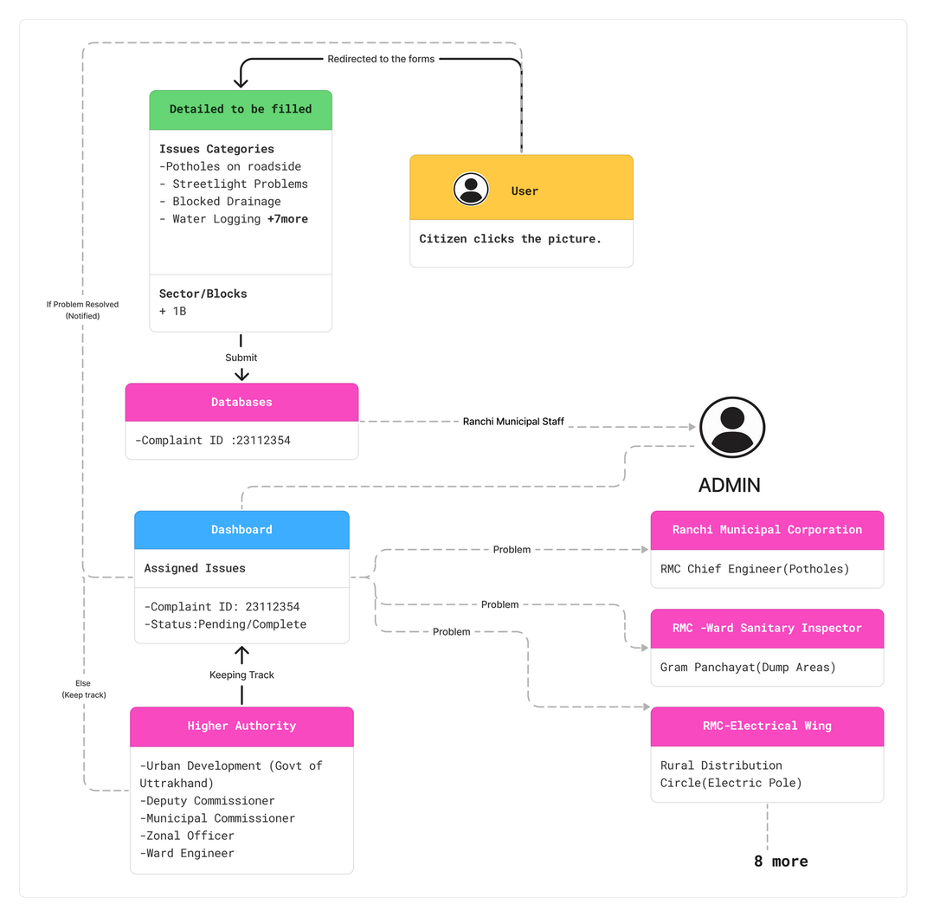
SAATHI
Proposed Solution
Acentralized, AI-powered platformthatstreamlines civic issue
reporting and resolutionby connectingcitizens directly with the relevant government departments.
AI-Driven Triage: Automatically categorizes and routes issues (potholes, garbage, etc.) to the correct department (RMC, Electrical Wing, etc.) using image recognition and geo-tagging. Transparent Tracking: Provides citizens with a unique Complaint ID and real-time status updates (Pending, In-Progress, Resolved) via an intuitive dashboard. Accountability through Escalation: Ensures timely resolution by automatically escalating unresolved issues to higher authorities. Inclusive & Scalable: Designed for both urban and rural communities with a multi-lingual, user-friendly interface to maximize citizen engagement. Data-Driven Governance: Offers analytics and heatmaps to authorities for predictive maintenance and efficient resource allocation, fostering sustainable urban development.
2

Slide 3

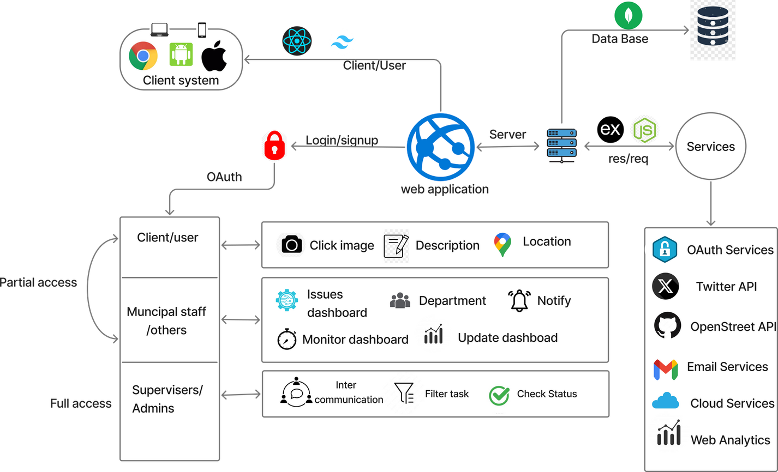













TECHNICAL APPROACH
System Architecture
Technology Stack
FRONTEND: React.js,React-Native,Redux,Next.js,Tailwind
CSS,Framer-Motion,jQuery
BACKEND : Node.js,Express,REST API, ,Supabase,Firebase,
Socket IO,Solidity,MongoDB
AI ML :TensorFlow Lite / PyTorch,BlockChain,GIS, PWA-Gamification ,NFT-ready
API SERVICES:LinkedIn API, GitHub API,Cloundinary,OAuth, Twlio
DEPLOYMENT:AWS,GitHub,GCP,Dockor

Slide 4













FEASIBILITY AND VIABILITY
POTENTIAL CHALLENGES
ANALYSIS OF THE FEASIBILITY OF THE IDEA
Delayed government response
01
Technological Feasibility
Lack of Transparency
02
Low citizen participation
Issue stay unresolved for weeks/months
Data Inaccuracy
Mobile-first design ensures accessbilty for the citizens.
Geotagging links issues to exact
locations for faster resolution.
Offline support a lows issue
reporting even with poor
internet.
People unaware or hesitant to report
Citizens don’t know the progress of complaints.
Duplicate/missing reports reduce system reliability
Operational Feasibility
Real-time dashboardsprovide Transparency to officials and citizens.
STRATEGIES TO OVERCOME CHALLENGES
Real-time dashboardsprovide Transparency to officials and citizens.
Smar t Auto- Routing
Scalable
Citizen Awareness Drives
Promote app adoption via
Issues auto-forwarded correct department, reducing delays.
Architecture supports adding more users, complaints, and departments without major changes.
compaigns.
Financial Feasibility
Early detectionof issues(e.g., fixing potholes) prevents accidents, lowering
repair/health costs.
Reduces duplicationof work and repeated repairs through verified reporting.
Unique Tracking IDs
Accessibility Features
Canstart at wardlevel and
Each complaint gets an ID for easy Progress tracking.
Multilingual options & voice- based reporting for
inclusivity.
expand to city, district,and state.
Future integration possible with
Community Verification
Upvoting & commentshelp confirm genuine reports, reduce duplicates.
04
03

Slide 5

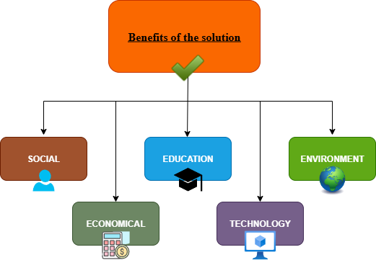

IMPACT AND BENEFITS
✅
Benefits of the Solution
Social:
Empowers citizens with a Digital Civic Voice to participate in governance. Builds trust & transparency between people and local authorities. Encourages community-driven collaboration for cleaner, safer neighborhoods.
Economic:
Reduces municipal costs by enabling AI-driven prioritization of resources. Saves manpower & time through automated routing & categorization of issues. Contributes to Smart City growth, attracting investments and boosting local economy.
Educational:
Promotes civic awareness & digital literacy among citizens. Acts as a practical case study for urban planning, governance & data science research. Can integrate into Smart Governance courses & hackathons for learning innovation.
🎯
Impact on the Target Audience
Technological:
Citizens: Gain a transparent and fast channel to raise civic issues, leading to higher engagement and trust. This can improve community participation by 40– 50%. Authorities: Achieve 30–40% faster resolution rates with AI-based routing and real-time dashboards, ensuring accountability and efficiency. Government: Access data-driven insights and predictive analytics for smarter decisions. Enables up to 25% savings in resource allocation. Community: Experience cleaner, safer, eco-friendly neighborhoods through proactive waste and sanitation handling. Builds sustainable smart cities.
Leverages AI + Geo-Intelligence for smart issue categorization & hotspot detection. Built on a Cloud-Native & Scalable Architecture, future-ready for IoT & Blockchain integration. Encourages Data-Driven Governance, enabling predictive analytics for urban development.
Environmental:
Faster response to waste management & sanitation issues
→ cleaner environment.
Supports sustainable urban ecosystems by addressing problems proactively.
Helps build eco-friendly smart cities aligned with SDGs (Sustainable Development
Goals).

Slide 6



RESEARCH AND REFERENCES
References
Our Solution
Ushahid i
SeeClick Fix
Raasta Fix
Feature
Ahmedabad
References taken by these platfrom :
Ushahidi (Global civic reporting platform):https://www.ushahidi.com/ SeeClickFix (USA): https://seeclickfix.com/ RaastaFix (India – Gurgaon): Times of India Report AI Civic Dashcam (Ahmedabad): News Link Smart City Ranchi Official Site: https://ranchismartcity.in/ Jharkhand Urban Development Dept: https://udhd.jharkhand.gov.in/
Image-base-issue
Auto Ai Dept(AI)
Research & Best Practices:
🔗
Geo-tragged-report
Image-Based AI Detection – Geo-Tagging for Transparency –
SpringerLink | arXiv
🔗
Smart Cities Mission Guideline
Automated Routing Engines –
🔗
Times of India
Dashboard Analytics – Citizen Notifications –
🔗
Smart Cities Dashboard
Rural+Urban cover
🔗
SeeClickFix | Smart Ranchi
Feasibility Facts:
Citizen notify
Rural Jharkhand has rapidly growing smartphone penetration (70%+), making web+mobile civic reporting practical. Govt. departments (Sanitation, PWD, Electricity, Forest, Urban Development) already have digital portals, so inte
Scable for jharkhand
Automated-dept-route

