Slide 1
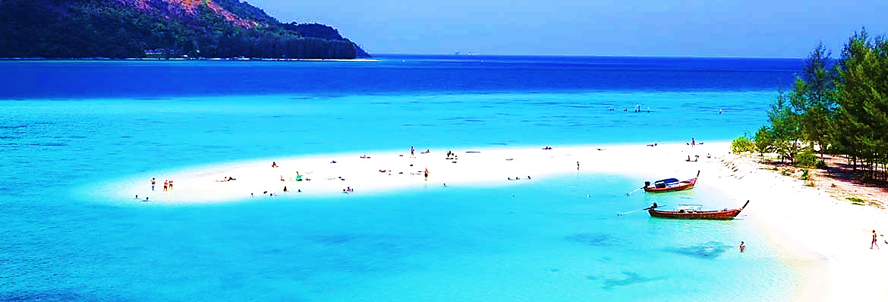
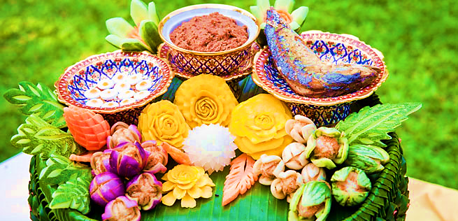
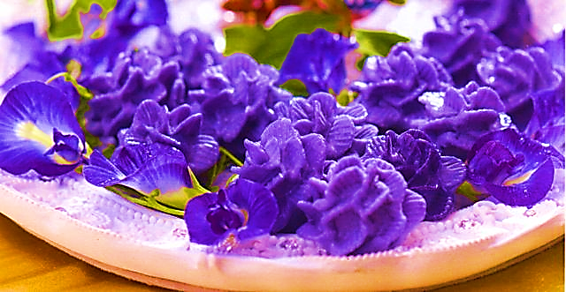
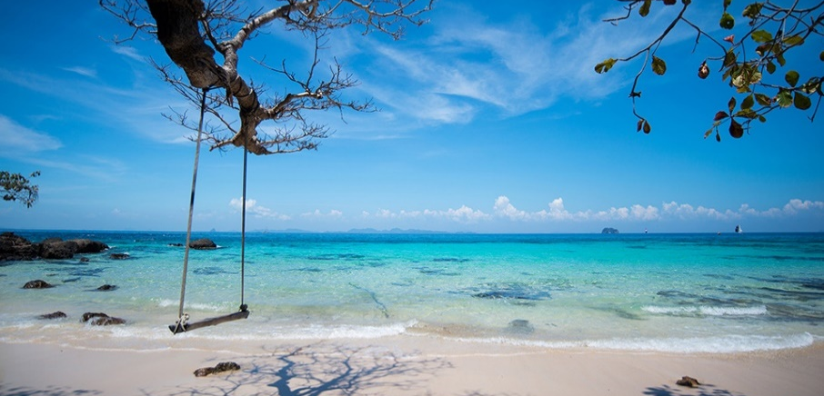
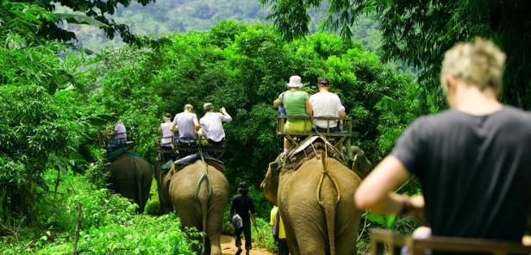
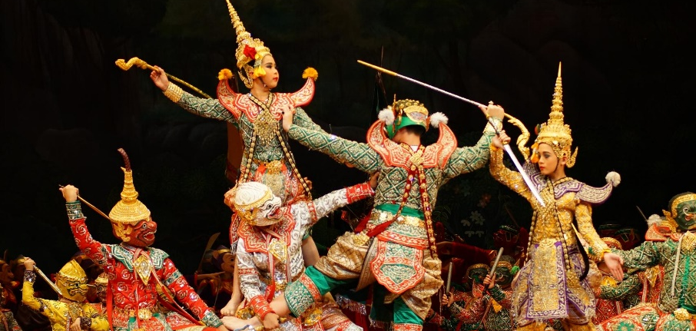
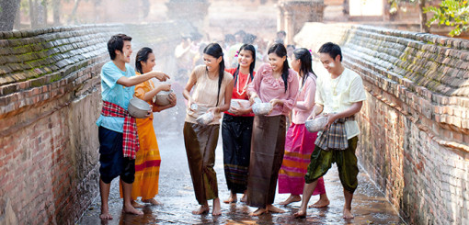







Home
Foods&Drinks
Desserts
Travel
Activities
History&Culture
Festivals
EN
Thailand
Paradise on earth
About Us
Thailand is a wondrous kingdom, featuring Buddhist temples, exotic wildlife, and spectacular islands. Along with a fascinating history and a unique culture that includes delectable Thai food and massage, Thailand features a modern capital city, and friendly people who epitomize Thailand’s “land of smiles” reputation.
Foods & Drinks
What to eat and drink
Desserts
Original Thai dessert
Travel
Places to visit
Activities
Amazing adventures
History & Culture
Unseen in Thailand
Festivals
Fun times!
What People Say
“Worth it”
Spending my holiday in Thailand is a brilliant idea. I’ve been in many beautiful places, none of them can compare to Thailand.
Best holiday ever!
- Cara Delving -
Share Your Moment
We welcome you to Thailand
Copyright © 2016
Wish you pleasant times

