Slide 1

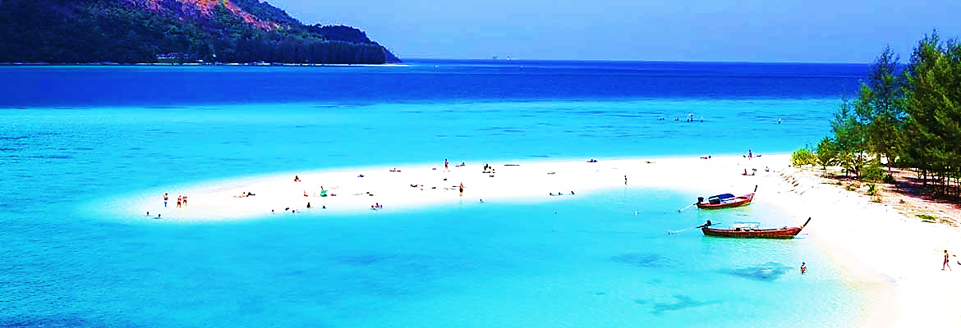

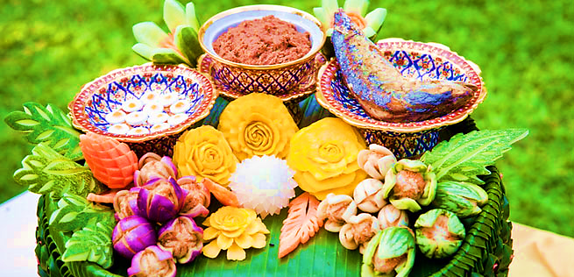
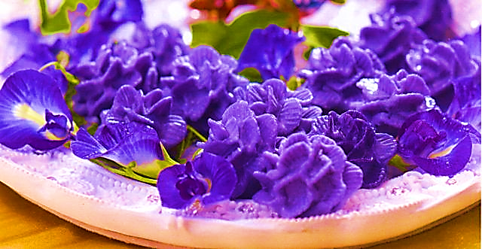
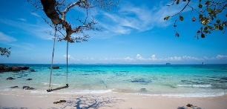
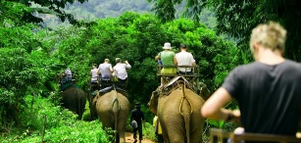
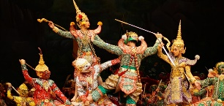
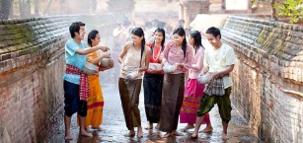
Foods & Drinks
What to eat and drink
Desserts
Original Thai desserts
Travel
Place to visit
Activities
Amazing adventures
History & Culture
Unseen in Thailand
Festivals
Fun times!
About Us
What People Say
Share Your Moment
We welcome you to Thailand
Copyright © 2016

