Slide 1
WeHelp!
102590044 梁桂花
http://www.cc.ntut.edu.tw/~t102590044/midterm2/index.html

Slide 2
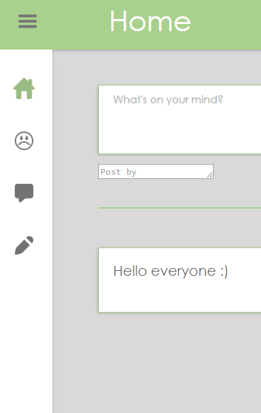
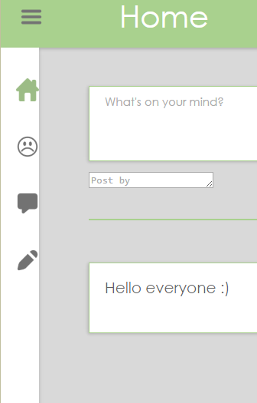
1. Wrong scale menu bar
Problem:
The menu bar’s size scale is not constant. Its size depends on width and height of website.
Solution:
Using grid to initialize menu bar’s scale.

Slide 3
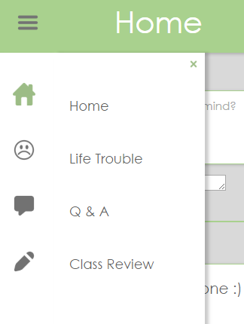
2. Color change
Problem:
The menu bar’s color does not change when pointer hovering over.
Solution:
Change background color where is pointed.

Slide 4
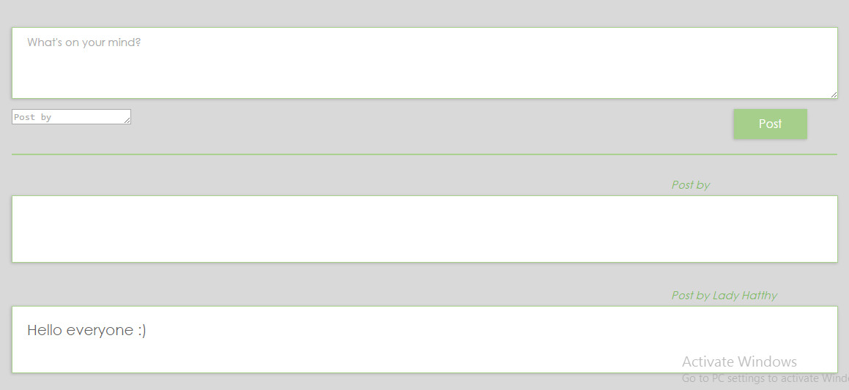
3. Left blank
Problem:
‘Post’ button and effect still working even though text is left blank.
Solution:
Change the ‘Post’ button and effect to disable class.

Slide 5
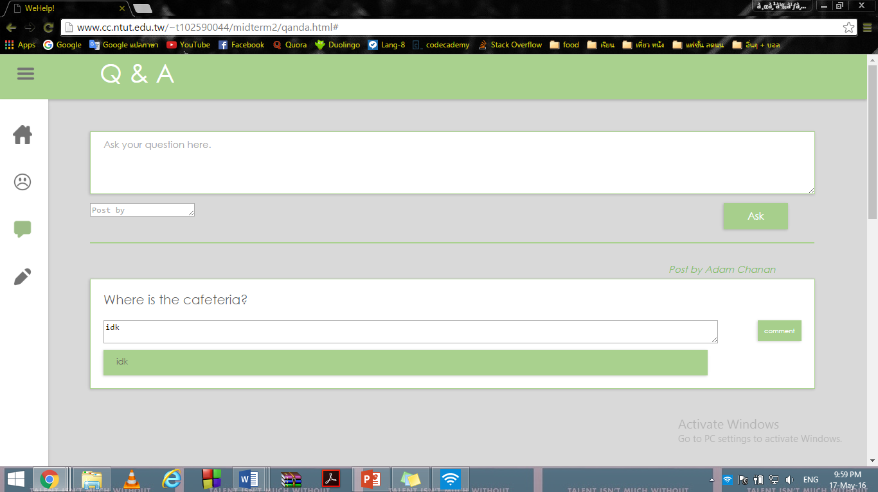
4.Text still appears
Problem:
Text still appears after clicking ‘comment’ button.
Solution:
Change comment box to none text.

Slide 6
5. No ‘comment by’ person
Problem:
There is no telling who is comment on the post which could cause any mistake.
Solution:
Add more of ‘comment by’.

Slide 7
6. No database connection
Problem:
There is no connection with the database which makes all post and comment disappear every time user clicks refresh.
Solution:
Use PHP to connect with database.

