Slide 1
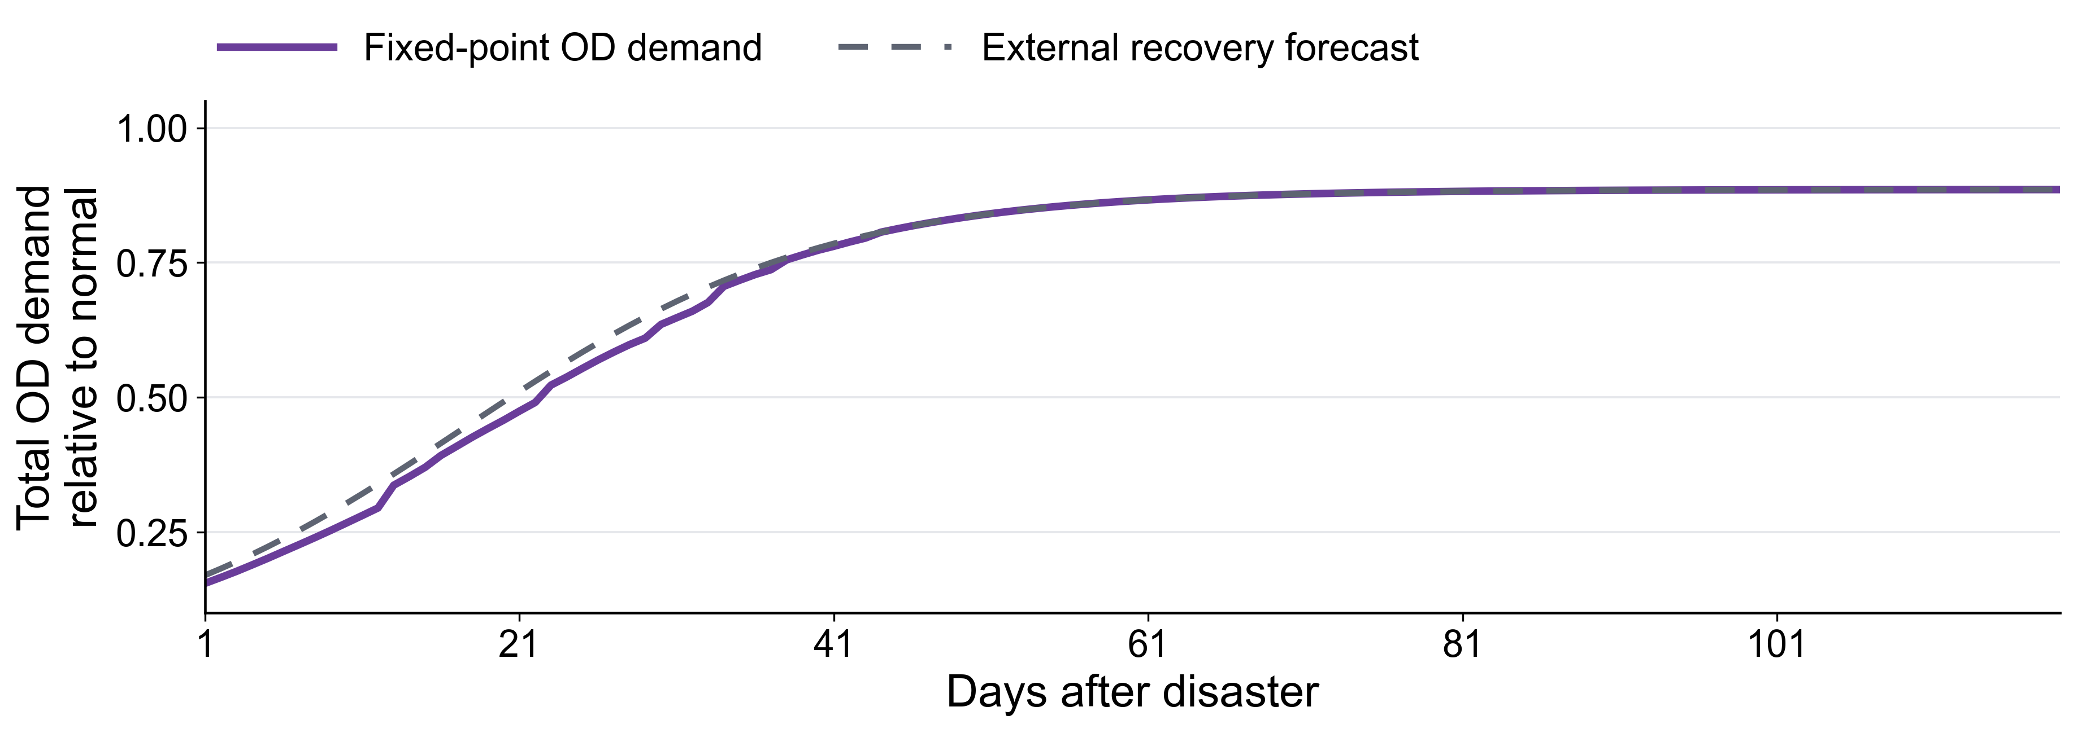
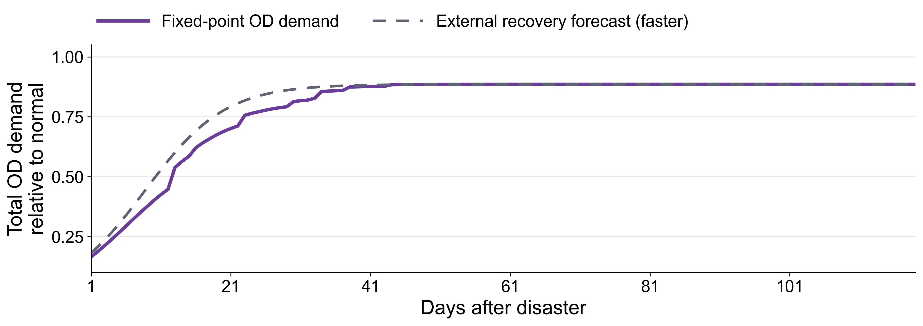
Endogenous human behavior vs external recovery speed
Recovers in 70 days
Recovers in 35 days
NOTE: The curve should recover to 1. It has been revised in the codes. Just haven’t updated the pictures in this slides.

Slide 2

Smoothed version
𝑞ₜ = 𝑞ₜᵉˣᵗᵉʳⁿᵃˡ + Hₜ + wₜ 𝑞ₜᵉˣᵗᵉʳⁿᵃˡ · [exp(−𝛾 Δ𝑐ₜ(𝑞ₜ)) − 1]
The share realized u days after a change is 1 − exp(−u/τ), where τ ≈ 2.34 days. With one-day time intervals, demand moves 34.82% toward its current target each day; approximately 95% of a sustained change is realized within 7 days.

Slide 3
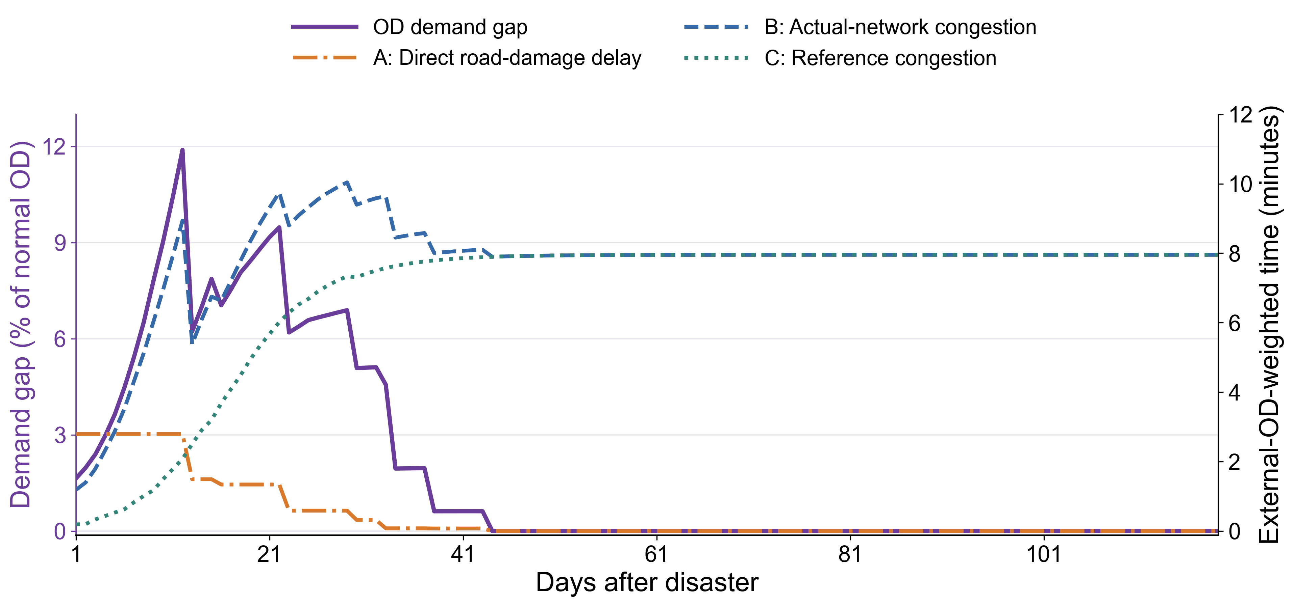
Endogenous human behavior decomposed
A: Additional free-flow travel time caused by road damage
B: Congestion delay in the actual network
C: Congestion delay in the undamaged reference network
Travel-time difference = A + B − C. All three components are averaged using external OD demand as weights.

Slide 4
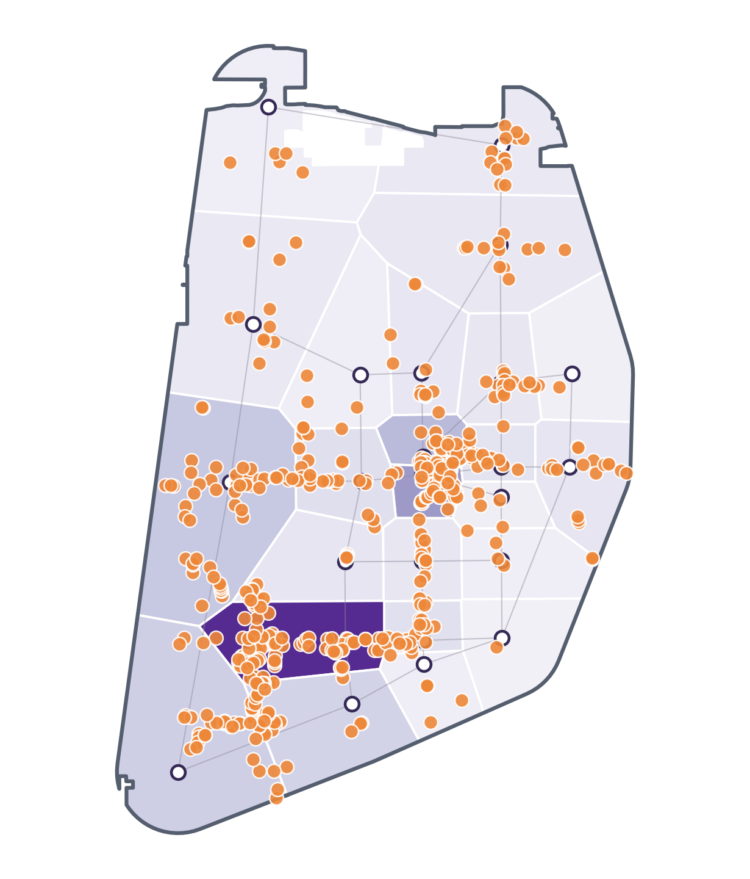
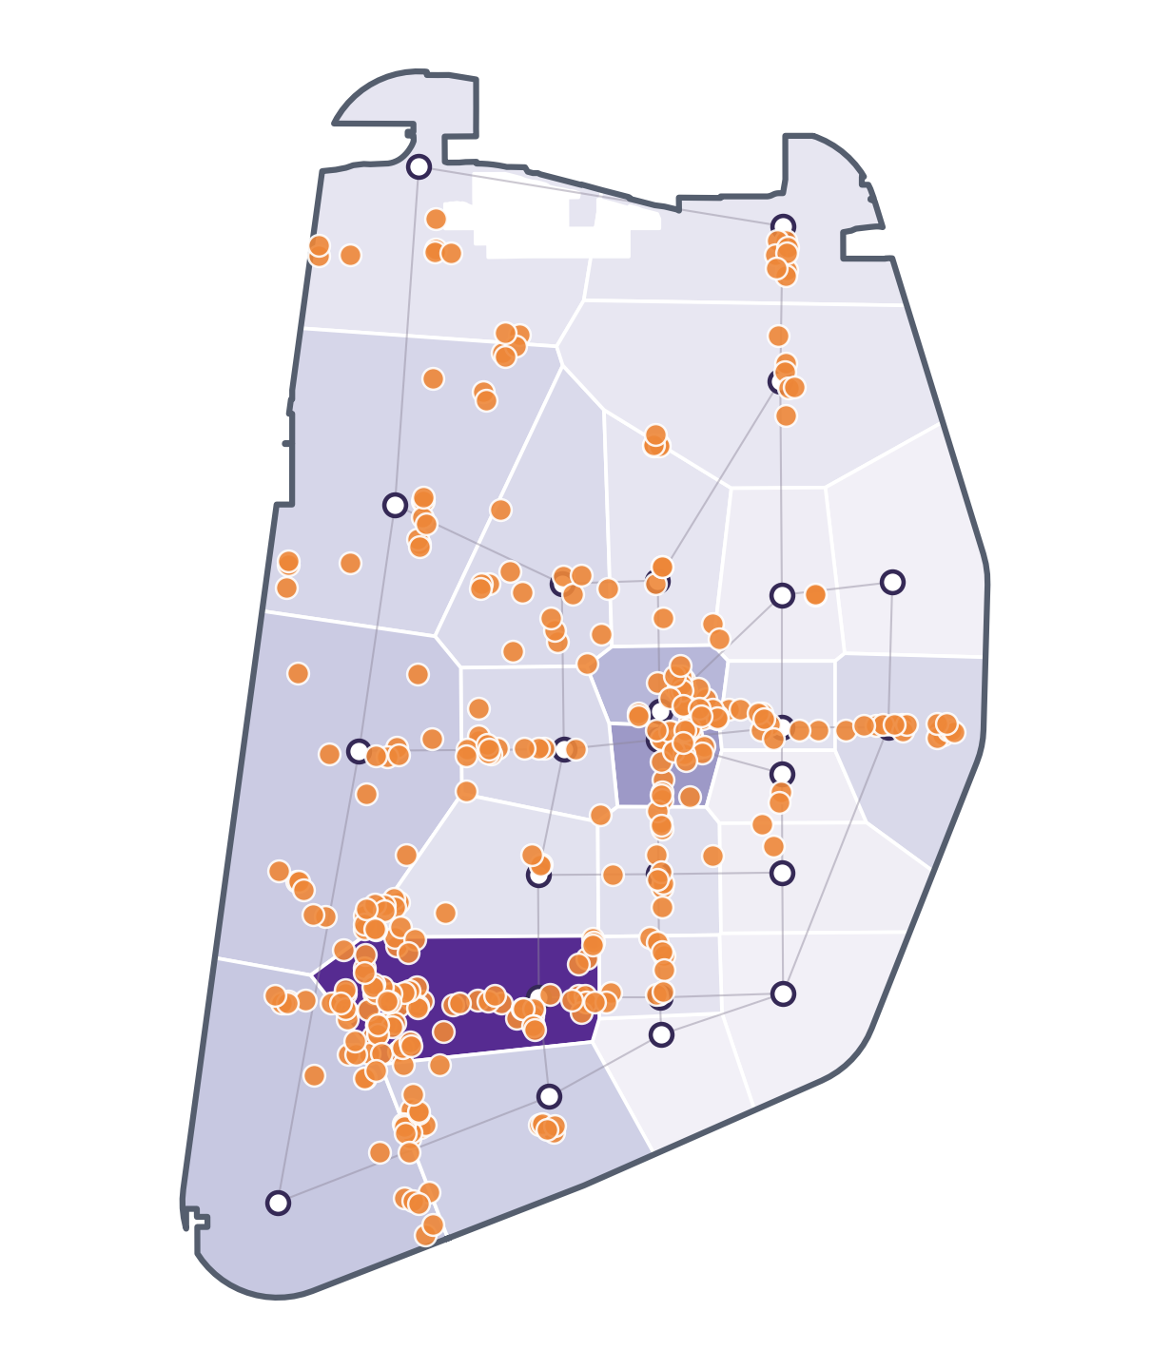
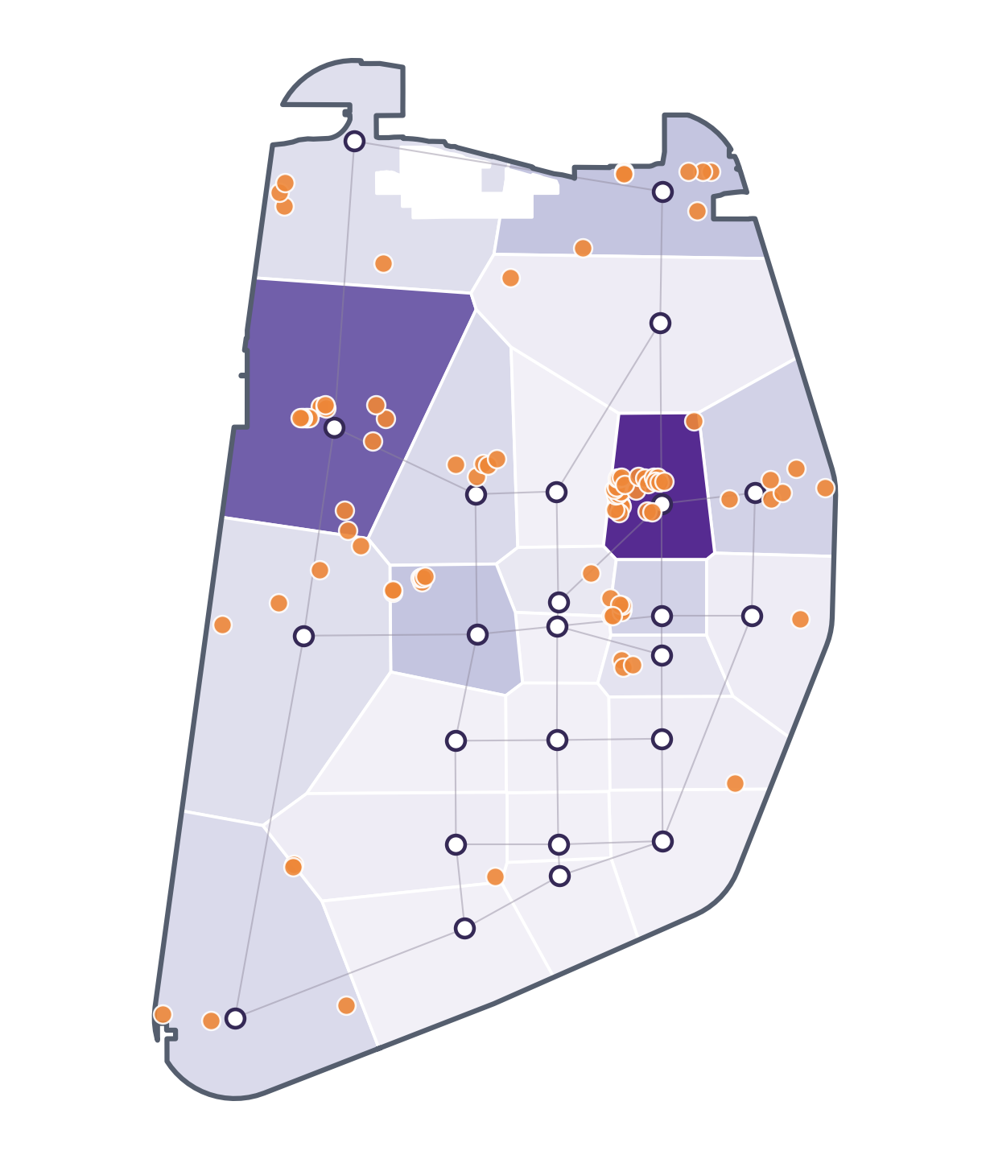
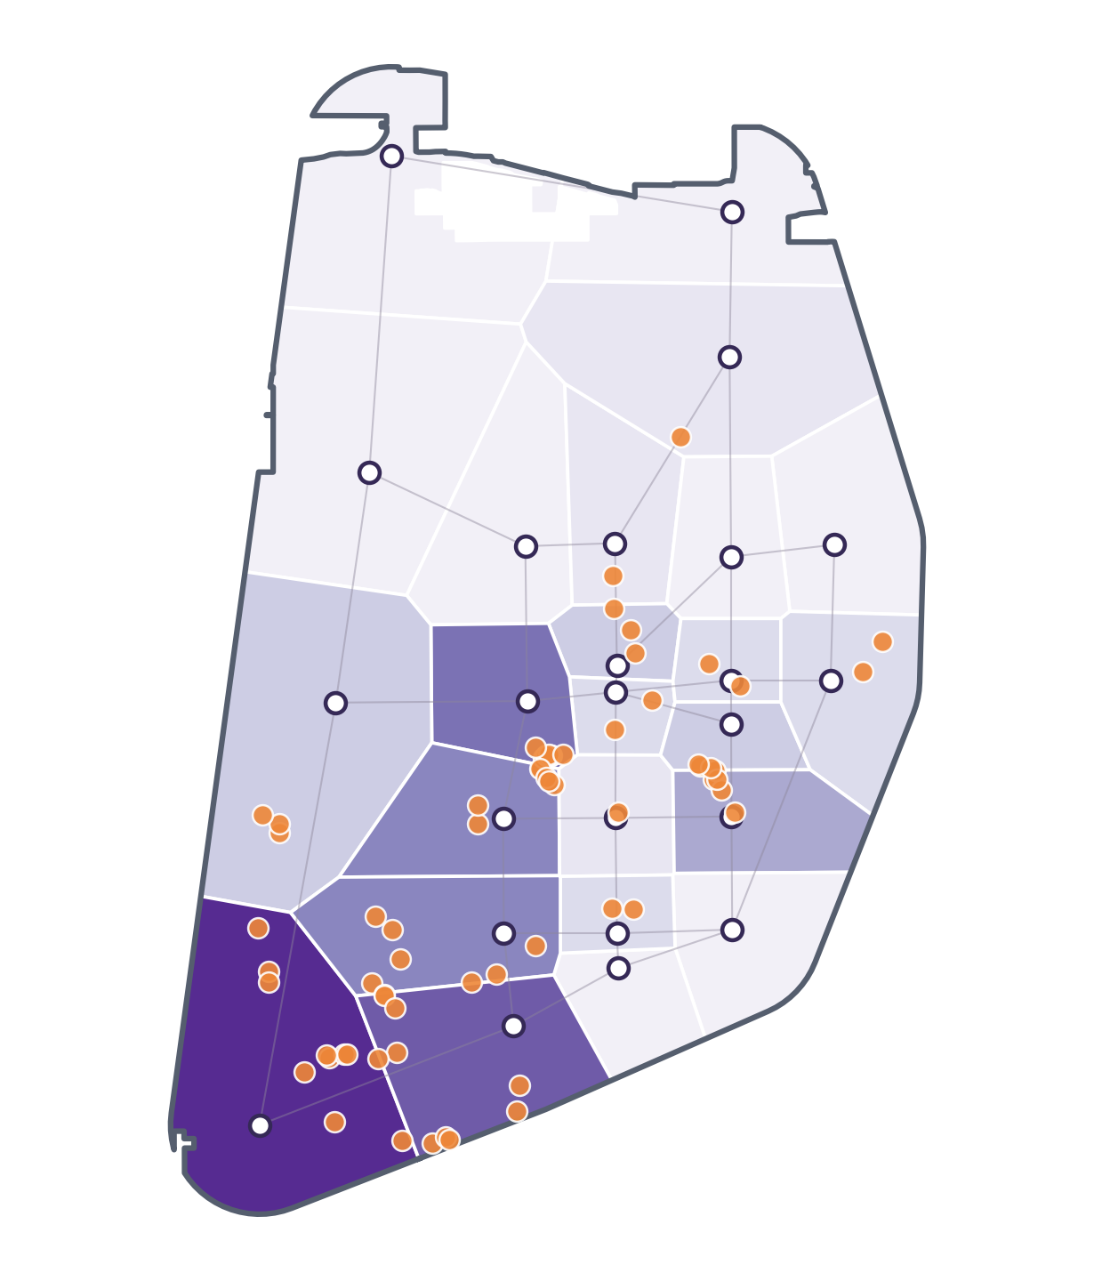
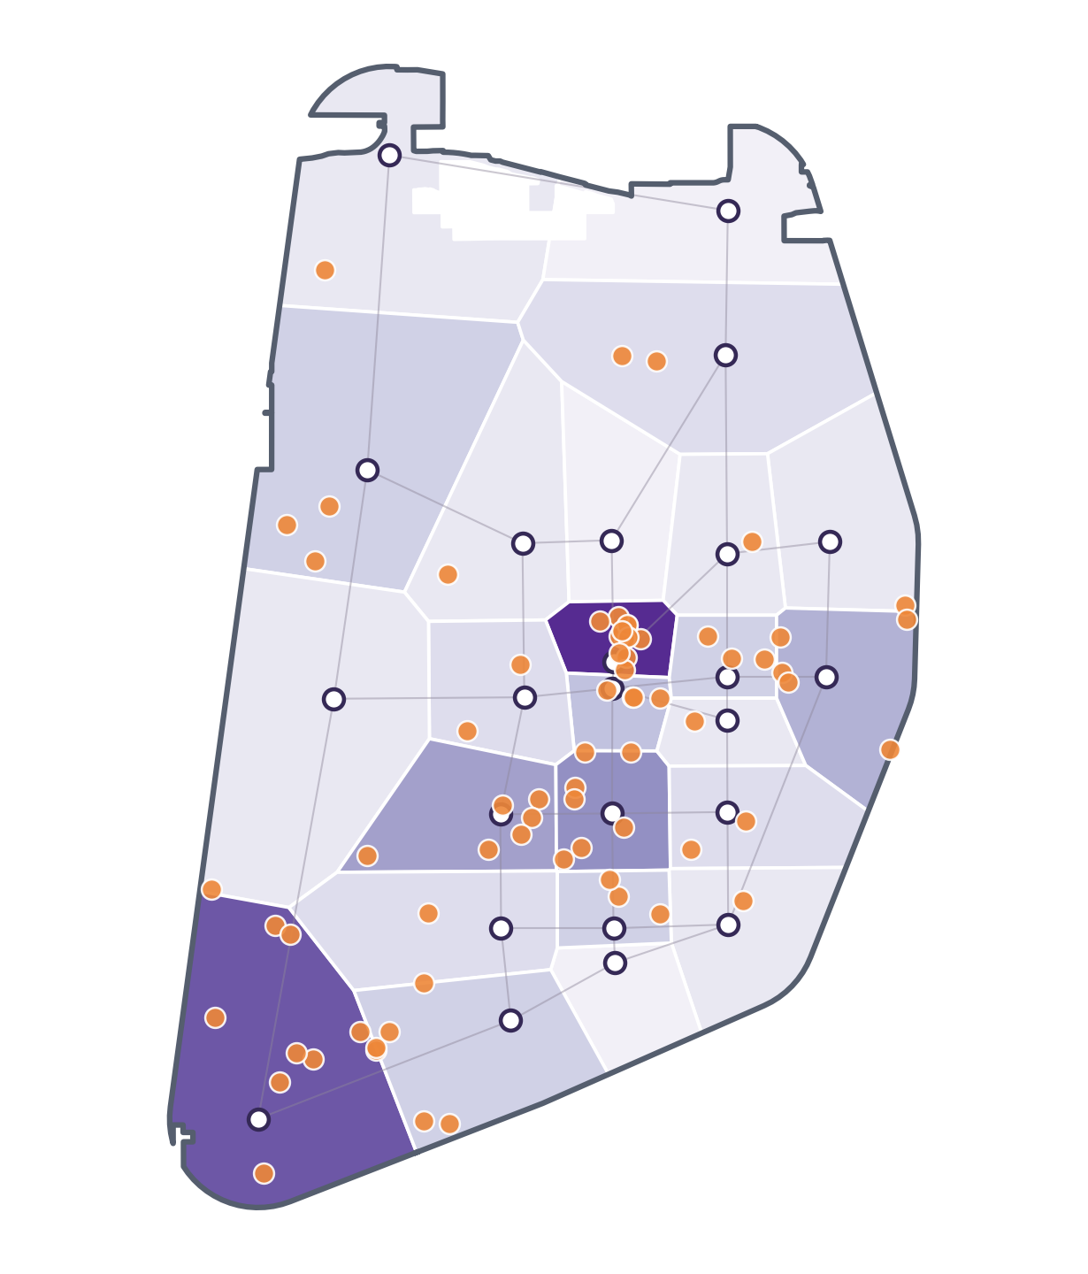
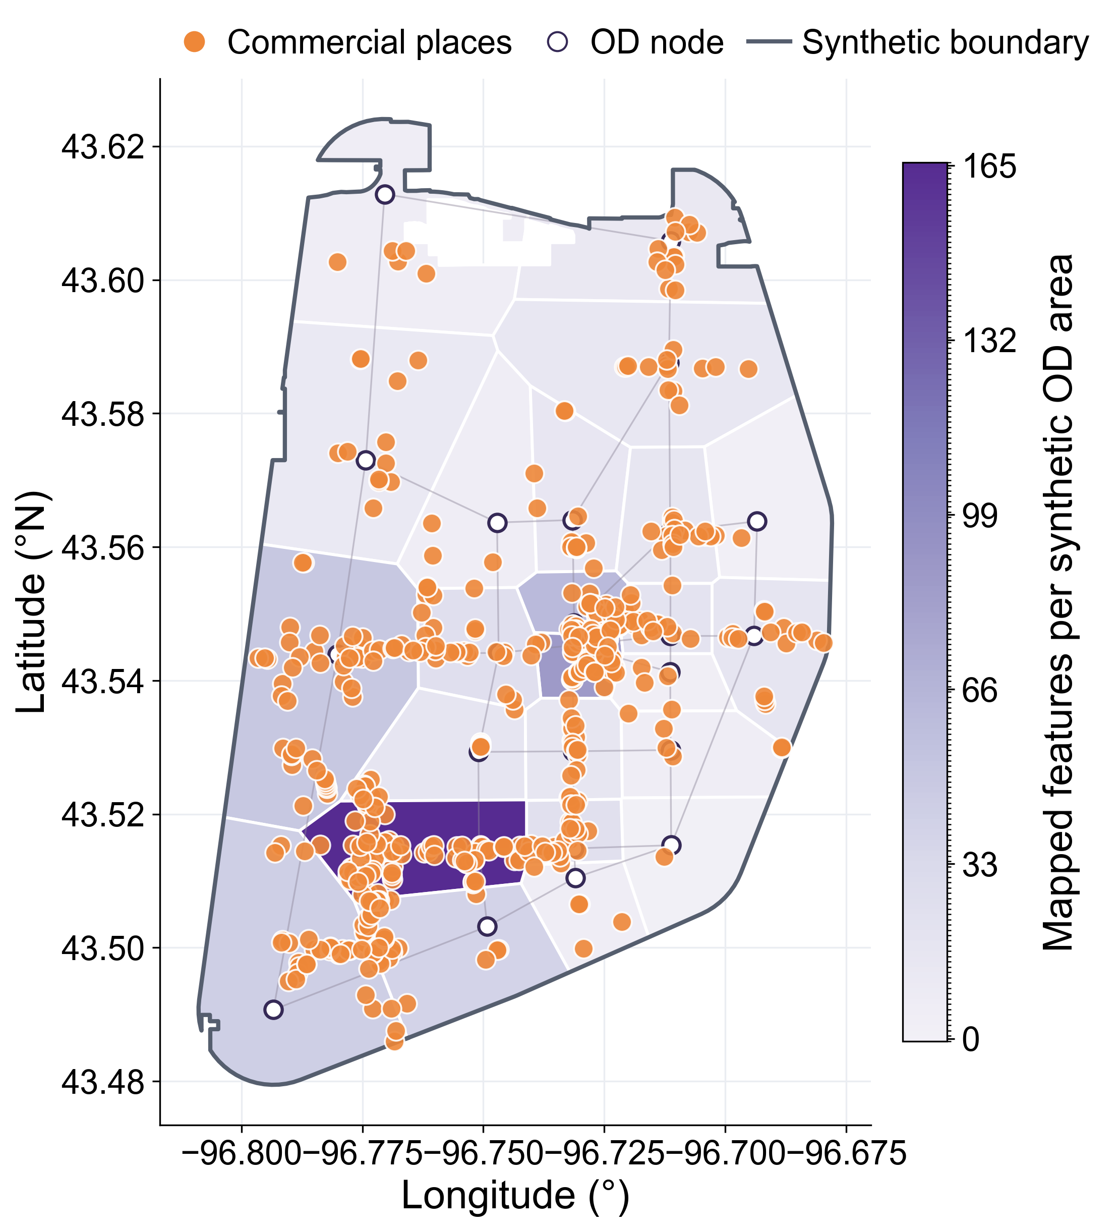
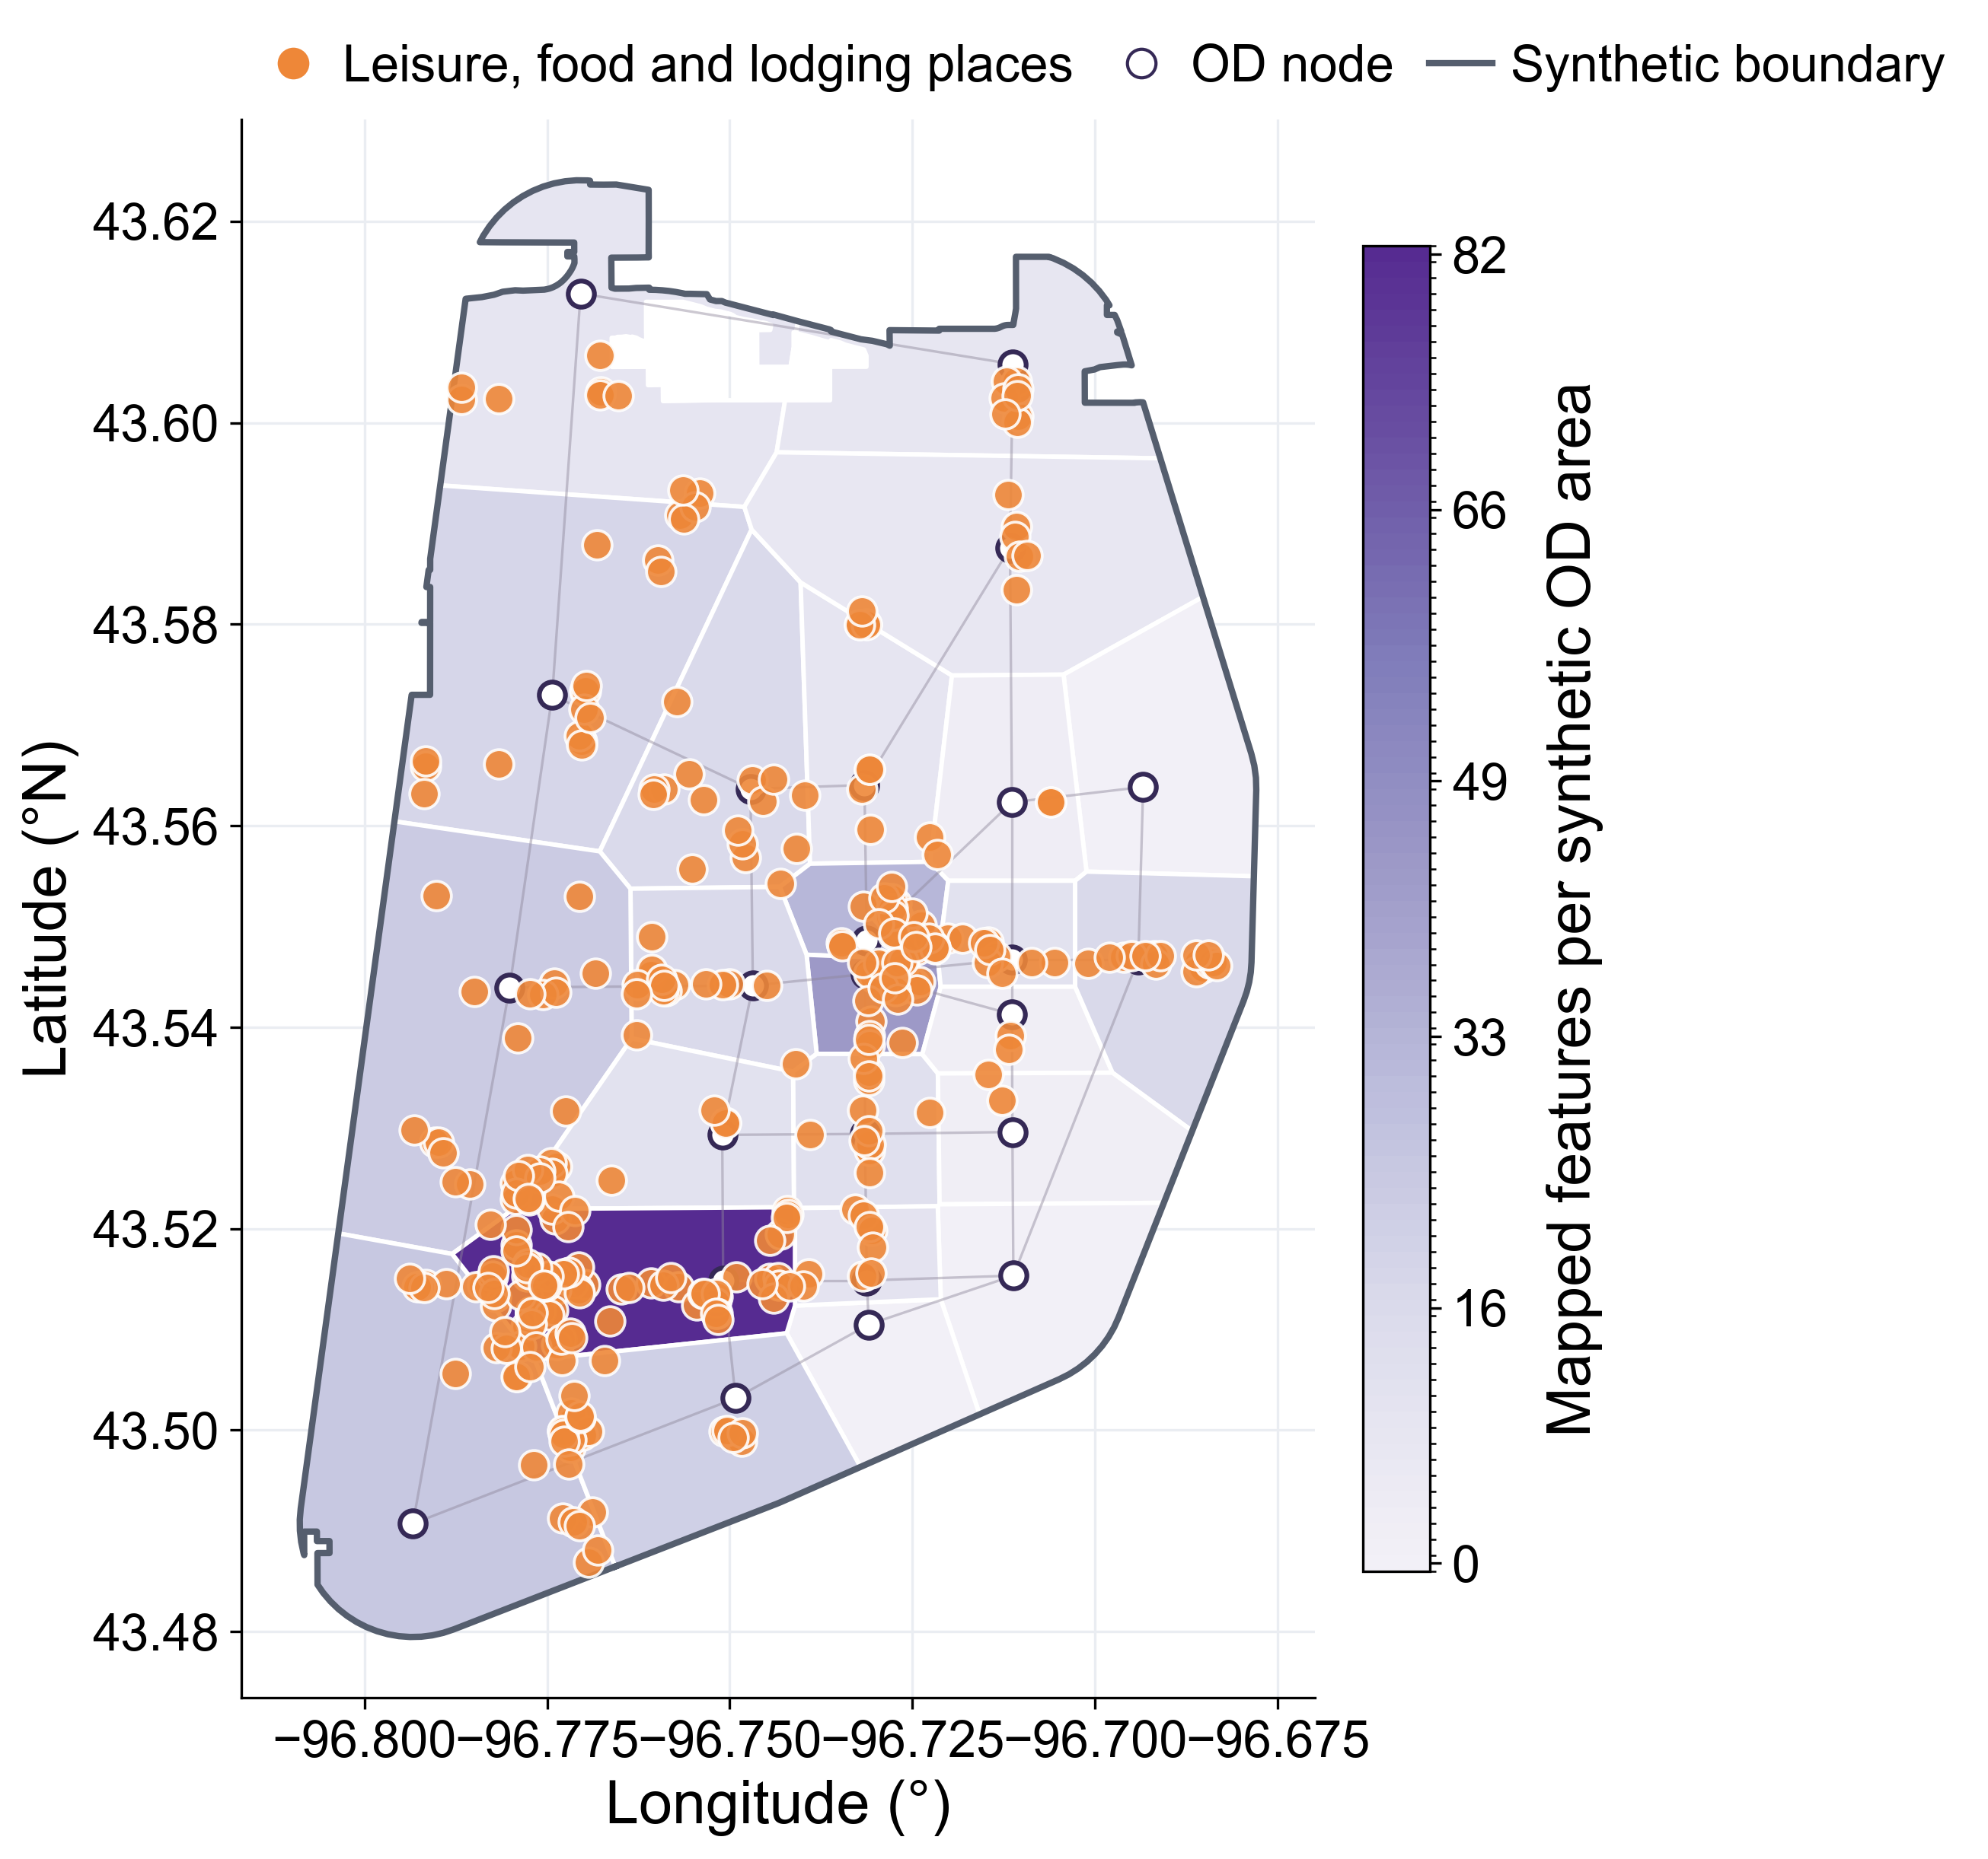
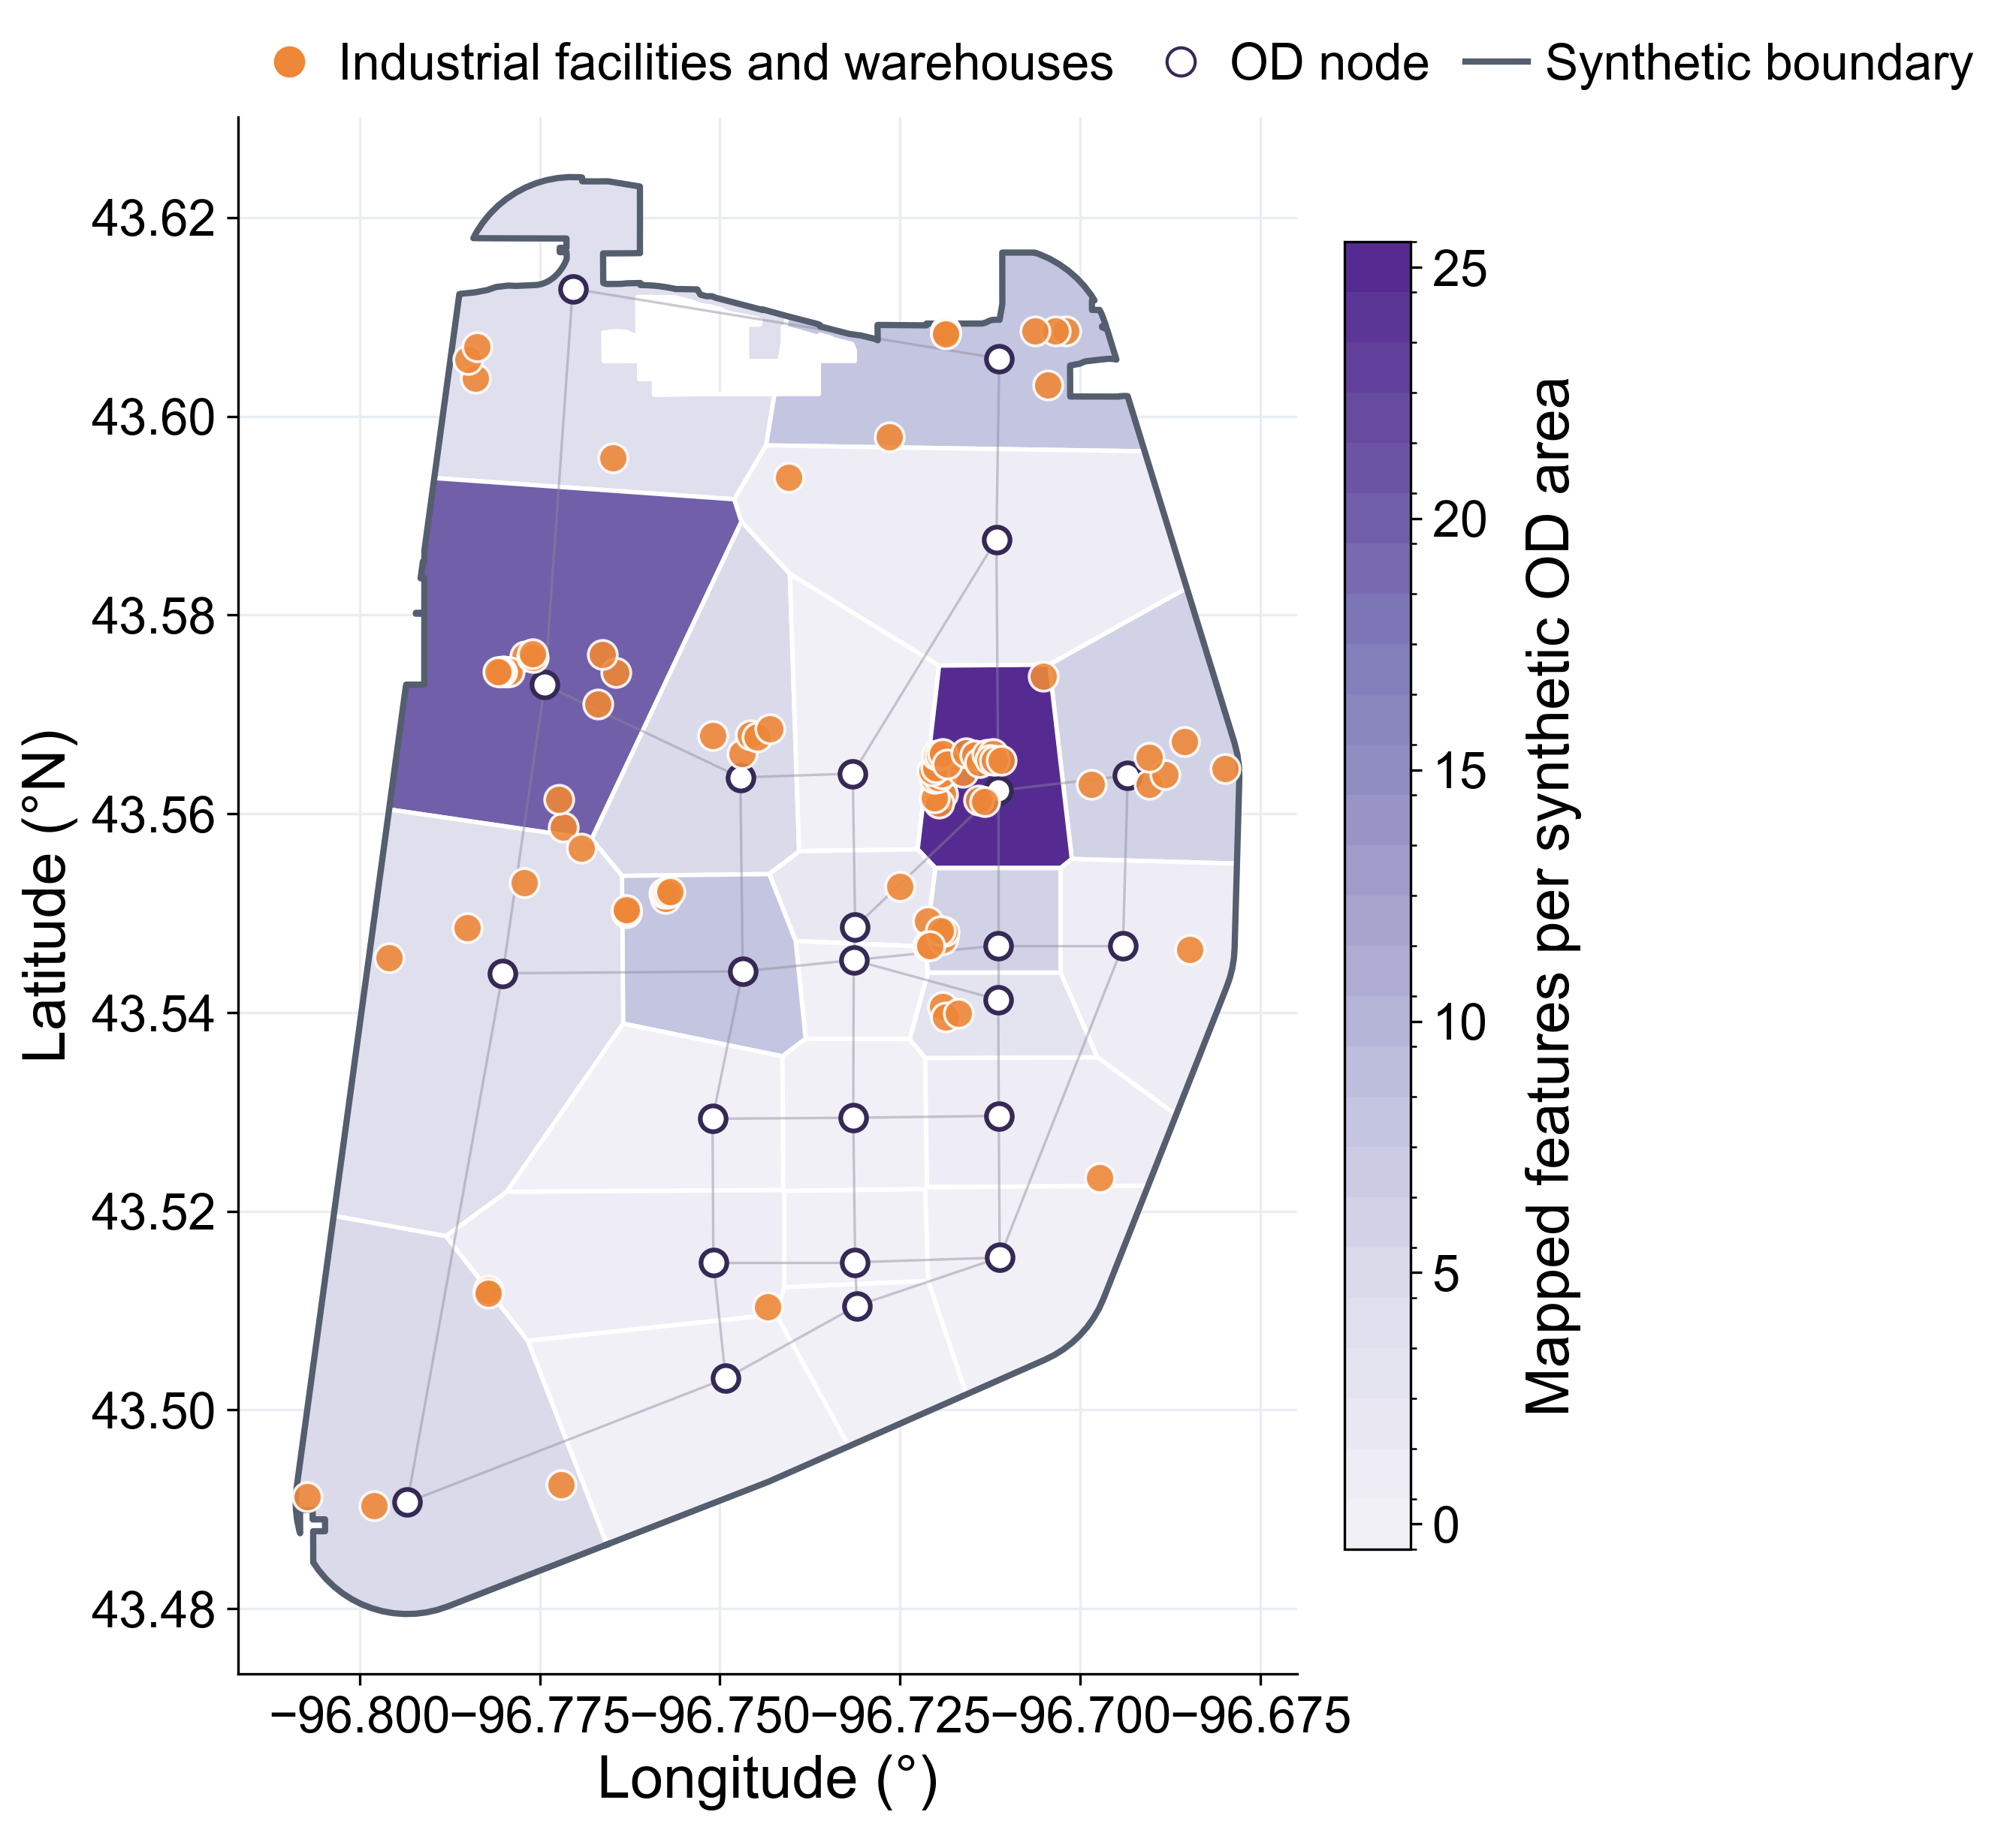
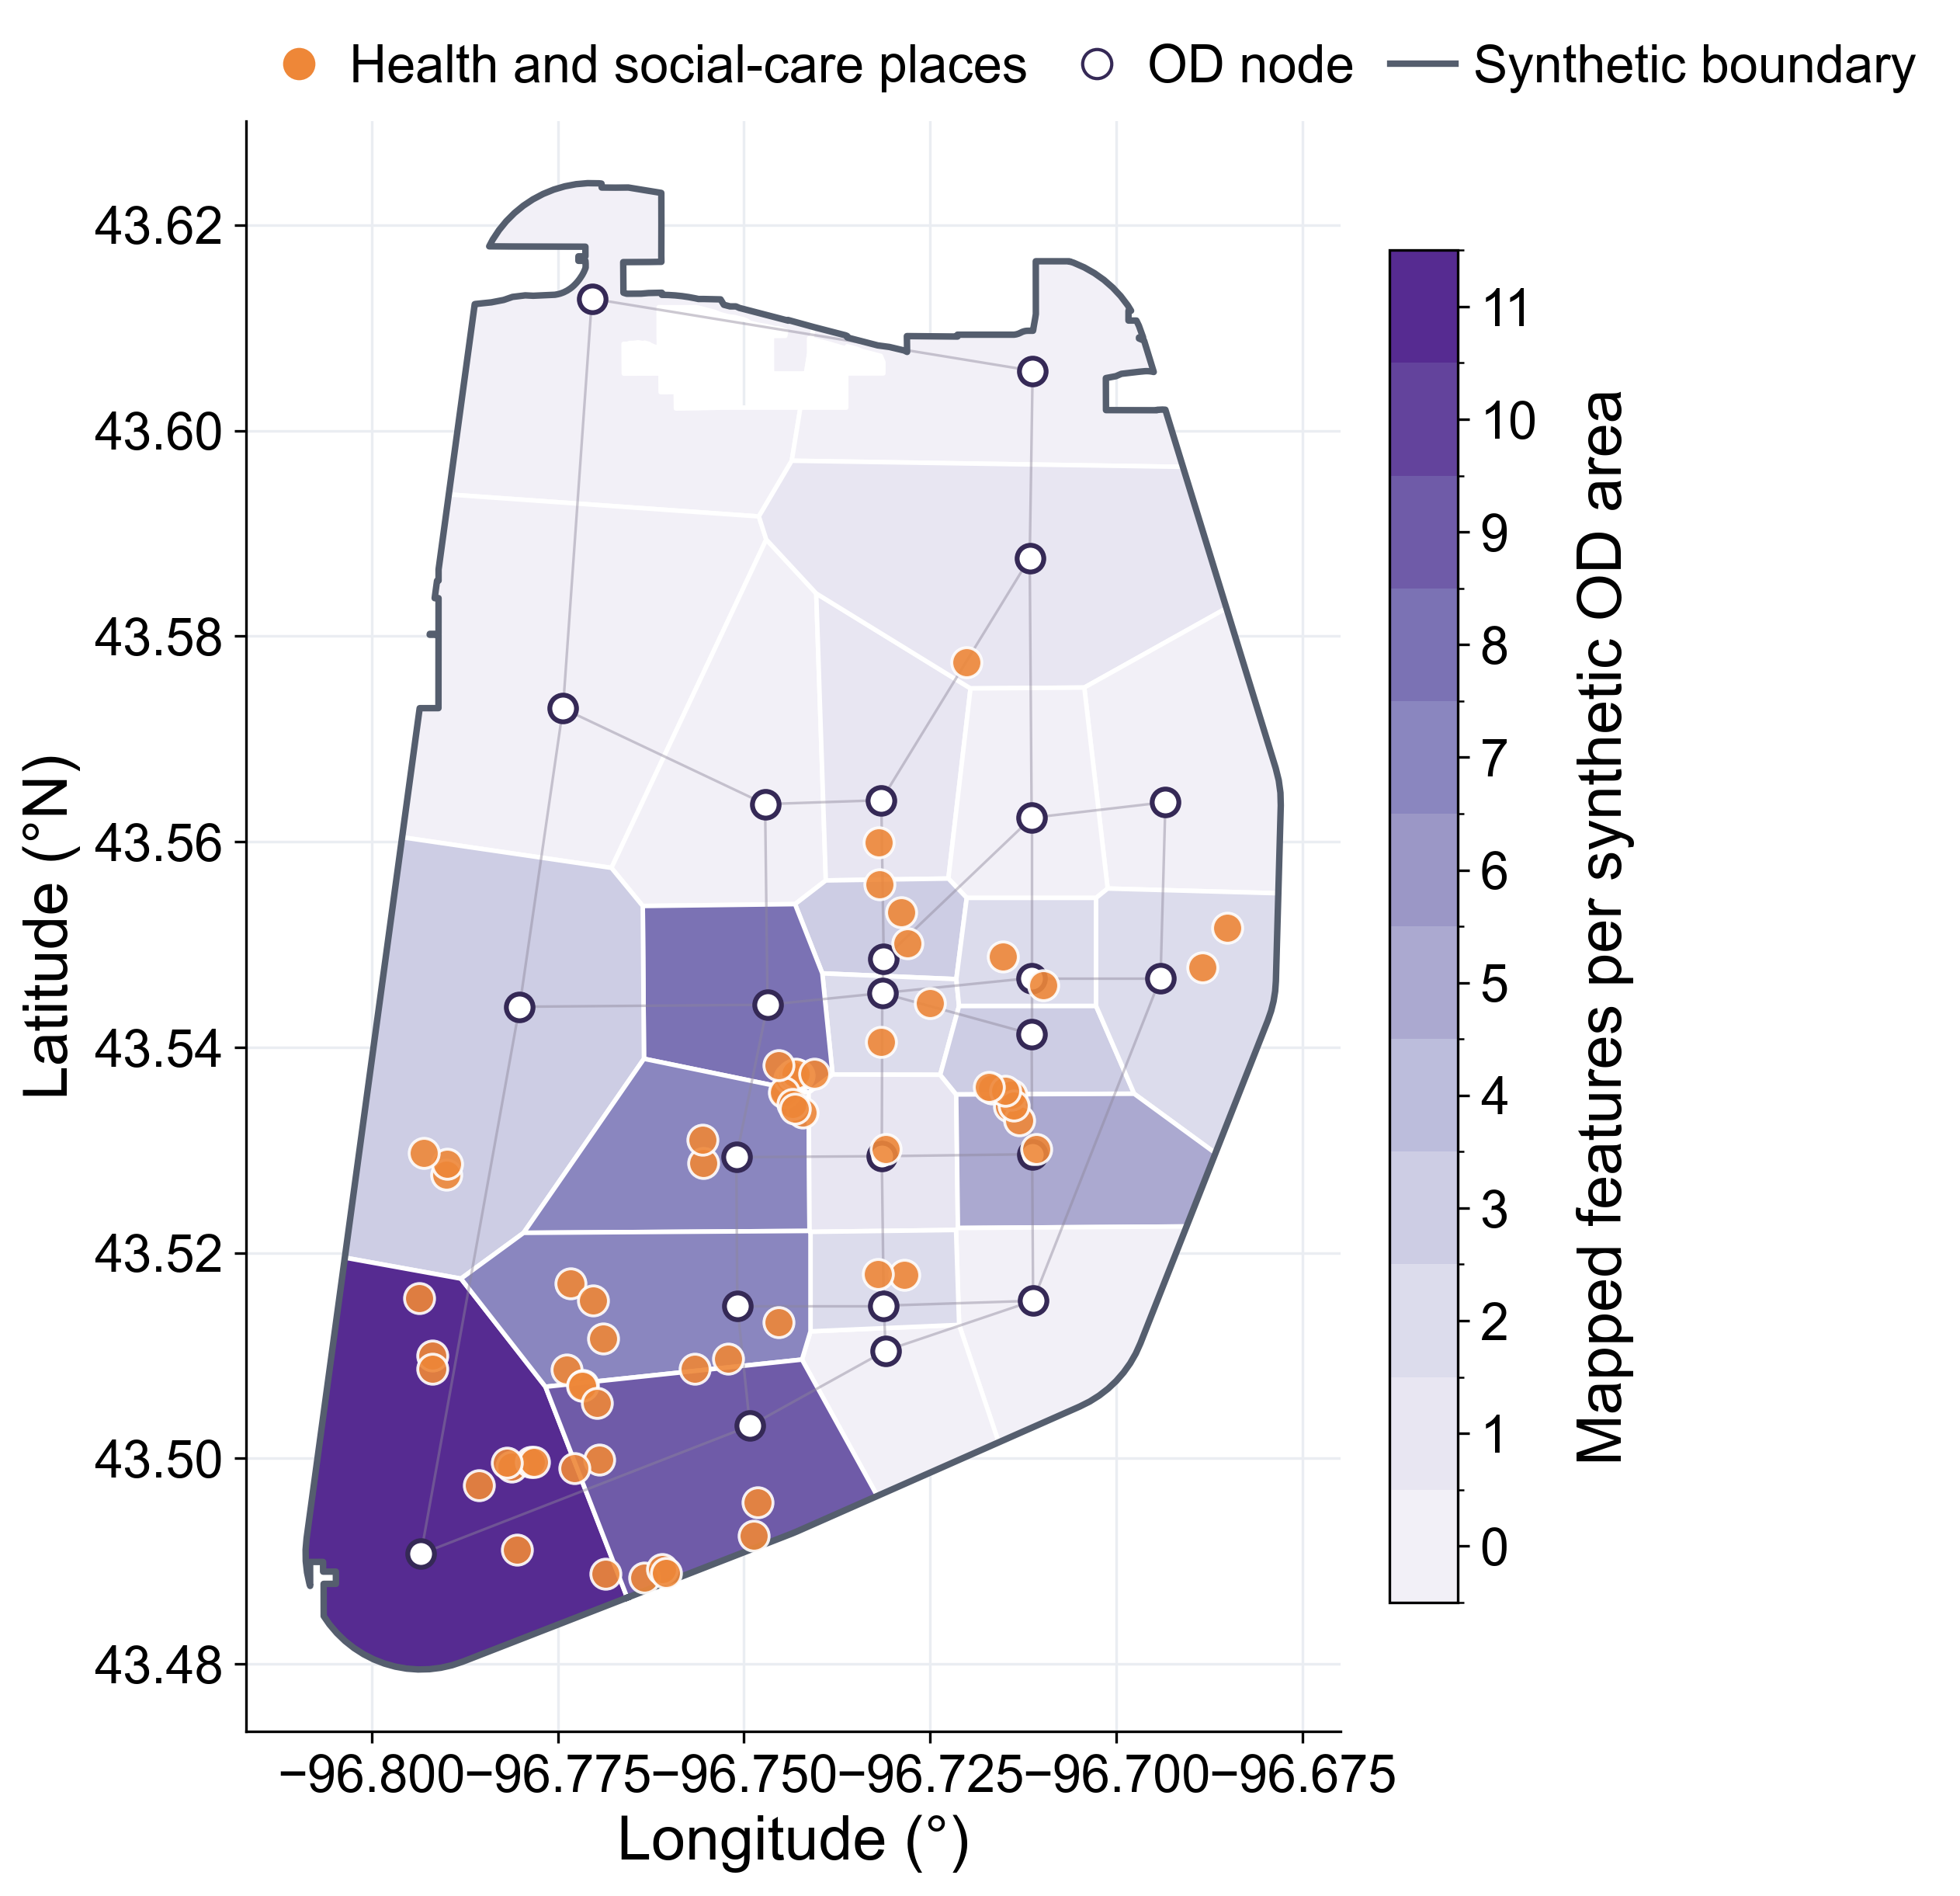
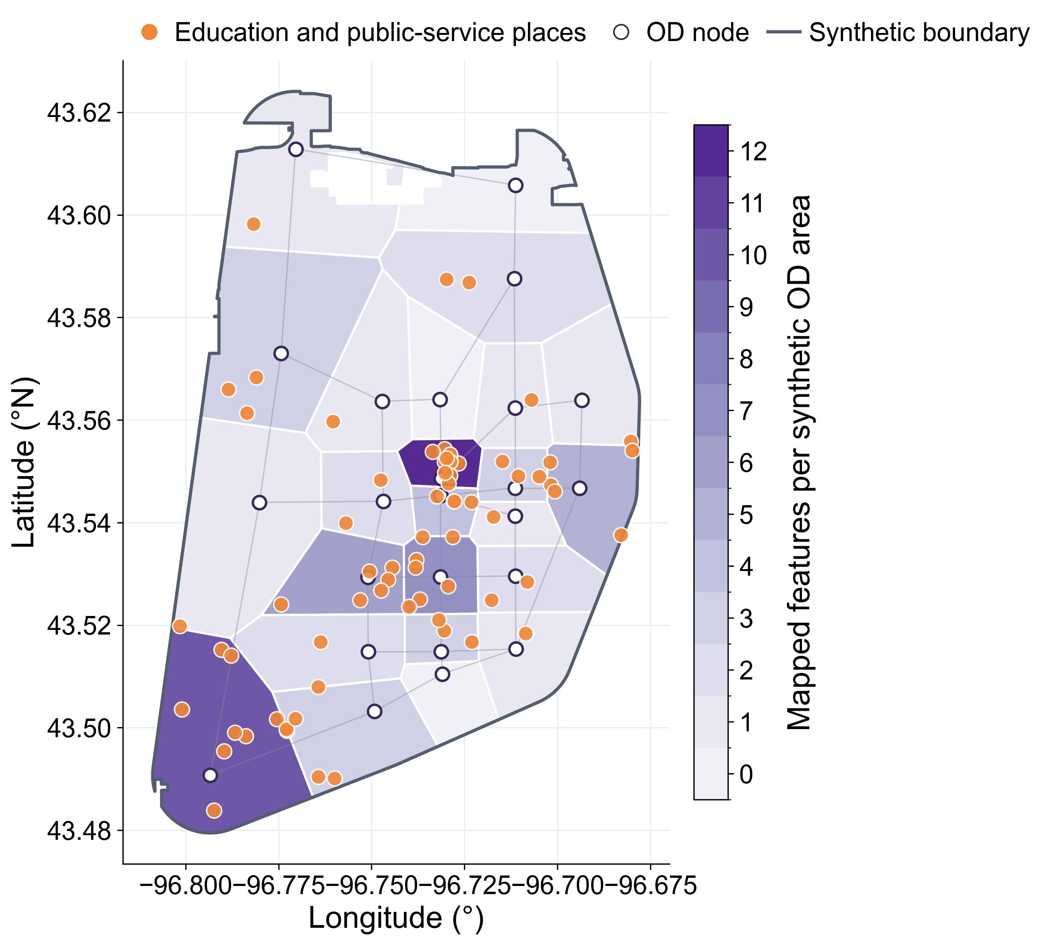
Mapped functions around Sioux Falls OD nodes
Commercial
Leisure
Industrial
Health
Public
Shops, offices, craft services, banks and markets.
Dining, lodging, arts, sports and recreation.
Industrial facilities and warehouses; no land-use polygons.
Medical, pharmacy and social-care facilities.
Schools, libraries, government and public-safety services.
Boundary: 24 nearest-node areas inside a 1.25-km buffered node hull, clipped to Sioux Falls city limits.
Orange: OpenStreetMap places. White circles: OD nodes. Dark outline: synthetic boundary. Darker purple: more places. Areas are not official traffic zones; counts are not jobs.

