Slide 1
Bee tracking with radar
Update: 21st January 2020
Polina & Khalid

Slide 2
Summary
Peak finding
Mapping channel response against angle / height
Angle estimation dictionary
Rotating dish measurements

Slide 3
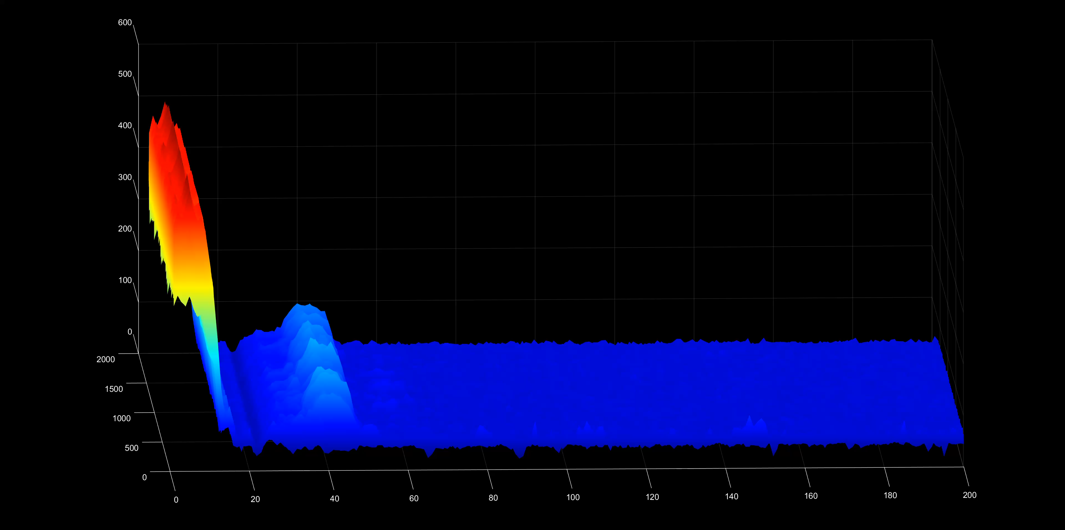
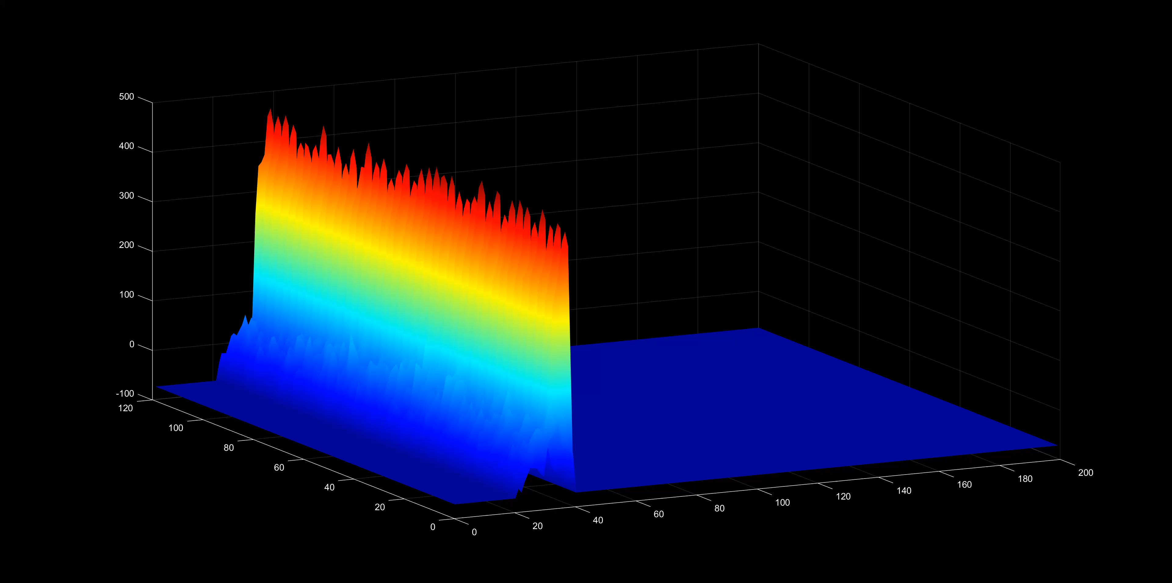
Peak Finding
First pre-process channel response
Search across sum of 5 channels
Search:
  Min peak height
  Min peak prominence
  Min peak width
Integrate peak energy -> save whole peak

Slide 4
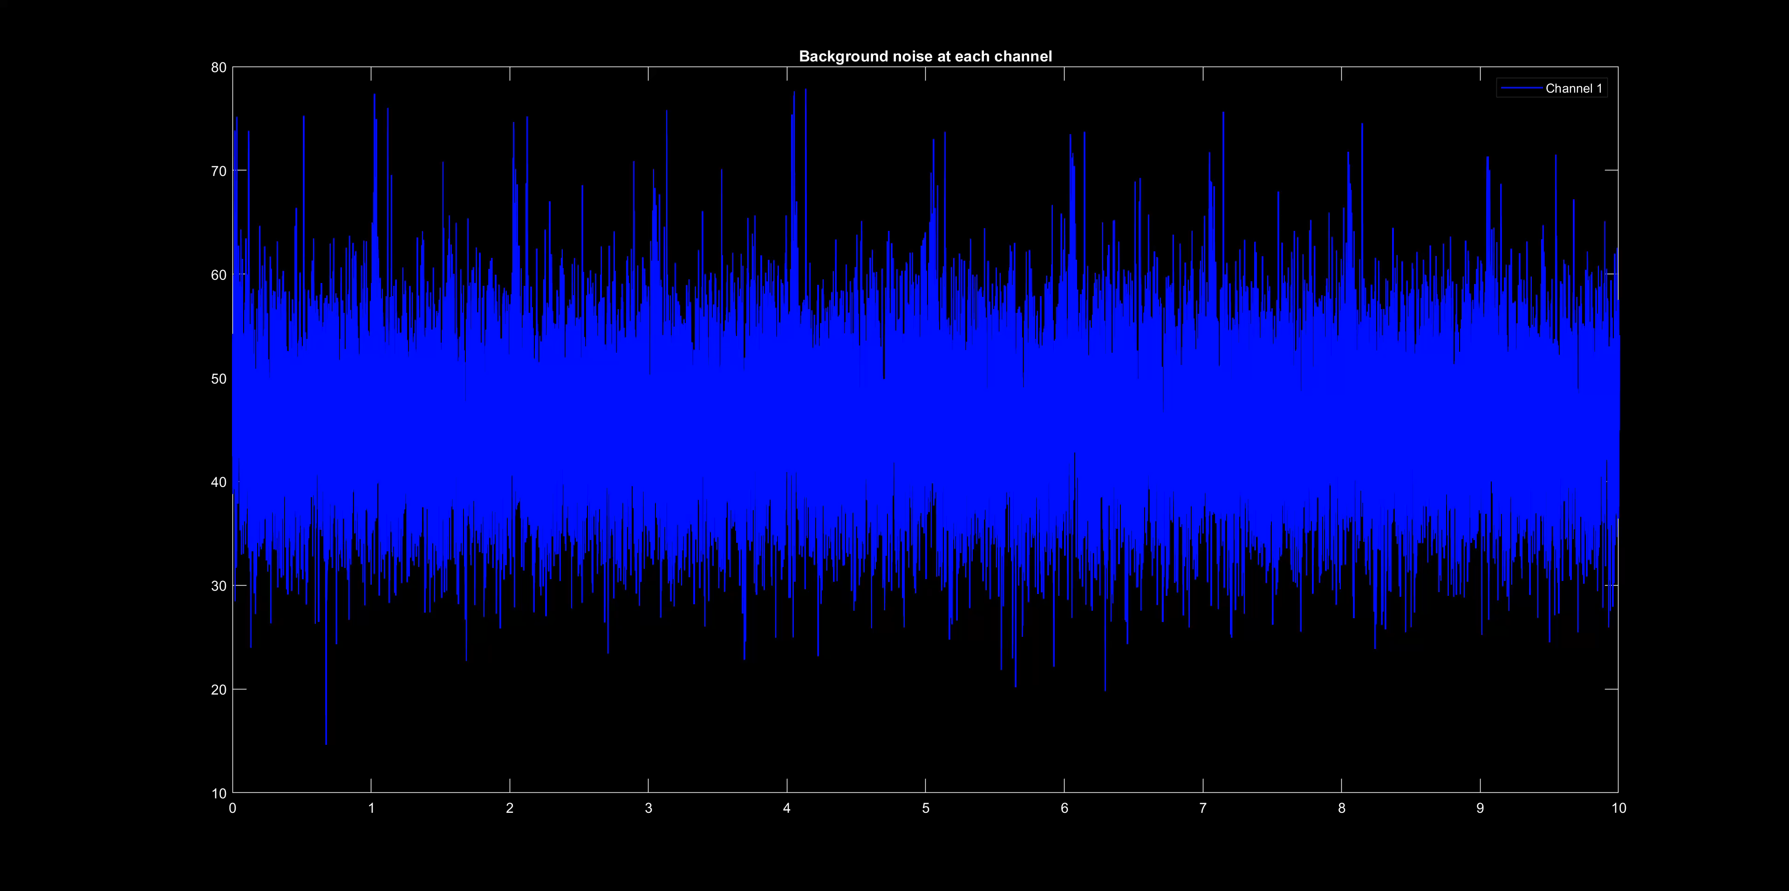
Issues related to channel responses
Channel responses not consistent
Calibration: estimate noise then determine SNR.
Will be improved by optimised array and systems design

Slide 5
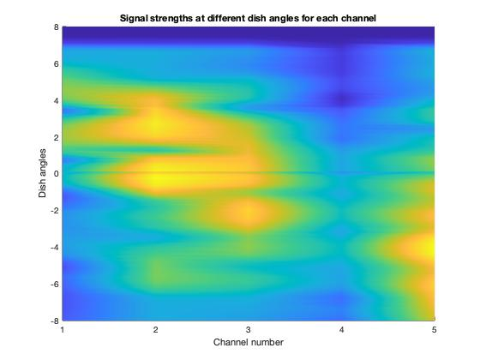
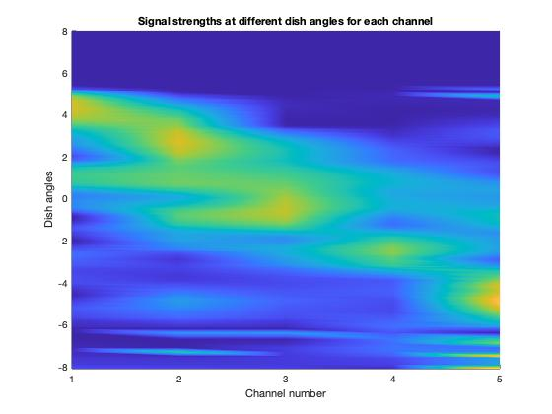
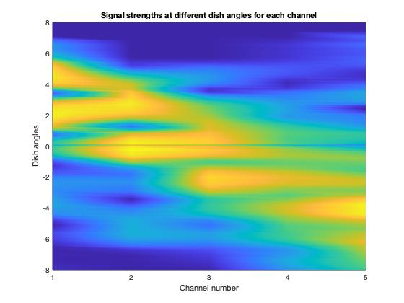
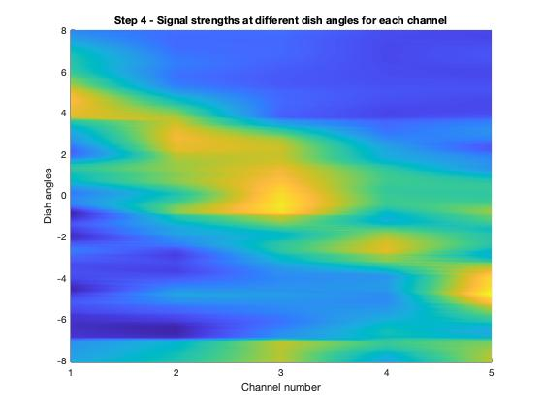
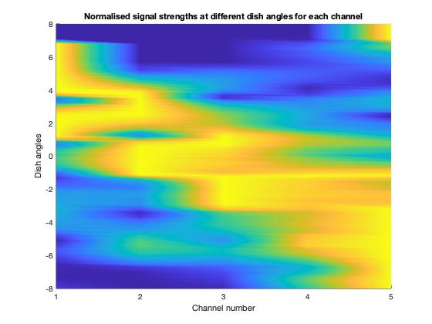
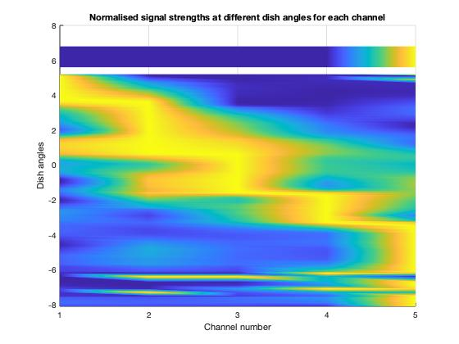
Channel Response
<Normalise to noise -> how noise is extracted>
<Normalise to max channel for each sample>
<Use this to get angle estimation dictionary via fitting>

Slide 6
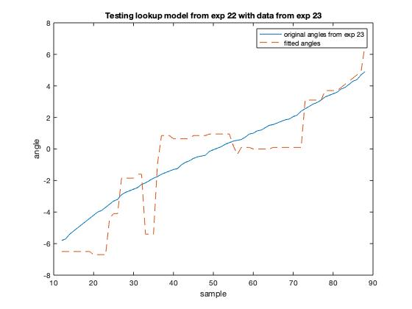
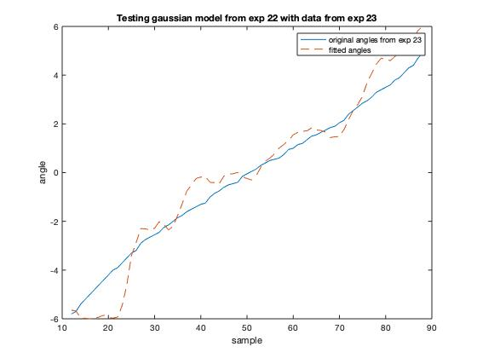
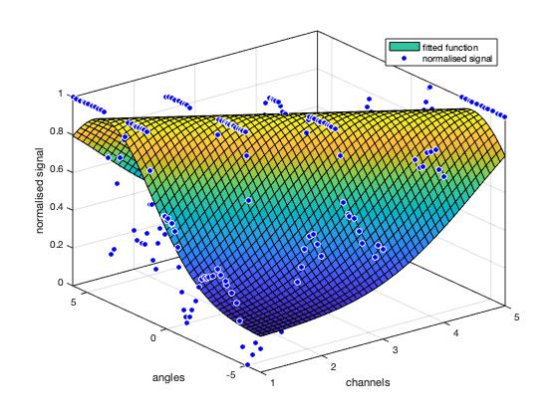
Angle Estimation Dictionary
Use channel responses at each angle to obtain angle estimation dictionary
Fitting methods: Gaussian fitting function / look-up table
Next task: ML techniques using multiple experiments

Slide 7
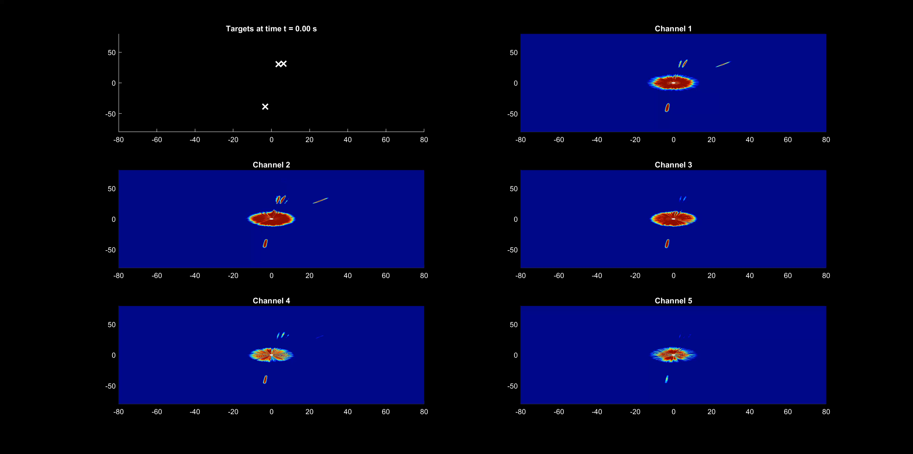
Rotating Dish Measurements
Software developed to obtain response to rotating dish
Current task: Using angle estimation dictionary to obtain elevation angle / height -> 3D position

