Slide 1
Quagga Automation Pipeline Prototype
Polina Proutskova

Slide 2
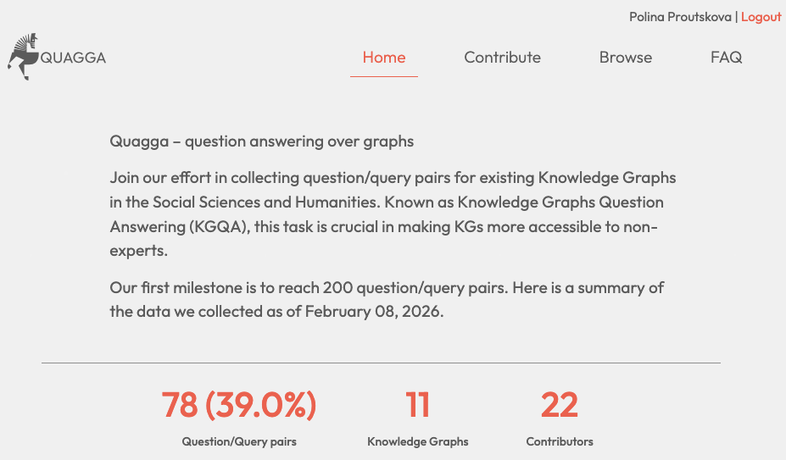
Quagga

Slide 3
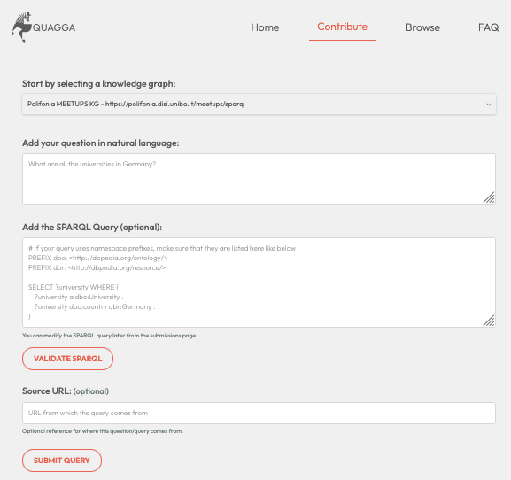
Quagga

Slide 4
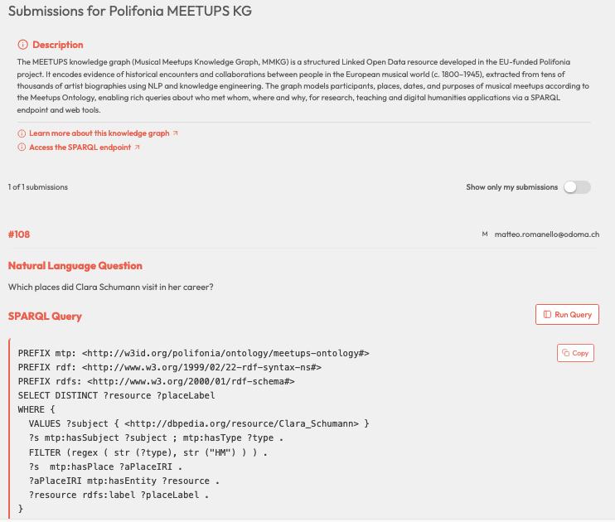
Quagga

Slide 5
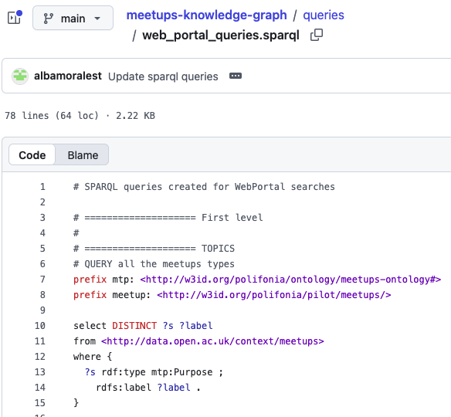
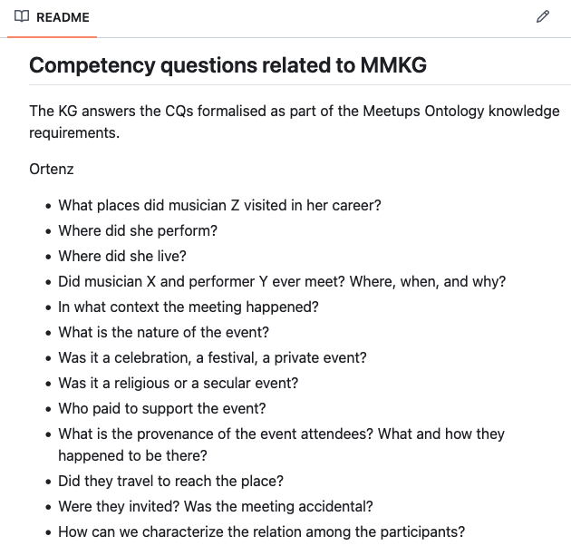
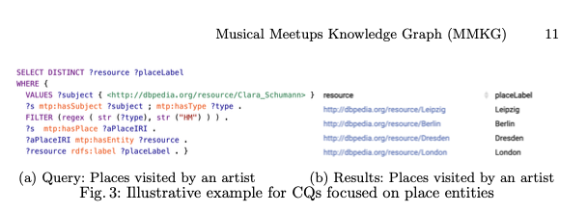
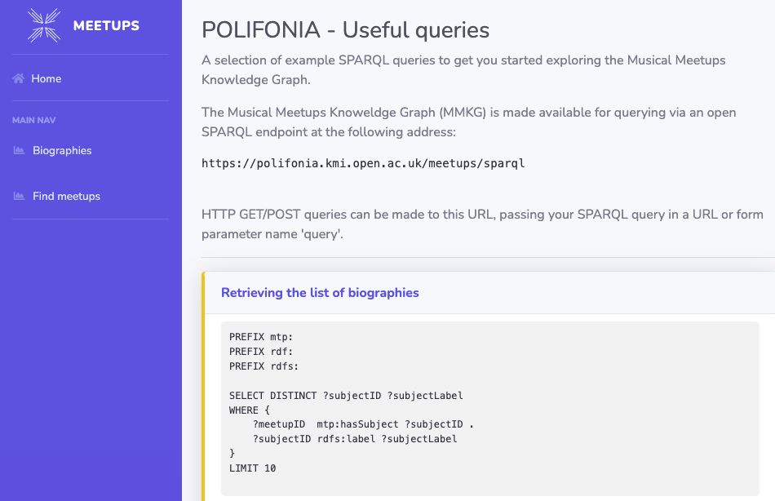
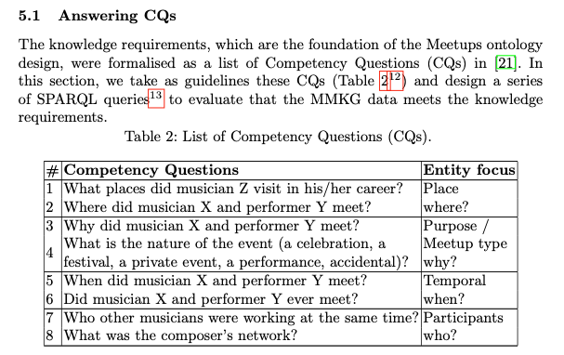
SPARQL and NL phrases sources
Repo code
Readme files
Academic articles
Related websites

Slide 6
Automation logic
• Deterministic extraction aligns SPARQL with provenance and evidence.
• LLM selects/rephrases/generates NL + confidence + confidence rationale from aligned evidence.
• Expert validation for lower confidence pairs
• This directly addresses the original task: expert-approved NL/SPARQL benchmark pairs.

Slide 7
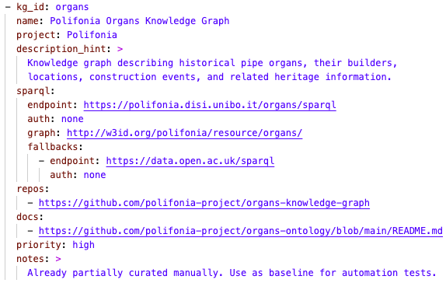
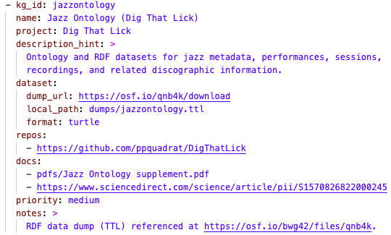
Seeds.yaml

Slide 8
Automation pipeline
1. Seed KGs and source locations
2. Extract SPARQL queries from sources (code, readme, websites, papers)
3. Enrich the queries with NL evidence: sparql comments, paragraphs immediately preceding the code in docs, captions, CQ tables or bullet lists
4. Execute queries and store run metadata
5. Generate NL + confidence and merge back
6. Pick the best pairs automatically based on LLM confidence and run status
7. Manually validate/correct NL questions flagged for review

Slide 9
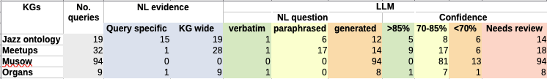
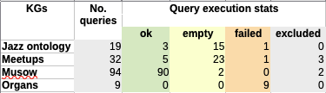
Current results

Slide 10
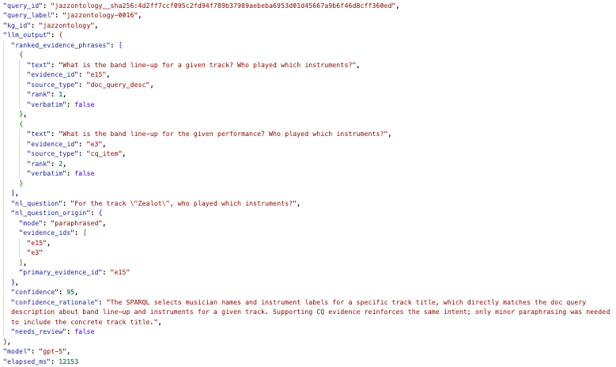
Current results

Slide 11
Next steps
Triage by confidence + run failures
Add KG discovery automation
Add manual validation/correction UI
Embeddings-based semantic matching?

Slide 12
Generalisation
Generalises to other domains
Makes expert effort strategic and visible
NL–SPARQL alignment for LLM interfaces
Clustering queries by semantic intent to enable interoperability measurements
New KGs onboarding

