Slide 1
CS5540 Advanced database Systems
6. B+ tree 2
Huiping Guo
Department of Computer Science
California State University, Los Angeles

Slide 2
Outline
Handle duplicates
Key compression
Bulk tree loading algorithm
6. B+ Tree 2 CS5540
6-<number>

Slide 3
Handle duplicates
Duplicate keys
  Several data entries have the same key value
Duplicate keys are ignored in the previous search, insertion and deletion
How to handle duplicates?
  Method 1: Use overflow page (like ISAM)
  Method2: treat duplicates as regular data entries
    We need to change the definition of B+ tree
    The left pointer of a node points to all data entries with keys less than OR EQUAL TO the index key
    The right pointer of a node points to all data entries with keys greater than or equal to the index key
6. B+ Tree 2 CS5540
6-<number>

Slide 4
Treat duplicates as regular data entries
Example use Alternative 2
  Problem: how to find the leftmost data entry
Root
5
5
17
30
2*
2*
5*
5*
5*
5*
5*
5*
14*
22*
27*
29*
33*
34*
38*
39*
We need to modify the basic search algorithm to find the leftmost data entry
6. B+ Tree 2 CS5540
6-<number>

Slide 5
Find the left-most data entry
Index entries may have duplicates
Use left-most entries on an index page
Find the leaf page
Scan left
Scan right
6. B+ Tree 2 CS5540
6-<number>

Slide 6
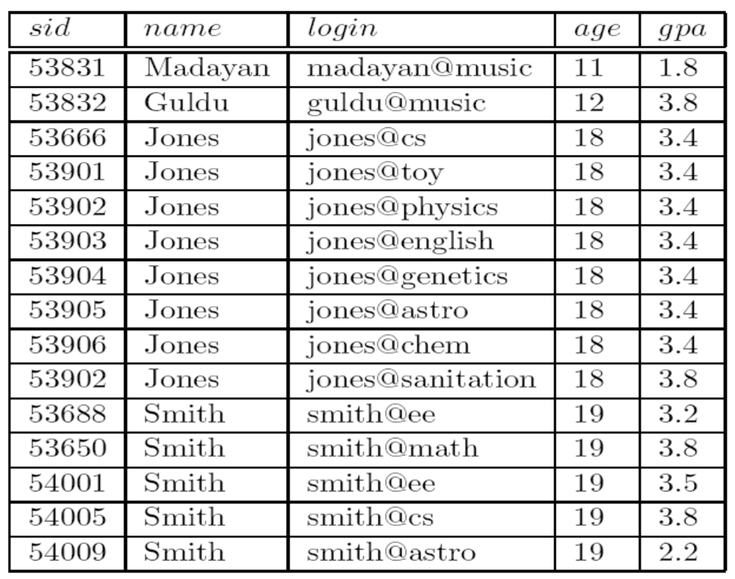
Example of handling duplicates
6. B+ Tree 2 CS5540
6-<number>

Slide 7
Overflow page approach (d=2)
Index on age
11 12 18 19
Primary page
18 18 18 18
19 19 19 19
18 18 18
6. B+ Tree 2 CS5540
6-<number>

Slide 8
Non overflow page approach
Index on age
18 18 19
11 12 18 18
18 18 18 18
18 18 19 19
19 19 19
search for students with age >= 19?
6. B+ Tree 2 CS5540
6-<number>

Slide 9
Non overflow page approach (cont.)
Index on gpa
3.4 3.4 3.8
1.8 2.2 3.2 3.4
3.4 3.4 3.4 3.4
3.4 3.4 3.5 3.8
3.8 3.8 3.8
What if we search for students with gpa=3.8?
6. B+ Tree 2 CS5540
6-<number>

Slide 10
Non overflow page approach (cont.)
Problems with this method
  If a record is deleted, we need to find the corresponding data entry to delete
  The process is not efficient because we may have to check several duplicate entries with the same key value
Solutions
  Treat rid value in the data entry as a part of the search key
  This solution turns the index into unique index (no duplicates)
6. B+ Tree 2 CS5540
6-<number>

Slide 11
Key Compression
Important to increase fan-out. (Why?)
  The height of a tree is determined by:
    The number of data entries
    The number of index entries ( fan out)
    Height=log_{fan_out}(# of data entries)
    Given the same # of data entries, the larger fan_out, the less height
  The number of page I/Os will be decreased if the height of the tree is decreased
6. B+ Tree 2 CS5540
6-<number>

Slide 12
Key Compression
What determine fan_out?
  The size of the an index entry
  The larger an index entry, the fewer index entries
  An index entry contains:
    A Key
    A page pointer
Key values in index entries only `direct traffic’
  can often compress them
6. B+ Tree 2 CS5540
6-<number>

Slide 13
key compression example
Two adjacent index entries in a node
The search key values are
  David Smith
  Devarakonda
To discriminate the two values, it’s sufficient to store the abbreviated forms “Da” and “De”
6. B+ Tree 2 CS5540
6-<number>

Slide 14
Prefix key compression
To compress an index entry
  we must examine the largest key value the subtree to the left of the key and
  the smallest smallest key value the the subtree to the right of the key
Daniel Lee David Smith Devarakonda
Dante Wu Darius Rex Davey Jones
Compress “David Smith” to “Dav” or “Davi”?
6. B+ Tree 2 CS5540
6-<number>

Slide 15
Bulk Loading of a B+ Tree
How to create a B+ tree on existing collection of data records?
Method 1:
  Start with an empty tree
  Repeatedly insert records using standard insertion algorithm
  slow
Method 2:
  Bulk Loading
  can be done much more efficiently.
6. B+ Tree 2 CS5540
6-<number>
Notes:
20

Slide 16
Initialization
Sort all data entries
Allocate an empty page to serve as root and insert a pointer to the first page
Add one entry (<low key value on page, pointer to page>)to the root page for each page of the sorted data entries.
Root
Sorted pages of data entries; not yet in B+ tree
3*
4*
6*
9*
10*
11*
12*
13*
20*
22*
23*
31*
35*
36*
38*
41*
44*
6. B+ Tree 2 CS5540
6-<number>

Slide 17
Insert node
6
9
10
11
Insert two index entries to in a new (root) page.
Root
6
10
3*
4*
6*
9*
10*
11*
12*
13*
20*
22*
23*
31*
35*
36*
38*
41*
44*
6. B+ Tree 2 CS5540
6-<number>

Slide 18
Insert node
12
13
Root
10
6
12
3*
4*
6*
9*
10*
11*
12*
13*
20*
22*
23*
31*
35*
36*
38*
41*
44*
6. B+ Tree 2 CS5540
6-<number>

Slide 19
Insert node
20
22
Root
10
6
12
20
3*
4*
6*
9*
10*
11*
12*
13*
20*
22*
23*
31*
35*
36*
38*
41*
44*
6. B+ Tree 2 CS5540
6-<number>

Slide 20
Insert node
23
31
Root
10
20
6
12
23
3*
4*
6*
9*
10*
11*
12*
13*
20*
22*
23*
31*
35*
36*
38*
41*
44*
6. B+ Tree 2 CS5540
6-<number>

Slide 21
Insert node
35
36
Root
10
20
6
12
23
35
3*
4*
6*
9*
10*
11*
12*
13*
20*
22*
23*
31*
35*
36*
38*
41*
44*
6. B+ Tree 2 CS5540
6-<number>

Slide 22
Insert node
38
41
Root
20
10
35
6
12
23
38
3*
4*
6*
9*
10*
11*
12*
13*
20*
22*
23*
31*
35*
36*
38*
41*
44*
6. B+ Tree 2 CS5540
6-<number>

Slide 23
Insert node
44
Root
20
10
35
6
12
23
38
44
3*
4*
6*
9*
10*
11*
12*
13*
20*
22*
23*
31*
35*
36*
38*
41*
44*
6. B+ Tree 2 CS5540
6-<number>

Slide 24
Summary of Bulk Loading
Index entries for leaf pages always entered into right-most index page just above leaf level.
When this fills up, it splits.
  Split may go up right-most path to the root.
Much faster than repeated inserts
6. B+ Tree 2 CS5540
6-<number>
Notes:
10

