Slide 1
CS5540 Advanced database Systems
8. External Sorting
Huiping Guo
Department of Computer Science
California State University, Los Angeles

Slide 2
Outline
Introduction to external sorting
External Merge Sort
  Internal sort
Minimize the number of runs
  Replacement Sort
Minimize I/O cost
  Blocked I/O
  Double buffering
Using B+ trees for sorting
  Clustered B+ tree index
  Unclustered B+ tree index
8. External Sorting CS5540

Slide 3
Why Sort?
A classic problem in computer science!
  http://www.sorting-algorithms.com/
  Widely used and relatively expensive
Data requested in sorted order
  Sorting records according to a search key (one or more fields)
When to use sorting
  Users may want answers in some order
  Sorting useful for eliminating duplicate copies in a collection of records
  Sorting is first step in bulk loading B+ tree index.
  A widely used algorithm for performing a very important relational algebra operation, called join, requires a sorting step
8. External Sorting CS5540
Notes:
4

Slide 4
Why external sorting?
Large size of databases
Limited memory
Minimize I/O costs
Basic idea
  Break the entire file into smaller subfiles(runs)
  Bring a subfile into memory, sort it, and write it out
  Produce a number of sorted subfiles
  Merge sort the subfiles
8. External Sorting CS5540
Notes:
Selection sort, insertion sort, bubble sort, quick sort, merge sort

Slide 5
Simple 2-Way External Merge Sort
The algorithm only uses three pages of main memory
Run
  When sorting a file, several sorted subfiles are typically generated in intermediate steps
  Each sorted subfile is called a run
Pass:
  an iteration where all the data have been processed.
Procedure
  In the first pass, the pages in the file are read in one at a time
  After a page is read in, the records on it are sorted and the sorted pages is written out
    Quick sort or any in-memory sorting technique can be used
  In subsequent passes, pairs of runs from the output of the previous pass are read in and merged to produce runs that are twice as long
8. External Sorting CS5540

Slide 6
Simple 2-Way External Merge Sort
Pass 0: Read a page, sort it, write it.
  only one buffer page is used
Pass 1, 2, …, etc.:
  three buffer pages used.
INPUT 1
OUTPUT
INPUT 2
Main memory buffers
Disk
Disk
8. External Sorting CS5540
Notes:
5

Slide 7
Simple Two-Way External Merge Sort
3,4
6,2
9,4
8,7
5,6
3,1
2
Input file
PASS 0
3,4
2,6
4,9
7,8
5,6
1,3
2
1-page runs
PASS 1
2,3
4,7
1,3
2-page runs
4,6
8,9
5,6
2
PASS 2
2,3
4,4
1,2
4-page runs
6,7
3,5
8,9
6
PASS 3
1,2
2,3
3,4
8-page runs
4,5
6,6
8. External Sorting CS5540
7,8
9
Notes:
6

Slide 8
Simple Two-Way External Merge Sort: cost
If the number of pages in the input file is 2^k
Pass 0 produces 2^k sorted runs of one page each
Pass 1 produces 2^(k-1) sorted runs of two pages each
Pass 2 produces 2^(k-2) sorted runs of four pages each
…
Pass k produces one sorted run of 2^k pages
8. External Sorting CS5540

Slide 9

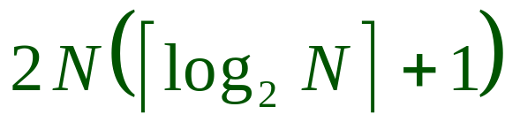
Simple Two-Way External Merge Sort: cost
Each pass we read + write each page in file.
N pages in the file => the number of passes
So total cost is:
8. External Sorting CS5540

Slide 10
General External Merge Sort
More than 3 buffer pages. How can we utilize them?
INPUT 1
. . .
INPUT 2
. . .
. . .
OUTPUT
INPUT B-1
Disk
Disk
B Main memory buffers
8. External Sorting CS5540
Notes:
7

Slide 11
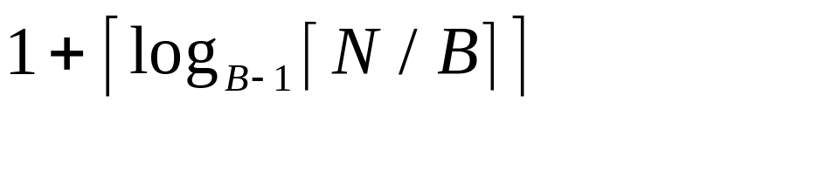
General External Merge Sort
Two important modifications to the 2-way merge sort algorithm:
  In pass 0, read in B pages at a time and sort internally to produce [N/B] runs of B pages (except for the last run, which may contain fewer pagers)
  In passes i=1,2,…, use B-1 buffer pages for input and use the remaining page for output: hence, you do a (B-1) way merge in each pass
Number of passes
Cost = 2N * (# of passes)
8. External Sorting CS5540

Slide 12
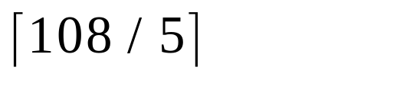

Example
with 5 buffer pages, to sort 108 page file:
  Pass 0: = 22 sorted runs of 5 pages each (last run is only 3 pages)
  Pass 1: = 6 sorted runs of 20 pages each (last run is only 8 pages)
  Pass 2: 2 sorted runs, 80 pages and 28 pages
  Pass 3: Sorted file of 108 pages
8. External Sorting CS5540

Slide 13
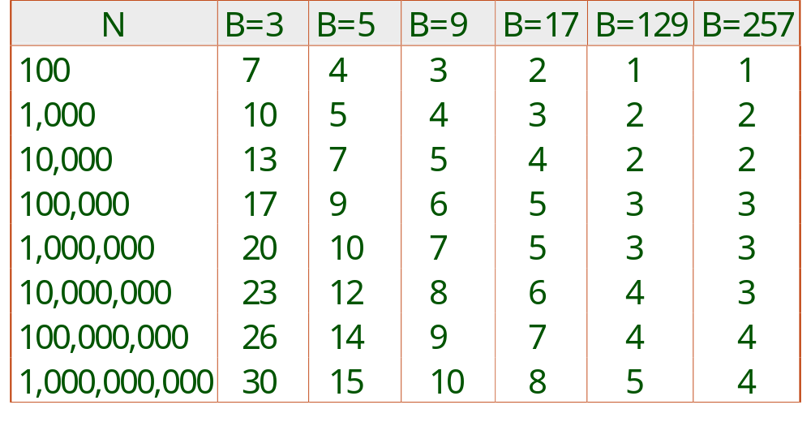
Number of Passes of External Sort
8. External Sorting CS5540
Notes:
9

Slide 14
Internal Sort Algorithm
How to merge sort runs of pages?
  Use internal sort algorithm
  Can merge sort large runs of pages with limited number of memory pages.
Internal sort algorithm
  Read in first page of B-1 runs
  Repeatedly put the smallest one in the output page
    Use a pointer in each page
8. External Sorting CS5540
Notes:
10

Slide 15
Example
B=3
1,2
3,5
run1
6,6
8,9
2,3
4,4
run2
6,7
8,9
8. External Sorting CS5540

Slide 16
Example
B=3
3,5
run1
6,6
1,2
8,9
2,3
4,4
run2
6,7
8,9
8. External Sorting CS5540

Slide 17
Example
B=3
3,5
run1
6,6
2
8,9
1
2,3
4,4
run2
6,7
8,9
8. External Sorting CS5540

Slide 18
Example
B=3
3,5
run1
6,6
8,9
1,2
2,3
4,4
run2
6,7
8,9
8. External Sorting CS5540

Slide 19
Example
B=3
run1
1,2
6,6
8,9
2,3
4,4
run2
6,7
8,9
8. External Sorting CS5540

Slide 20
Example
B=3
3,5
run1
1,2
6,6
3,5
8,9
2,3
4,4
run2
6,7
8,9
8. External Sorting CS5540

Slide 21
Example
B=3
run1
1,2
6,6
3,5
8,9
2
3
4,4
run2
6,7
8,9
8. External Sorting CS5540

Slide 22
Example
B=3
run1
1,2
6,6
3,5
8,9
2 3
4,4
run2
6,7
8,9
8. External Sorting CS5540

Slide 23
Example
B=3
run1
1,2
6,6
3,5
2,3
8,9
4,4
run2
6,7
8,9
8. External Sorting CS5540

Slide 24
Example
B=3
run1
1,2
6,6
5
2,3
8,9
3
4,4
run2
6,7
8,9
8. External Sorting CS5540

Slide 25
Example
B=3
run1
1,2
6,6
5
2,3
8,9
3,4
4
run2
6,7
8,9
8. External Sorting CS5540

Slide 26
Example
B=3
run1
1,2
6,6
5
2,3
8,9
3,4
4
run2
6,7
8,9
8. External Sorting CS5540

Slide 27
Example
B=3
run1
1,2
6,6
5
2,3
8,9
4
3,4
6,7
run2
8,9
8. External Sorting CS5540

Slide 28
Example
B=3
run1
1,2
6,6
2,3
8,9
3,4
6,7
4,5
run2
8,9
8. External Sorting CS5540

Slide 29
Example
B=3
run1
1,2
2,3
8,9
6,6
3,4
6,7
4,5
run2
8,9
8. External Sorting CS5540

Slide 30
Example
B=3
run1
1,2
8,9
2,3
6,7
3,4
4,5
6,6
run2
8,9
8. External Sorting CS5540

Slide 31
Example
B=3
run1
1,2
8,9
2,3
3,4
8,9
4,5
6,6
run2
6,7
8. External Sorting CS5540

Slide 32
Example
B=3
run1
1,2
9
2,3
8
3,4
8,9
4,5
6,6
run2
6,7
8. External Sorting CS5540

Slide 33
Example
B=3
run1
1,2
9
2,3
8,8
3,4
9
4,5
6,6
run2
6,7
8. External Sorting CS5540

Slide 34
Example
B=3
run1
1,2
2,3
3,4
4,5
6,6
run2
6,7
8,8
9,9
8. External Sorting CS5540

Slide 35
Replacement sort
Minimize the number of runs
  Can write out runs of approximately 2B in pass0
  Reduce the number of passes
Note:
  Replacement sort only affect the size of runs produced in pass 0
  It works the same way as external merge sort in other passes
8. External Sorting CS5540

Slide 36
Replacement sort
Idea
  Reserve one page for input, one for output.
  Repeatedly pick the tuple in the B-2 pages (current set)
    with the smallest k value
    Still greater than the largest k value in the output buffer
  Move the chosen tuple to the output buffer
  Add next input to the current set
8. External Sorting CS5540

Slide 37
Replacement sort (Cont.)
2
3
12
4
5
4
1
3
Input
Current set
Output
8. External Sorting CS5540

Slide 38
Replacement sort
When to terminate the current run and start a new run?
  As long as some tuple t in the current set has a bigger k value than the most recently appended output tuple
  When every tuple the the current set is smaller than the largest tuple in the output buffer, the output buffer is written out and becomes the last page in the current run
  Start a new run
8. External Sorting CS5540

Slide 39
Exercise
input
Memory
output
Sorting results?
12
42
2
11
B=4
Each page can only hold two tuples
73,5,39,17,5,8,11,17,19,58,7,1,35,26
8. External Sorting CS5540

Slide 40
Exercise
input
Memory
output
Sorting results?
2
12
11
42
73
5
B=4
Each page can only hold two tuples
39,17,5,8,11,17,19,58,7,1,35,26
8. External Sorting CS5540

Slide 41
Exercise
input
Memory
output
Sorting results?
2
39
39
11
17
17
12
73
42
5
B=4
Each page can only hold two tuples
5,8,11,17,19,58,7,1,35,26
8. External Sorting CS5540

Slide 42
Exercise
input
Memory
output
Sorting results?
2
5
39
73
11
8
17
12
8
42
5
73
B=4
Each page can only hold two tuples
5,8,11,17,19,58,7,1,35,26
8. External Sorting CS5540

Slide 43
I/O cost for External Merge Sort
Simple cost metric: Number of page I/Os
  Minimize the number of passes
    Produce longer runs in pass 0
    Longer runs often means fewer passes!
    Use replacement sort in pass 0
  Maximize the fan-in during merging
    Allocate just one buffer page per run and one buffer page for the output of the merge
    If B buffer pages are available, we can merge B-1 runs
Disadvantage: ignore blocked access
8. External Sorting CS5540

Slide 44
I/O cost for External Merge Sort
More on cost metric
  Blocked I/O
    Reading several consecutive pages is much cheaper than reading the same number of pages individually
    Reduce the average cost to read or write a single page
  It might be better to read and write in units of more than one page
8. External Sorting CS5540

Slide 45
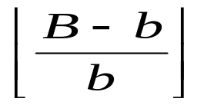
Blocked I/O
Read and write in units called buffer blocks (b pages)
Reserve one buffer block for output
Read in one block b pages from each run
  How many runs can we merge in each pass?
8. External Sorting CS5540

Slide 46
run1
Input 0
Input 1
run2
output
Input 2
Input 3
run3
run4
8. External Sorting CS5540

Slide 47
run1
Input 0
Input 1
run2
output 0
Input 2
output 1
Input 3
run3
run4
8. External Sorting CS5540

Slide 48
Blocked I/O (Cont.)
Ex: B=10
  With one page input, merge 9 runs at a time
  With two page input, merge 4 runs at a time
Trade-offs
  Blocked I/O reduces average cost to read/write a single page
  Increases the number of passes
8. External Sorting CS5540

Slide 49


Blocked I/O (Cont.)
B buffer pages, blocking factor b pages, N pages to be sorted
First pass:
N1 = sorted runs (replacement sorting)
In subsequent passes:
Merge F = runs at a time
The number of passes
8. External Sorting CS5540

Slide 50
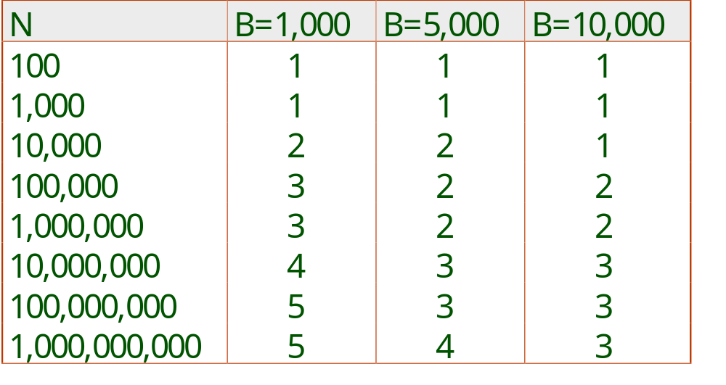
Number of Passes of Optimized Sort
Block size = 32, initial pass produces runs of size 2B.
8. External Sorting CS5540
Notes:
13

Slide 51
Example
Seek time: st
Rotation al delay: rd
Transfer time (one page): tt
B=5000, N=100,000
Compute the I/O cost for the following cases:
(assume replacement sorting is used)
b=1
b=32 (for both input and output)
b=64 (for both input and output)
b1=32 for input, b2 = 40 for output
8. External Sorting CS5540

Slide 52
Example
Seek time: st
Rotation al delay: rd
Transfer time (one page): tt
B=5000, N=100,000
Compute the I/O cost for the following cases:
(assume replacement sorting is used)
b=1
C = #of runs produced in pass0 = N/2B
M= # of runs that can be merged = B-1
P = #of passes ( log_{M}C + 1)
2*N*P *(st+rd+tt)
8. External Sorting CS5540

Slide 53
Example
Seek time: st
Rotation al delay: rd
Transfer time (one page): tt
B=5000, N=100,000
Compute the I/O cost for the following cases:
(assume replacement sorting is used)
b=32 (for both input and output)
b=64 (for both input and output)
C = #of runs produced in pass0 = N/2B
M= # of runs that can be merged = (B-b)/b
P = #of passes ( log_{M}C + 1)
2 *(N/b) *P* (st+rd+b*tt)
8. External Sorting CS5540

Slide 54
Example
Seek time: st
Rotation al delay: rd
Transfer time (one page): tt
B=5000, N=100,000
Compute the I/O cost for the following cases:
(assume replacement sorting is used)
4) b1=32 for input, b2 = 40 for output
C = #of runs produced in pass0 = N/2B
M= # of runs that can be merged = (B-b2)/b1
P = #of passes ( log_{M}C + 1)
(N/b1) *P* (st+rd+b1*tt) + (N/b2) *P* (st+rd+b2*tt)
reading
writing
8. External Sorting CS5540

Slide 55
Double Buffering
Problems in external sorting
  All tuples in an input block have been consumed
  CPU may be idle for the duration of time taken for reading in one block
Solutions
  To overlap CPU and I/O processing
8. External Sorting CS5540

Slide 56
Double Buffering (Cont.)
INPUT 1
INPUT 1'
INPUT 2
OUTPUT
INPUT 2'
OUTPUT'
b
Disk
INPUT k
block size
Disk
INPUT k'
B main memory buffers, k-way merge
8. External Sorting CS5540

Slide 57
Using B+ Trees for Sorting
Scenario: Table to be sorted has B+ tree index on sorting column(s).
Idea: Can retrieve records in order by traversing leaf pages.
Is this a good idea?
  Cases to consider:
    B+ tree is clustered Good idea!
    B+ tree is not clustered
      Could be a very bad idea!
8. External Sorting CS5540
Notes:
15

Slide 58
Clustered B+ Tree Used for Sorting
Cost: root to the left-most leaf, then retrieve all leaf pages (Alternative 1)
If Alternative 2 is used? Additional cost of retrieving data records: each page fetched just once.
Index
(Directs search)
Data Entries
("Sequence set")
Data Records
Always better than external sorting!
8. External Sorting CS5540
Notes:
16

Slide 59
Unclustered B+ Tree Used for Sorting
Alternative (2) for data entries; each data entry contains rid of a data record. In general, one I/O per data record!
Index
(Directs search)
Data Entries
("Sequence set")
Data Records
8. External Sorting CS5540
Notes:
17

