Slide 1

COVID Symptoms
Causal Analysis
Using a DEMI knowledgebase to estimate PCR-positive probability from symptoms
HI 823 • Professor Abdul • Spring 2026
Paridhi Pradhan

Slide 2
Why this problem matters
COVID symptoms overlap with flu and other respiratory illnesses, so symptom-only decisions need probability and context.
10.4%
2–14 d
observed PCR-positive baseline
typical symptom window
Patients may report fever, cough, dyspnea, fatigue, headache, nausea, diarrhea, or loss of taste/smell.
Testing access and delays make triage support useful.
A transparent model is easier to explain than a black-box classifier.
PCR
target outcome
Project goal: estimate P(COVID PCR+) as evidence accumulates.
2 | COVID Symptoms Causal Analysis

Slide 3
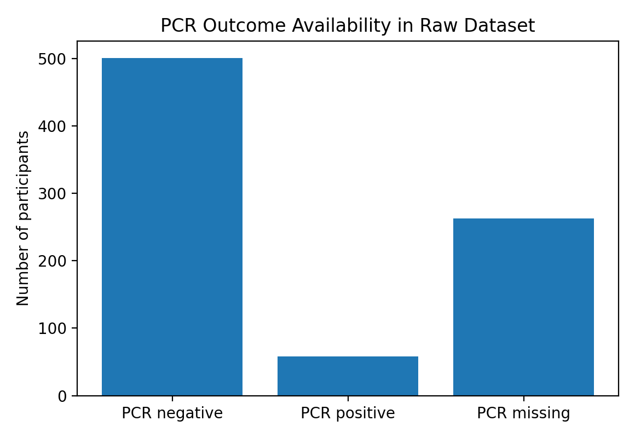
Data and knowledgebase
822
472
70,983
participants
raw variables
DEMI evidence rows
Cleaned COVIDCARE data
DEMI knowledgebase
Probability output
PCR outcome available for 559 participants: 58 positive and 501 negative.
3 | COVID Symptoms Causal Analysis

Slide 4
DEMI workflow used in the notebook
1
2
3
4
Temporal order
Total effect
Direct evidence
Final probability
Retain “code before target” counts
Compare P(PCR+ | symptom) vs P(PCR+ | no symptom)
Use likelihood ratios and risk differences
Update baseline odds for the patient scenario
Posterior odds = baseline odds × likelihood ratio evidence
(half-weighted in the demo to reduce double-counting of correlated symptoms)
4 | COVID Symptoms Causal Analysis

Slide 5
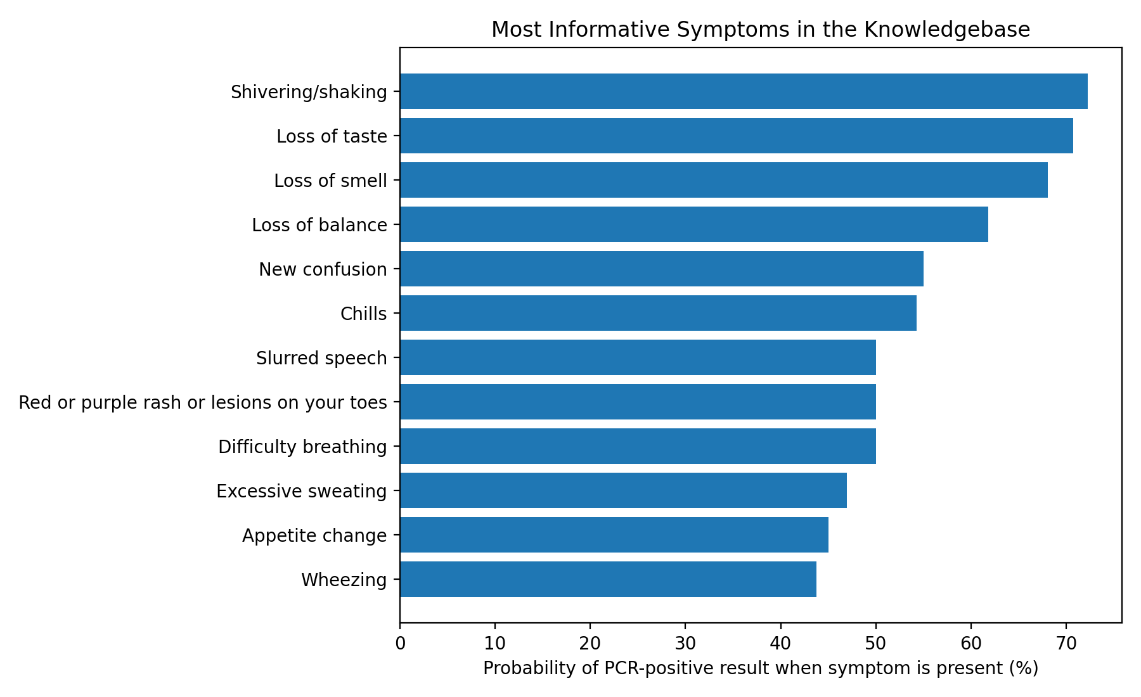
Which symptoms raised COVID probability most?
Strongest signals were neurologic symptoms tied to smell/taste and systemic symptoms such as chills and fever.
70.7%
P(PCR+ | loss of taste)
68.1%
P(PCR+ | loss of smell)
54.3%
P(PCR+ | chills)
5 | COVID Symptoms Causal Analysis

Slide 6
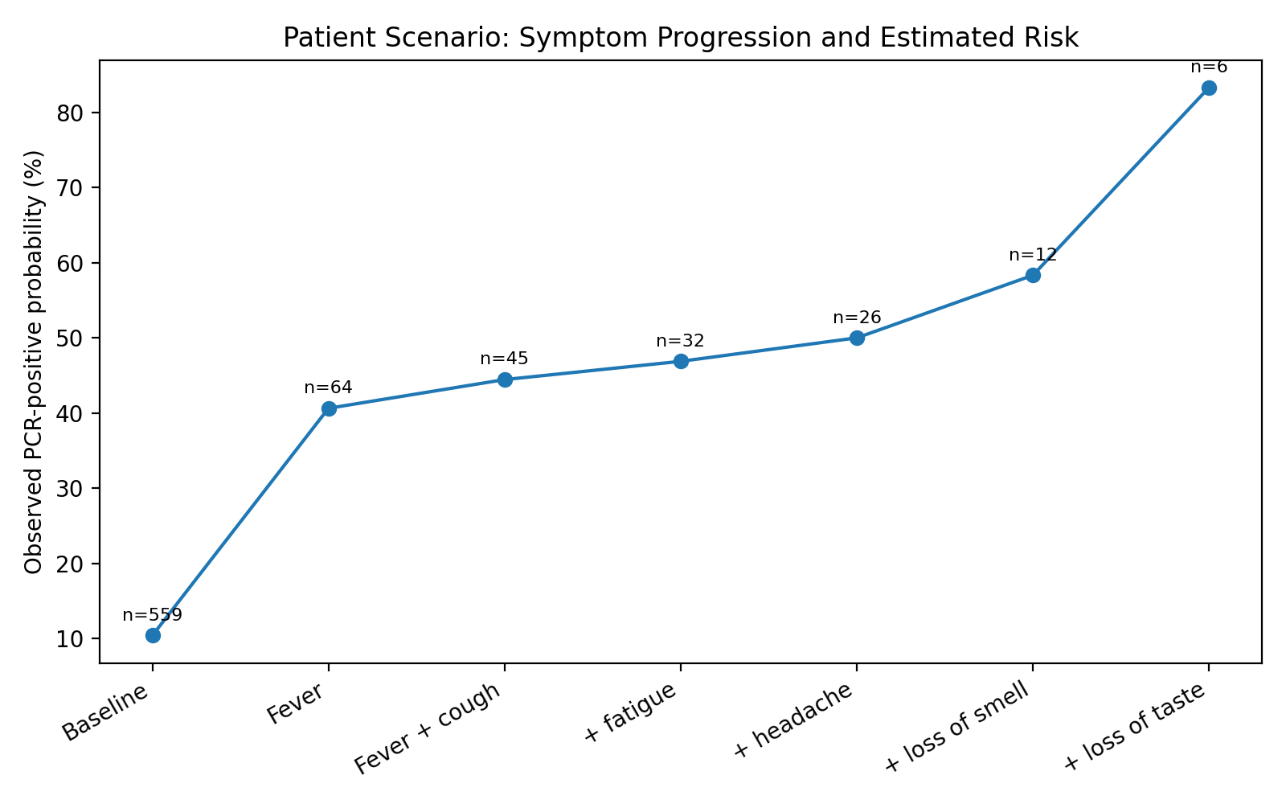
Patient scenario: symptoms accumulate
Scenario
Fever
Cough
Fatigue
Headache
Loss of smell
Loss of taste
83.3%
observed in matching raw cases (5/6)
96.6%
tempered DEMI-style estimate
6 | COVID Symptoms Causal Analysis

Slide 7
Healthcare value and limitations
Healthcare problem addressed
Limitations
Supports triage when PCR is delayed
Explains why risk rises as symptoms cluster
Can be calibrated to local prevalence
Symptoms are correlated and observational
Full scenario had small matching n
Output is not a diagnosis; testing remains needed
Key interpretation: DEMI is transparent decision support, not a replacement for testing.
7 | COVID Symptoms Causal Analysis

Slide 8
What to submit
Final deliverables
Video flow
JAMA-style final report
Recorded video or Canvas upload
Presentation slides
GitHub repository link
Introduce title, name, professor, course, Spring 2026
Run the notebook and show outputs
Explain healthcare problem and findings
Show the GitHub repository files
Suggested GitHub name: covid-symptoms-causal-analysis
8 | COVID Symptoms Causal Analysis

