Slide 1
Passcode Dataset to Identify Users
STAT 702 Final Exam Project
Presented by
Prakash Paudyal
6/15/2018

Slide 2
Objective
Given the passcode dataset, develop a classification model for predicting the unknown subjects

Slide 3
Dataset
Passcode dataset consists of the time taken for typing the passcode of a specific system for 51 users.
System can be used by only one user at a time.
Variables used:
Subject: unique ids for 51 users
Session index: indexes for the sessions (7 or 8)
Reps: Repetition of the passcode within each session
Hold time: Amount of time “.” key is held down
Up-Down time: Time between the “.” key coming up and pressing down the “t” key.
Down-Down time: Time between pressing down the “.” key and pressing down the “t” key.

Slide 4
Task
Multi-class classification problem with 51 possible classes
Steps:
Explore the dataset
Build models
Predict the user
Compare the performance of the different models

Slide 5
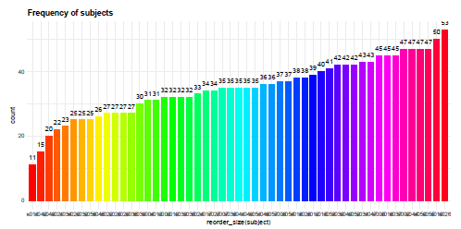
Dataset Exploration
Frequency distribution of the subjects in each class

Slide 6
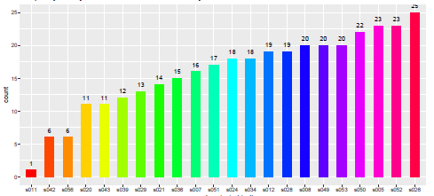
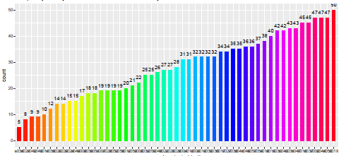
Dataset Exploration
User participation in session 7 (top) vs session 8 (bottom)

Slide 7
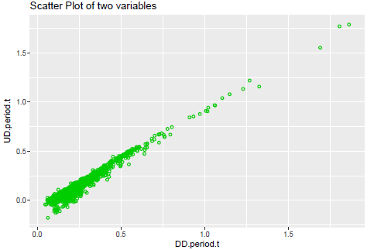
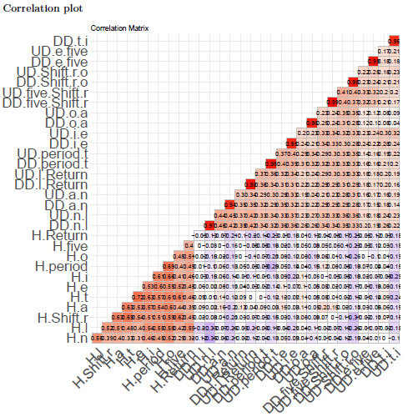
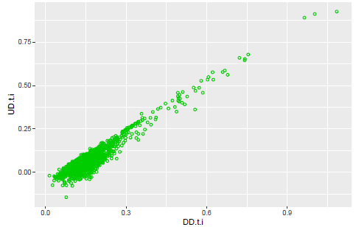
Dataset Exploration
No missing data was found.
Linear relationship between UD and DD.
Measured correlation between variables. Very strong correlation
between the DD and UD variables.

Slide 8
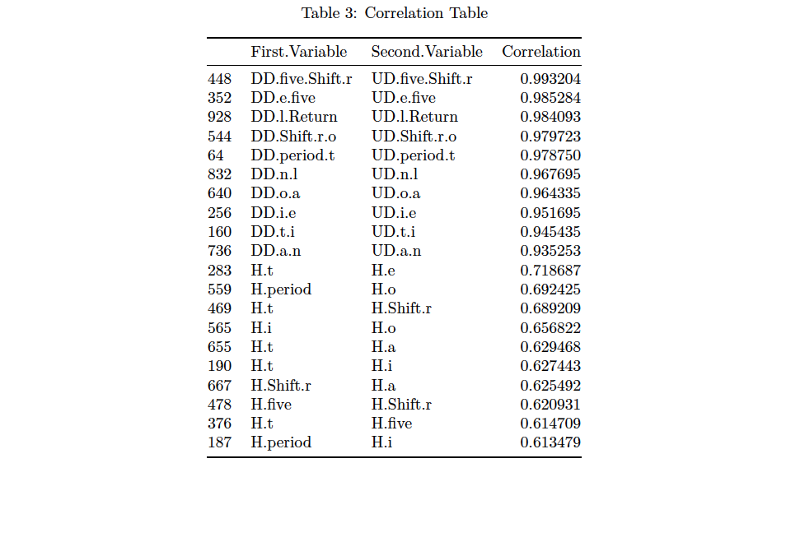
Dataset Exploration

Slide 9
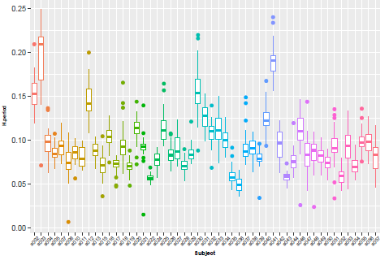
Dataset Exploration
Box plot of hold time variable for most of the subjects are not
overlapping with each other

Slide 10
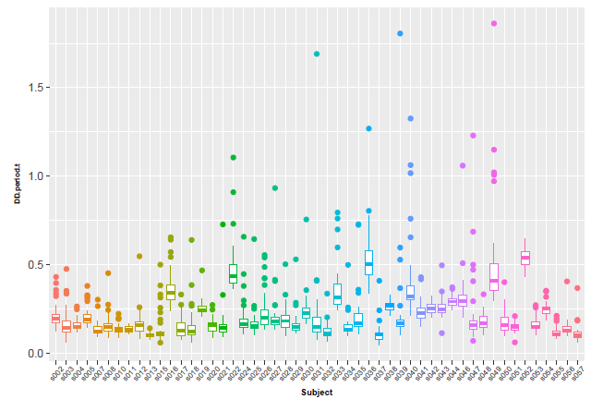
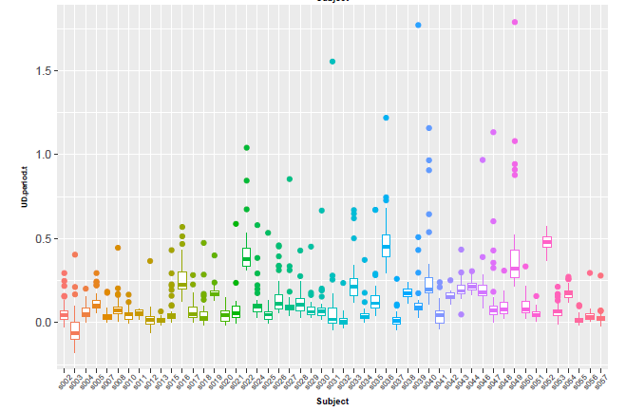
Dataset Exploration
For DD and UD some of them are overlapping and some are not overlapping
We conclude that there is difference among the 51 variables

Slide 11
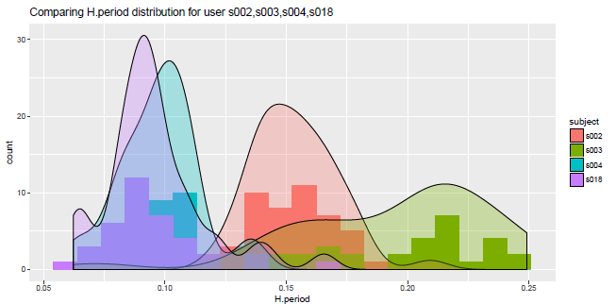
Dataset Exploration
Density plot for Hold time to compare the subjects

Slide 12
Preparing training and test dataset
Used sample() and createPartition() function from r package to ensure a good proportion of subject and session in each training and test data.
Training data: 70%, test data: 30%

Slide 13
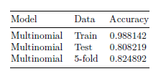
Model I: Multinomial logistic regression
Models nominal outcome variables ,in which the log odds of the outcomes are modeled as a linear combination of the predictor variables

Slide 14
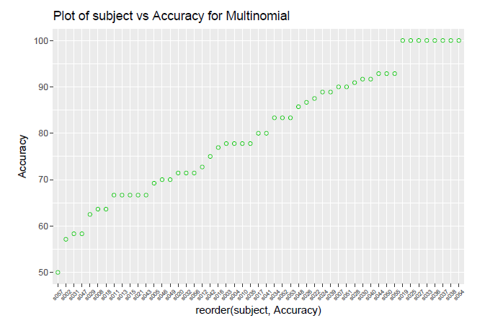
Model I: Multinomial logistic regression

Slide 15
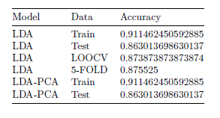
Model II: Linear Discriminant Analysis (LDA)
Finds the linear combination of original variables that provide the best possible separation between the group.
Also experimented with LDA-PCA so as to reduce the dimensionality of the predictor space

Slide 16
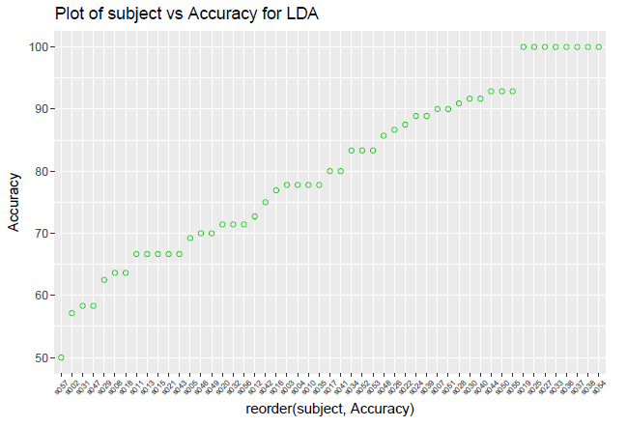
Model II: Linear Discriminant Analysis (LDA)

Slide 17
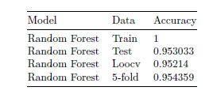
Model III: Random Forest
Builds a number of decision trees on bootstrapped training samples.

Slide 18
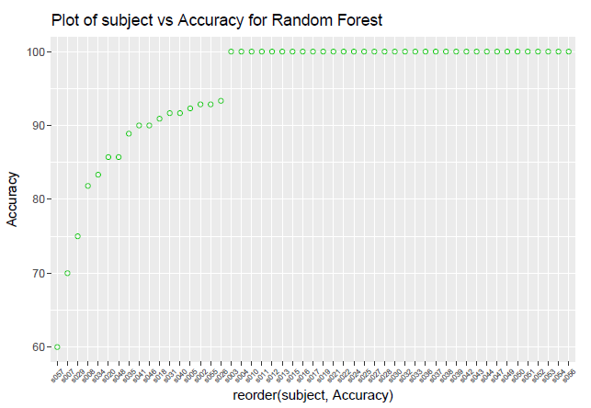
Model III: Random Forest

Slide 19
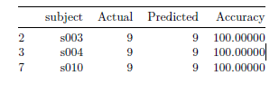
Conclusion
Random forest performed the best for the given dataset.
Accuracy on the test dataset was 95.3033 %.
Subject-wise accuracy was 100 % for most of the subjects
This method is well-suited for multiclass problems

Slide 20
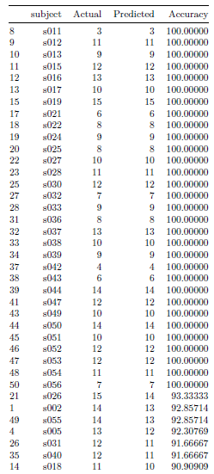
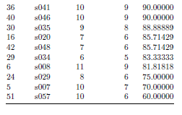

Slide 21
Thankyou!!

