Slide 1
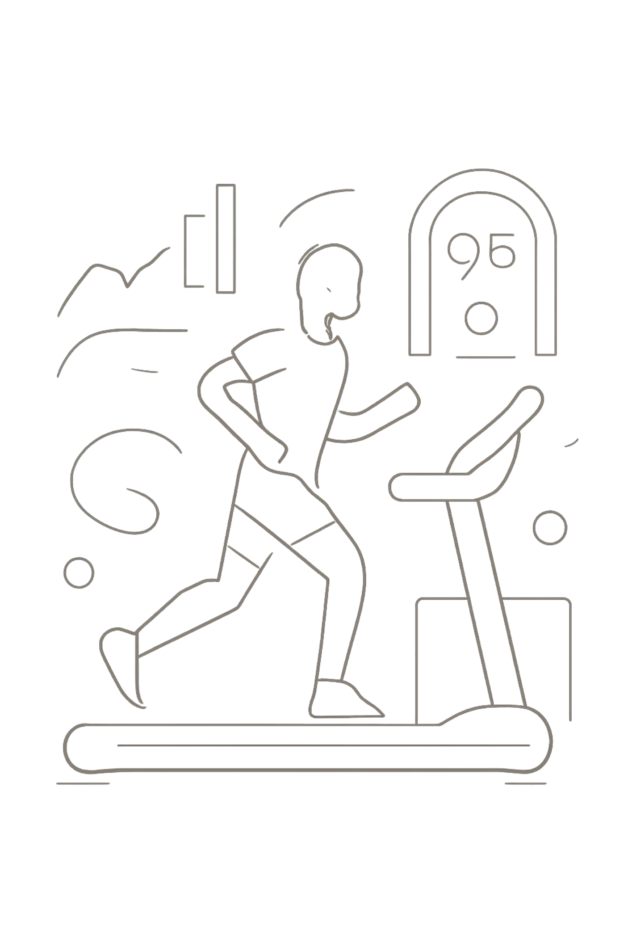
Gym Progress Prediction Using Machine Learning
A data-driven fitness forecasting system that predicts weight, body fat percentage, and goal achievement probability — powered by Gradient Boosting models trained on 30,000 real gym records.
PROJECT BY PRANIT PATIL
PYTHON · FLASK · SCIKIT-LEARN · GRADIENT BOOSTING

Slide 2

Project Overview
This system leverages supervised machine learning to give gym members and trainers a clear, quantified picture of future fitness outcomes. By training on a large dataset of real gym records, the model generates three core predictions that directly inform training and nutrition decisions.
⚖️ Weight After 90 Days
📊 Body Fat Percentage
Regresses current metrics to forecast body weight at a 90-day horizon.
Estimates future body composition using lifestyle and workout inputs.
🎯 Goal Achievement Probability
Classifies the likelihood of reaching a stated fitness goal based on behavioral patterns.

Slide 3

THE CHALLENGE
What Members Ask
Problem Statement
How much weight will I lose in 90 days?
What will my body fat percentage be?
Am I on track to reach my goal?
What should I change in my routine?
Most gym members set fitness goals without a realistic sense of what's achievable. Without data-driven guidance, progress estimates are guesswork — leading to frustration, plateauing, and dropout.
This system addresses that gap by translating individual fitness data into personalized, probabilistic forecasts. Members gain visibility into where they'll be in 90 days, what their body composition will look like, and how likely they are to hit their target — all before committing to a program.
What This System Answers
Precise weight projection
Body fat estimate
Goal probability score
Personalized recommendations
The goal is to replace intuition with evidence, helping members and trainers make smarter, faster decisions.

Slide 4
Dataset & Features
The model was trained on 30,000 anonymized gym member records, capturing a rich set of demographic, behavioral, and nutritional variables. This breadth of features enables the model to learn nuanced relationships between lifestyle inputs and fitness outcomes.
Demographics
Workout Behavior
Age, gender, and baseline BMI form the foundational profile for each member.
Workout days per week, cardio hours, and strength training sessions capture training intensity.
Nutrition Intake
Recovery & Wellness
Daily calories, protein grams, and water intake quantify dietary adherence.
Sleep hours and self-reported stress levels add a recovery dimension to the model.

Slide 5
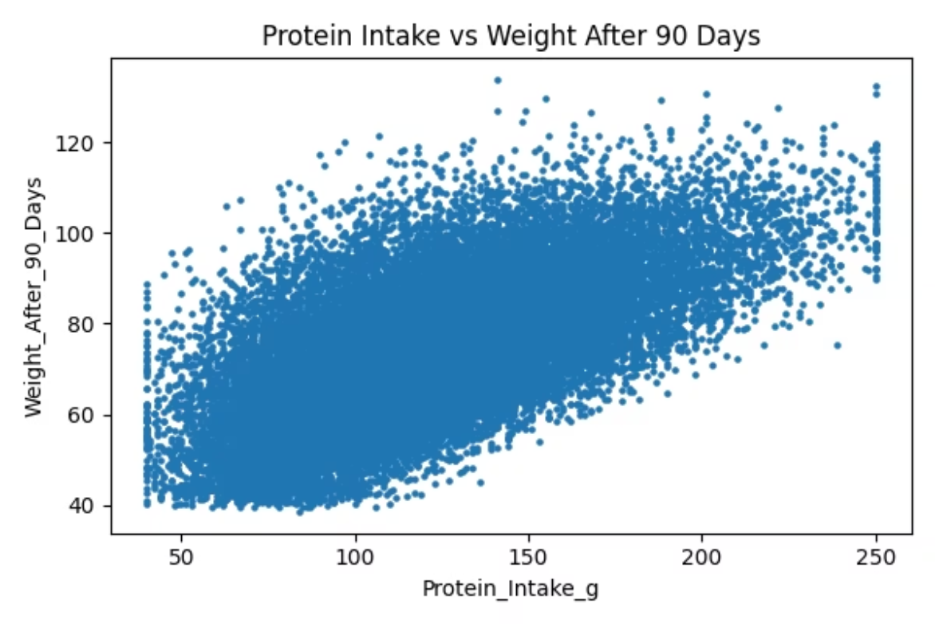
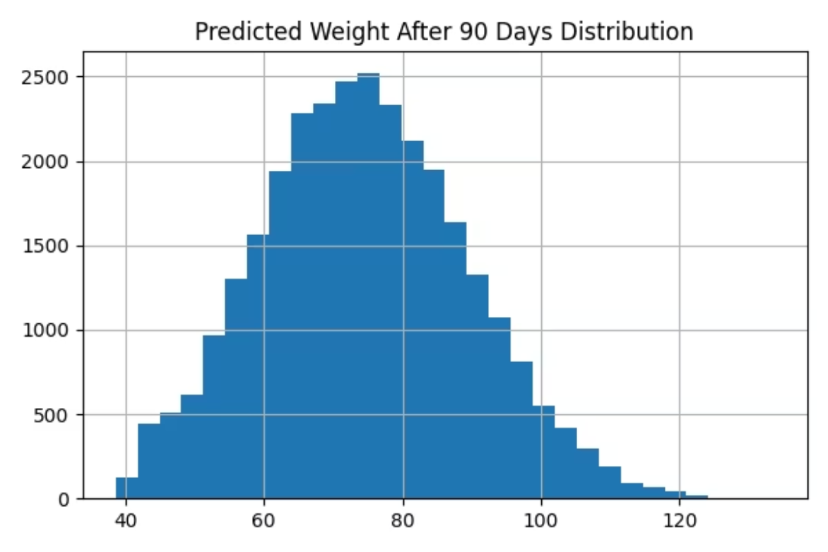
Dataset Visualizations
Exploratory data analysis revealed meaningful distributions across key features. The visualizations below highlight patterns in member demographics, workout frequency, and nutritional habits — all of which serve as critical inputs to the prediction models.
These distributions informed feature engineering decisions and helped identify which variables carry the strongest predictive signal for weight change and goal attainment.

Slide 6
Project Scope
Beyond a single prediction endpoint, this system is designed to serve multiple stakeholders across the fitness ecosystem — from individual members to gym operators and app developers.
Personalized Fitness Forecasting
Trainer Assistance Tools
Gym Analytics Dashboard
Personal trainers can use model outputs to design more effective, evidence-based programs.
Gym owners gain aggregate insights into member progress trends and program effectiveness.
Individual members receive tailored 90-day projections based on their unique profile and habits.
Fitness App Integration
Health Recommendation Engine
The prediction API can be embedded into existing fitness platforms via REST endpoints.
The system generates actionable nutrition and training suggestions alongside each prediction.

Slide 7

Technology Stack
The system is built on a lean, production-ready stack that balances simplicity with ML capability. Flask serves predictions via a lightweight REST API, while Scikit-Learn's Gradient Boosting models deliver high accuracy without the overhead of deep learning frameworks.
Frontend & Backend
Why Gradient Boosting?
HTML / CSS — Responsive GymAI web interface
Flask — Python web framework for API and routing
Gradient Boosting excels on tabular data with mixed feature types. It handles non-linear relationships, is robust to outliers, and provides strong performance without extensive hyperparameter tuning — making it ideal for this use case.
ML & Data Libraries
Gradient Boosting — Regressor & Classifier (Scikit-Learn)
Pandas & NumPy — Data manipulation and numerical computing
Joblib — Model serialization and persistence
Models are serialized with Joblib and loaded at runtime, enabling fast, stateless predictions in the Flask app.

Slide 8

How the System Works
Feature Engineering
ML Models
Compute BMI, active hours, protein/kg, cardio ratio, deficit.
Run gradient boosting regressor and classifier.
User Input
Predictions
Enter fitness details and goals.
Produce weight, body fat, and goal probability.
The end-to-end pipeline transforms raw user inputs into three actionable predictions in seconds. Engineered features — such as BMI, Weekly Active Hours, Protein per KG, Cardio Ratio, and Calorie Deficit — are computed before being fed into the trained models.
GymAI Application Features
Prediction Dashboard
Goal Probability Ring
Central hub displaying all three model outputs at a glance.
Visual gauge showing likelihood of achieving the stated fitness goal.
Personalized Recommendations
Body Fat Reference Insights
Contextual nutrition and training tips generated per user profile.
Benchmarks and reference ranges to contextualize body fat predictions.

Slide 9







Machine Learning Pipeline
A rigorous, reproducible pipeline ensures data quality and model reliability from ingestion through deployment. Each stage is designed to maximize signal extraction and minimize noise.
Data Collection
Cleaning
Feature Engineering
30K gym records aggregated and ingested.
Outliers removed, missing values imputed.
BMI, active hours, protein/kg, cardio ratio, calorie deficit derived.
Scaling & Encoding
Model Training
Evaluation
Normalization and one-hot encoding applied.
Gradient Boosting Regressor & Classifier fit.
R² and AUC metrics validated on hold-out data.
Deployment
Models serialized and served via Flask API.
Key Engineered Features
Why These Features Matter
BMI — Body Mass Index from height and weight
Weekly Active Hours — Combined cardio and strength volume
Protein per KG — Protein intake normalized by body weight
Cardio Ratio — Proportion of cardio vs. total workout time
Calorie Deficit — Difference between intake and estimated expenditure
Raw inputs alone don't capture the physiological relationships driving fitness outcomes. These engineered features encode domain knowledge — such as the importance of protein density and energy balance — directly into the model, significantly boosting predictive accuracy.

Slide 10
Model Performance & Conclusion
The Gradient Boosting models achieved exceptional accuracy on held-out test data, validating the feature engineering approach and confirming the system's readiness for real-world deployment.
0.989
0.95
30K
Weight Prediction R²
Goal AUC Score
Training Records
Near-perfect regression fit — the model explains 98.9% of variance in 90-day weight outcomes.
Strong classification performance — the model reliably distinguishes goal achievers from non-achievers.
A large, diverse dataset ensures robust generalization across member profiles and gym contexts.
Key Takeaway
What's Next
The Gym Progress Prediction system demonstrates that machine learning can deliver accurate, actionable fitness forecasts at scale — empowering members, trainers, and gym operators to make data-informed decisions.
Expand dataset with longitudinal member tracking
Add personalization through user feedback loops
Integrate wearable device data streams
Build a mobile app companion for GymAI

