Slide 1

Bug Tracking System

Slide 2
Table of Contents
01
02
03
04
Application Overview
Application Features
UI Snapshots
Learning

Slide 3
Application Overview

Slide 4
Topic: Bug Tracking System
In a typical bug tracking system, features included are:
Viewing all the bugs
Raising bugs (done by the tester) for a project
Resolving the bugs (done by the developer)
Closing the bugs (done by the manager)
We have included all the above features in our application, as well as, other features such as register/login user, creating new project etc.
In the upcoming slides we will explain all the features of our application

Slide 5
Overview of Layered Architecture
There are three schemas/model defined in our project:
User (Manager, Developer or Tester)
Bug
Project
The User Class, has attributes related to them, such as user_id, username, email, fullName, projectCount, lastLoggedIn and userRole.
The Bug class, stores blueprint information related to the bug object, attributes include bug_id, bug_name, bug_description, created_by, created_on, projectId, and severity_level
The Project class stores blueprint information related to the project object, attributes include, project_id, projectStatus, projectName, projectManager, startDate, noOfBugs.

Slide 6
Overview of Layered Architecture
The DAO layer, has various methods, made according to the problem statement
DAO Layer has 4 sub-packages:
User: Includes the features common to all the users
Manager: Includes features accessible to only managers
Developer: Includes features accessible to only developers
Tester: Includes features accessible to only testers
The Service layer is responsible for calling the DAO layer, with the right parameters, it also has 4 sub-packages, similar to the ones mentioned in the DAO layer.
The service layer can be called using the Controller layer, the object for the particular use case can be created in the controller layer.

Slide 7
Application Features

Slide 8
Manager Features
Creating a new project
Assigning project to a developer
Assigning a bug to a developer
Accepting or Rejecting a bug which was raised by a tester
Closing a bug, which has been completed by a developer

Slide 9
Developer Features
Changing Bug status to Marked (as in completed)
Get a list of all the assigned bugs

Slide 10
Tester Features
Reporting a new bug
Viewing bugs reported by themselves

Slide 11
Features Common to all Users
Register / Login
Getting their own details (user_id, username, email, fullname, no_of_projects, last_logged_in, role)
Getting a list of all assigned projects
Getting a list of all project members

Slide 12
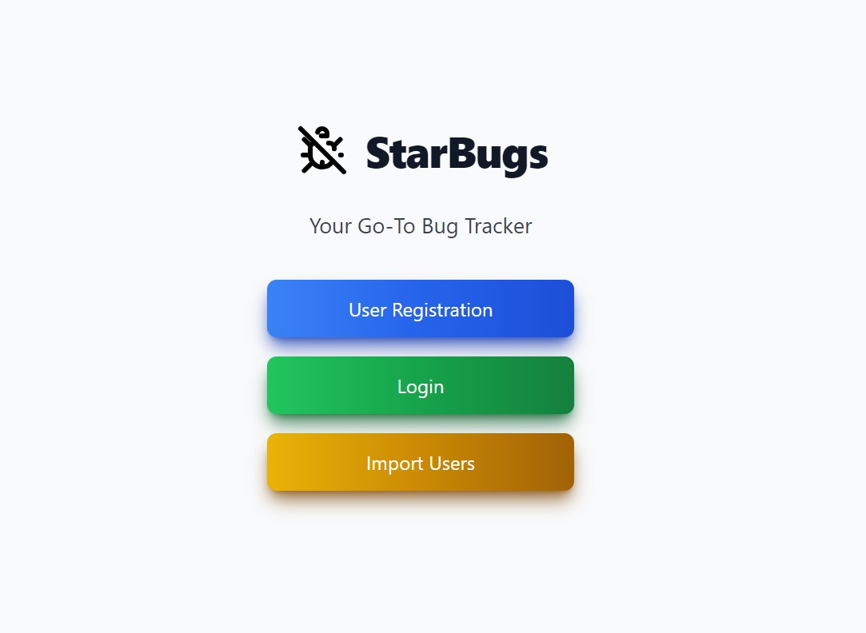
User Interface-Index

Slide 13
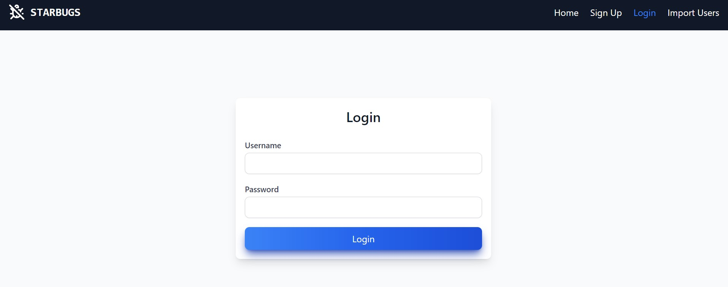
Login

Slide 14
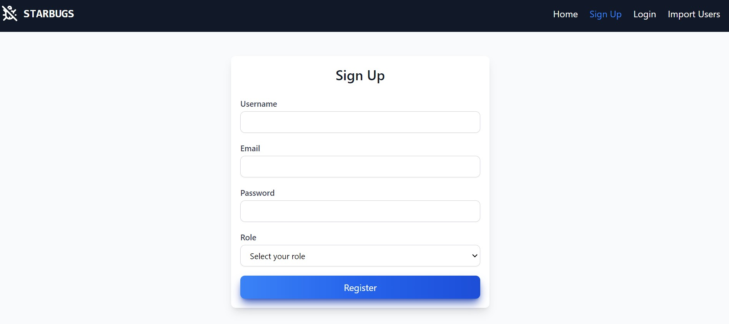
Register

Slide 15
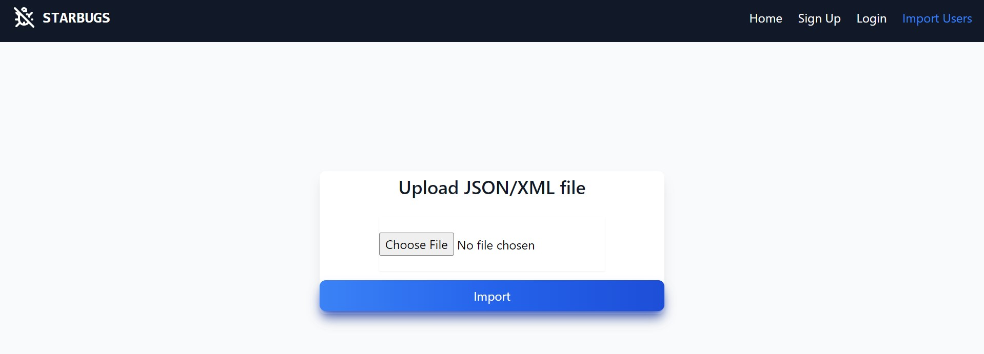
Import User

Slide 16
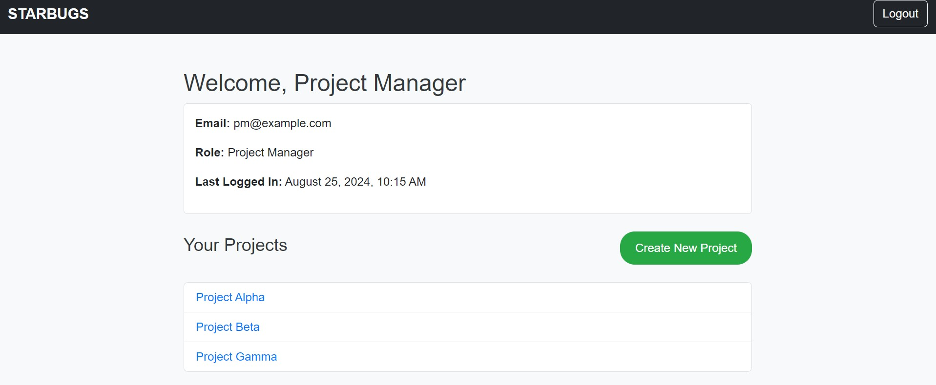
Project Manager index

Slide 17
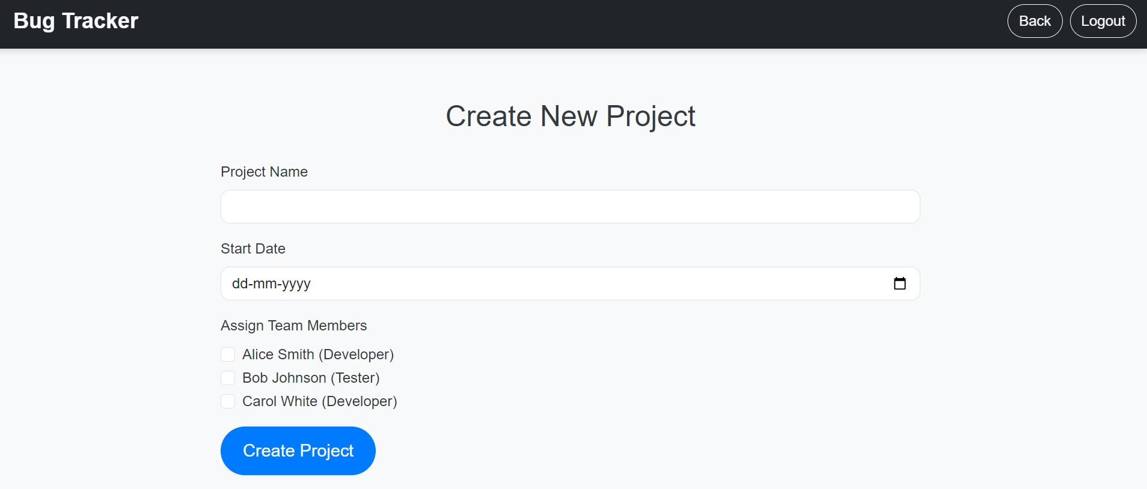
Create New Project

Slide 18
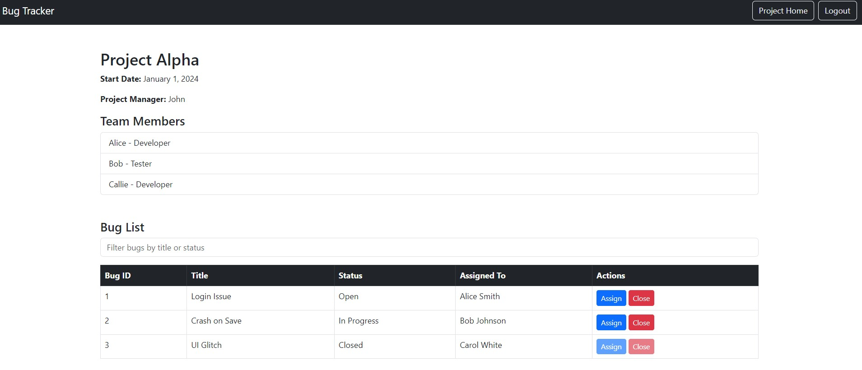
Project Details

Slide 19
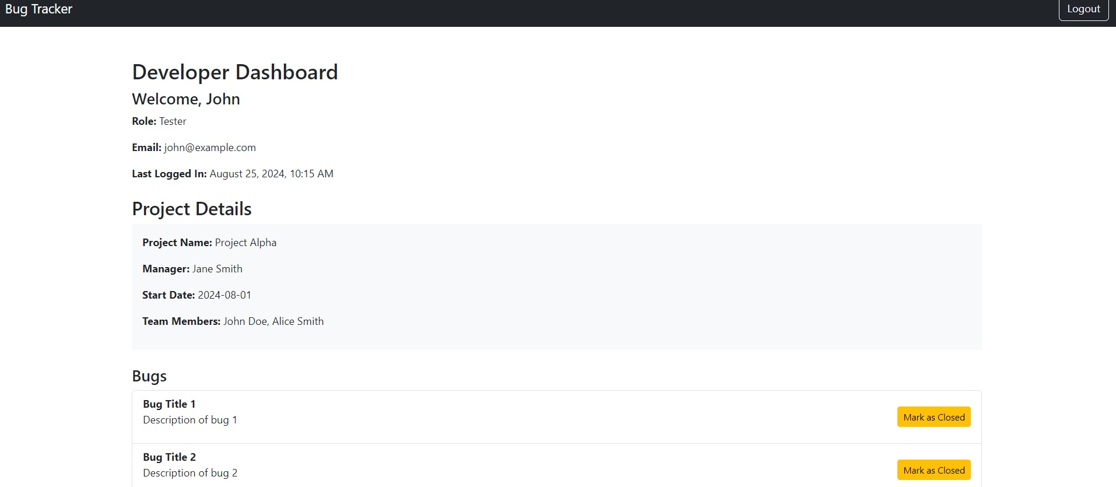
Developer Index

Slide 20
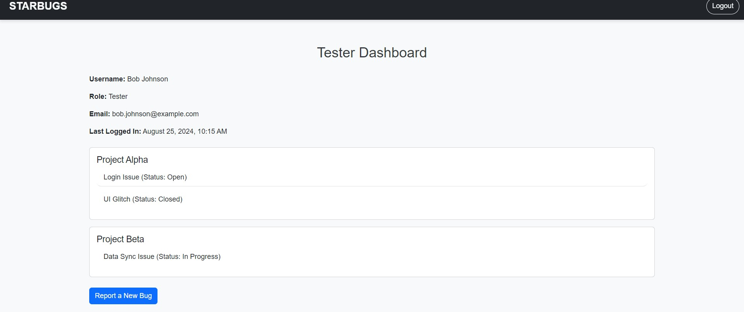
Tester Index

Slide 21
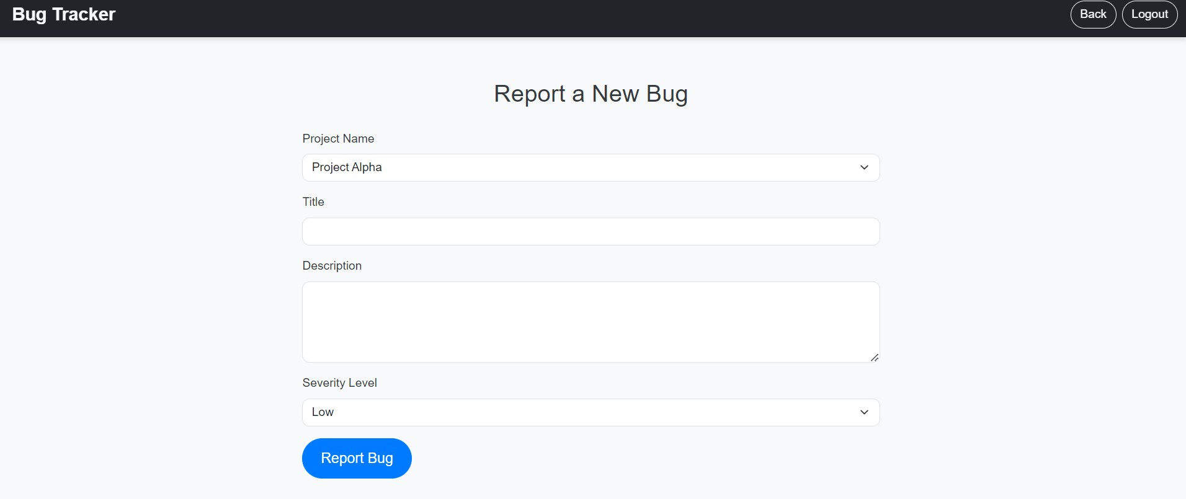
Report Bug

Slide 22
Learning

Slide 23
Key Learnings
We Learned about how to build a Layered Application, which spans across multiple layers, such as DAO, Service, Controller, etc.
We learned how to collaborate with team members on git/github. We learned how to architect the Database using ER Diagrams.
We also learned how to build the complete backend with the help of the architecture diagrams we designed such as UML diagrams, and the data flow diagrams, giving us a clear picture of what we want to achieve.

Slide 24
Tools & Technologies Used
Git/Github
HTML
CSS
JavaScript
Java
IntelliJ

Slide 25
Thanks!
Team Members:
Achyuta Upadhya
Gurudev C K
Indrani Sarkar
Janvi Somani
Prathmesh Potabatti
Rishita Soni
Siddharth S

