Slide 1
Predictions for token splitting
Praval Pattam

Slide 2
What are we doing?
We plan to pre-split the tokens, So that during times of high traffic we can reduce the overhead at the TPU
This can be done with
Time Series Analysis
We will be predicting token counts as well as TPS

Slide 3
How to solve the PROBLEM?
Statistics
Simple Moving Average, Weighted Moving Average
Autoregressive models
Regression Models such as Random Forests, XGBoost etc
Sequence models
Recurrent Neural Networks
Long Short Term Memory
Transformers
Temporal Fusion Transformers

Slide 4
comparision
Method | Strengths | Limitations | Use Cases
Simple Moving Average | Easy to calculate, smooths out short-term fluctuations. | Equal weight to all data points, less responsive to recent changes. | Basic trend analysis, short-term forecasting.
Weighted Moving Average | More responsive to recent changes, flexible weighting. | Requires choosing appropriate weights, more complex than SMA. | Trend analysis, short-term forecasting with emphasis on recent data.
Random Forests, XGBoost | Handles non-linear relationships, robust to overfitting, feature importance. | Requires more computational resources, hyperparameter tuning needed. | Complex time series forecasting, feature-rich datasets.
Recurrent Neural Networks | Captures temporal dependencies, suitable for sequential data. | Struggles with long-term dependencies, vanishing gradient problem. | Simple time series forecasting, basic sequential tasks.
Long Short-Term Memory | Captures long-term dependencies, mitigates vanishing gradient problem. | More complex architecture, requires more computational resources. | Complex time series forecasting, long sequences.
Temporal Fusion Transformers | Captures complex temporal patterns, handles static and dynamic features. | High computational cost, requires large datasets for training. | Multi-horizon forecasting, complex temporal patterns.

Slide 5
What should we use?
FOR predicting Tokens per second
Exponential Weighted Moving Average
FOR predicting Token counts
Temporal Fusion Transformers

Slide 6
Examples of Features
Time Features
Time_of_day
Day_of_the_week
Day_of_the_month
Week_of_the_month
Month
Is_the_day_a_holiday
Lag Features
Lag_1: t-1th day txn count
Lag_2: t-2th day txn count
Lag_3: t-3th day txn count
Rolling Stats Features
SMA
WMA
We can find out more features which through more through data analysis

Slide 7
Training and inference time
Training Time (Fraud Model – RF Classifier)
3 months of data at 22k TPS – 6 hours
1,71,07,20,00,000 data points
Inference Time (Fraud Model – RF Classifier)
300 microseconds
(Information from the MLops Team)
Expected Training time
At 200 TPS one day of data – 20 minutes
1,72,80,000 data points
So essentially, we can re-train the model daily

Slide 8
Doubts in design
How many token denominations?
Eg: 10, 20, 500, 1000? Do we know the most common tokens? What happens to the other tokens that don't fall into these denominations
How/Where is the data from Kafka stored (In some dB?)
Is there some sort of dB? Or some schema from where we can get this data?
When will the TPU pre-split all of these token happen?
(At low traffic times? i.e night?)
How many TPUs are there?
What happens if during presplitting we have some incoming transaction?
Should the txn have higher priority than the pre-splitting?

Slide 9
Appendix

Slide 10


Statistics
Simple Moving Average
Weighted Moving Average
Definition: Average of data points over a specified window.
Formula: SMA
Purpose: Smooths out short-term fluctuations.
Example: 3-day SMA.
Definition: Moving average with different weights for each data point.
Formula: WMA
Purpose: Gives more importance to recent data.
Example: 3-day WMA with weights [0.1, 0.3, 0.6].

Slide 11
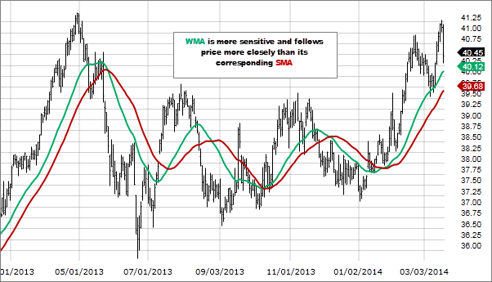
SMA vs WMA

Slide 12

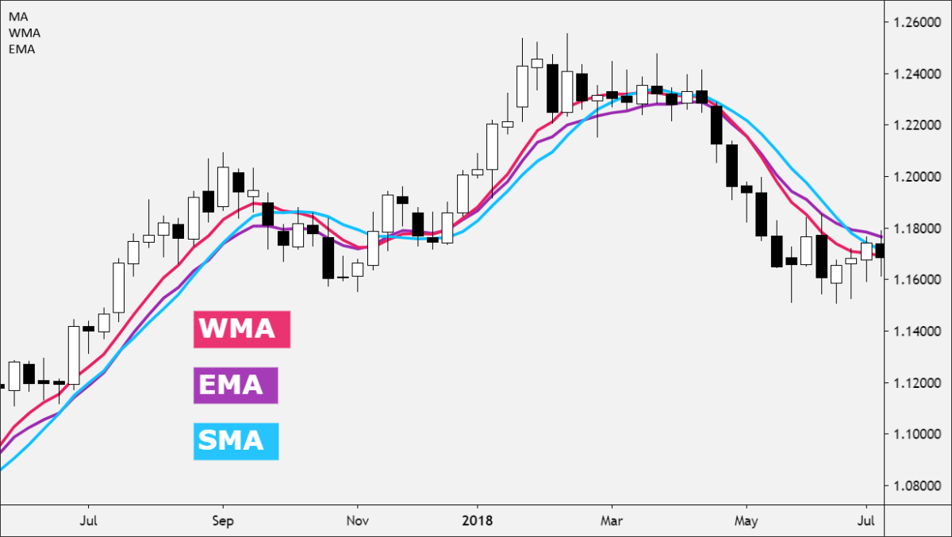
Exponential weighted moving average

Slide 13
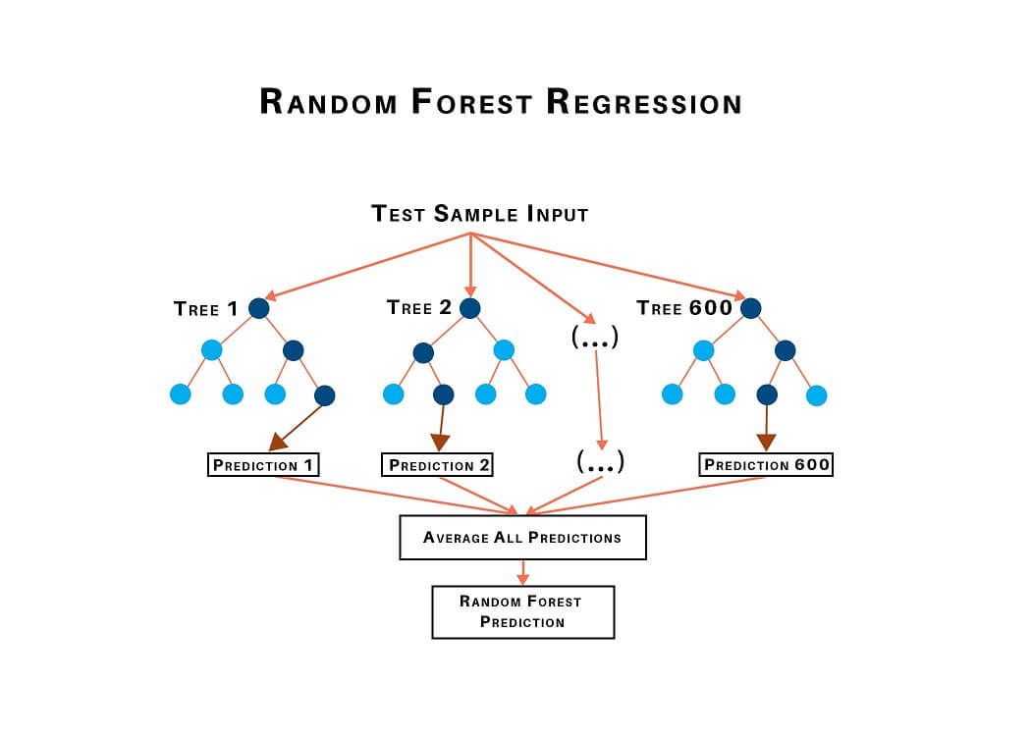
Autoregressive models
Autoregressive (AR) models predict future values based on past values of the time series. We train these models by fitting them to historical data, using lagged values as features. For example, an AR(1) model uses the previous day's value to predict the next day's value.
Regression models like Random Forests and XGBoost are powerful tools for forecasting. We train these models by using historical data and engineered features such as lag values, moving averages, and external factors. These models learn the relationships between the features and the target variable, enabling them to make accurate predictions for future time points.

Slide 14
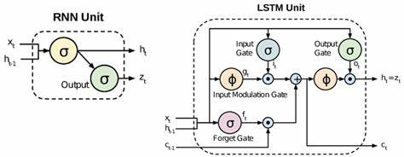
Sequence models
Sequence models like Recurrent Neural Networks (RNNs) and Long Short-Term Memory (LSTM) networks are designed to handle sequential data. We train these models by feeding them sequences of historical data, allowing them to learn temporal dependencies and patterns. Features such as lagged values, moving averages, and external factors are used to capture the context of each time step, enabling the models to make accurate predictions for future time points.
Recurrent Neural Networks
Long Short Term Memory
Architecture: RNNs have a simple loop structure that allows information to be passed from one time step to the next.
Memory: RNNs can capture short-term dependencies but struggle with long-term dependencies due to issues like vanishing and exploding gradients.
Use Cases: Suitable for tasks with short sequences, such as simple time series forecasting and basic text processing.
Architecture: LSTMs have a more complex structure with gates (input, forget, and output gates) that control the flow of information, allowing them to maintain and update a cell state over long sequences.
Memory: LSTMs are designed to capture both short-term and long-term dependencies, effectively addressing the vanishing gradient problem.
Use Cases: Ideal for tasks with long sequences, such as complex time series forecasting, speech recognition, and natural language processing.

Slide 15
Transformers
Temporal Fusion Transformers
Temporal Fusion Transformers (TFTs) are specialized versions of transformers tailored for time series forecasting. They incorporate both static and dynamic features, allowing them to handle temporal patterns and external factors effectively.
We train TFTs by providing them with sequences of historical data and relevant features, enabling them to learn intricate temporal relationships and make accurate multi-horizon forecasts.
Paper at
https://arxiv.org/pdf/1912.09363
Multi-horizon Time Series Forecasting

Slide 16
THANK YOU

