Slide 1
IBM University Engagement Project Submission
“Exploring the Power of Agentic AI with IBM Granite and LangFlow”

Slide 2

Project Tile – Social Media Agent
Domain of Project – Entertainment
Student Name | Recent Passport Photo | Email ID | Mobile number [WhatsApp]
Pravina Mahendra Patil |  | ppravina250@gmail.com | 7666921529

Slide 3
Problem Statement -
Problem Statement : Social Media Agent
The Challenge:
Brands, influencers, and organizations struggle to keep up with the fast-paced and fragmented world of social media. Content trends evolve hourly, audience sentiment shifts rapidly, and competitor strategies are difficult to track. Managing multiple platforms often leads to scattered insights, missed engagement opportunities, and ineffective campaigns. The challenge is not only to collect social media data but also to analyze, predict, and recommend actions in real time
The Objective:
Build an agentic Al application that acts as an intelligent social media companion. The solution should:
1. Fuse Multichannel Data: Collect and synthesize content, comments, hashtags, and competitor posts from platforms like X, LinkedIn, Instagram, and Facebook into unified insights.
2. Enable Multimodal Interaction:- Accept user inputs (text, images, or voice prompts) and generate creative post drafts, captions, or campaign ideas aligned with brand tone
3. Create a Predictive & Agentic Layer:- Forecast trending hashtags, audience sentiment shifts, and competitor engagement patterns while suggesting the best posting schedules.
4. Visualize Social Media Pulse:- Provide a dashboard with real-time analytics-engagement trends, influencer mapping, sentiment tracking, and campaign performance forecasts.

Slide 4
Proposed Solution -
Proposed Solution: AI-Powered Social Media Agent
The proposed solution is a multi-agent AI-powered Social Media Agent designed to automate content creation, audience engagement, and social media analytics. The system uses AI models, Retrieval-Augmented Generation (RAG), and intelligent workflows to provide personalized marketing assistance and improve online brand presence.
At its core, the solution uses a RAG pipeline to collect and analyze social media trends, brand information, audience behavior, and marketing insights from trusted sources. The retrieved knowledge is stored in a vector database, allowing AI models to generate relevant content and recommendations.
The system consists of four key agents:
Content Creation Agent generates captions, posts, hashtags, and marketing content based on brand goals and target audiences.
Strategy Agent analyzes trends, competitors, and audience insights to recommend posting schedules, campaigns, and growth strategies.
Engagement Agent manages comments and messages, performs sentiment analysis, and provides automated customer responses.
Analytics Agent tracks performance metrics, analyzes engagement, and provides optimization suggestions.
The platform includes an interactive dashboard built using Streamlit or React to manage posts, monitor analytics, schedule content, and visualize social media growth.
Frameworks like LangFlow manage agent workflows, while AI platforms such as IBM watsonx.ai and Granite Models support content generation, reasoning, personalization, and scalable AI deployment.
Overall, the AI-powered Social Media Agent provides an intelligent solution for automating social media management, improving audience engagement, and enabling data-driven marketing decisions.

Slide 5
Technology Used
LangFlow Platform – For designing and orchestrating multi-agent workflows visually, enabling smooth communication between different AI agents such as content creation, engagement, strategy, and analytics agents.
IBM Granite Models – For natural language understanding, content generation, reasoning, sentiment analysis, and personalized social media recommendations.
IBM Cloud – Provides secure, scalable infrastructure for deploying, managing, and running the Social Media Agent efficiently with high availability.
RAG (Retrieval-Augmented Generation) – Used to fetch real-time social media trends, brand information, audience insights, and marketing knowledge before generating accurate and context-aware responses.
IBM watsonx.ai – For AI model deployment, embeddings, prompt management, monitoring, and responsible AI governance.
Vector Database (FAISS/Chroma) – Stores and retrieves social media knowledge, trend data, and brand information to support RAG-based content generation and recommendations.
Frontend Dashboard (React/Streamlit) – Provides an interactive interface for content generation, post scheduling, analytics visualization, and social media management.
LLM APIs (Granite/OpenAI/Gemini) – Used for generating captions, hashtags, marketing strategies, customer responses, and intelligent social media insights.

Slide 6
Langflow component Used -
Chat Input Component – Interface where users enter queries, preferences, or meal details through text, voice, or image inputs.
IBM watsonx AI Agent Component – Processes user inputs using IBM Granite models to generate personalized nutrition insights and recommendations.
IBM Granite Model: Granite-4.0-8B-Instruct – Fast and efficient instruction-following model used for real-time diet recommendations and nutritional analysis.
Chat Output Component – Displays AI-generated responses such as diet plans, nutritional analysis, and health suggestions.
File Component – Stores and retrieves user data, meal logs, and nutritional datasets for analysis and tracking.
Memory Component – Stores conversation context and user preferences to enable personalized and consistent recommendations.

Slide 7
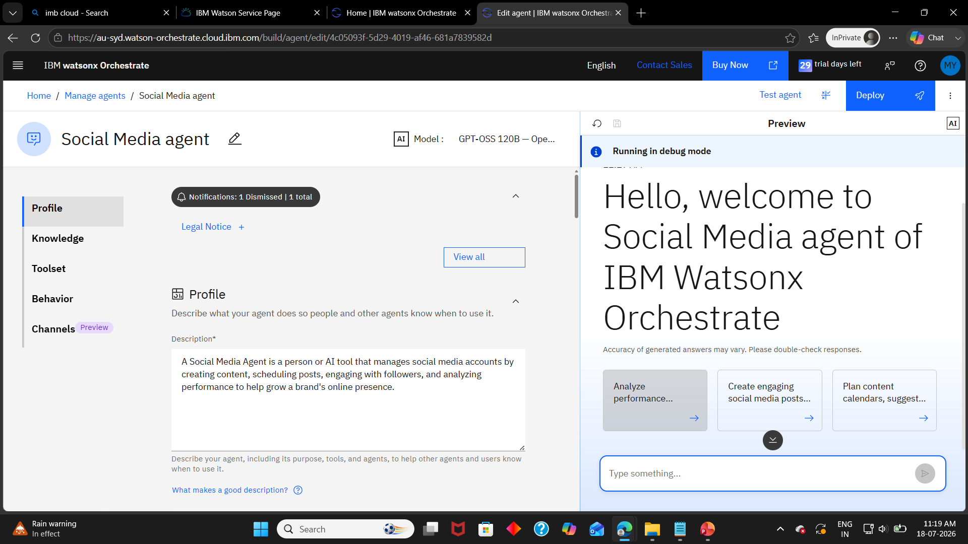

Slide 8
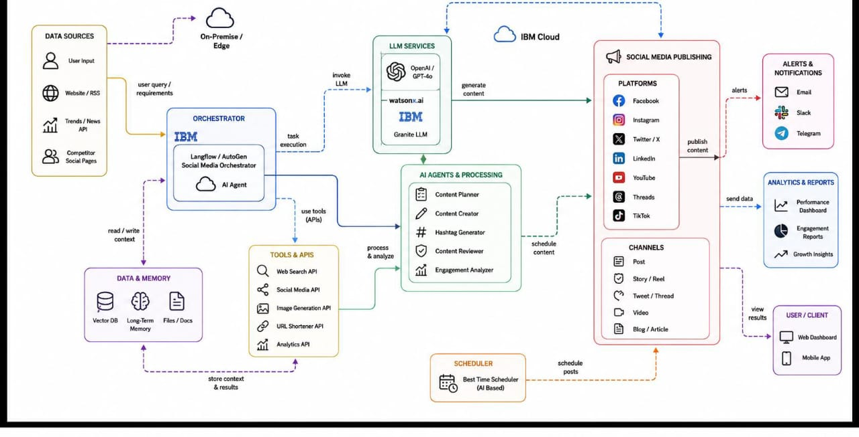
Architecture blueprint

Slide 9

Role of Agentic AI in the solution
Role of Agentic AI in Social Media Agent
Agentic AI enables the Social Media Agent to operate as an intelligent, autonomous system rather than a basic content generation tool. Using IBM watsonx.ai and IBM Granite models, it coordinates multiple specialized agents to manage social media tasks such as content creation, trend analysis, audience engagement, and performance monitoring.
Each agent performs a specific role—such as analyzing audience behavior, generating creative posts, identifying trending topics, scheduling content, and evaluating engagement metrics—while collaborating with other agents. This multi-agent approach improves efficiency, maintains content quality, and ensures relevant and personalized social media strategies.
Agentic AI provides context awareness by understanding brand identity, target audience, platform requirements, and user preferences to generate suitable content. It supports real-time adaptation by analyzing current trends, feedback, and engagement data to continuously improve recommendations and content strategies.
Additionally, agents communicate and share insights with each other, enabling better decision-making, automated workflows, and optimized social media performance.
Overall, Agentic AI transforms the Social Media Agent into a proactive, intelligent, and goal-oriented system that helps users create, manage, and optimize social media content effectively while improving audience interaction and online presence.

Slide 10
Novelty and Uniqueness
The proposed Social Media Agent stands out by combining Agentic AI, RAG, and personalization into a single intelligent content management system.
Multi-Agent Intelligence – Instead of relying on a single content generation tool, multiple specialized agents collaborate to handle different social media tasks such as content creation, trend analysis, audience engagement, and performance monitoring.
RAG-Based Accuracy – Integrates real-time information retrieval with AI generation to create relevant, up-to-date, and context-aware social media content while reducing outdated or inaccurate information.
Hyper-Personalization – Generates customized posts and campaigns based on brand identity, target audience, platform requirements, user preferences, and engagement patterns.
Real-Time Feedback Loop – Continuously improves content strategies by analyzing audience interactions, comments, trends, and performance metrics to optimize future posts.
Multi-Modal Content Support – Supports text, image, and other media inputs to create engaging and diverse social media content suitable for different platforms.
Trend-Aware Engagement – Goes beyond basic post generation by identifying emerging trends, analyzing audience sentiment, and recommending strategies to improve reach and engagement.
Scalable & Enterprise-Ready – Built on IBM watsonx.ai with IBM Granite models, ensuring reliable AI-driven content generation, governance, and secure deployment.
This makes the solution a smart, adaptive, and proactive social media assistant, not just a content creation tool. It helps users automate workflows, enhance audience engagement, and make data-driven decisions for stronger digital presence.

Slide 11
Git Hub Link
1.Website- https://ppravina250-ops.github.io/Social-Media/
·
·
·

Slide 12
Future Scope
1. Integration with Advanced Social Media Analytics & Marketing Platforms – The system can be integrated with social media analytics tools and marketing platforms to collect real-time data such as audience engagement, follower growth, sentiment analysis, and content performance metrics. This will enable the Social Media Agent to provide more accurate insights, optimize content strategies, and recommend data-driven campaigns based on actual audience behavior.
2. AI-Powered Voice Assistant & Multilingual Content Generation – Enhancing the system with voice-enabled interaction and multilingual content generation will improve accessibility and usability. Users can create, manage, and optimize social media content in their preferred language through natural conversations, making the solution more inclusive for global audiences and diverse markets.
3. Automated Content Scheduling & Cross-Platform Management – The Social Media Agent can be enhanced to automatically schedule, publish, and manage content across multiple platforms. This will help users maintain consistent online presence while reducing manual effort and improving workflow efficiency.
4. Advanced Sentiment Analysis & Audience Insights – Future enhancements can include AI-driven sentiment analysis to understand audience reactions, identify emerging trends, and provide recommendations for improving engagement and brand communication strategies.
5. Generative AI for Creative Media Production – The system can be extended with advanced generative AI capabilities to create high-quality images, videos, captions, and campaign ideas, enabling faster and more creative social media content development.
·
·
·

Slide 13
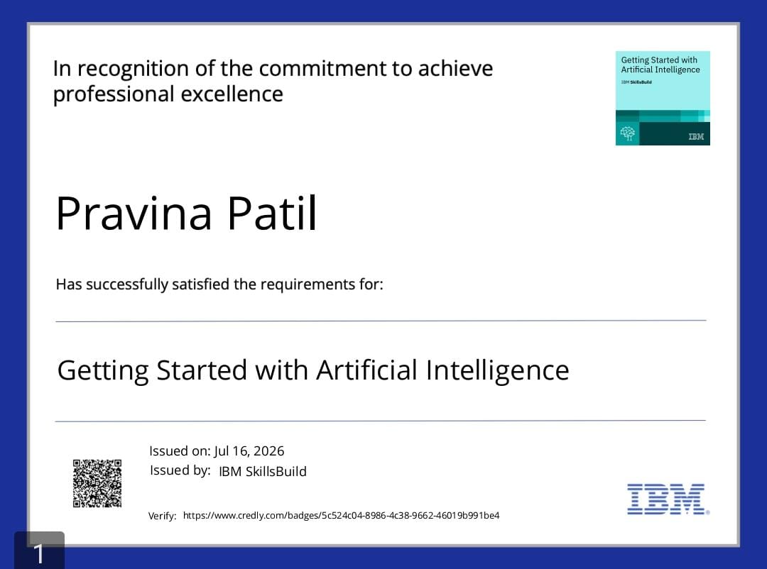
Certificates Earned:
Please add your credly certificate

Slide 14
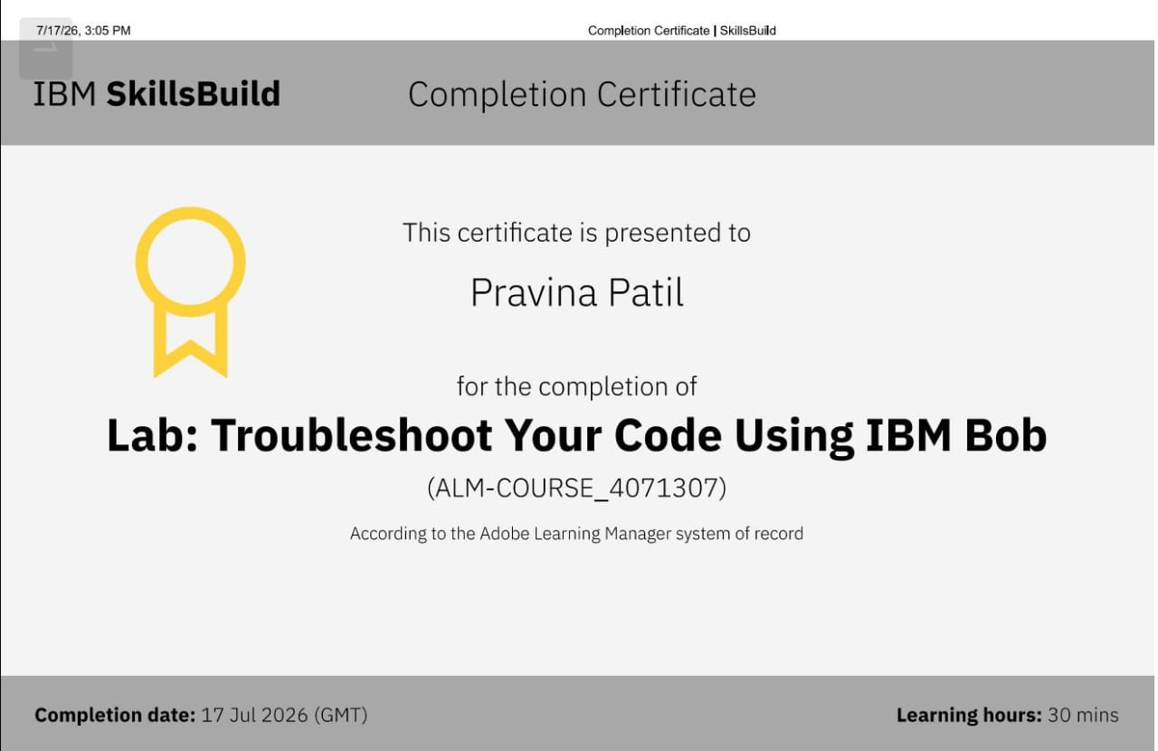
Certificates Earned:​
Add your IBM BOB Certificate

Slide 15


