Slide 1

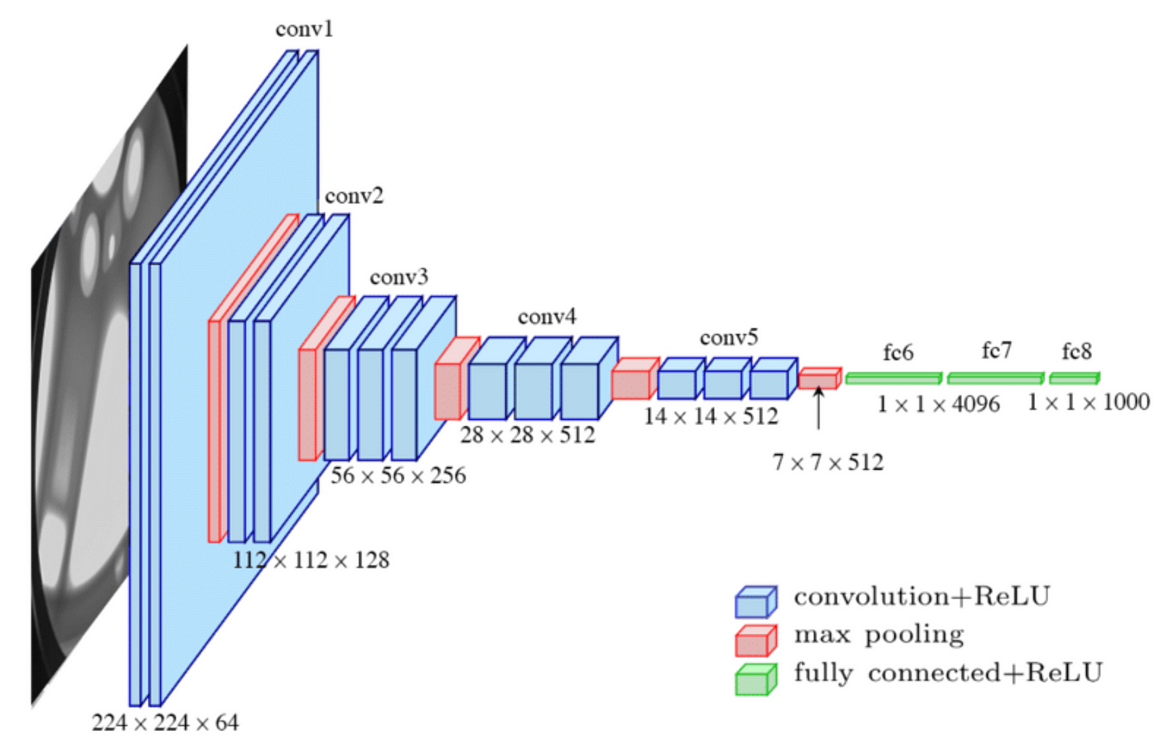
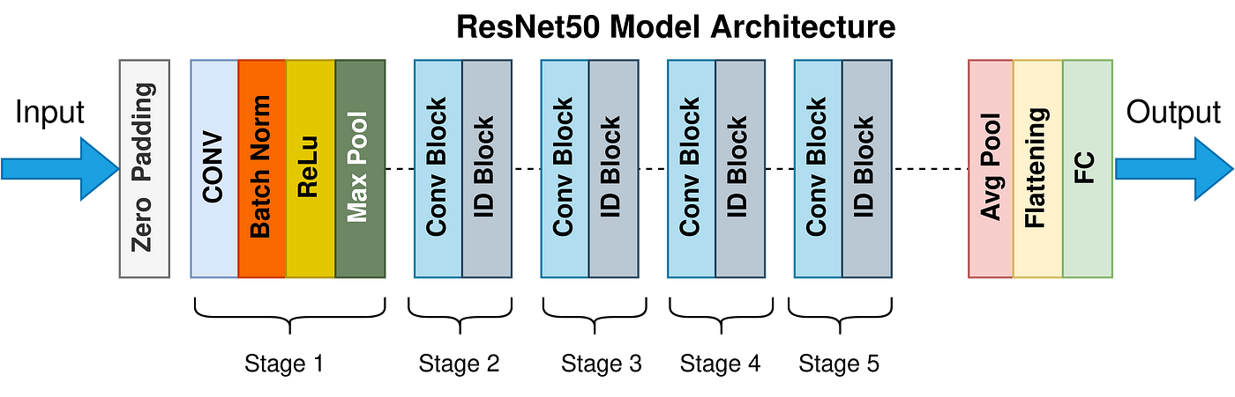
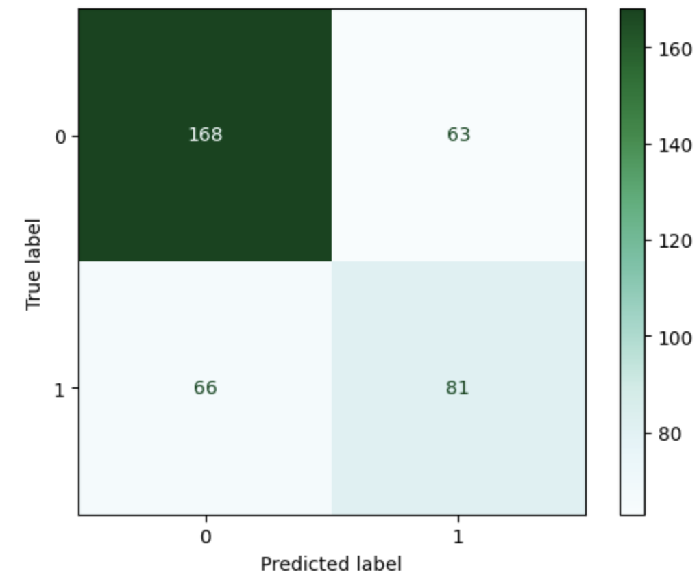
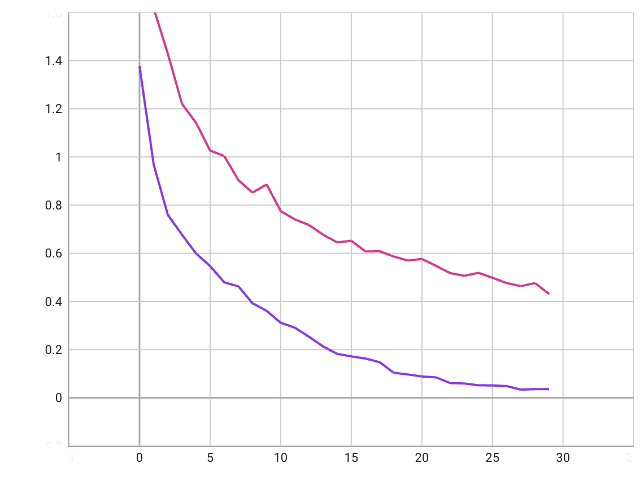
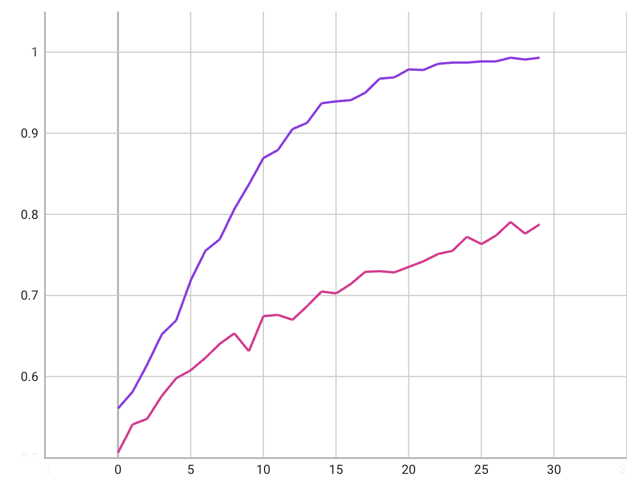
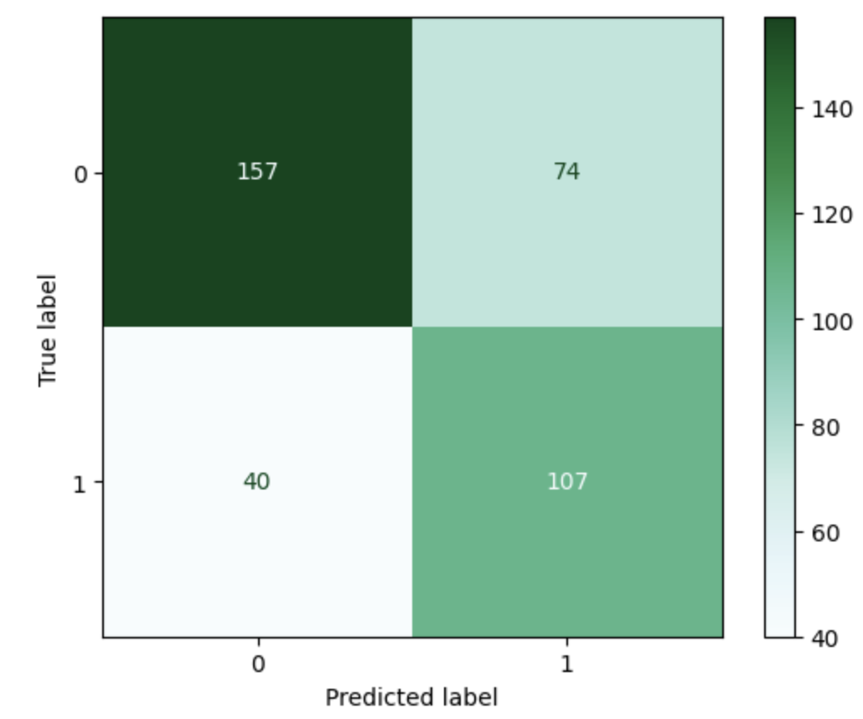
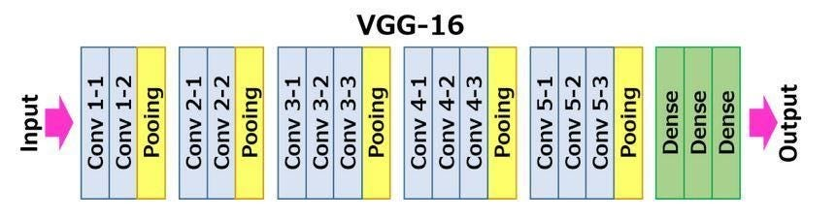
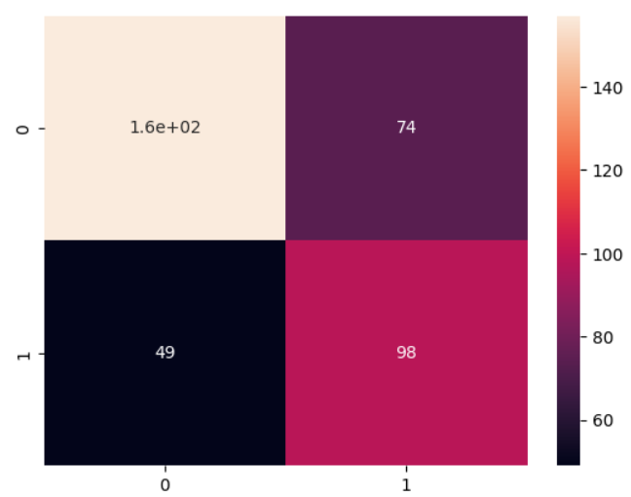
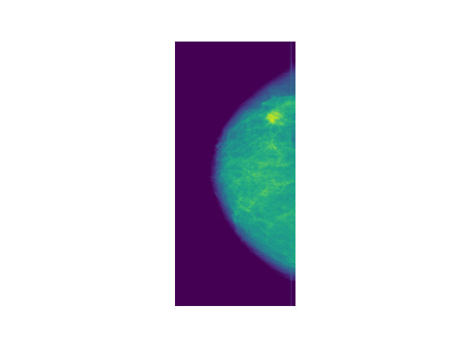
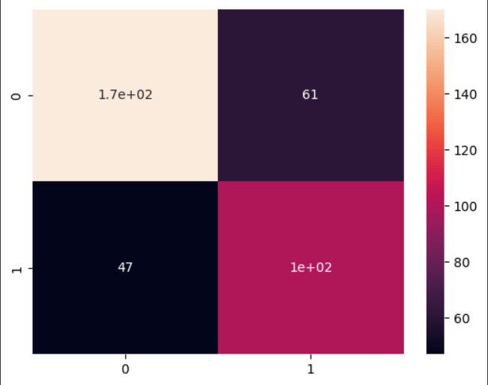
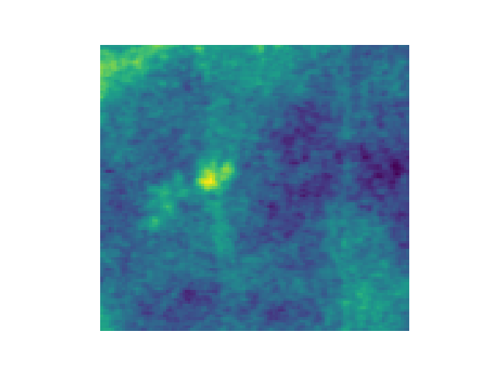
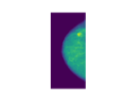
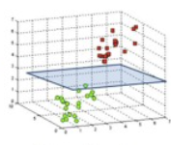


Classifying Benign and Malignant Masses in Mammograms
Ahmad Abdal Qader, Anna Pritchard, Pranav Premdas Georgia Institute of Technology
Introduction
Methods: Overall Model Architecture
Results: VGG16 + Dense Classification
Discussion
Breast Cancer
Feature Selection
Cross-Validation
With approximately 2.3 million cases and almost 700,000 deaths recorded in 2020 alone, breast cancer is one of the most prevalent types of cancers in women around the world (WHO). Early detection has been shown critical to the success of delivered treatments. Mammography is a low-dose radiation imaging technique and is the most commonly used screening tool for breast cancer (Nelson et al 2016).
While mammographs show abnormalities which could be masses or calcifications, a radiologist cannot tell malignant from benign tumors solely on the mammograph, and a biopsy is usually required for verification which takes time, is costly, and involves numerous risks.
In recent years, there has been increasing interest in automating breast cancer detection in mammograms. These efforts have been successful at segmenting out abnormalities in the mammographs, however they do not provide any further insights about the nature and seriousness of these abnormalities.
In this study, we propose a Convolutional Neural Network-based method to classify mammographs containing masses into benign and malignant. We first use a VGG16 model to extract features from cropped bounding boxes containing the mass, then compare the performance of a dense neural network and a gradient-boosted tree at classifying those features into benign and malignant.
Our results show that a dense neural network is able to achieve a classification accuracy of 69.8% compared to 67.5% achieved by a gradient-boosted tree (71.5% when using ResNet50). Overfitting seems to be a critical hurdle due to the nature of the features extracted by the VGG16 model. Further work is needed to better extract and compress features from the cropped images before the use of machine learning or deep learning techniques for the classification.
VGG16: 13 convolutional layers, 5 max pool layers, 3 dense layers
ResNet50: 49 convolutional layers, 3 max pool layers, 1 dense layers
Num layers | 256 | 128 | 64
Average k-fold accuracy | 63.89 | 64.27 | 64.57
Model Performance
Pre-trained
Pre-trained
Fine-tuned
ResNet50 + XGBoost most accurate overall
Fine-tuned VGG16 was most specific for malignant tumors
Classification
training accuracy training loss
AI for Detection
x,y
Trade-off of using Dense Layer classifier vs CNN+XGBoost
. . .
class
...
Advantages of Dense Layer Classifier:
Simplicity: Dense layer classifiers are simple and computationally efficient
End-to-end learning: The model learns to extract features and classify images simultaneously, without relying on any external feature extraction.
Advantages of CNN+XGBoost:
Performance: CNN+XGBoost can achieve better performance on tasks that require spatial reasoning.
Robustness: It is less sensitive to the choice of hyperparameters and noise in the dataset.
Tree 1
Tree 2
Tree N
Fine-tuned
epochs
64 units
Result 1
Result 2
Result N
Accuracy
Pre-trained: 65.9 %
Fine-tuned: 69.8 %
Dense Network
XGBoost
Methods: VGG16 + Dense network
K-fold cross validation to decide how many units in the dense network
50 % dropout layer used before first dense layer
Same dense network architecture used with pre-trained VGG16 and fine-tuned VGG16
VGG16 fine tuning: make last 4 layers trainable
Results: ResNet50/VGG16 + XGBoost
Future Directions
VGG16 + XGBoost
To further improve model accuracy, we could try to augment the mammography data prior to training our models. These augmentations would include:
Adding gaussian noise
Rotating images
Flipping images
Decreasing contrast
We could also incorporate non-image features to see if classification accuracy is improved. For example, we could incorporate patient age and breast tissue density.
More tuning of the VGG16 and dense network could further improve model accuracy. For example, we could try SGD instead of Adam as the optimizer or vary number of trainable layers.
We would also like to try on larger datasets. We were limited in data storage capacity, so chose a smaller dataset.
Training Strategy:
adam optimizer (1e-5 lr)
binary cross entropy loss
Accuracy: 67.5%
trainable
Mammography Dataset
Dense Network Architecture:
Flatten Layer
Dropout Layer
Dense Layer 1: 64 units, relu activation
Dense Layer 2: 1 unit, sigmoid activation
We use a standardized subset of the Digital Database for Screening Mammography (DDSM) called the Curated Breast Imaging Subset (CBIS) provided publicly on Kaggle. The set contains full mammographs, cropped images containing the abnormality, along with the ground truth validation. Further, the training dataset used in this work had a split of 48% Malignant and 51% Benign cancer.
. . .
class
Methods: ResNet50/VGG16 + XGBoost
K-fold cross validation along with RandomsearchCV was used for hyper parameter tuning of the classifier.
ResNet50 + XGBoost
Accuracy: 71.5%
“Benign”
VGG 16
Hyper parameter tuning
References
XGBoost
Nelson HD, Cantor A, Humphrey L, et al. Screening for Breast Cancer: A Systematic Review to Update the 2009 U.S. Preventive Services Task Force Recommendation [Internet]. Rockville (MD): Agency for Healthcare Research and Quality (US); 2016 Jan. (Evidence Syntheses, No. 124.) 1, Introduction.
VGG16 architecture: medium.com, neurohive.io
Dataset: CBIS-DDSM: Breast Cancer Image Dataset from Kaggle
ResNet50
Classification
0 – Benign
1 – Malignant
Input Images
Feature extraction
Training

