Slide 1
Negative Taste Experiences in Gormsey
Peter Prevos

Slide 2
Problem Statement
Chlorine levels about 0.6 mg/L are acceptable by only 50% of customers
A minimum chlorine residual is required for public health
Exploratory analysis of chlorine levels for all Gormsey suburbs

Slide 3
Laboratory Data
Monthly samples are taken from customer taps in each town.
Sampled between 2069-01-01 and 2070-12-31.
Fields:
Sample_No: Number of the sample
Date: Date the sample was taken
Sample_Point: Sample point asset number
Suburb: Gormsey suburb
Result: Test result
Sample tap (mass.gov).

Slide 4
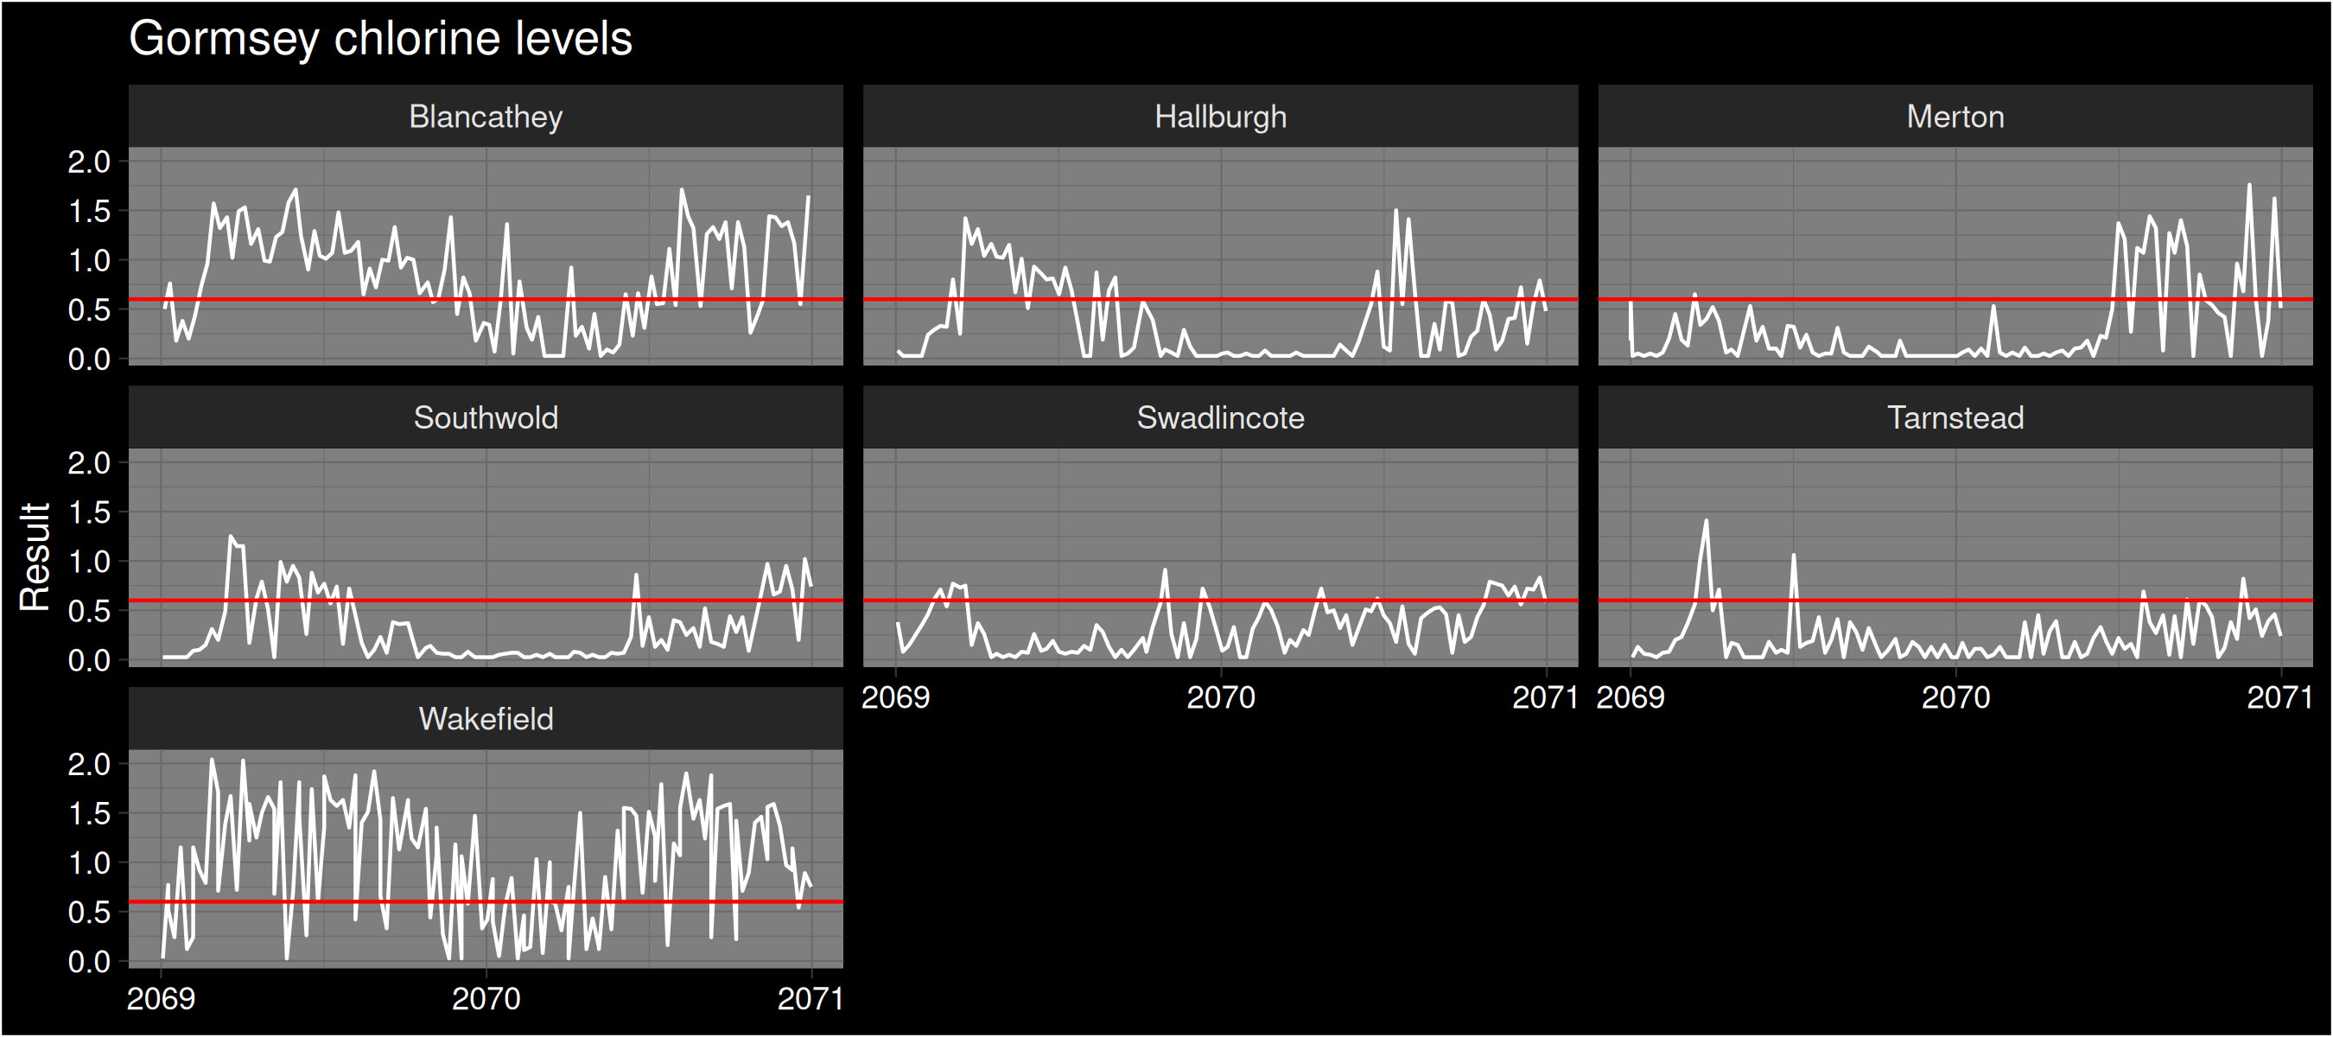
Explore results

Slide 5
Top-three High Chlorine Locations
Suburb | Minimum Cl | Mean Cl | Maximum Cl | Negative taste %
Wakefield | 0.03 | 1.00 | 2.04 | 71
Blancathey | 0.03 | 0.82 | 1.71 | 63
Hallburgh | 0.03 | 0.37 | 1.50 | 26

Slide 6
Conclusion and Recommendation
Chlorine levels in some Gormsey suburbs are high
High levels lead to a negative customer experience
Highest level in Wakefield.
Further research required to correlate taste complaints with chlorine levels

