Slide 1



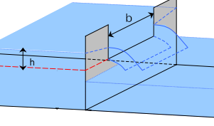







R⁴H2O : : SESSION ONE CHEAT SHEET
Arithmetic
Case Study 0
Data Frames
Statistics
R is meme proof (applies BODMAS)
Cd <- 0.62
g <- 9.81
b <- 0.5
h <- 100 / 1000
q <- (2 / 3) * Cd * sqrt(2 * g) *
b * h^(3 / 2)
Rectangular data (called a Tibble in
Tidyverse) to store structured data.
turb_results <- turbidity$Result
mean(turb_results)
median(turb_results)
min(turb_results)
max(turb_results)
range(turb_results)
quantile(turb_results,
probs = 0.95,
method = 7)
var(turb_results)
sd(turb_results)
3 – 3 * 6 + 2
glimpse(gormsey)
Columns: variables
gormsey$Result
gormsey[, 6]
gormsey[, "Result"]
Rows: observations
gormsey[1:10, ]
Gormsey[1:10, 4]
Variables
Use meaningful variable names
Packages
diameter <- 150
nonRevWater <- 10
non_rev_water <- 20
Packages are libraries of functions and data files to extend R. The CRAN website lists most packages. Initiate libraries every script with the packages you need, e.g.:
Counting Data
Vectors
Count number of
rows for each variable
Grouping
library(tidyverse)
Create vectors:
length(gormsey$Measure)
unique(gormsey$Measure)
count(gormsey, Measure)
count(gormsey, Measure, Town)
nonRevWater <- c(1, 3, -1, 0)
day <- 1:4
Tidyverse is a collection of packages. Click on the hexagonal package logos for more info.
Vector subsets:
Reading CSV Files
nonRevWater[2]
nonRevWater[2:3]
Use group_by to create a grouped copy of a table by columns
The summarise function acts on each group
The readr package reads delimited files, such as CSV (Comma-Separated Values).
Filtering Data
Math Functions
library(readr)
gormsey <-
read_csv("data/water_quality.csv")
Filter extracts rows
that meet logical criteria
sqrt(nonRevWater)
sum(nonRevWater)
prod(nonRevWater)
factorial(nonRevWater)
abs(nonRevWater)
exp(nonRevWater)
log(nonRevWater, base = 10)
turb_gr <- group_by(turbidity,
Town)
summarise(turb_gr,
avg = mean(Result),
max = max(Result))
Logical operators
== equal to ! ’or’
! not equal to & ’and’
Use stringr package for wildcards
Reading Excel Files
The readxl package imports Excel files.
turb_mert <- filter(gormsey,
Measure == "Turbidity" &
Town != "Merton")
Turbidity <- filter(gormsey, str_detect(Measure, "^t")
Finding Help
library(readxl)
read_excel("data/water_quality.xlsx", sheet = 2, skip = 3)
Use help function or ? to read internal help.
Read the detailed cheat sheets on rstudio.com/resources/cheatsheets
Extreme outcomes can be NaN (Not a Number) or Inf (approaching infinity).
CC BY SA Peter Prevos • peter@prevos.net • lucidmanager.org • Updated: 2022-03-20

Slide 2



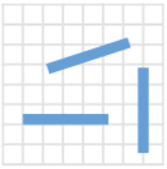

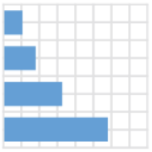

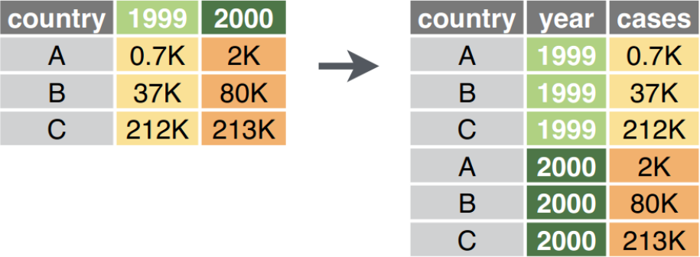
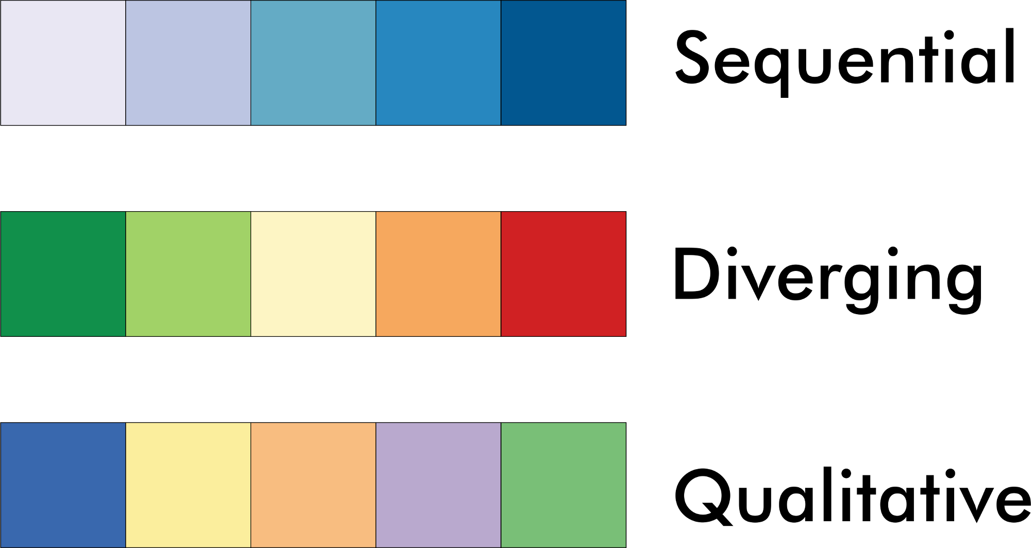

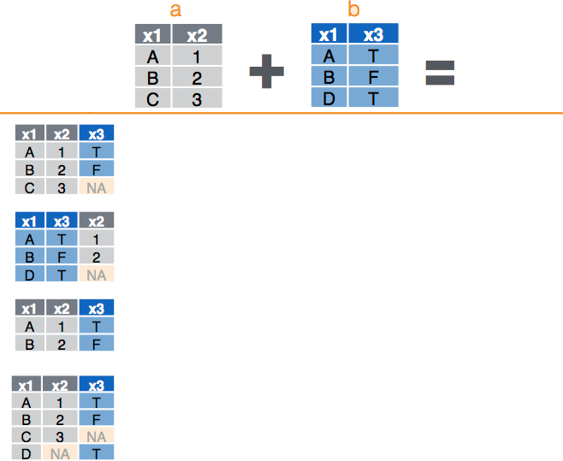


R⁴H2O : : SESSION ONE CHEAT SHEET
ggplot2
ggplot2 continued
Missing Data
Grammar of Graphics
Layer 5: Statistics and annotations
Indicated with NA. Test for missing data with is.na()
Use na.rm = TRUE option to ignore missing data in calculations. Check help for each function for details.
Theme
Coordinates
Statistics
Facets (graph grids)
Geometries
Aesthetics
Data
geom_smooth(method = "lm")
Add linear model to data (default is Loess)
is.na(customers$term)
mean(customers$p01, na.rm = TRUE)
geom_hline(aes(yintercept = 5))
Add horizontal line (indicating limits)
Layer 1: Data
Layer 6: Coordinates
Tidy Data
coords_flip()
ggplot(gormsey)
Rotate axes
pivot_longer(data, 2:3, names_to = "year", values_to = "cases")
Layer 2: Aesthetics
scale_*_continuous()
scale_*_log10()
ggplot(gormsey, aes(Measure))
Colour aesthetics (fill = for surfaces and color = for lines)
Define x and y scales
Layer 7: Theme
scale_fill_brewer()
scale_color_brewer()
scale_*_manual()
Pre-configured themes (use TAB key to explore)
theme_*()
Use theme() for fine-tuning the design.
Cleaning Data
pivot_wider(data, names_from = year,
values_from = cases)
Layer 3: Geometries
ggplot(gormsey, aes(Measure)) +
geom_bar()
Variable Types
customers <- read_csv("casestudy2/customers")
type_convert(customers)
Joining Data
ggplot(turbidity, aes(Date, Result)) + geom_line()
Manually convert to a number:
as.numeric()
ggplot(turbidity, aes(Date, Result)) + geom_boxplot()
Selecting Variables
left_join(a, b, by = "x1")
select(customers, p01:p10)
select(customers, sarts_with("p")
rename(new_name = old_name)
Join matching rows from b to a
ggplot2 website has extensive documentation on geometries.
right_join(a, b, by = "x1")
Layer 4: Facets
Join matching rows from a to b
line
facet_wrap(~Suburb)
inner_join(a, b, by = "x1")
Changing of Adding Variables
Retain only rows in both sets
grid
facet_grid(Measure~Suburb)
mutate(variable1 = formula1,
variable2 = formula2)
full_join(a, b, by = "x1")
Retain all rows
CC BY SA Peter Prevos • peter@prevos.net • lucidmanager.org • Updated: 2022-03-20

