Slide 1
Gormsey Trihalomethane Compliance
Dr Peter Prevos

Slide 2
Problem Statement
New guideline lowers the maximum value for THMs at the customer tap to 0.20 mg/l.
This report reviews historical data to assess the risk of non-compliance.
Assumes no operational changes are implemented.

Slide 3
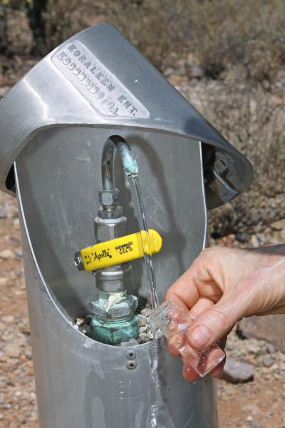
Methodology
Monthly samples are taken from customer taps in each town.
Data avalable between 2069-01-11 and 2070-12-17.
Fields:
  Sample_No: Number of the sample
  Date: Date the sample was taken
  Sample_Point: Sample point asset number
  Town: Town
  Result: Test result
Sample tap.

Slide 4
Exploratory Analysis
Suburb | Samples
Blancathey | 24
Merton | 24
Snake’s Canyon | 24
Southwold | 24
Swadlincote | 24
Tarnstead | 24
Wakefield | 24
Summary sample numbers.

Slide 5
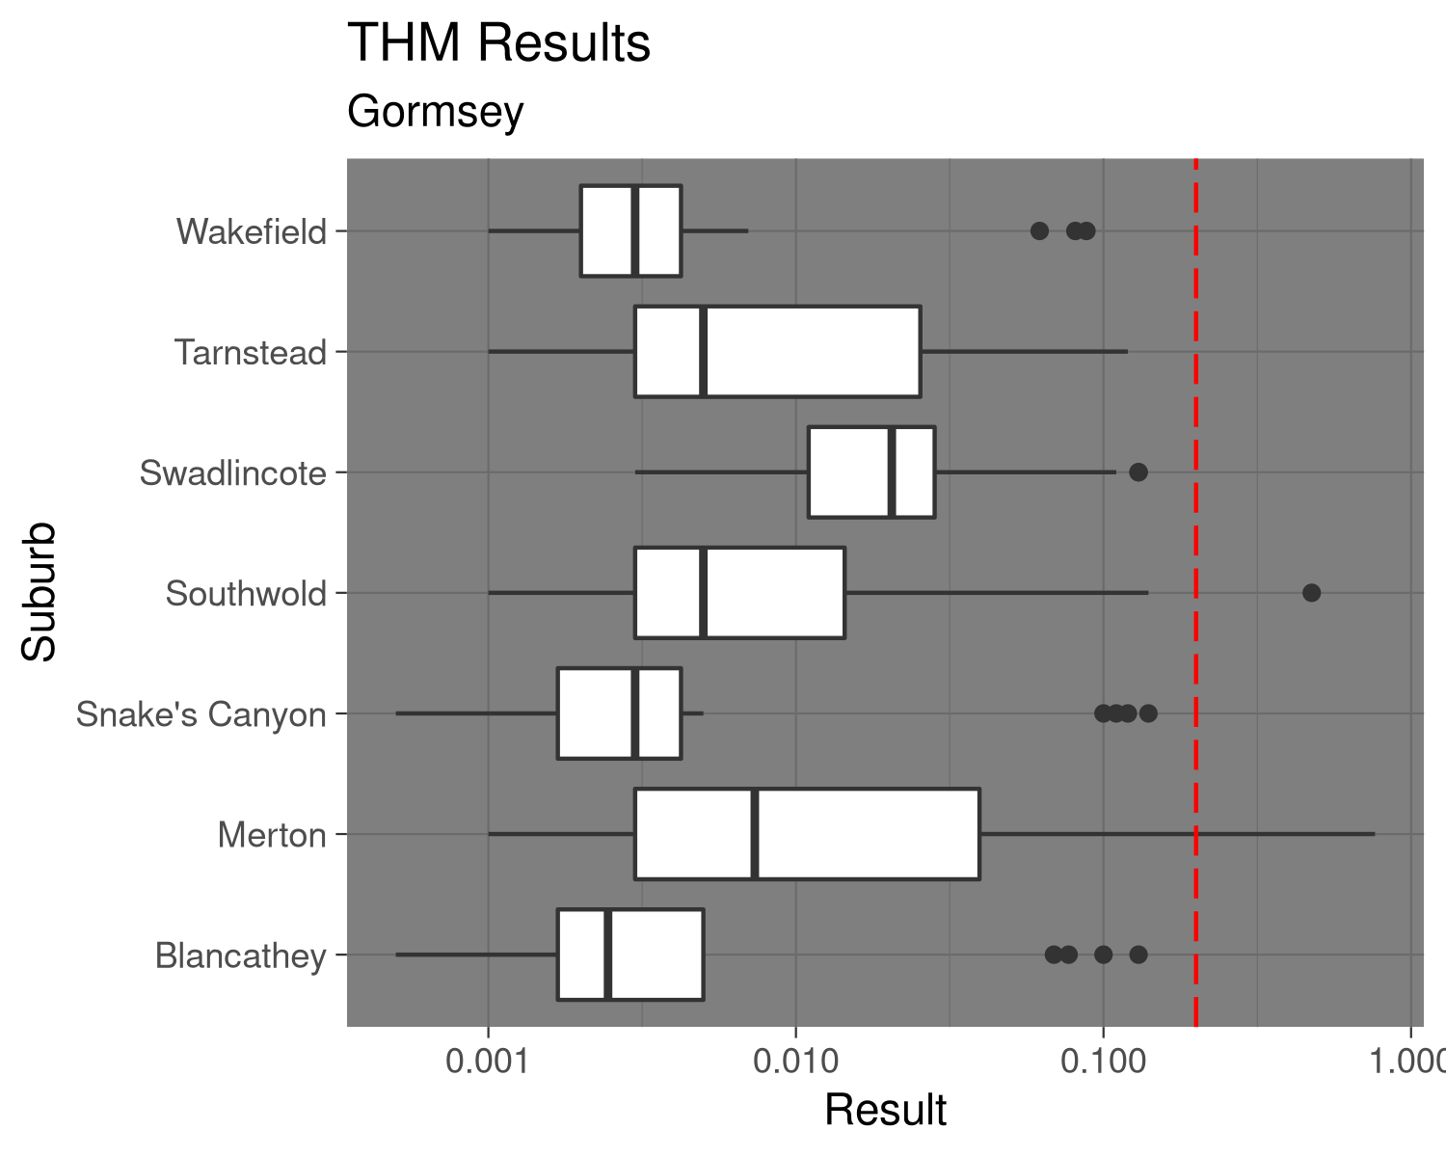
Analysis

Slide 6
Summary
5 samples exceeded the proposed new limit in
Further investigation required to determine the cause.

