Slide 1
CS 450
Module R3

Slide 2
Today's Agenda
R1 and R2 review
Module R3 Introduction
Schedule R1 Grading Next Week
Module R4 Introduction

Slide 3
Module R1
Due next Friday before your evaluation
We'll schedule evaluation times today
Only those present will receive a grade
You will turn in:
A zip archive of your Module R1 code (email this)
A paper copy of your Module R1 code
Your programmer's manual
Your user's manual (See Intro to MPX slides)

Slide 4
Module R2
Due two weeks from now
You'll use the same evaluation time as Module R1
You will turn in the same materials as R1:
Zipped code (emailed to abrady1@mix.wvu.edu)
Printed code
Updated programmer's manual
Updated user's manual

Slide 5
Module R3 Introduction
Previously:
R1 adds user interaction and command handling
R2 adds structures (PCBs) to store processes
Module R3 loads actual code into your PCBs
These processes then dispatched to execute on the CPU, one at a time, until they give up control

Slide 6
How MPX Processes Work
The CPU can only run one process at a time
To give the illusion of simultaneous execution, processes need to run in short bursts
The OS must handle changing from one process to another, without affecting process execution
In other words, MPX performs a context switch

Slide 7
Context Switching
With MPX, a process voluntarily gives up CPU access in the middle of execution.
MPX needs a way to save the current "context" of the running process so it can resume later
However, how can MPX "know" when a process is ready to give up the CPU?
We can accomplish this using interrupts

Slide 8
Interrupts & Handlers
An interrupt signals a hardware or software event
When an interrupt is generated, the CPU calls an interrupt handler to figure out what happened
Interrupt handlers:
Push context info onto a stack –Turbo C automatically does this for you
Interrupts can occur at any time, they are not predictable, therefore the complete system state has to be preserved
Execute something
Interrupt handlers should do only what is absolutely necessary and contain as little code as possible
Pop context information from the stack and restores it – Turbo C automatically does this for you
Restoring the system state so whatever what running before the interrupt can continue

Slide 9
Interrupt Keyword
Interrupt keyword (Turbo C Only)
Used to designate interrupt handlers; automatically injects assembly code that saves CPU register values
void interrupt name()
Note there cannot be parameters, and there cannot be a return value
With R3, process that wish to give up the CPU will generate an interrupt, which MPX will handle.
Thus, MPX can remove the process and insert a new one.

Slide 10
Generating Interrupts in MPX
MPX processes will use the “sys_req” function to generate an interrupt. When a process generates an interrupt, it will have a status associated with it. For R3/R4- the statuses are
IDLE- means the program is not done terminating, so put it back in the ready, not suspended state and reinsert it into the ready queue
EXIT- program wants to terminate- so delete its PCB from memory
Other statuses, such as READ and WRITE, will need to be handled in Module R6.

Slide 11
Dos.h functions
You will need to include dos.h
#include <dos.h>
Construct a far pointer
unsinged char * MK_FP(unsigned int SEGMENT, unsigned int OFFSET)
Get the segment of a far pointer
unsigned char FP_SEG(void*)
Get the offset of a far pointer
unsigned char FP_OFF(void*)

Slide 12
R3: Breakdown
R3 is due along with R4 on Friday March 11th
You will be writing two interrupt handlers
The dispatcher will give the first process on the ready queue control of the CPU, thus allowing it to execute
The sys_call handler will handle interrupts generated by MPX programs and call the dispatcher to run the next ready process

Slide 13
R3 Overview
Two interrupt handlers
Dispatcher
will be called by the MPX OS
Sys_call
will be triggered by an interrupt
Temporary Function
Load Processes
Temporary Commands
To call dispatcher
To load test processes

Slide 14
Context
When a process is interrupted, the values in all of the CPU registers must be saved. This information will be placed on the stack by Turbo C, but to access it, you will need to define a C structure- the PCB’s context.
Sample is below- note that you can call the structure whatever you want, but you MUST use the same datatypes and have the registers in the same order!
typedef struct context {
unsigned int BP, DI, SI, DS, ES;
unsigned int DX, CX, BX, AX;
unsigned int IP, CS, FLAGS;
} context;

Slide 15
Context Switching
An important part of this Module is context switching. Context switching allows the system to replace a process that is currently running with a different process. In a context switch, you must:
Save the context of the running process
Replace it with the context of the process you want to run
Turbo C automatically saves 12 registers for you when you use the interrupt keyword. However, the SS and the SP must also be saved, and Turbo C does not do this automatically.
In Turbo C, you can directly access the SS and SP using _SS and _SP. You should save them into variables of type unsigned short.
You can assign new values to the SS and SP using the dos functions mentioned earlier:
_SS = FP_SEG(sys_stack)
_SP = FP_OFF(sys_stack) + SYS_STACK_SIZE
When assigning new values to _SS and _SP, you should use intermediate variables.
When accessing (saving or changing) the SS and SP, you must do so in consecutive, uninterrupted steps.

Slide 16
Parameters
Parameters cannot be passed to an interrupt handler in the normal way.
When an MPX process generates an interrupt, sys_req will place certain parameters on the process’s stack.
We need a structure to represent the parameters so that we can access them:
typedef struct params{
int op_code; --operation code, IDLE, EXIT, READ, WRITE, etc
int device_id; --TERMINAL, COM_PORT
byte *buf_addr; --buffer address
int *count_addr; --size of the buffer
} params;
op_code is the main concern of ours for now… it will be either IDLE or EXIT, as described before
Byte = unsigned char
We will discuss later how to access these parameters

Slide 17
R3: Variables Needed (Example)
Variables to save and manipulate the stack segment (SS) and stack pointer (SP).
unsigned short ss_save;
unsigned short sp_save;
unsigned short new_ss;
unsigned short new_sp;
The process that is currently running will not be in any queue, but we still need to keep track of it, so we need a variable to hold a pointer to that process’s PCB. We designate this “cop” (current operating process)
PCB *cop;
Temporary system stack
char sys_stack[SYS_STACK_SIZE];
Use a symbolic constant for the sys_stack_size- make it at least 1024

Slide 18
Stack Manipulation using Dos.h
Save stack pointers
ss_save = _SS
sp_save = _SP
Restore stack pointers
_SS = ss_save
_SP = sp_save
Switch to temporary stack using intermediate variables
new_ss = FP_SEG(&sys_stack);
new_sp = FP_OFF(&sys_stack) + SYS_STACK_SIZE;
_SS = new_ss;
_SP = new_sp;
Make a far pointer to stack top
stack_top = MK_FP(ss_save, sp_save);

Slide 19
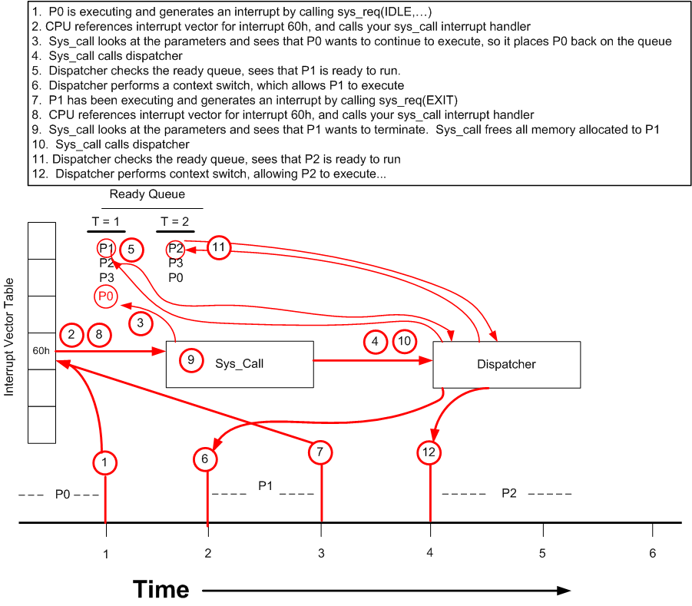
Example: Illustration of R3

Slide 20
Procedure: sys_call
Parameters: none
Returns: null
Sample Prototype
void interrupt sys_call();
Sys_call is not directly called. It is invoked (indirectly) by MPX processes requesting to go IDLE or EXIT
Sys_call interprets system call parameters, puts the currently running process back in a queue or deletes it, depending on the nature of the interrupt.
Then calls the dispatcher to allow the next process on the ready queue to run.

Slide 21
Sys_call: outline
When an MPX process generates an interrupt, the sys_req function places the parameters on the stack. In sys_call, you need to access those parameters to uncover the reason the interrupt was generated.
Access the stack and get the parameters
params *param_ptr = (params*)(MK_FP(_SS, _SP) + sizeof(context))
Switch to temporary stack
Check the parameters (might be useful to do in a SWITCH statement as we will be adding to this later)
If param_ptr->op_code = IDLE
Process wants to continue executing
Set cop state to ready
Insert cop into the ready queue (in priority order)
If param_ptr->op_code = EXIT
Process wants to terminate
Delete cop (free its memory)
Set cop = null
Call the dispatcher

Slide 22
Procedure: Dispatcher
Parameters: none
Returns: void
Sample prototype
void interrupt dispatch()
The dispatcher will be responsible for running processes from the ready queue.
When the dispatcher is called, this means that the process that is “currently” running doesn’t need to run anymore, and another process should be given control of the CPU.
The dispatcher is called directly from the sys_call handler.

Slide 23
Dispatcher
The first time the dispatcher is run, it needs to see if the stack pointers (SS and SP) have been saved yet – if not you must save them so dispatcher has a way of returning to the function which originally called it.
Check to see if ss_save is NULL
If yes, save the stack pointers (_SS, _SP) to the save variables
Now, we need to find the next process that will run
Find the first process in the ready queue that is not suspended
If no PCB is ready, we need to restore the MPX state
Set the cop variable to NULL
Restore the stack pointers (SS, SP) using the save variables
Return
If a PCB is found that is ready, we need to perform a context switch to allow that process to run
Set the cop variable equal to the process that is next in line to run
Remove the process from the ready queue and set its state to “RUNNING”
Context switch
Set _SS and _SP equal to the PCB’s stack pointer using dos.h functions
Return

Slide 24
Dispatcher: Outline
If sp_save is null
Save current SS and SP
Look for the first PCB that is ready, not suspended
If one is found
Set COP = that PCB
Remove from ready queue, set state to RUNNING
Set _SS and _SP to the cop’s stack (context switch)
Else
Set COP to NULL
Restore SS and SP
Set sp_save & ss_save = null;
end

Slide 25
R3 Initialization
We need to set the interrupt vector to point to your system call handler (sys_call). This is so the interrupt instruction generated by MPX processes causes sys_call to be called. If you call your system handler sys_call, you would need to use the command:
sys_set_vec(sys_call)
Returns 0 if no problem
Returns ERR_SUP_INVHAN if invalid handler name
You should also set all of your stack save variables to null in the initialization.
You also need to modify your allocate_pcb function (R2), specifically when you set the stack_top pointer, you should set it to
Stack_top = Stack_base + Stack_size – sizeof(context)

Slide 26
Test Processes
On Dr. Mooney’s website is a file named “procs-r3.c” This contains 5 test processes we will use to test R3. In order to use these, however, you will need to create a procedure (load_procs) to load these processes into your MPX system.

Slide 27
Load Processes: outline
Need to do the following sequence 5 times (once for each process). Assumed that you have created a PCB* np, and a context* npc
np = Call your setuppcb function, give PCB name (ex “testproc1” or “test1”), priority = 0, class = APPLICATION
npc = (context*) np->stack_top;
npc->IP = FP_OFF(&test1_R3); //test1_R3 is a func name in procs-r3.c
npc->CS = FP_SEG(&test1_R3);
npc->FLAGS = 0x200;
npc->DS = _DS;
npc->ES = _ES;
Insert np into the ready queue in priority order
Repeat for each test process
You should also include uniqueness checks on the process names.

Slide 28
Temporary Commands
Load processes
Will call your load_procs() function to load the test processes from procs-r3.c
No parameters
Suggested commands: load, load_test, loadr3, etc.
Dispatch
Will call dispatcher
No parameters
Suggest commands: go, dispatch
Do not combine these commands- you should have one command to load the processes and a separate command to call dispatcher

Slide 29
How to use procs-r3.c
Put prototypes for the test processes in your R3.C or R3.H file (ex. void test1_R3(void);)
Link procs-r3.c with your project when you compile, DO NOT INCLUDE IT!
Use your load command to load the processes.
Use your dispatch command to run them
You should see all 5 test processes run with lines like
Test n dispatched; loop count = 1
You should be able to load and dispatch these processes infinitely many times.
If your system crashes after doing this a couple of times, you more than likely have a memory leak.

Slide 30
Tips and Hints
Change your “sys_init” call to have the parameter “MODULE_R3”
Sys call and dispatcher should be short functions. Neither should require more than 30-40 lines of code.
Do not use printf statements inside your dispatcher and sys_call functions. They will cause problems and make your code harder to debug.
Remember to always manipulate _SS and _SP in consecutive, simple statements.
Suspended processes and blocked processes should never be run. To test your program, try loading the processes and then blocking/suspending a few before calling dispatch. Only those in the ready, not suspended state should run, and all others should remain in their appropriate queues until they have been run.
Do not declare variables inside of interrupt handlers- make any variables you need to use in an interrupt handler global.
Most R3 errors can be traced back to R2 functions
Read the project manual for R3- there is more pseudocode available in the manual.

Slide 31
Documentation
Programmer’s Manual
Add on to what you did already
Temporary Commands Manual
Add your load and dispatch commands
User’s Manual
Nothing new to add- no need to turn it in.
Program comments
No manuals due with this module, but it is expected that all of these functions are in the final version of the manuals.

