Slide 1

OS
Project 1
TEAM 6
정석원
박상혁
강지원

Slide 2
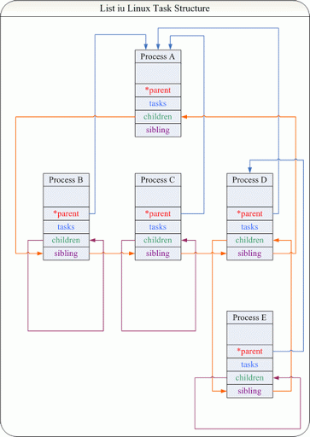
List iu Linux Task Structure

Slide 3
1
2
3
4
5
6
7
8
9
10
11
if(access_ok(VERIFY_READ, _nr, sizeof(int)) == 0)
return -EFAULT;
if(access_ok(VERIFY_WRITE, _nr, sizeof(int)) == 0)
return -EFAULT;
if(copy_from_user(&nr, _nr, sizeof(int)) != 0)
return -EFAULT;
if(nr < 1)
return -EINVAL;
if(access_ok(VERIFY_WRITE, buf, sizeof(struct prinfo) * nr) == 0)
return -EFAULT;
Check accessibility of user memory
Used ‘access_ok’ to check user pointer is valid.
Used ‘copy_from_user’ to copy data from user space.
/kernel/ptree.c – sys_ptree

Slide 4
1
2
3
struct task_struct
*parent = task->real_parent,
*first_child = list_first_entry_or_null(&task->children,
struct task_struct, sibling);
Used ‘list_first_entry_or_null’ macro to get the first element from the sibling list of children.
If the list doesn’t have any child, it returns NULL.
/kernel/ptree.c – record_process

Slide 5
1
2
3
4
struct task_struct *next_sibling
= (parent && (&(parent->children) != (task->sibling).next))
? (list_entry((task->sibling).next, struct task_struct, sibling))
: NULL;
Used ‘list_first_entry_or_null’ macro to get the first element from the sibling list of children.
If the list doesn’t have any child, it returns NULL.
/kernel/ptree.c – record_process

Slide 6
1
2
3
4
5
// record process down here
if(tvr->nr < tvr->nr_max) {
record_process(task, tvr->data + tvr->nr);
}
(tvr->nr)++;
If ‘nr’ is smaller then max of ‘nr’, ‘record_process’ function is called to copy information of task_struct.
No matter how big ‘nr’ is, ‘nr’ gets incremented.
/kernel/ptree.c – traverse_process

Slide 7
1
2
3
4
5
// recursion and iteration start
list_for_each(child_list, &task->children) {
struct task_struct* child =
list_entry(child_list, struct task_struct, sibling);
traverse_process(child, tvr);
}
Start of process traverse.
Used `list_for_each` macro to iterate `traverse_process` for every children of current process.
/kernel/ptree.c – treverse_process

Slide 8
1
2
3
4
5
6
7
8
9
10
11
12
13
14
15
16
17
18
19
int main() {
int nr = NR_MAX; int nr_tot = 0;
struct prinfo *buf =
(struct prinfo*)malloc(sizeof(struct prinfo)*NR_MAX);
if(buf == NULL) {
fprintf(stderr, "User memory allocation failed\n");
return 0;
}
printf("---------------syscall test start!----------------\n");
nr_tot = syscall(__NR_ptree, buf, &nr);
printf("---------------syscall test end!----------------\n");
if (nr_tot < 0) { perror("syscall ptree error"); }
else {
print_ptree(buf, nr);
printf("number of total process: %d\n", nr_tot);
printf("number of copied process: %d\n", nr);
free(buf);
}
return 0;
}
Check if user memory allocation has failed
Test Code1

Slide 9
1
2
3
4
5
6
7
8
9
10
11
12
13
14
15
16
17
void print_ptree(struct prinfo *ptree, int nr) {
int now = 0; stack_pnt = 0;
int stack[nr];
int i;
for (i=0; i<nr; i++) {
print_form(ptree, i, now);
if (ptree[i].next_sibling_pid != 0) {
stack[stack_pnt] = now; stack_pnt++;
}
if (ptree[i].first_child_pid != 0) {
now++;
}
else {
stack_pnt--;
now = stack[stack_pnt];
}
}
Print ‘ptree’.
Test Code2

Slide 10
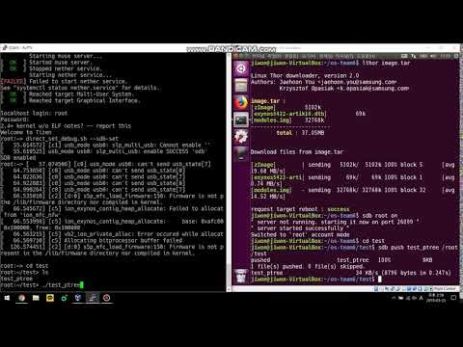
https://youtu.be/Mfu0eS-cbcM
Execute Demo

